Slide 1
Interactive Quiz for 8-11 Formers
Автор:
Ольга Михайловна Степанова
учитель английского языка
МБОУ «Цивильская СОШ №1
имени Героя Советского Союза М.В. Силантьева»
города Цивильск Чувашской Республики
2016

Slide 2
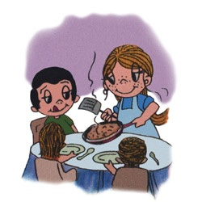
Love is... making pancakes on Saturday… .
morning

Slide 3
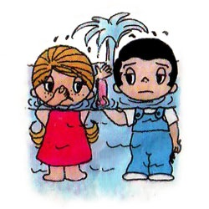
Love is...
letting him do the plumber’s … .
work

Slide 4
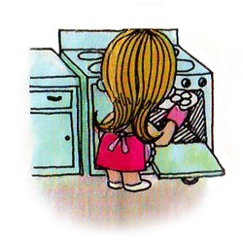
Love is...
keeping his meal hot when he comes … late.
home

Slide 5
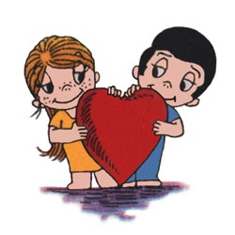
Love is...
two people sharing one … .
heart

Slide 6
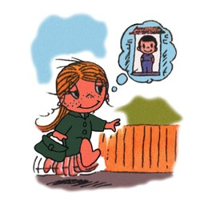
Love is...
hurrying to get home – knowing he’ll be … .
there

Slide 7
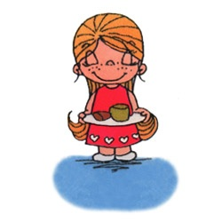
Love is...
sending him a message of … with the first coffee of the day.
love

Slide 8
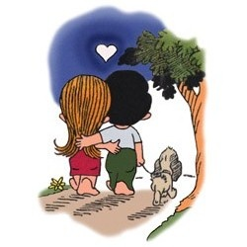
Love is...
walking the … , together.
dog

Slide 9
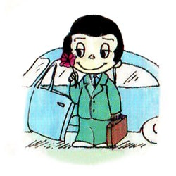
Love is...
finding a … on the car’s seat.
rose

Slide 10
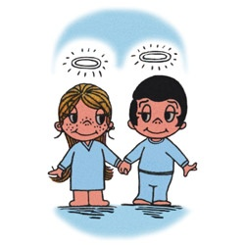
Love is...
bring out the best
in each … .
other

Slide 11
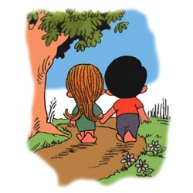
Love is... taking her home … .
safely

Slide 12
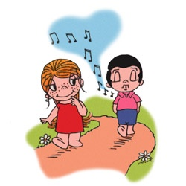
Love is...
like … to your ears.
music

Slide 13
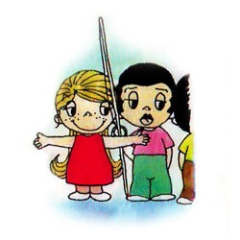
Love is...
approving his
fishing … .
adventures

Slide 14
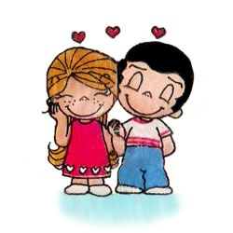
Love is...
… for two.
happiness

Slide 15
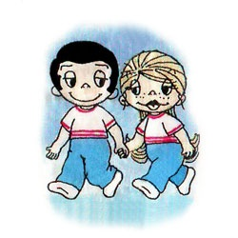
Love is...
taking her to the … you lived before marrying.
place

Slide 16
Love is...
sending her
a “love … ”.
fax

Slide 17
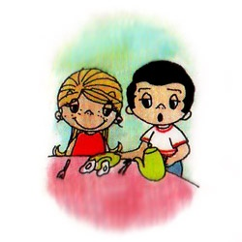
Love is... preparing her … in the morning.
breakfast

Slide 18
Love is...
spending a few minutes together at midnight before… .
Christmas

Slide 22
Sources
http://loveishate.ru/comics/pic710/
http://1.bp.blogspot.com/-x7drm-SyINQ/UszksKsSiBI/AAAAAAAAFHc/56zn1G3OPzc/s1600/Animated+valentine's+Day+Wallpaper+&+History+(35).gif
http://www.emmajanedance.co.uk/storage/Mini.gif?__SQUARESPACE_CACHEVERSION=1426509005076
https://s-media-cache-ak0.pinimg.com/originals/51/07/6f/51076fe4598373a5022d34bf2e83b837.gif

