Slide 1
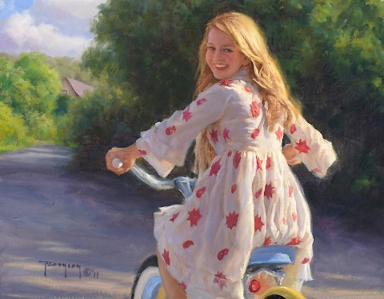
Country Beauty
by
Robert Duncan
Art
Gallery
for 7-11
Formers
Автор:
Ольга Михайловна Степанова
учитель английского языка
МБОУ «Цивильская СОШ №1
имени Героя Советского Союза М.В. Силантьева»
города Цивильск Чувашской Республики
2016

Slide 2
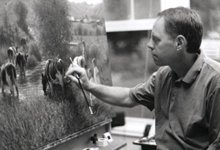
Robert Duncan is an American West artist.

Slide 3
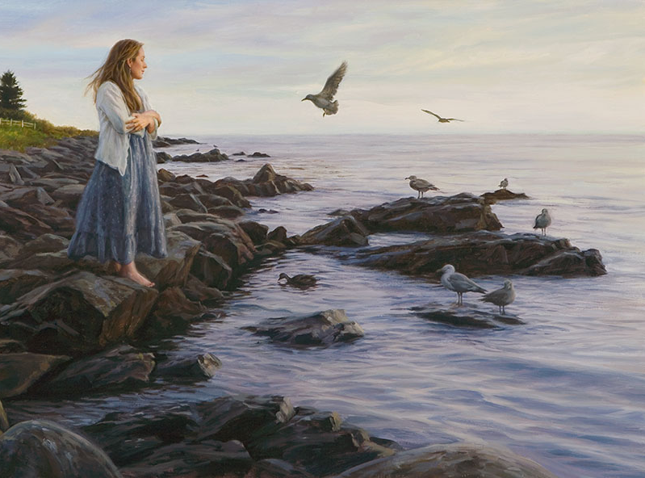
Duncan was born in Salt Lake City in 1952, one of ten children. He spent idyllic summers in Wyoming, helping his grandparents on their 10,000-acre cattle ranch.

Slide 4
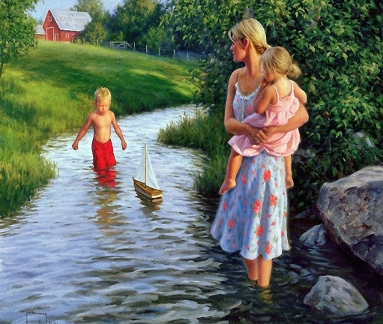
The Green River, which ran through their property, and the surrounding open country fostered his love for rural living.

Slide 5
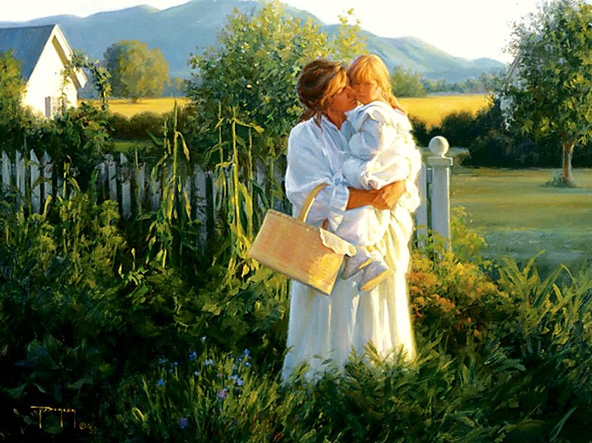
He started drawing constantly at age five.
His grandmother gave him his first set of paints when he was eleven and paid for three oil painting lessons.

Slide 6
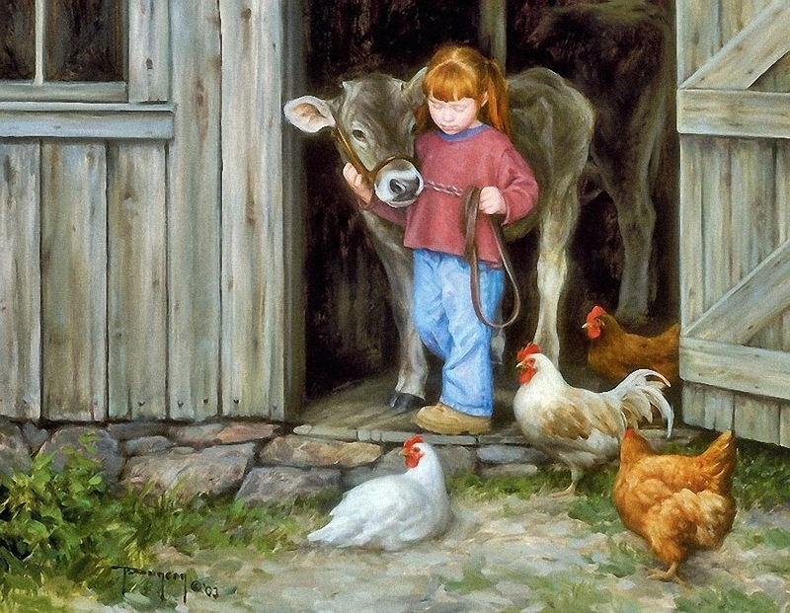
Duncan studied art at the University of Utah and worked as a commercial artist until he decided to devote his career to the fine art of the American West.

Slide 7
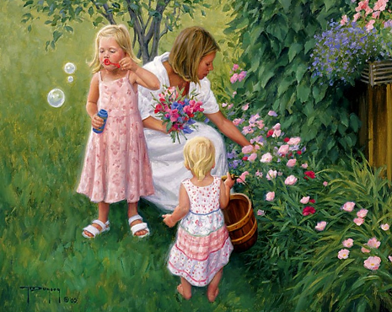
At age 29, Duncan was elected into the prestigious Cowboy Artists of America. He won two silver medals in their annual exhibition at the Phoenix Art Museum.

Slide 8
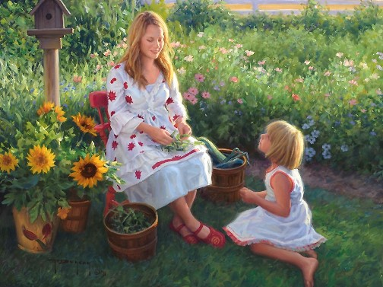
After over five years with this organization, he resigned so he could devote more time to painting family, friends, and the countryside of the Heber Valley in Utah.

Slide 9
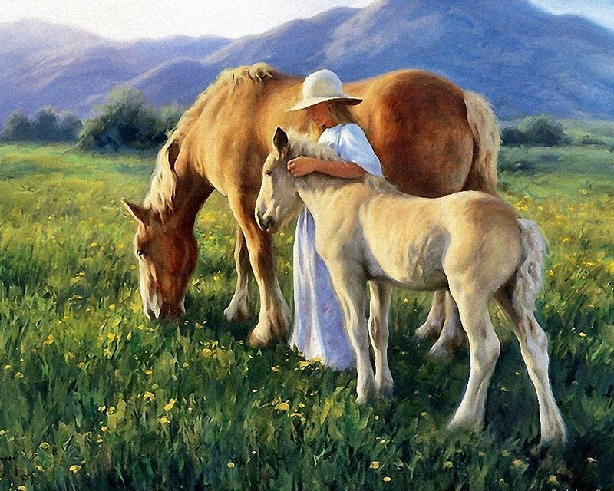
He paints rural settings throughout the U.S.

Slide 10
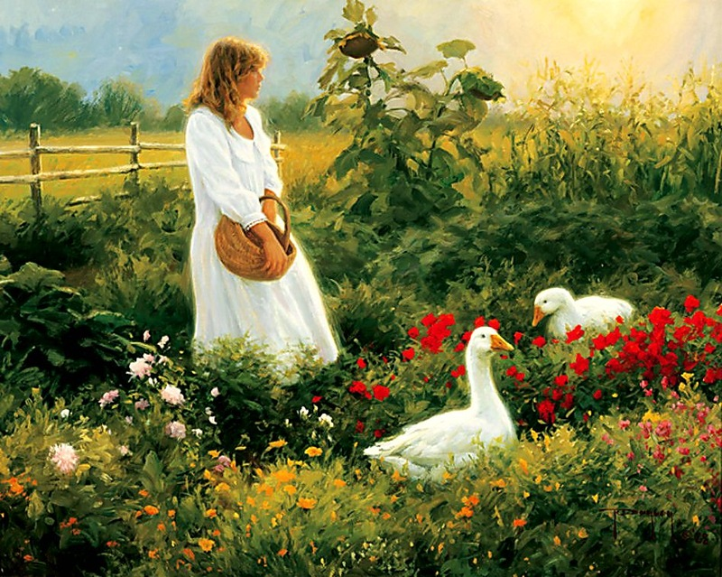
For over thirty years, he has shown his original paintings with Trailside Galleries in Scottsdale, Arizona, and Jackson, Wyoming.

Slide 11
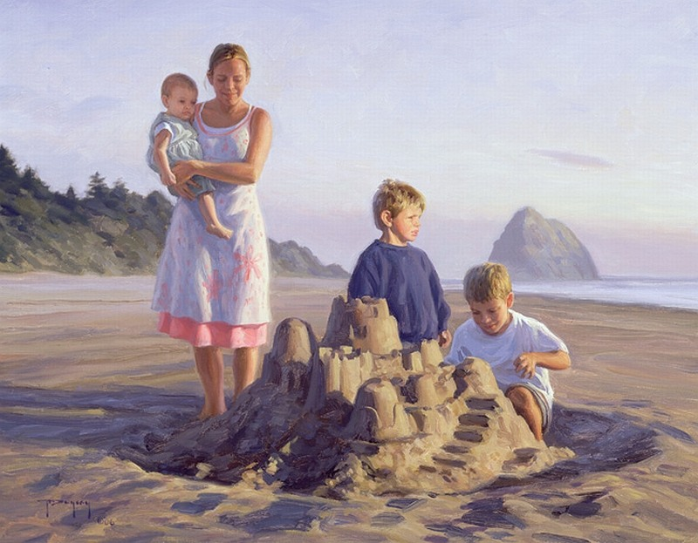
He has been invited to numerous shows around the United States, including the Masters of the American West Exhibition at the Autry
National Center, and the Great American Artists Show
in Cincinnati.

Slide 12
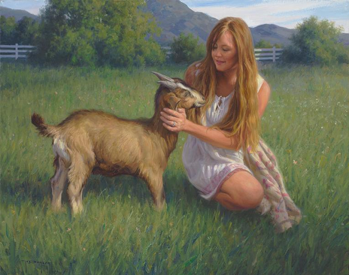
For many years, New York Graphic Society in New York City carried Duncan’s prints and posters.

Slide 13
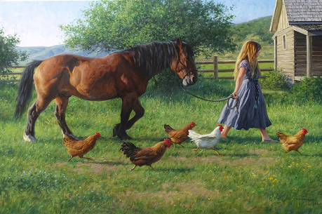
Seeking more control over his work,
he created Robert Duncan Studios, which publishes and distributes his art, including limited edition prints, posters, art cards, and calendars.

Slide 14
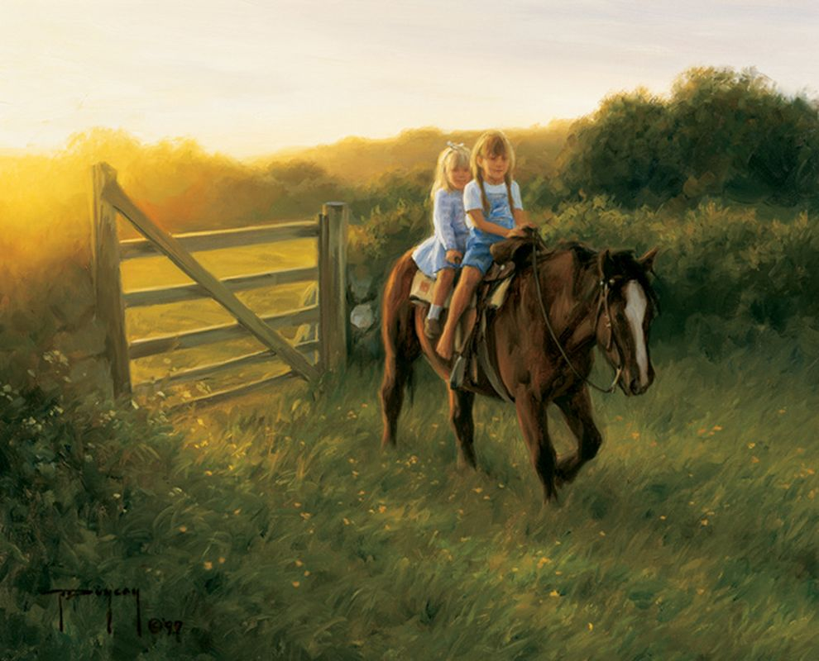
In 1982, Robert Duncan was elected to membership
in the Cowboy Artists of America.

Slide 15
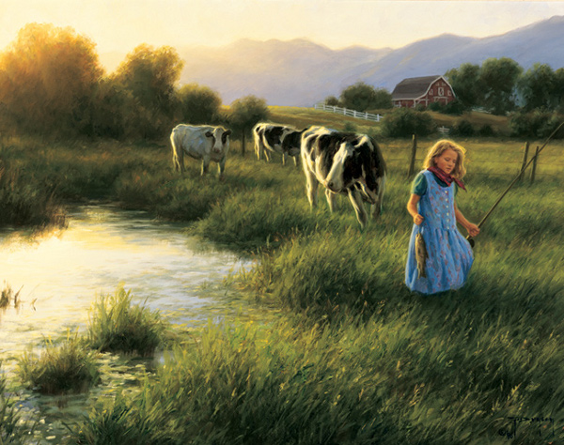
In 1987, he resigned from the CAA to devote more time to painting the things closest to him - his family and the rural lifestyle.

Slide 16
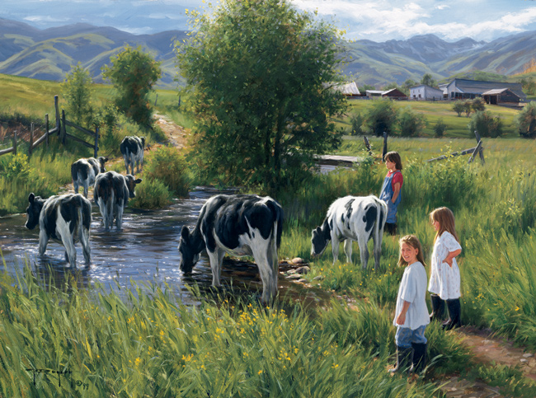
He lives with his wife, Linda and their six children in the little town of Midway in Northern Utah.

Slide 18
http://www.trailsidegalleries.com/exhibitions/coast-to-country-robert-duncan
https://www.christcenteredmall.com/stores/art/duncan/duncanbiography.htm
http://www.mormonwiki.com/Robert_Duncan

