Slide 1
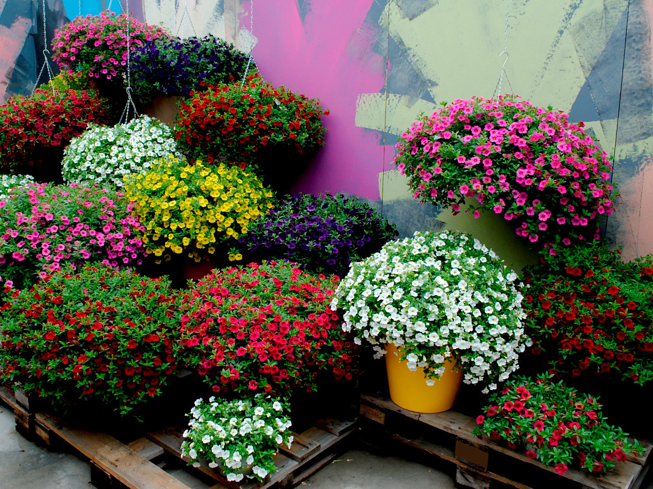
Million Bells
Calibrachoa
Tips for young gardeners, the 8-11 Formers
fallen in love with flowers
Автор:
Ольга Михайловна Степанова
учитель английского языка
МБОУ «Цивильская СОШ №1
имени Героя Советского Союза М.В. Силантьева»
города Цивильск Чувашской Республики
2016

Slide 2
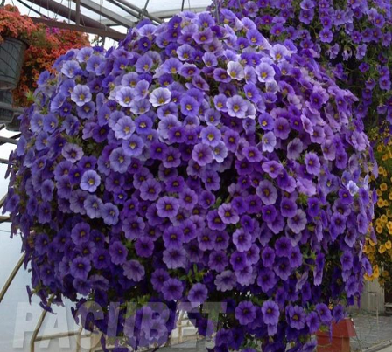
While Calibrachoa million bells may be a fairly new species, this dazzling little plant is a must-have in the garden. Its name comes from the fact that it features hundreds of small, bell-like flowers that resemble miniature petunias.

Slide 3
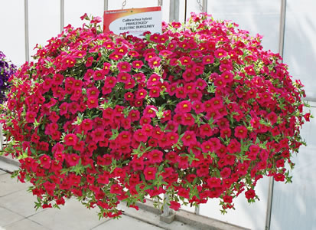
Calibrachoa, commonly called million bells or trailing petunia, is a tender perennial that produces mounds of foliage, growing only 3 to 9 inches tall, along trailing stems and flowers in shades of violet, blue, pink, red, magenta, yellow, bronze and white.

Slide 4
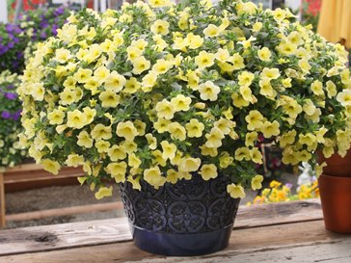
Introduced in the early 1990s, all cultivars of Calibrachoa are hybrids with the original species native to South America. They are prolific bloomers from spring to frost.

Slide 5
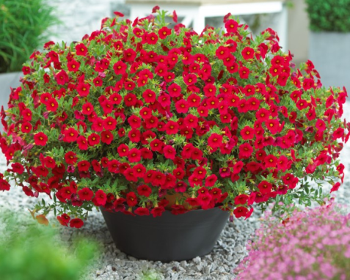
Growing Calibrachoa million bells is easy. They prefer to be grown in moist but well-drained, organically rich soil in full sun. They do not tolerate high pH soils, though the plants will take very light shade and may tolerate some drought.

Slide 6
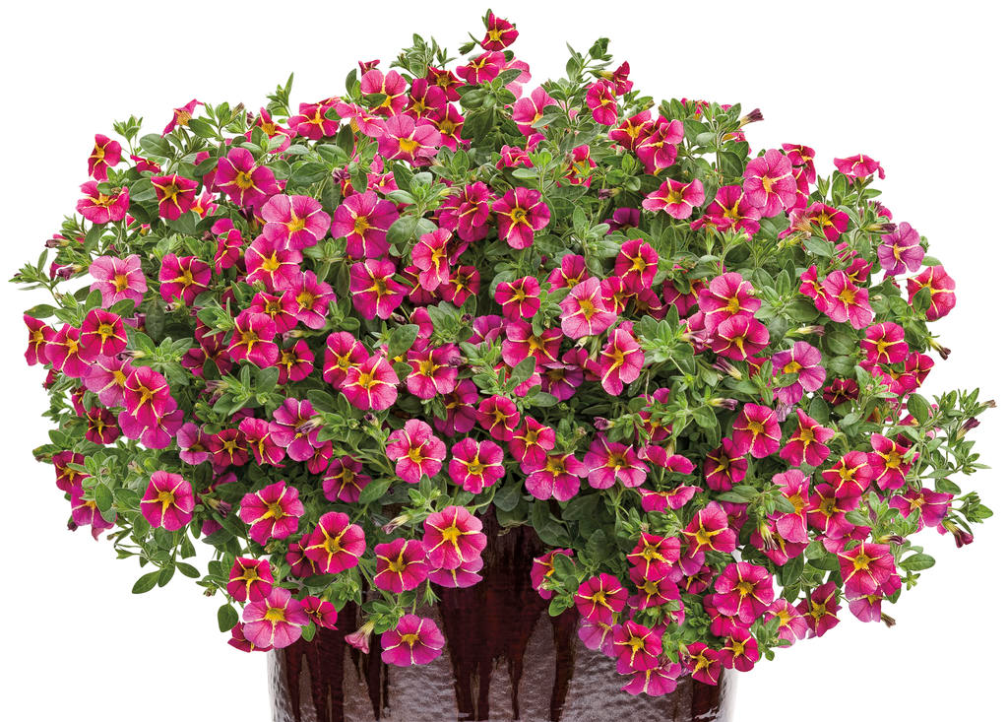
In fact, plants with some shade will survive longer into the summer months, especially in warmer regions.
Purchase or plant your seedlings in spring and set out after the last frost in your area.

Slide 7
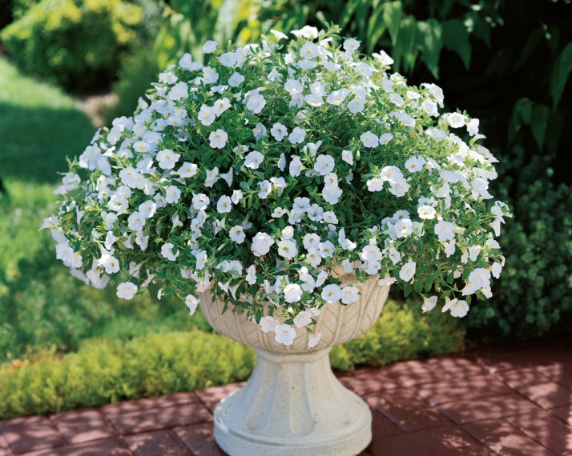
Caring for million bells flower is minimal. The soil should be kept fairly moist but not soggy, especially in full sun areas as they may succumb to the intense heat of summer. Container plants require more watering.

Slide 8
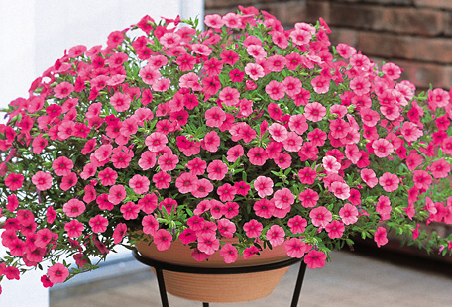
Calibrachoa care includes periodic fertilizer applications in the garden, though you may need to fertilize more regularly when in a container or hanging basket.

Slide 9
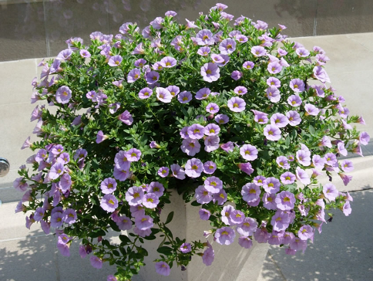
Deadheading this plant is not required, as it is considered to be self-cleaning, meaning the spent flowers readily drop following bloom. You can, however, pinch Calibrachoa back regularly to encourage a more compact growth habit.

Slide 10
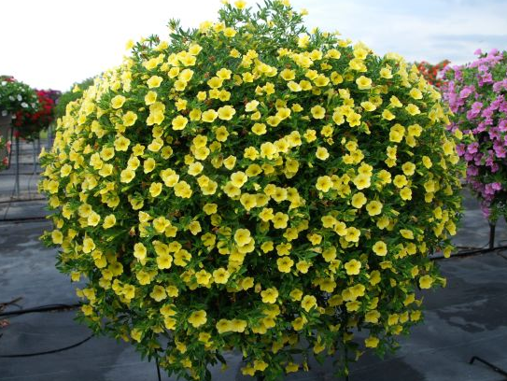
Would you like an annual flower that blooms nonstop without the need for deadheading? How about one that spills gracefully over the sides of your containers and hanging baskets, but has a dense trailing habit rather than a spindly one? Million bells plants fit this description, and they attract hummingbirds and butterflies to boot.

Slide 11
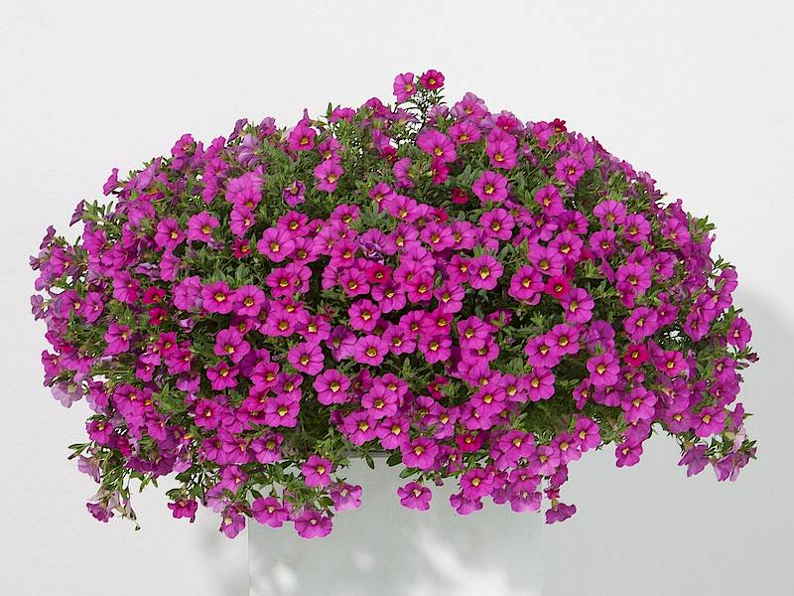
Plants produce little seed, if any, and must be vegetatively propagated. However, most of these hybrid cultivars are patented (trademark of the Suntory company), which prohibits Calibrachoa propagation in commercial markets.

Slide 12
You can, however, propagate your own plants for personal use through cuttings that are overwintered indoors.

Slide 13
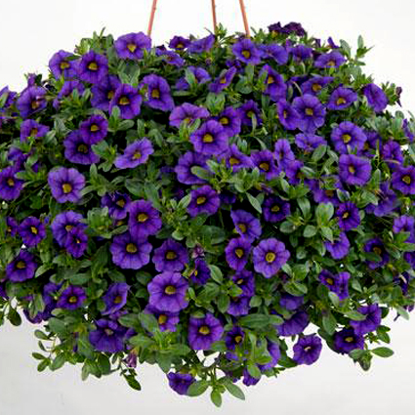
Try to find a stem that has small buds but no flowers on it. Cut this stem off at least 6 inches from the tip, removing any lower leaves. Place your cuttings in an equal mix of half potting soil and half peat moss. Water well.
,

Slide 14
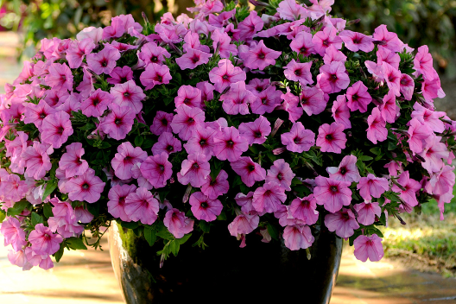
Keep the cuttings moist and warm (about 70 F. (21 C.), placing your future million bells flower in bright light. Roots should begin to develop
within a couple weeks.

Slide 15
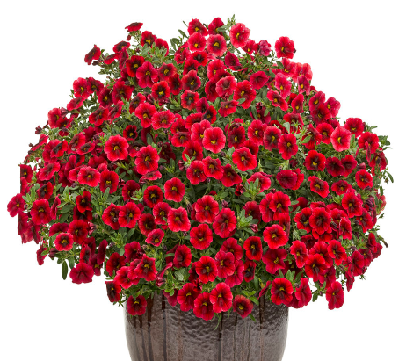
Enjoy Gardening!
Enjoy Growing Million Bells!

Slide 16
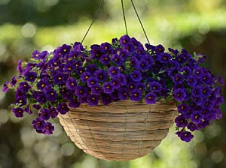
Source
http://www.gardeningknowhow.com/ornamental/flowers/million-bells/calibrachoa-million-bells.htm

