Slide 1
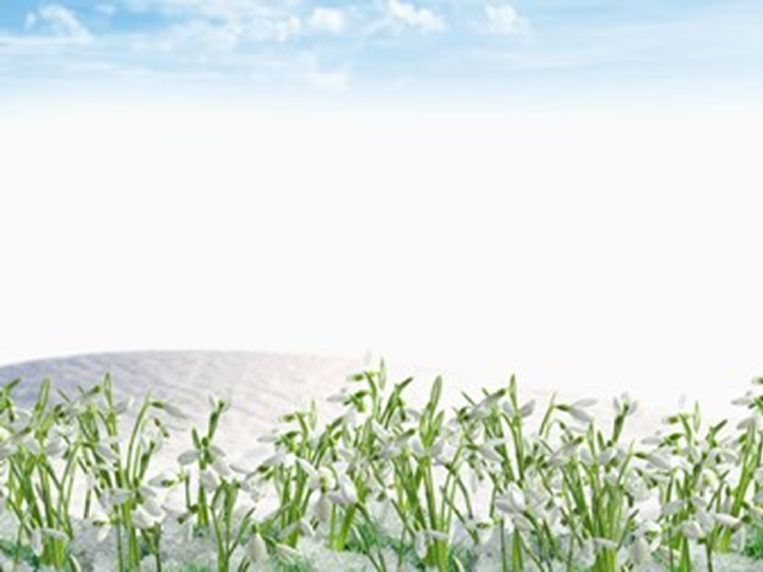
Magical Carpets of Snowdrops
Excursion to the snowdrops fields for the 7-11 Grades
Автор:
Ольга Михайловна Степанова
учитель английского языка
МБОУ «Цивильская СОШ №1
имени Героя Советского Союза М.В. Силантьева»
города Цивильск Чувашской Республики
2016

Slide 2
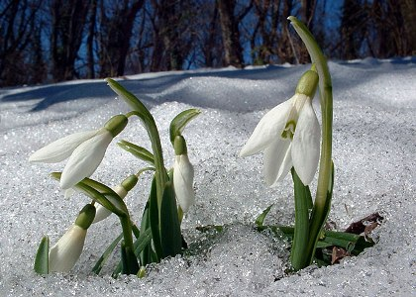
Keep an eye out for the first signs of spring

Slide 3
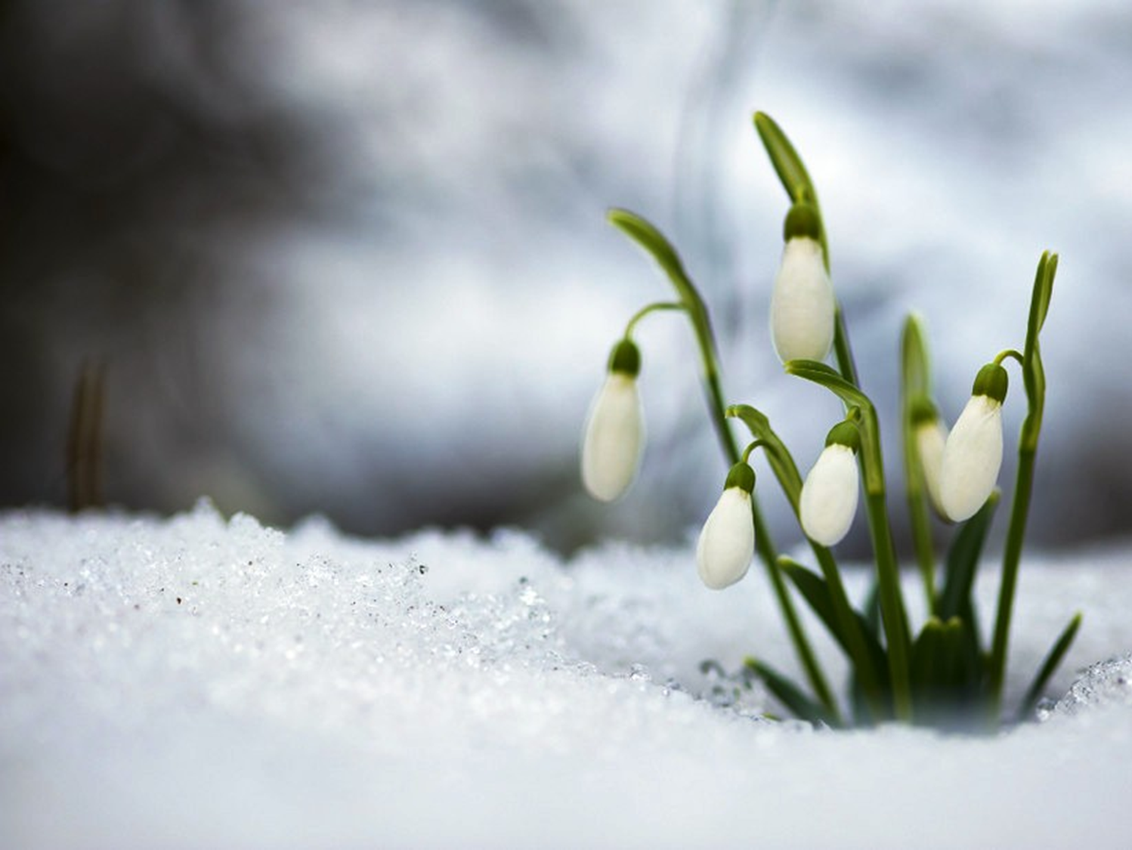
Snowdrops peeping through the snow
Heads bowed in silent prayer
Giving thanks for warm sunshine
While new born lambs skip
without a care…
by Mandy Berry

Slide 4
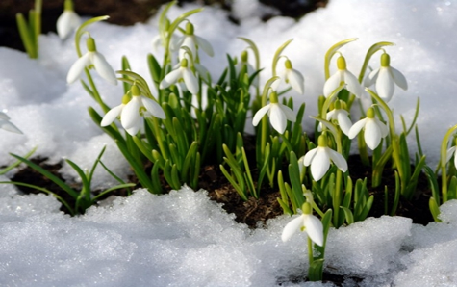
Snowdrop plant looks like three drops of milk hanging from a stem. This accounts for the Latin name Galanthus which means milk-white flowers. These Snowdrop bulbs, are originally from Europe and Asia Minor.

Slide 5
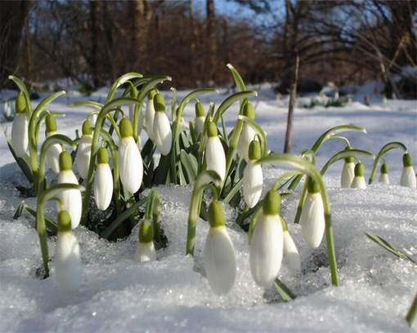
Snowdrops are the early spring flowering bulbs. Two or three straplike leaves, dark green in color, grow from each bulb.
The white flowers are usually borne singly, mostly in early spring but sometimes in mid to late winter, which makes them the earliest flowering bulb.
The three inner petals have green tips and overlap the outer petals to form a tube.

Slide 6
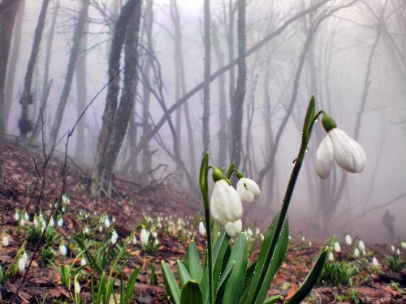
Three thousand years ago, in Homer's epic poem Odyssey, the god Mercury (Hermes) gave Ulysses an herb called Moly. Moly herb (Galanthus nivalis) made Ulysses immune to the forgetfulness poisons of the witch Circe and counteracted the amnesia
that Circe had inflicted on his crew.

Slide 7
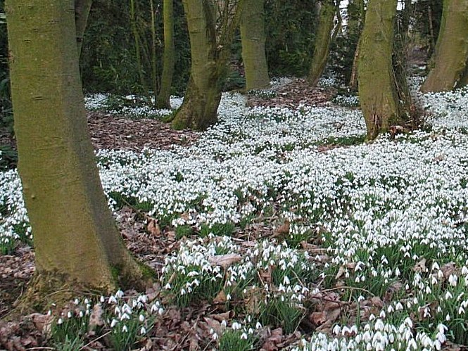
In Greek and Roman mythology, Mercury is known as the Messenger for the Gods and the BRINGER OF DREAMS. By having the Bringer of Dreams give Ulysses this herb, perhaps Homer was also conveying the historically known dream enhancing benefits of this extract.

Slide 8
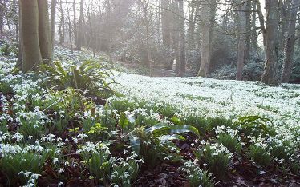
As the snow in their name suggests, Snowdrops may not even wait for the snow to melt before emerging from their winter sleep, instead pushing right up through the snow a delightful sight for the winter-weary.

Slide 9
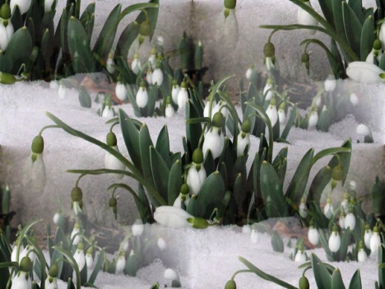
Did you know the Scientific name for Galanthus means milk flower. These lovely flowers are among the first to raise their heads in the New Year, when it is warm they release a fragrance.

Slide 10
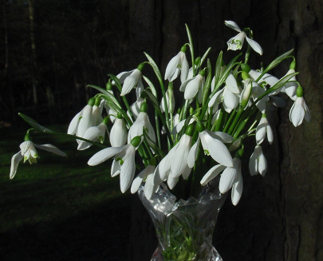
Look carefully at the snowdrops to see their green markings on the inside. Did you know that soldiers were so enchanted by snowdrops that they brought them back from the Crimean War battlefields to plant in their gardens (1853 - 1856).

Slide 11
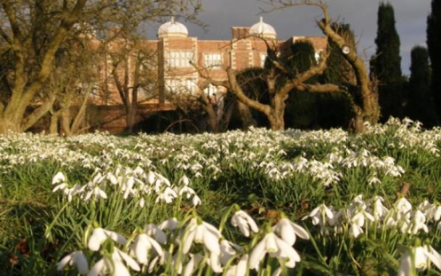
Snowdrops and other plants from the Amaryllidaceae family have a naturally occurring substance in them called galantamine. This is sold as a medication for Alzheimer’s disease under the name of Reminyl.

Slide 12
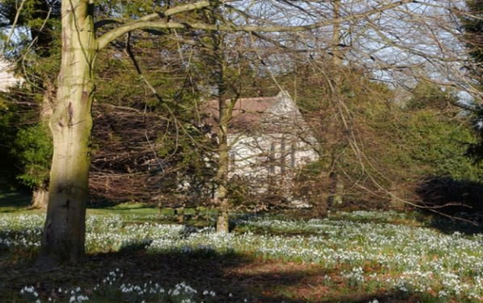
Galantamine was first used, in eastern Europe in the 1950s to treat memory problems but it wasn’t until 2010 that it became widely used in the UK when the National Institute for Clinical Excellence (NICE) authorised
its use.

Slide 13
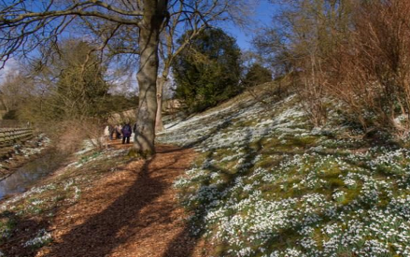
The flower, perhaps unsurprisingly given its status as one of the first signs of new spring life, has come to symbolize hope and consolation as well as purity. White is classically a colour associated with these traits,
but appearances can be deceptive…

Slide 14
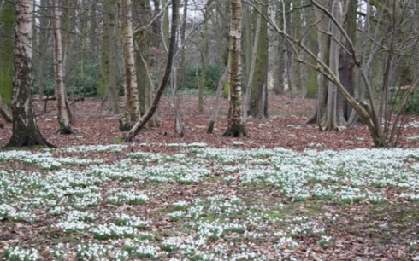
A superstition has developed around snowdrops. Although very pretty, a single flower indicates impending death and it should never be brought into the house. This is possibly as a result of the poisonous qualities it possesses.

Slide 15
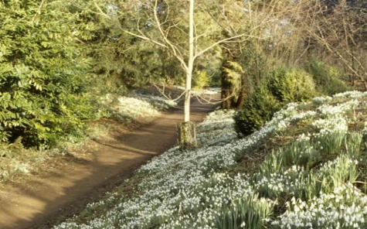
Since the 1950s Kew Gardens have been monitoring the growth of snowdrops.
In the mid-part of the 20th century they would generally appear in February,
since the 1990’s they have been arriving increasingly quickly.
These days they are sometimes found as early in the year as January,
an indication of the UK’s changing climate.

Slide 16
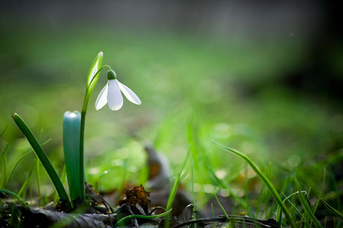
April 19 is the Day of snowdrop in England.
The holiday is celebrated from April 18, 1984.
The British are very fond of this snow-white flower, bred and planted flower beds in city,
it as successfully
as hyacinths and tulips
in Holland.

Slide 17
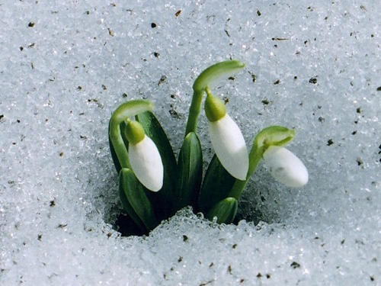
The flower is a symbol of hope. According to legend, the snowdrop became the symbol of hope when Adam and Eve were expelled from the Garden of Eden.
When Eve was about to give up hope that the cold winters would never end, an angel appeared. She transformed some of the snowflakes into snowdrop flowers, proving that the winters do eventually give way to the spring.
Let Hope Always Be with You!

Slide 18
http://www.theflowerexpert.com/content/aboutflowers/wildflowers/snow-drop
http://www.telegraph.co.uk/gardening/gardens-to-visit/snowdrop-day-the-best-events-this-year/
http://relax.com.ua/holidays/the-day-of-snowdrop/
http://www.countryfile.com/countryside/nine-things-you-might-not-know-about-snowdrops
http://azecology.az/en/news/intheworld/1678-19-april-snowdrop-day.html

