Slide 1
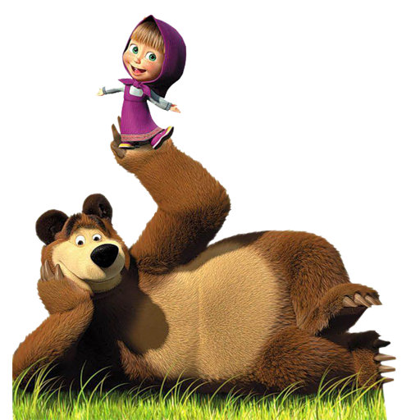
Masha
and
the Bear
Interactive Quiz
For 7 -11 Grades
Автор:
Ольга Михайловна Степанова
учитель английского языка
МБОУ «Цивильская СОШ №1
имени Героя Советского Союза М.В. Силантьева»
города Цивильск Чувашской Республики
2016

Slide 2
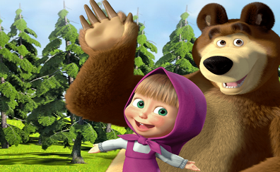
Masha and the Bear is an animated television series based loosely on the Russian folk … , "Masha and the Bear".
tale

Slide 3
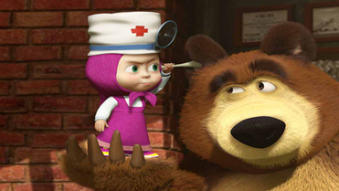
The series focuses on the adventures of a little … named Masha and an anthropomorphic bear.
girl

Slide 4
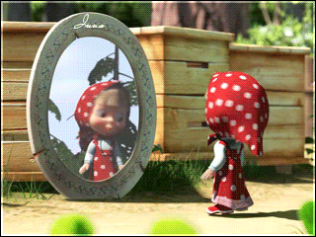
Masha is depicted as a precocious, happy, kind, and mischievous little girl, while the bear is a fatherly retired circus performer that tries to keep Masha out of trouble but often ends up the unintended … of her mischief.
victim

Slide 5
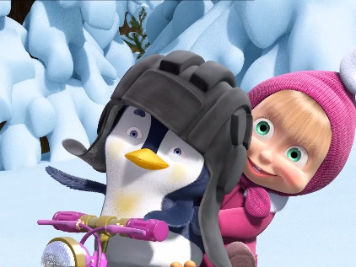
There are a number of supporting characters in the series, including Masha's cousin, a … adopted by the Bear
penguin

Slide 6
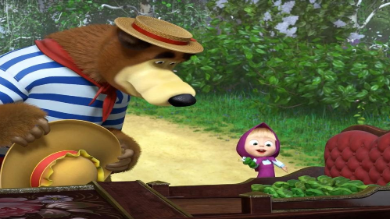
You can meet a young panda cub who is the Bear's … , a tiger that worked with the bear in the circus, and a female bear that is the object of the bear's affections.
cousin

Slide 7
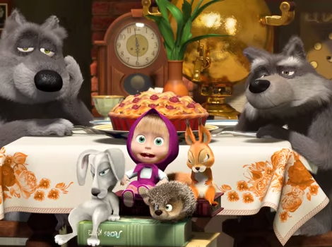
There is a rabbit, squirrels and hedgehogs, two wolves who live near the bear's house, and a pig, goat, and dog who live in Masha's front … .
yard

Slide 8
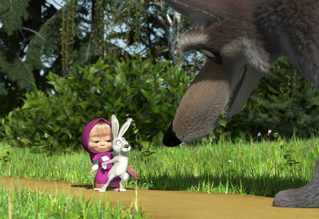
Masha, her cousin and Father Frost are the only characters who speak. The others communicate through pantomime or wordless … .
sounds

Slide 9
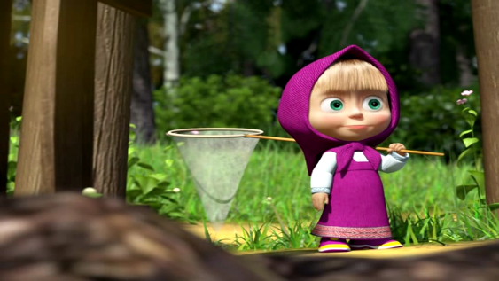
Many of the episodes have proved popular on video-sharing website YouTube; in particular, "Recipe For … " has received over 1.14 billion views, making it the site's thirteenth most viewed video of all time.
Disaster

Slide 10
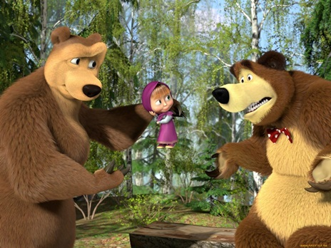
Vita
The other episodes with over 200 million views are: "Laundry Day", with over 450 million views; "Bon Appètit", with over 420 million views; "La Dolce … ", with over 380 million views.

Slide 11
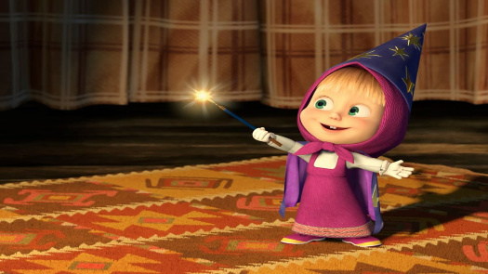
The most popular episodes are "Two Much", with over 290 million views; "Little Cousin", with over 260 million views; "Hocus-Pocus", with over 250 million views and "One, Two, Three! Light the Christmas … !", with over 230 million views.
Tree

Slide 12
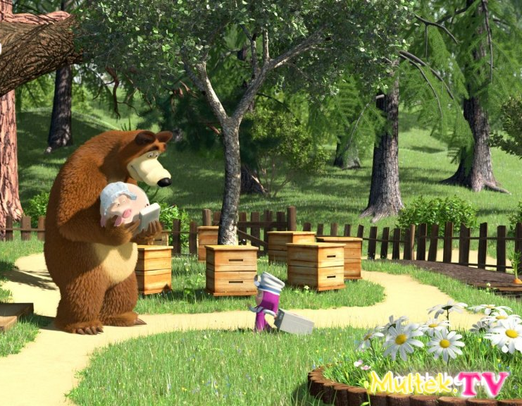
Plot
Television
series
Masha is a Russian girl who lives in the … with her pig, goat and dog.
forest

Slide 13
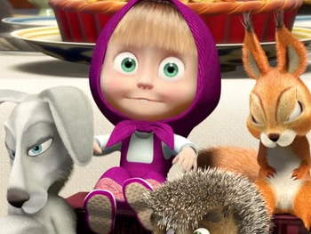
All the animals in the … are afraid of her as she forces them to play with her.
forest

Slide 14
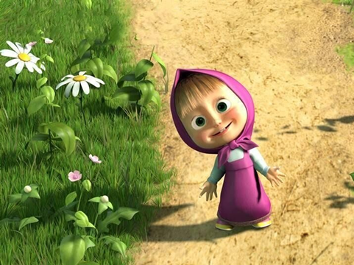
One morning, Masha sees a … and inadvertently follows it inside the home of a bear who has gone fishing.
butterfly

Slide 15
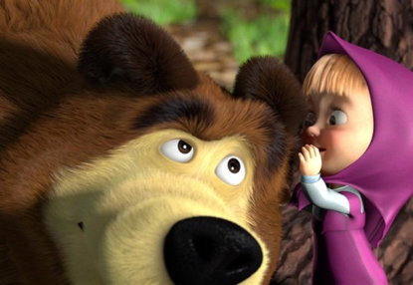
While playing there, she makes a big mess. When the bear returns, he sees the … caused by Masha.
disaster

Slide 16
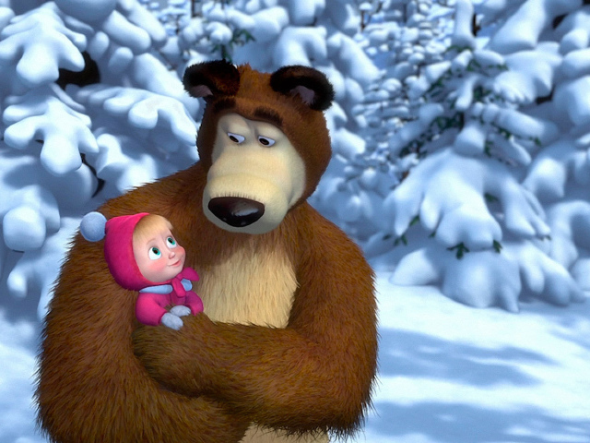
The bear tries to get rid of Masha, but he is unsuccessful, and he and Masha become … .
friends

Slide 17
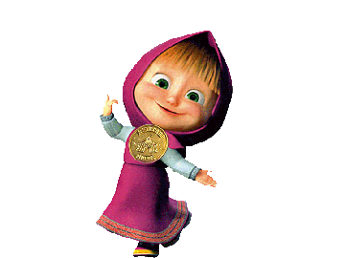

Slide 18
Source
https://en.wikipedia.org/wiki/Masha_and_the_Bear

