Slide 1
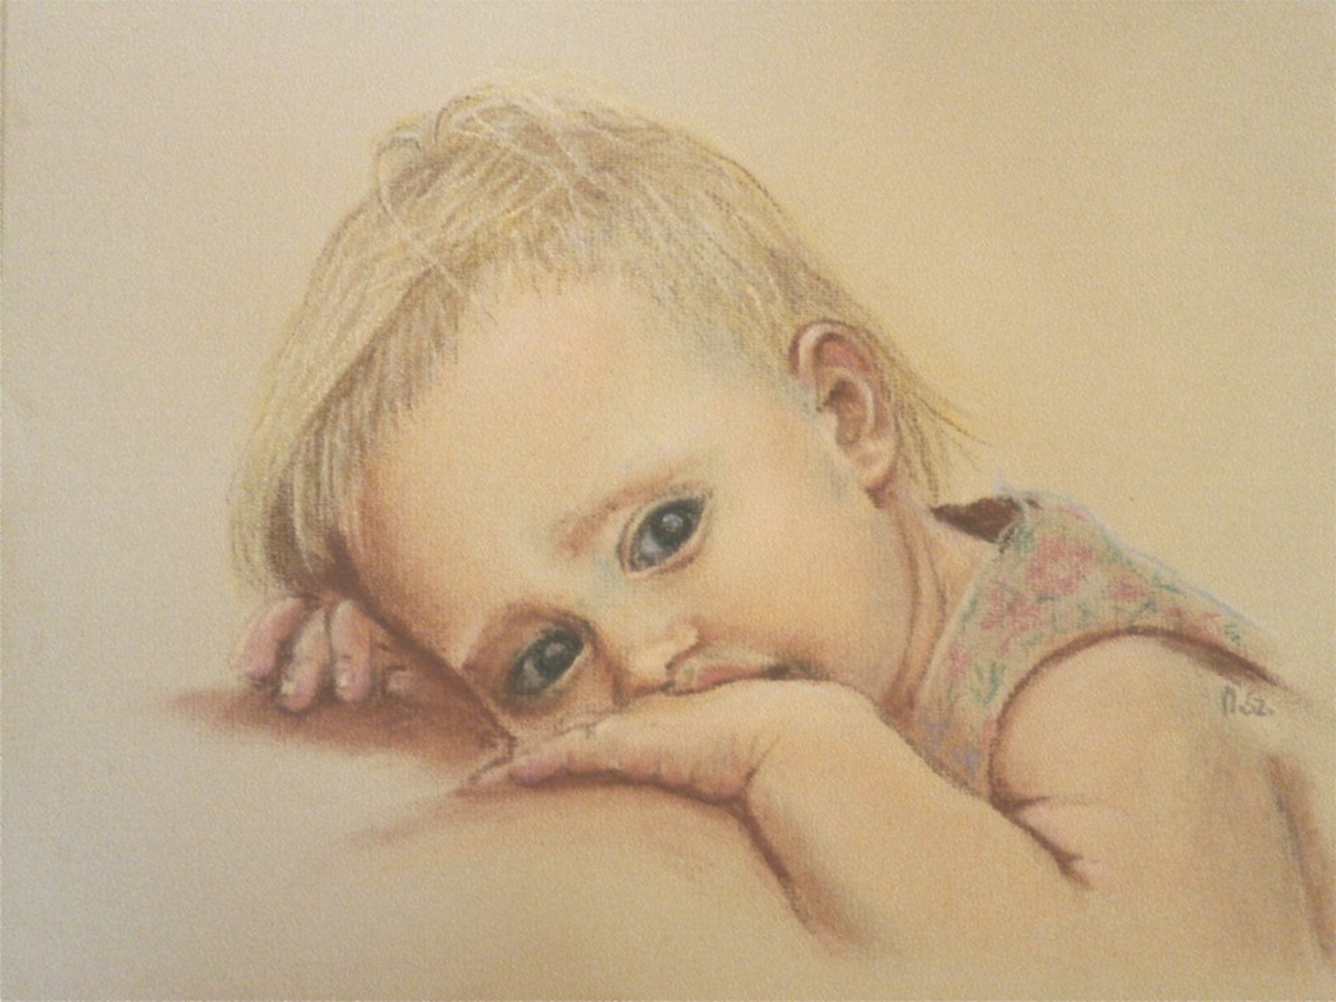
Touching the fine art
Art Gallery for the 8-11 Grades
Автор:
Ольга Михайловна Степанова
учитель английского языка
МБОУ «Цивильская СОШ №1
имени Героя Советского Союза М.В. Силантьева»
города Цивильск Чувашской Республики
2016

Slide 2
We enjoy the art
for one main reason - it brings joy, inspiration into our souls.
Beautiful and kind paintings make our mood positive
and often even cure different diseases.
That is why we ought to enjoy fine art.
It’s my personal view onto the fine art.
Olga Stepanova

Slide 3
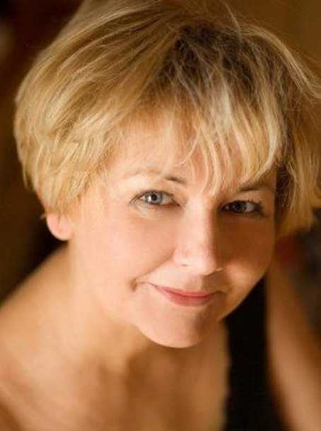
Meet
one of the talented artists
from Poland
Maria Szymańska

Slide 4
Enjoy the Artist’s
tender portraits
and
discover her feelings
in her short Interview…

Slide 5
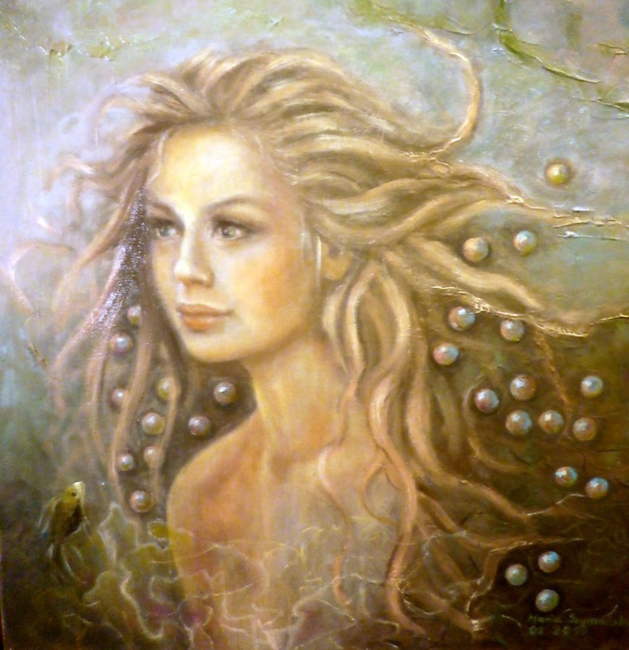
Painting is … a passion for me.

Slide 6
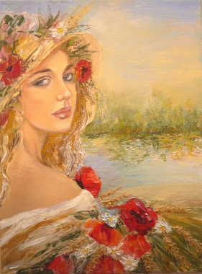
Your first picture was sold ...
I do not remember

Slide 7
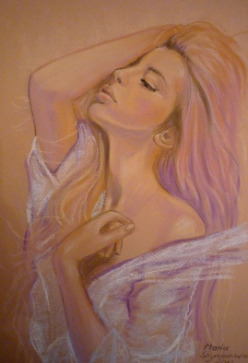
One secret which
You could to share with
other artists … I do not share the secrets :)

Slide 8
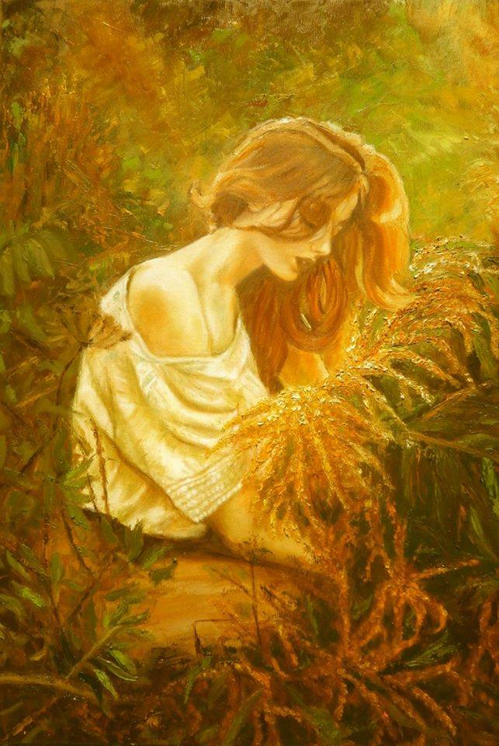
What inspires You is ... music, poetry, nature

Slide 9
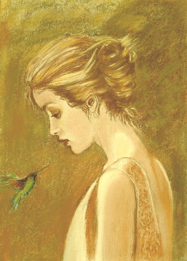
I would like
to…
to have more
time

Slide 10
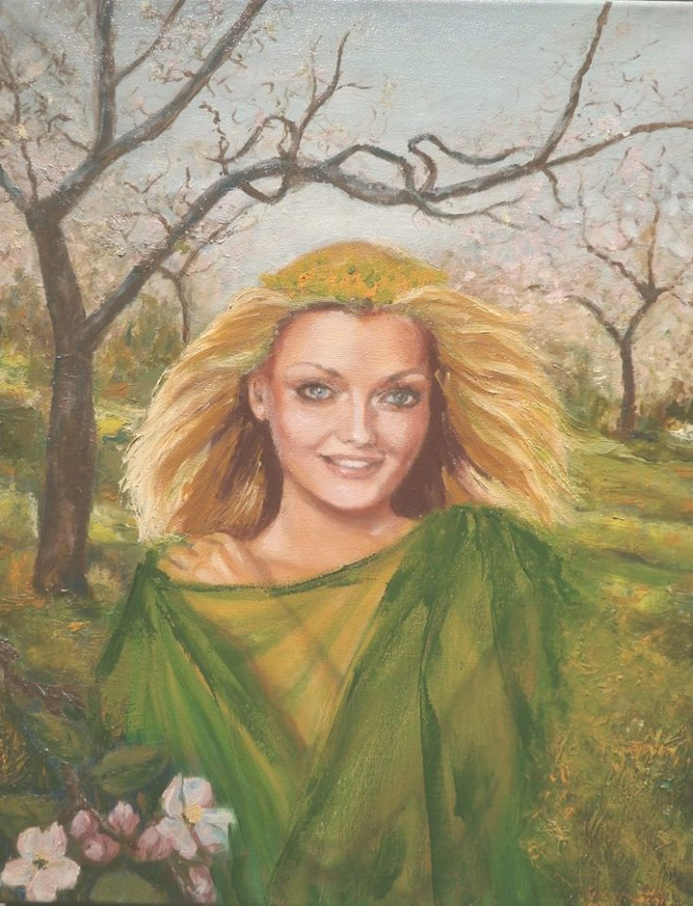
You
love
it
when ... music lulls me to sleep

Slide 11
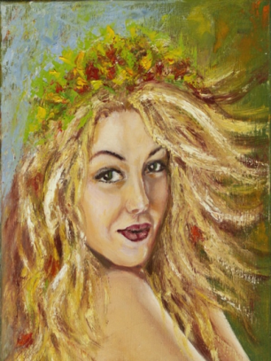
Do
you
like nights?.. warm nights with falling stars

Slide 12
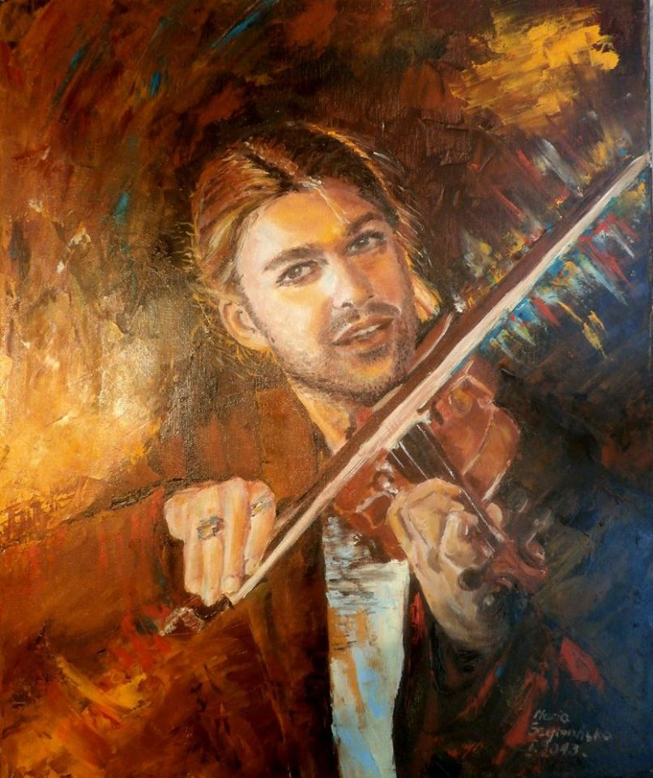
If
You could
no longer paint ...
I can not imagine such a situation

Slide 13
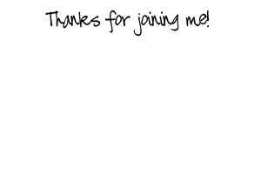

Slide 14
Source
http://www.touchofart.eu/ru/Maria-Szymanska/#biography

