Slide 1
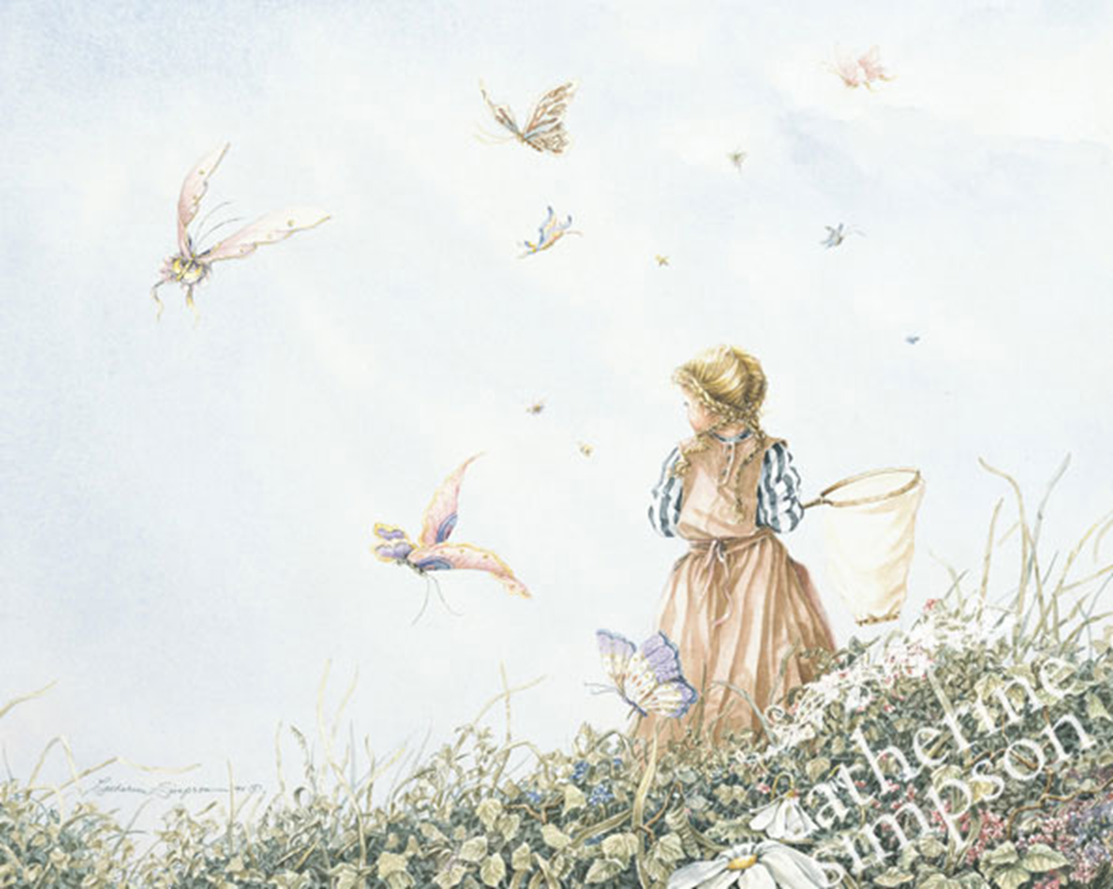
Forever Young
Art Gallery for 8-11 Grades
Автор:
Ольга Михайловна Степанова
учитель английского языка
МБОУ «Цивильская СОШ №1
имени Героя Советского Союза М.В. Силантьева»
города Цивильск Чувашской Республик
2016

Slide 2
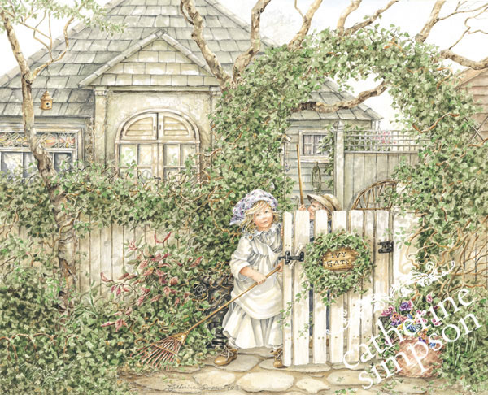
Catherine Simpson
Lives in London, Ontario, Canada
Pine Ridge Art has been producing her calendar since 1995
A storyteller with children in the lead roles
Self-taught artist whose predominant medium is watercolor.

Slide 3
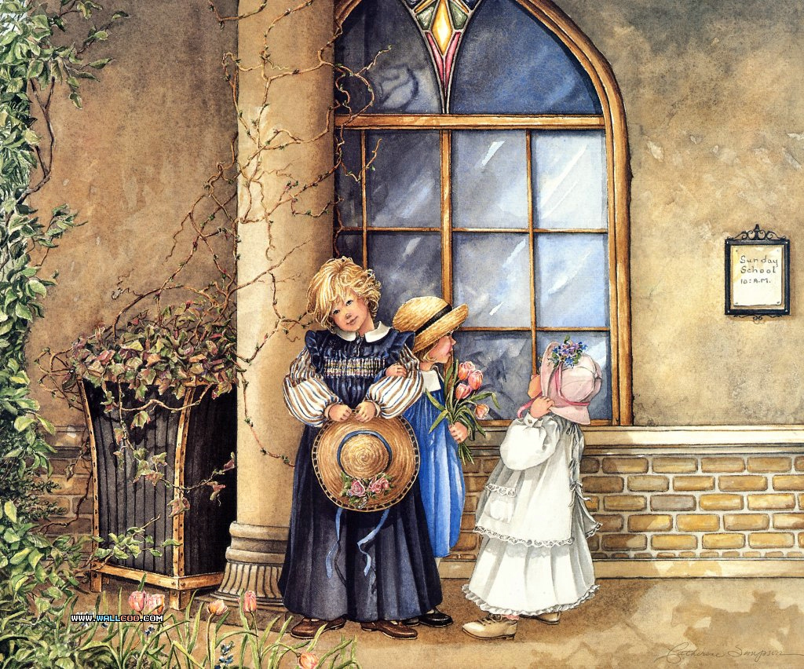
Catherine Simpson is emerging as a storyteller with children in the lead roles. Her predominant medium is watercolour as well as silverpoint and pencil drawings.

Slide 4
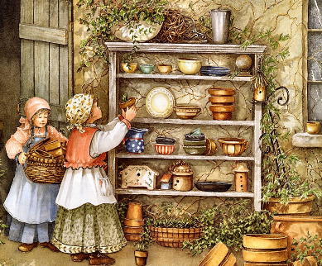
An appreciation for life's lighter side is easily ascertained when viewing her children studies.
An appreciation for life's lighter side is easily ascertained when viewing her children studies.

Slide 5
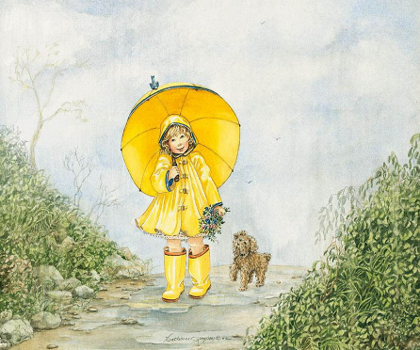
It is with true feeling that Catherine portrays the simple message of the children
that are depicted in each composition.

Slide 6
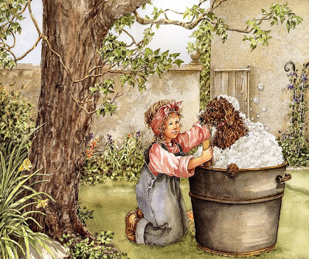
Catherine was born in London, Ontario, Canada, where she produces her "Forever Young" series of paintings.

Slide 7
Her work enjoys a universal appeal, is appreciated by young and old alike and can be found in both corporate and private collections in Canada, the United States and internationally.

Slide 8
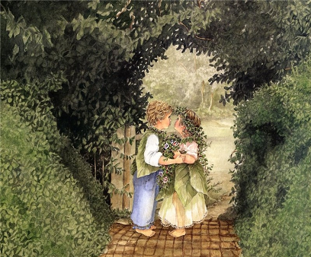
Participation in numerous gallery exhibitions and major juried art festivals has created a demand for her work resulting in a selection of limited edition prints, decorator prints and collector plates, figurines and the award winning Pine Ridge Art Catherine Simpson Forever Young Calendar

Slide 9
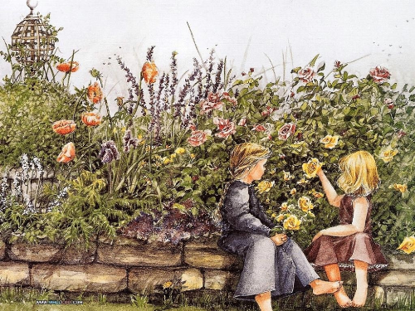
Catherine is a self-taught artist whose artistic gift has been acknowledged during her career with Best in Show, Peoples Choice, and the Canadian Collectable of the Year nominations six times - and awarded twice.

Slide 10
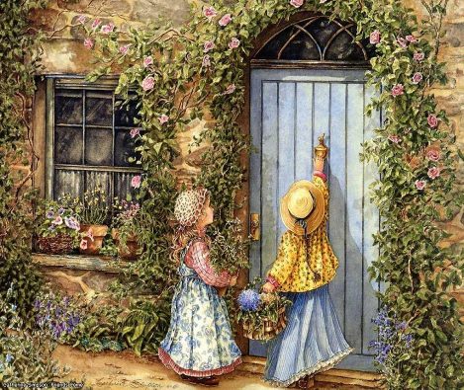
"I continue to try and capture those special memories of childhood that we can all share. Hopefully the stories
I tell will trigger at least one personal memory for you, of your family or your own childhood days.”
Catherine Simpson

Slide 11
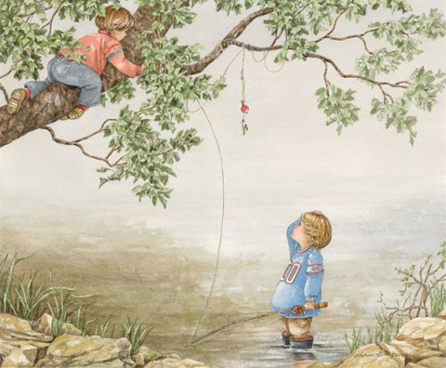
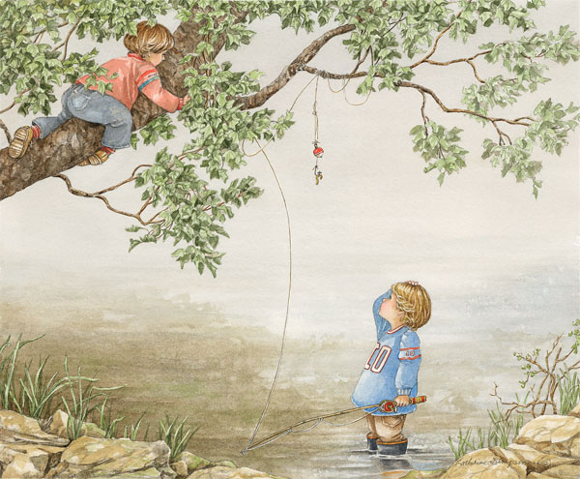
Rediscovering those special times in our lives should help to brighten up each and every day ahead ~ and remind us to let our hearts ~ Be Forever Young!
Catherine Simpson

Slide 12
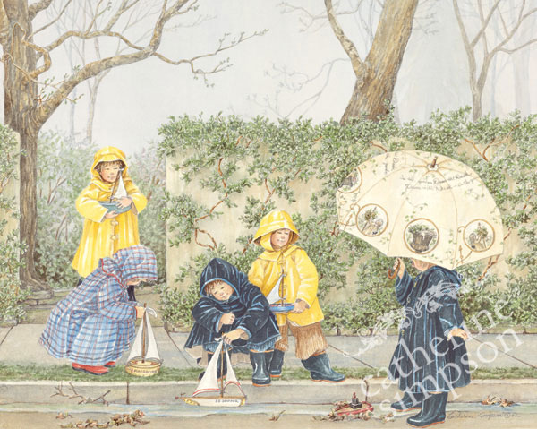
“In the attic of every grownups head joyful memories of youth are safely tucked away waiting to be rediscovered.
My art attempts to light the way.“
Catherine Simpson

Slide 13
Catherine Simpson's
Forever Young
painting feature garden-inspired settings and lovable children that will carry you back to the simplicity of childhood all year long. They provide plenty of happy childhood moments and make us stay young forever.

Slide 14
The End
You are always

Slide 15
Source
http://catherinesimpson.com/index.php/about-catherine/
http://catherinesimpson.com/index.php/gallery?ccm_paging_p_b15=1

