Slide 1
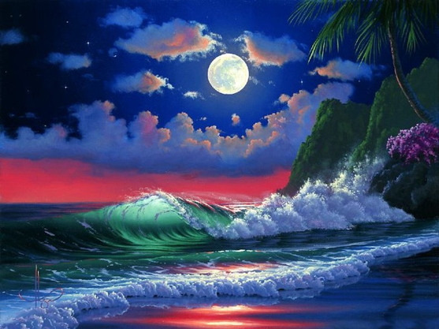
Art
Gallery
the Academy
of Soul
Art
Gallery
with
Interactive
Quiz
for 8-11
Grades
Автор:
Ольга Михайловна Степанова
учитель английского языка
МБОУ «Цивильская СОШ №1
имени Героя Советского
Союза М.В. Силантьева»
города Цивильск Чувашской Республики
2016

Slide 2
Art is the Therapy. The more you watch positive paintings, the more it cures your heart, the more it inspires you.
Enjoy the Fine Art and cure your heart.

Slide 3
“Autumn seemed to arrive suddenly that year. The morning of the first September was crisp and golden as an … .”
― J.K. Rowling
onion
orange
apple
apple

Slide 4
“Every artist dips his brush in his own soul, and paints his own … into his pictures.”
― Henry Ward Beecher
nature
mood
silence
nature

Slide 5
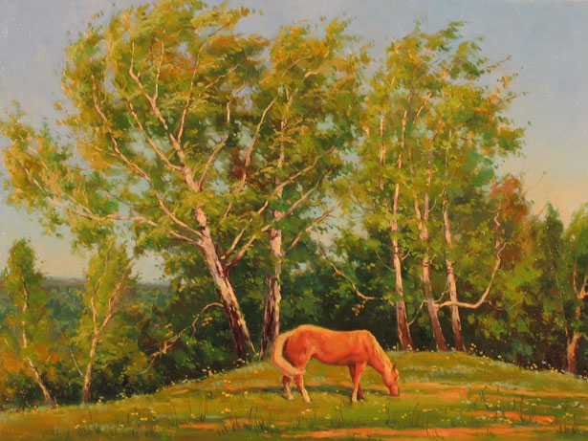
“Art is the proper task of … . ”
― Friedrich Nietzsche
mind
life
heart
life

Slide 6
“The painter has the Universe in his mind and … .”
― Leonardo da Vinci
fingers
head
hands
hands

Slide 7
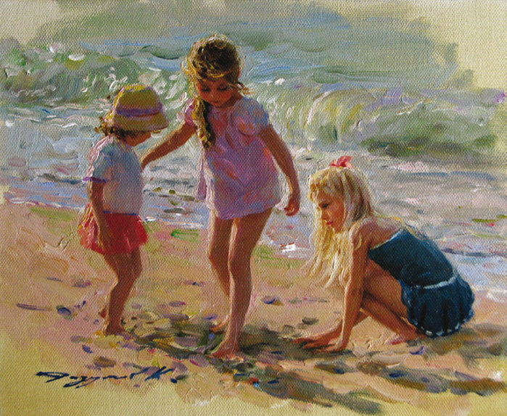
“I don't paint dreams or nightmares, I paint my own … .”
― Frida Kahlo
reality
future
feelings
reality

Slide 8
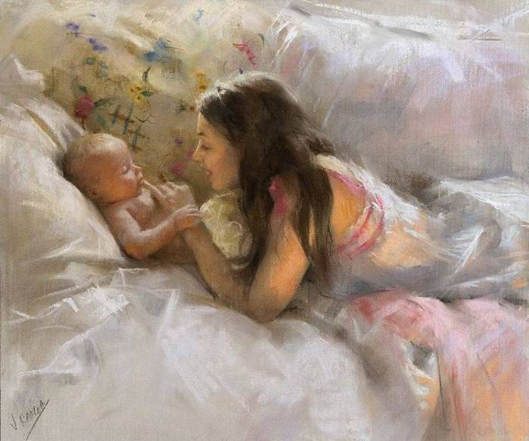
“The human body is the best … of art.”
― Jess C. Scott
wish
work
touch
work

Slide 9
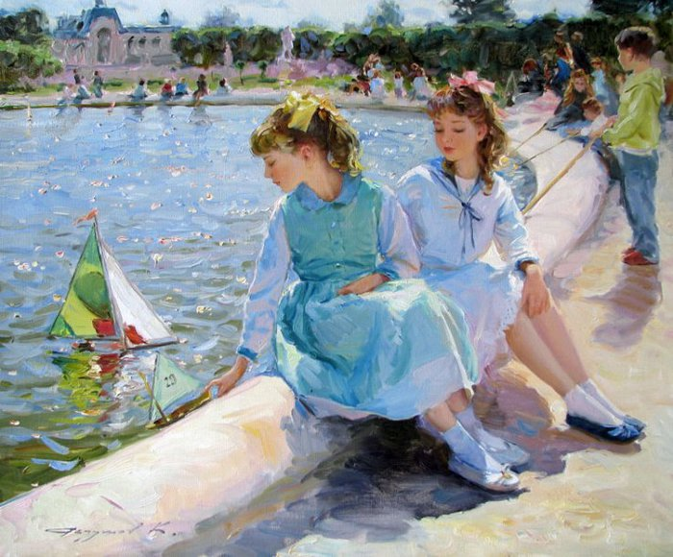
“You use a glass mirror to see your face; you use works of art to see your … .”
― George Bernard Shaw
soul
body
love
soul

Slide 10
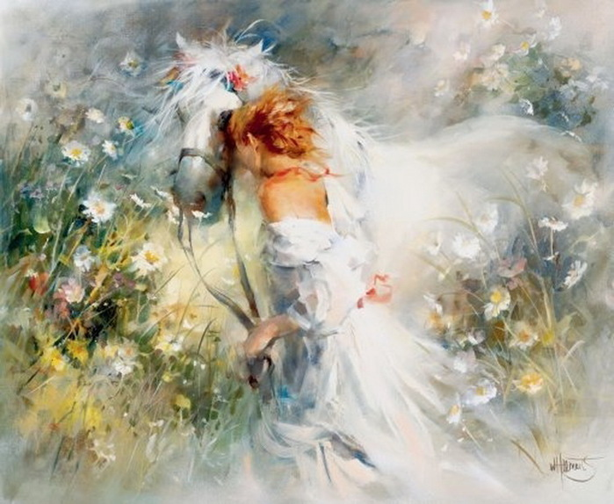
“The … of art is to represent not the outward appearance of things, but their inward significance.”
― Aristotle
plot
problem
aim
aim

Slide 11
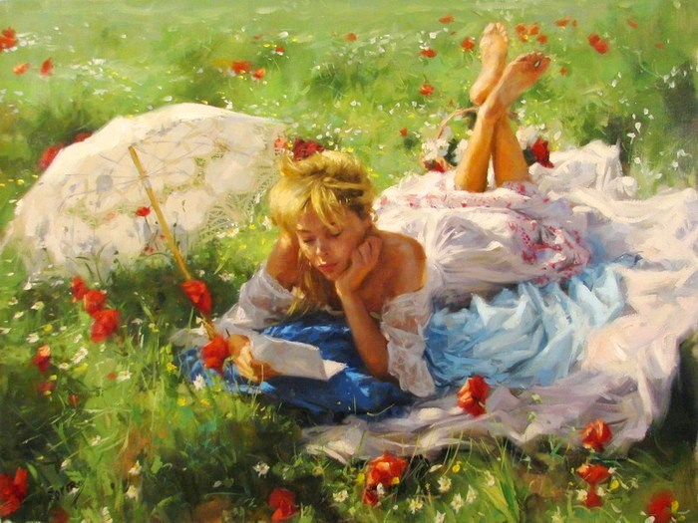
“Art washes away from the soul the … of everyday life.”
― Pablo Picasso
rubbish
dust
dirt
dust

Slide 12
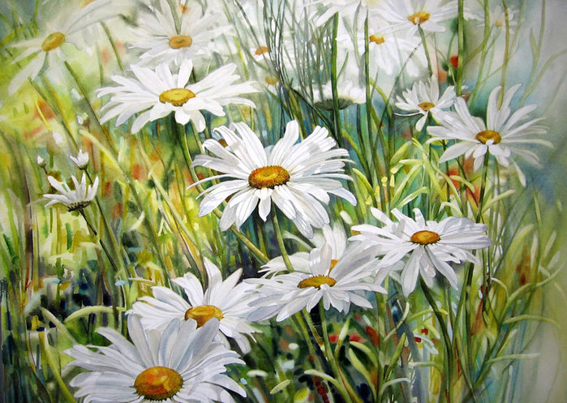
“Every human is an artist. The dreams of your life is to make beautiful … .”
― Miguel Ruiz
art
painting
scene
art

Slide 13
“I dream my painting and I paint my … .”
― Vincent van Gogh
world
dream
place
dream

Slide 14
The trip to Academy of Soul
is over
For Being Here

Slide 15
Source
http://www.goodreads.com/quotes/tag/art

