Slide 1
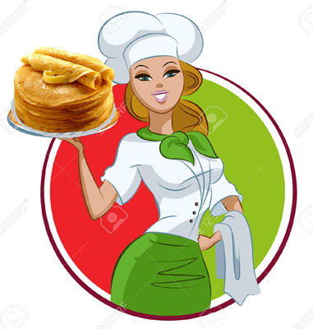
Delicious
Pancakes
Receipt
for 8-11
Grades
Автор:
Ольга Михайловна Степанова
учитель английского языка
МБОУ «Цивильская СОШ №1
имени Героя Советского Союза
М.В. Силантьева»
города Цивильск Чувашской Республики
2016

Slide 2
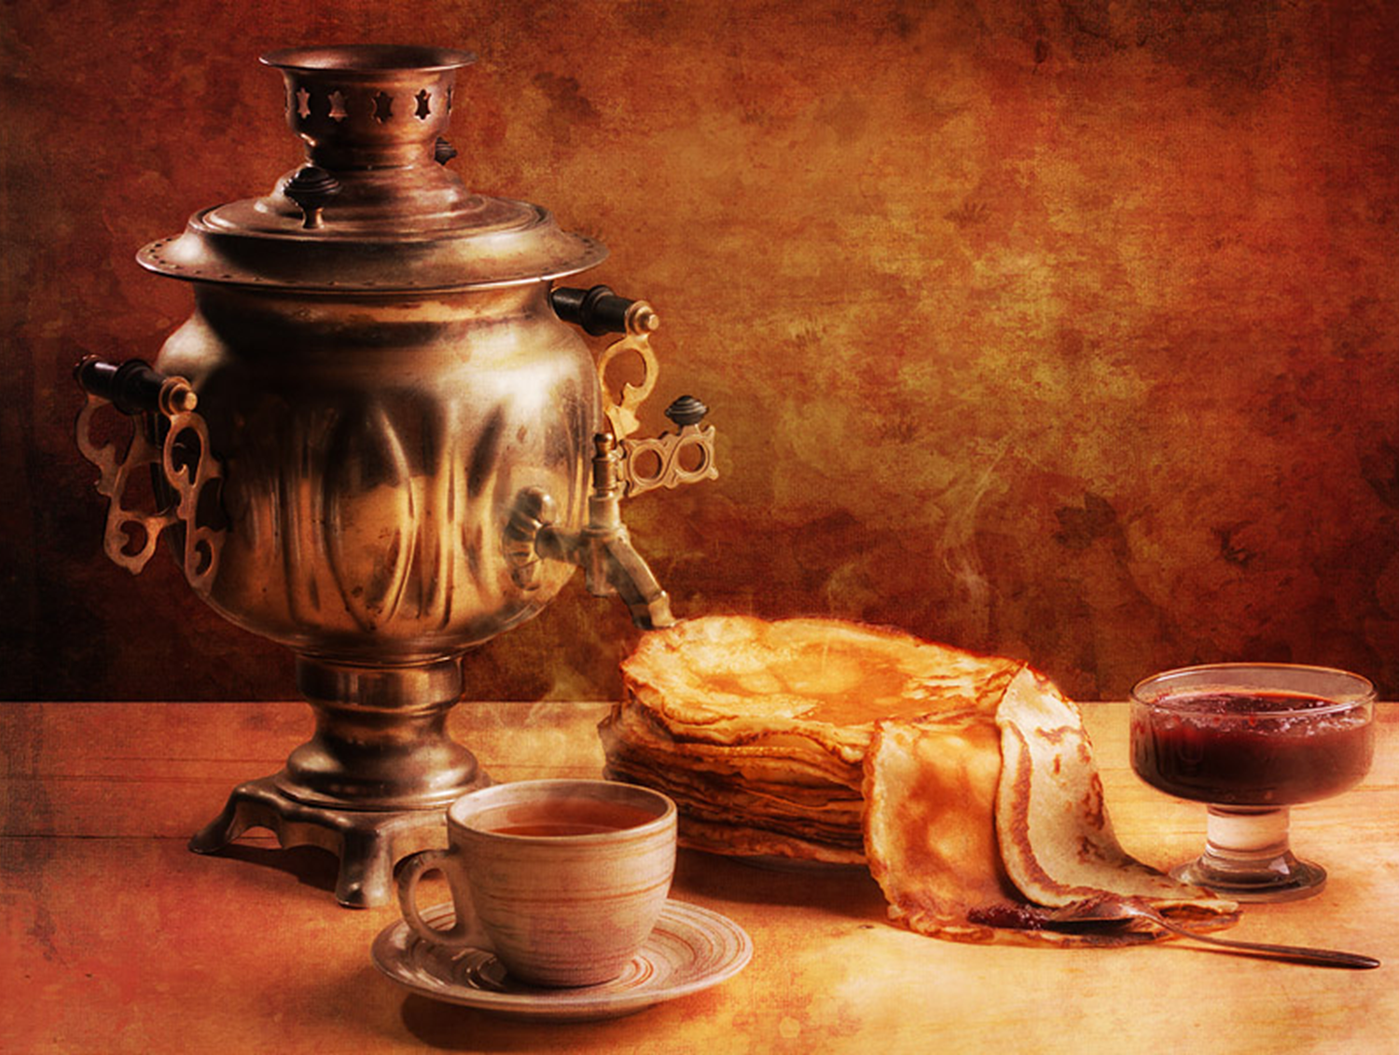
Pancakes are a delicious dish served typically at breakfast time.
Commonly made by adding water to a box mix, mediocre pancakes are brought to life.
But there is a way to achieve greatness.
A pancake above and beyond the ordinary, just follow the right steps.

Slide 3
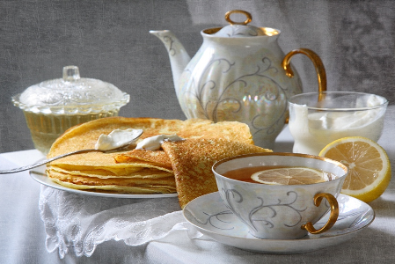
It takes a bit of planning to acquire the necessary ingredients. They are as followed: all-purpose flour, white sugar, baking powder, baking soda whole milk, large egg, vegetable oil, and to the pleasure of the cook, butter, syrup, and fruit toppings made be added.

Slide 4
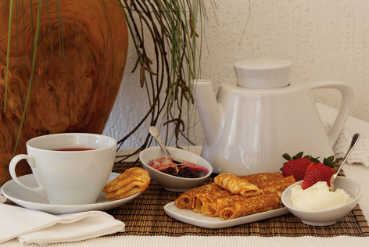
There is also kitchen appliances and tools that are needed.
They are as followed: electric griddle, one large bowl, one small bowl, a whisk,
a spatula, measuring cups sizes 1 cup, 1 tablespoon, 1 teaspoon and 1/2 teaspoon.

Slide 5
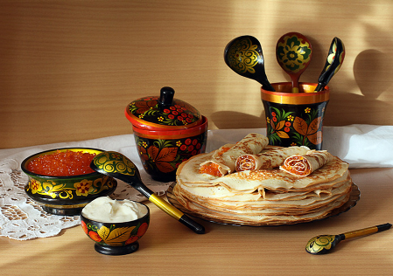
The directions are easy when you follow them properly.
First turn on the electric griddle to the setting of med-high heat.
Next in the large bowl combine 1 cup of flour, flour gets messy as it is being removed from the container. It is often fluffy, to properly measure one cup, gently press the flour into the measuring cup and smooth it flat.

Slide 6
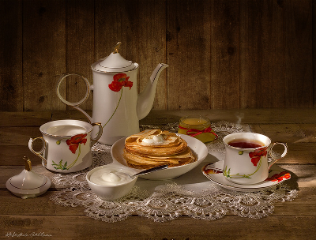
It does make an interesting surface to doodle in, one may find themselves making smile faces or peace signs in the tempting texture of the flour. When ready, dump the flour in the large bowl. Next it is time to add the baking soda 1/2 a teaspoon, and the baking powder 1 teaspoon. Mix these three dry ingredients, to make adding the wet ingredients easier, make a well in the middle of the mix, that will allow a gentle ease for mixing.

Slide 7
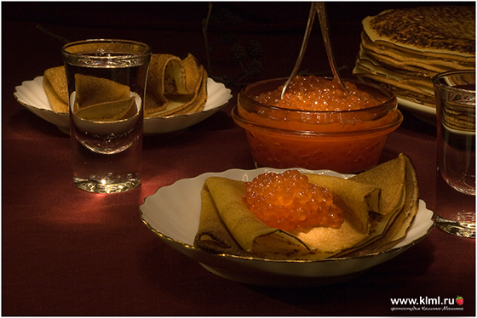
The small bowl will contain the wet ingredients, mix them together as so...
1 large egg, 1 cup of milk, 2 tablespoons of vegetable oil. When these are mixed well pour into the large bowl and mix them together. This is pancake batter.
At this point the griddle should be ready to cook on.

Slide 8
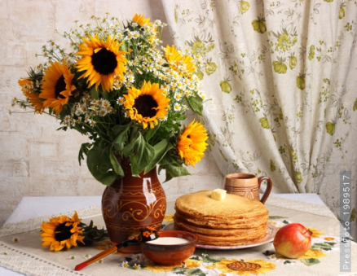
Depending on the size of the pancakes, different spoons sizes could be used to transfer the batter to the the griddle. Personally, I like to use a 1/4 cup measuring cup. Before I pour my batter, I like to layer a film of butter on the griddle, this gives a nice end result to the pancake.

Slide 9
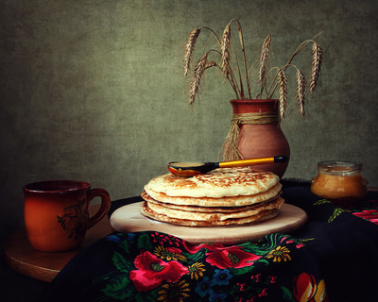
The pancakes are on the griddle and cooking now. Note the little holes, reserve bubbles in the batter, as the pancake cooks those outside ends start to thicken and the ratio of holes diminishes. When there is a thick crust, almost like a pie or pizza crust around the pancake but still some inverted bubbles in the middle, flip the pancake over to cook the other side. The smell of cooking butter will linger in the air.
зима

Slide 10
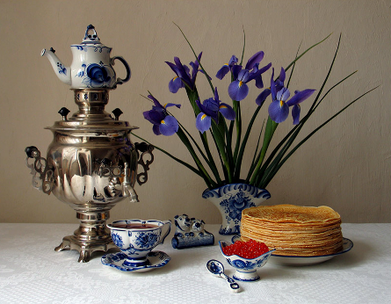
Transfer the cooked pancakes to a plate, don't forget to shut off the griddle.
Toppings for the pancakes are at the eaters pleasure. Some more melted delicious butter may be spread on the tops.

Slide 11
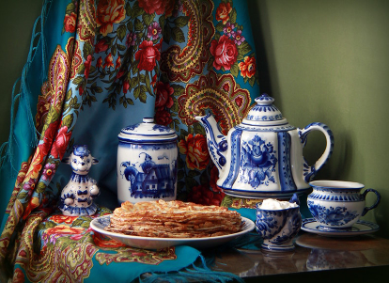
Syrup is a common enjoyment with maple goodness and sticky texture. Fruits, like sliced banana, strawberries and blueberries are good to add. If one is feeling the need for an explosion of flavors, the combination of any of the additions is encouraged.

Slide 12
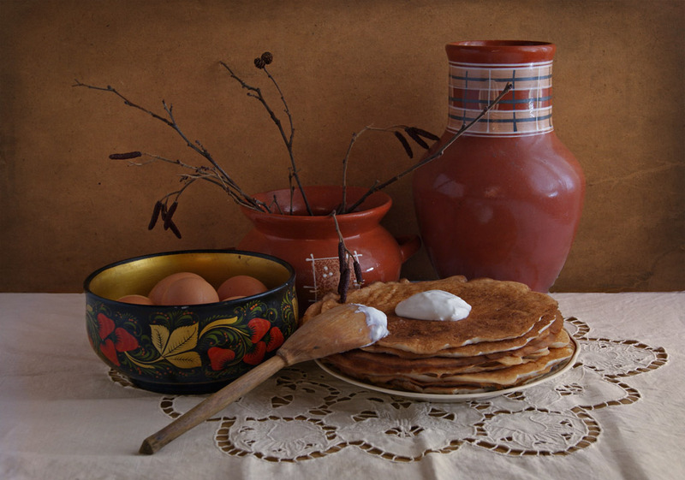
If all the directions have been properly followed then breakfast is served.
A fork was not on the list of utensils, but now would be a good time to find one, since pancakes are not the best finger food, especially with syrup on them.

Slide 13
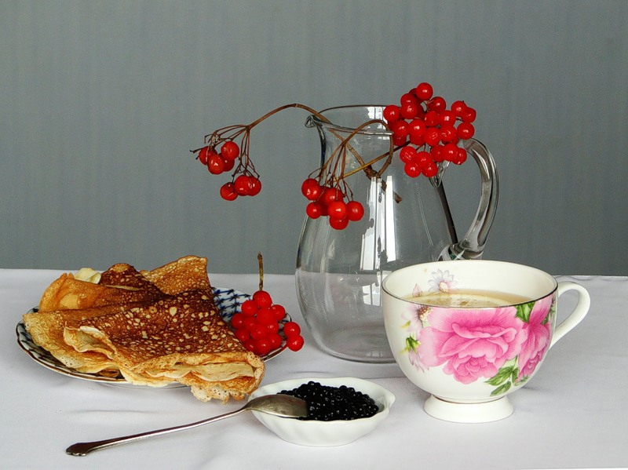
Enjoy the meal with every bite!

Slide 14
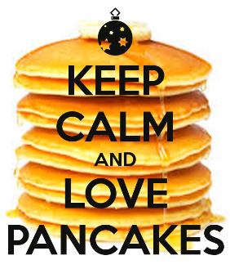
Источник
Источник
http://www.poetrysoup.com/poem/pancakes_714608
Источник фотослайдов - fotki.yandex.ru

