Slide 1
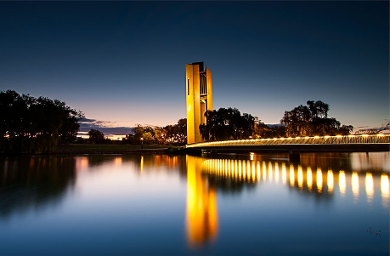
Canberra
the Capital city of Australia
Interactive Quiz
for 8-11 Grades
Автор:
Ольга Михайловна Степанова
учитель английского языка
МБОУ «Цивильская СОШ №1
имени Героя Советского Союза
М.В. Силантьева»
города Цивильск Чувашской Республики
2016

Slide 2
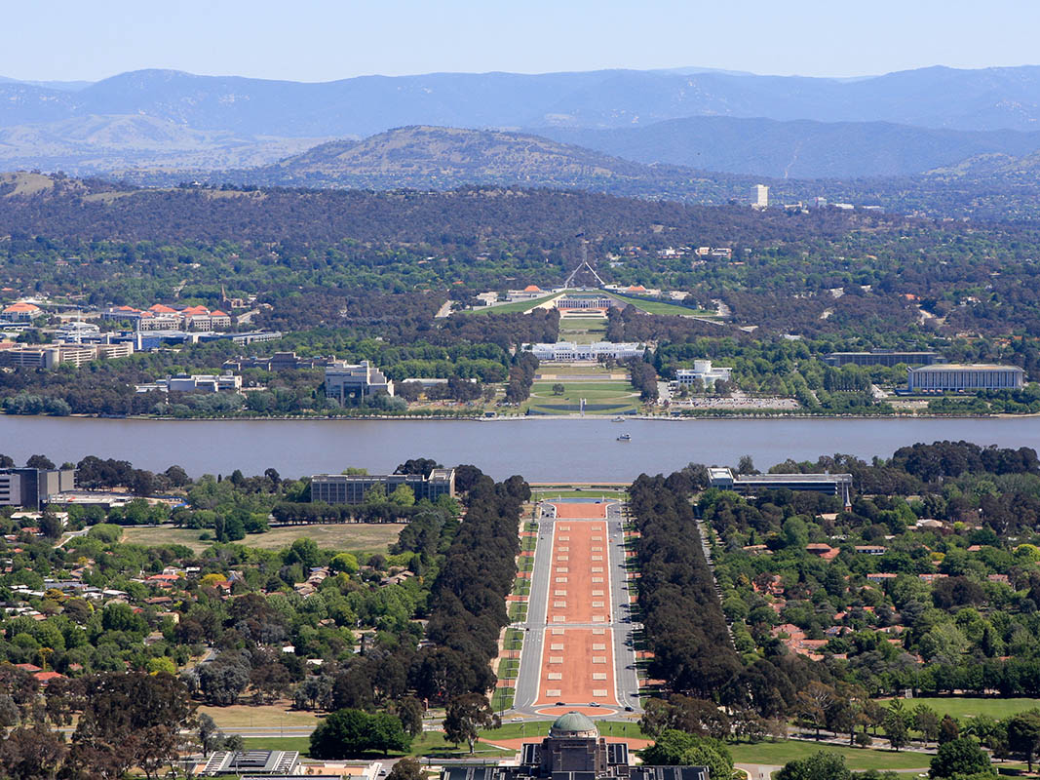
Nestled between two mountains – Black Mountain and Mt Ainslie, and located on the ancient lands of the Indigenous Ngunnawal people, Canberra’s name is thought to mean
‘… place’
that is derived from the Aboriginal word Kamberra.
chatting |  | singing |  | meeting |  | dancing

Slide 3
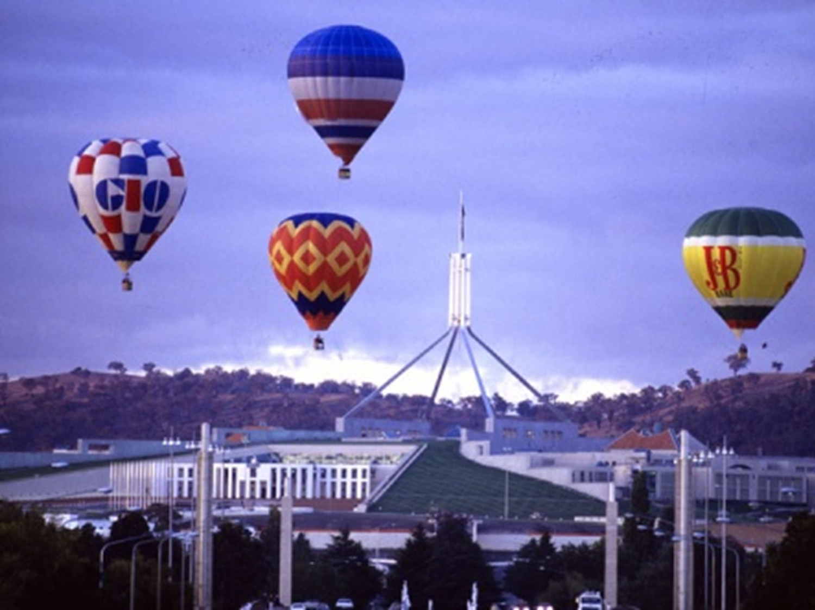
There’s no better way to fully appreciate the capital’s … than from a hot air balloon as you drift peacefully over the city – one of the only places in the world where you can get the chance to fly over a Parliament House.
charm |  | people |  | streets |  | fountains

Slide 4
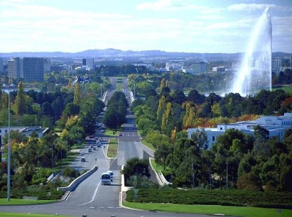
Canberra’s special contrast of nature and urban living was planned in 1912 by master designer, Walter Burley Griffin and his wife Marion Mahony Griffin, both … architects, who won an international design competition to design the capital.
Chicago |  | London |  | Paris |  | New York

Slide 5
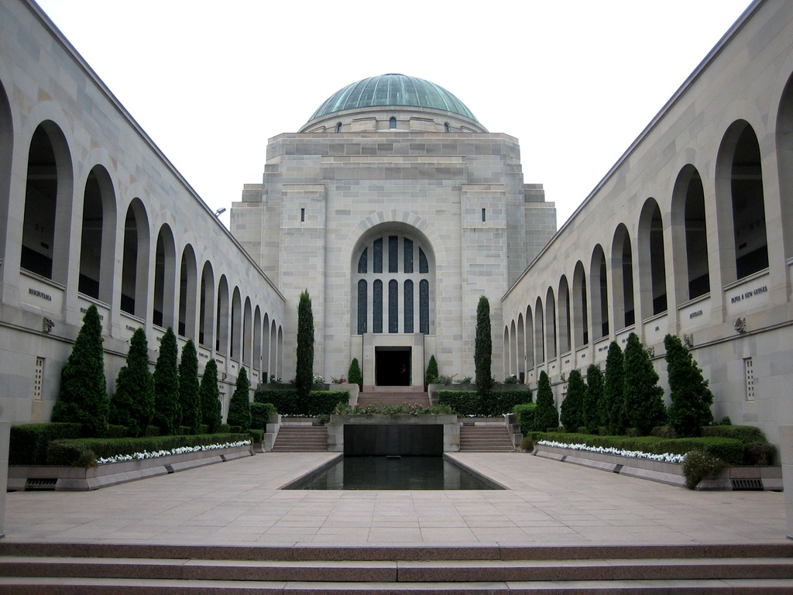
The city is the administrative centre of the federal government and is home to the major national attractions that collect, archive and
exhibit the nation's art, cultural,
historical and social … .
leasure |  | measure |  | pleasure |  | treasures

Slide 6
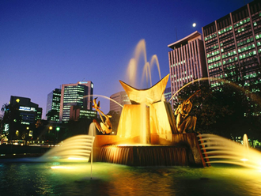
Canberra is home to four universities, including the Australian National University, which attracts scholars from around the world, as do the modern facilities of Mount Stromlo Observatory and the space-tracking … at Tidbinbilla.
indness |  | policy |  | possibility |  | facility

Slide 7
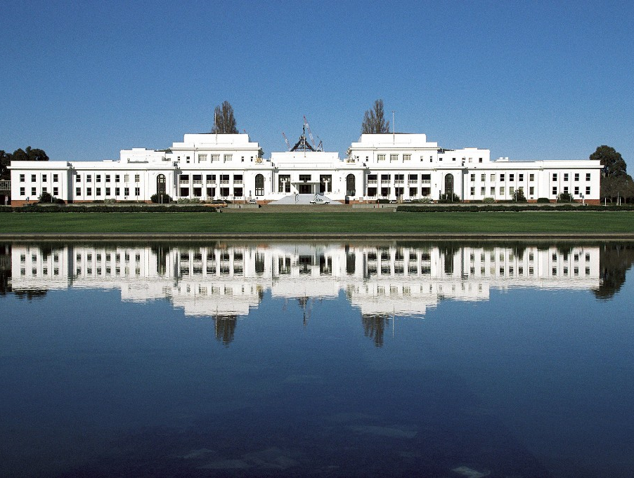
Canberra is a major center of diplomatic activity; more than 40 nations have established permanent diplomatic missions . A corps of news correspondents is in residence to cover political and other national events. Conventions and conferences of technical, scientific, and educational groups are held from time to time. The city attracts about a million Australian and international … each year.
artists |  | teenagers |  | singers |  | visitors

Slide 8
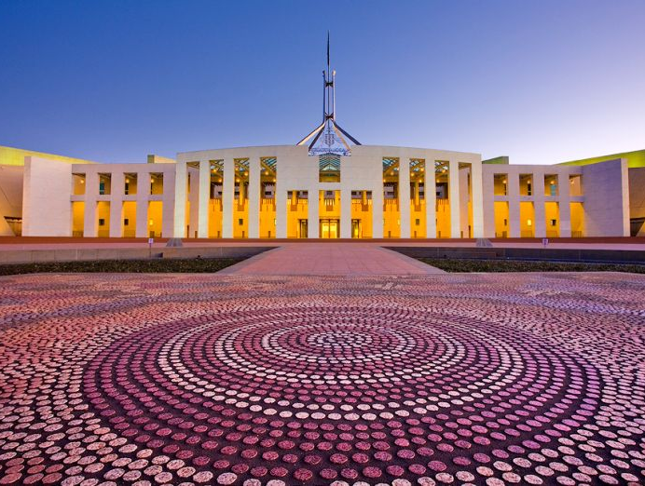
Canberra Day is held on the second Monday in March each year, the culmination of a 10 day Celebrate Canberra festival where Canberrians are able to celebrate the physical beauty, and cultural diversity and vibrancy of their city. The Canberra … of the Year is named at this time.
Miss |  | Citizen |  | Beauty |  | Friend

Slide 9
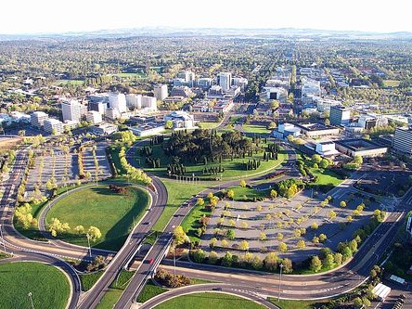
Approximately two per cent of the Canberra workforce is employed by one of the security agencies. In some parts of Canberra, you have more chance of living next door to a … than just about any other city on earth.
athlete |  | bodyguard |  | spy |  | inventor

Slide 10
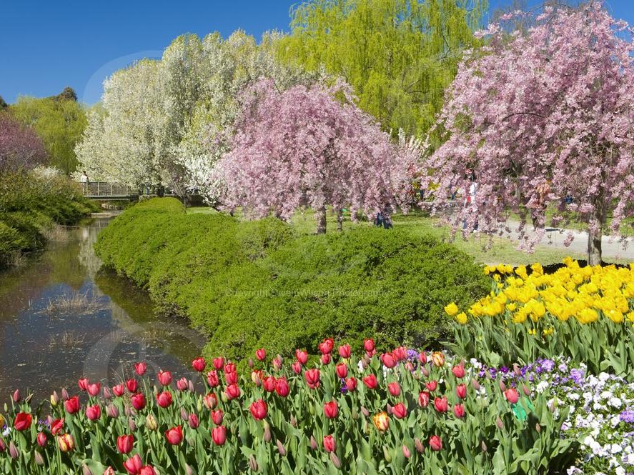
The city's calendar is punctuated with a wide variety of exhibitions and celebratory events, including the National Multicultural Festival (with street parades and a program of artistic and cultural activities) and the Vintage Festival, both in May; the National Folk Festival, in April; and the Australian Science Festival and the International Chamber Music Festival, both in May. The Australian spring brings the monthlong Floriade (September-October), centered around outdoor … of a million flowering bulbs and other plants.
displays |  | fountains |  | exhibitions |  | shows

Slide 11
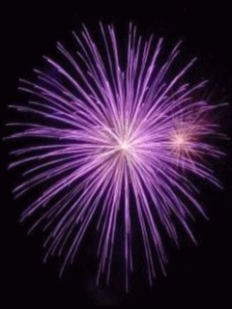
The End!
Who is a winner?
You?
The Prize goes
to …you!
Congratulations!!!

Slide 12
Source
http://www.abc.net.au/tv/documentaries/downloads/canberraconf_facts.pdf
http://www.forteachersforstudents.com.au/site/themed-curriculum/australian-capital-territory/facts/
http://visitcanberra.com.au/visitor-information/canberra-facts-and-figures
http://hubpages.com/travel/10-Facts-about-Canberra-Australia
http://www.australia.gov.au/about-australia/australian-story/canberra-australias-capital-city

