Slide 1
Holiday Spirit Parade for 7-11 Grades
Walking through
Автор:
Ольга Михайловна Степанова
учитель английского языка
МБОУ «Цивильская СОШ №1
имени Героя Советского Союза
М.В. Силантьева»
города Цивильск
Чувашской Республики
2016

Slide 2
We all know that when three-leaf clovers come out, it's St. Patrick's Day. This Irish holiday is always celebrated on March 17th, which is the day that Saint Patrick died. He was a missionary way back in the 4th century who converted the Irish to Christianity.

Slide 3
Many stories are told in connection with St. Patrick. The three-leaf clover was said to be used by the saintly bishop to explain the Trinity to the pagans, which is why it is such a common St. Patrick's Day symbol today.

Slide 4
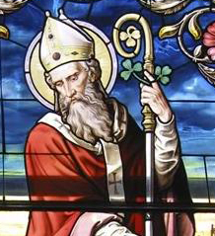
Today, St. Patrick is the patron saint of Ireland, of many dioceses throughout the English-speaking world, and of engineers. He is also invoked against the
fear of snakes and snakebites.

Slide 9
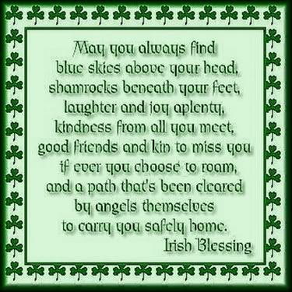

Slide 11
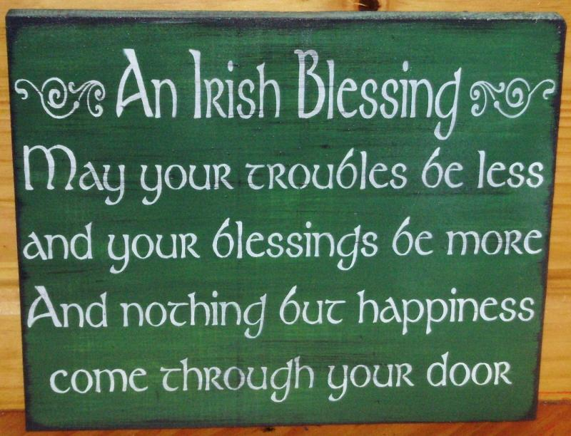

Slide 14
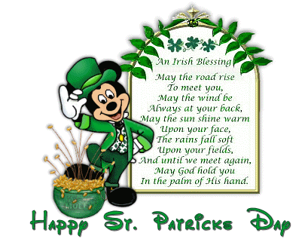

Slide 16
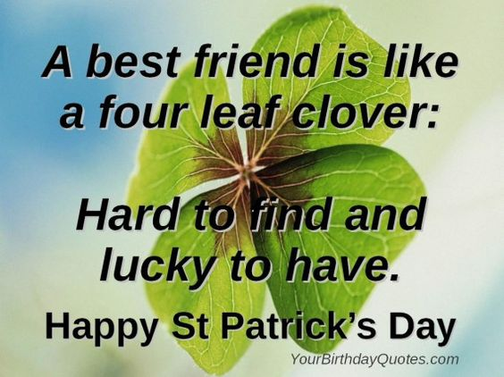

Slide 17
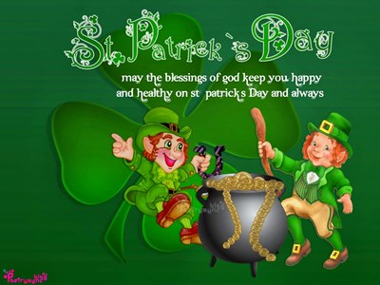

Slide 21
Source
http://www.theholidayspot.com/patrick/poems.htm
http://festvalspoint.com/wp-content/uploads/2016/02/St-Patricks-Day-Poems-for-Kids-580x435.jpg
http://www.dummies.com/how-to/content/who-is-st-patrick-and-why-do-we-celebrate-st-patri.html
Изображения для слайдов взяты на fotki.yandex.ru

