Slide 1
Classic Irish Blessings
Interactive Quiz
to Enrich
Your Vocabulary
Автор:
Ольга Михайловна Степанова
учитель английского языка
МБОУ «Цивильская СОШ №1
имени Героя Советского Союза М.В. Силантьева»
города ЦивильскЧувашской Республики
2016

Slide 2
HOLD |  | TAKE |  | RISE |  | PRAY
MAY THE ROAD RISE TO MEET YOU,
MAY THE WIND BE ALWAYS AT YOUR BACK
MAY THE SUN SHINE UPON YOUR FACE
THE RAINS FALL SOFT UPON YOUR FIELDS
AND, UNTIL WE MEET AGAIN,
MAY GOD … YOU IN THE PALM OF HIS HAND

Slide 3
CLOUDS |  | BIRDS |  | ANGELS |  | WINDS
MAY GOD GRANT YOU MANY YEARS TO LIVE,
FOR SURE HE MUST BE KNOWING
THE EARTH HAS … ALL TOO FEW
AND HEAVEN IS OVERFLOWING

Slide 4
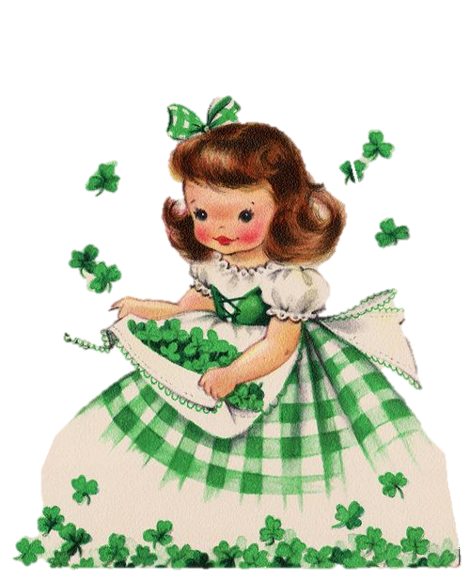
HEART |  | CHEST |  | EYES |  | SOUL
WALLS FOR THE WIND, AND A ROOF FOR THE RAIN,
AND DRINKS BESIDE THE FIRE-
LAUGHTER TO CHEER YOU
AND THOSE YOU LOVE NEAR YOU,
AND ALL THAT YOUR … MAY DESIRE!

Slide 5
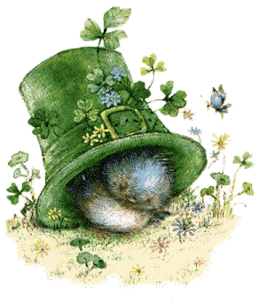
EVENING |  | AFTERNOON |  | DAY |  | MORNING
MAY YOUR POCKETS BE HEAVY & YOUR HEART BE LIGHT
MAY GOOD LUCK PURSUE YOU EACH
… & NIGHT

Slide 6
TROUBLES |  | SUN |  | PACIENCE |  | BLESSINGS
ALWAYS REMEMBER TO FORGET THE THINGS THAT MADE YOU SAD
BUT NEVER FORGET TO REMEMBER THE THINGS THAT MADE YOU GLAD.
ALWAYS REMEMBER TO FORGET THE TROUBLES THAT PASSED AWAY
BUT NEVER FORGET TO REMEMBER THE … THAT COME EACH DAY

Slide 7
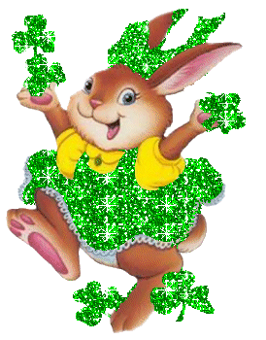
FORGIVE |  | HELP |  | LOVE |  | RESPECT
MAY YOUR NEIGHBOURS …
YOU
TROUBLE NEGLECT YOU
THE ANGELS PROTECT YOU
AND HEAVEN ACCEPT YOU

Slide 8
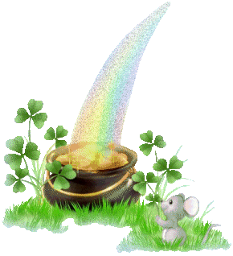
WEED |  | GREED |  | SEED |  | DEED
MAY SOFT GENTLE BREEZES BRUSH O'ER YOUR FACE,
FOR EACH LOVING TOUCH IS GOD'S WARM EMBRACE.
MAY YOU HAVE ENOUGH FOR ALL THAT YOU NEED,
AND NEVER BE HURT BY ANOTHER ONE'S … .

Slide 9
START |  | SMART |  | PART |  | ART
MAY GOD GRANT YOU:
A PUPPY OR KITTEN TO LICK ON YOUR CHIN,
A LOTTERY TICKET - AND SURE IT'S A WIN!
A PANTRY FULL OF YOUR FAVOURITE FOODS,
A CLOSET LINED WITH THE BEST OF GOODS.
BUT MOST OF ALL, IN YOUR ARMS AND YOUR HEART:
THE LOVE OF YOUR LIFE -AND MAY YOU NEVER … !

Slide 10
RAINBOWS |  | APPLES |  | SHOWERS |  | HAPPINESS
MAY YOU HAVE LOVE THAT NEVER ENDS
LOTS OF MONEY, AND LOTS OF FRIENDS
HEALTH BE YOURS, WHATEVER YOU DO,
AND MAY GOD SEND MANY … TO YOU!

Slide 11
AVOID |  | HATE |  | LEAVE |  | LOSE
MAY YOUR BLESSINGS OUTNUMBER
THE SHAMROCKS THAT GROW,
AND MAY TROUBLE … YOU
WHEREVER YOU GO.

Slide 12
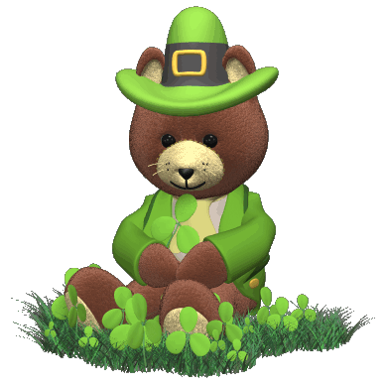
smiles |  | kisses |  | hugs |  | dances
May your day be touched
by a bit of Irish luck,
brightened by a song in your heart,
and warmed by the … of the people you love.

Slide 14
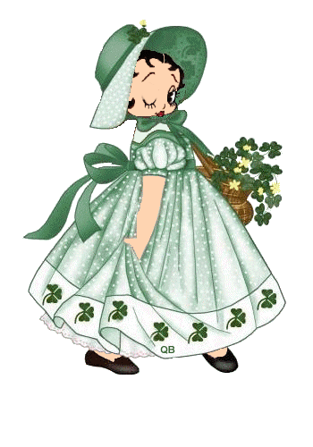

Slide 15
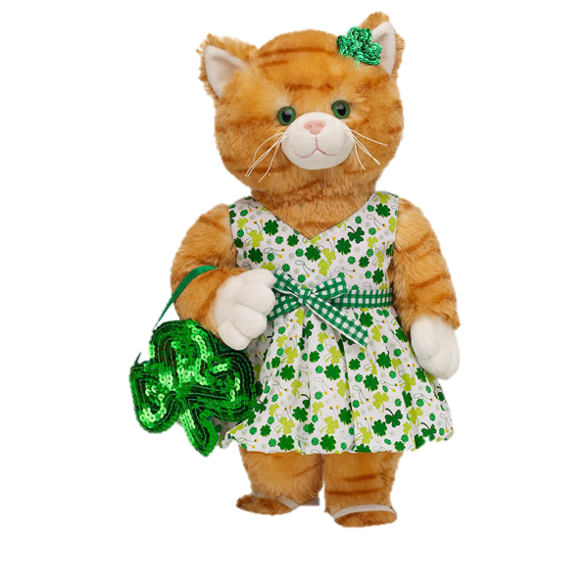
The End!

Slide 16
Sources
http://www.telegraph.co.uk/news/worldnews/europe/ireland/12196661/St-Patricks-Day-march-17-Everything-you-need-to-know-Irelands-patron-saint.html
http://www.staidenshomeschool.com/activities/st_patricks_day/St_Patricks_Day_blessings.html
https://www.pinterest.com/pin/402298179184853212/

