Slide 1
Welcome
to Happiness!
Интерактивная
викторина
для 8-11
классов
Автор:
Ольга Михайловна Степанова
учитель английского языка
МБОУ «Цивильская СОШ №1
имени Героя Советского Союза
М.В. Силантьева»
города Цивильск Чувашской Республики
2016

Slide 2
“Happiness is a state of … .”
Aristotle
activity

Slide 3
“When one … of happiness closes, another opens, but often we look so long at the closed door that we do not see the one that has been opened for us.”
Helen Keller
door

Slide 4
“The two enemies of human happiness are pain and … .”
Arthur Schopenhauer
boredom

Slide 5
“Happiness is not in the mere possession of money; it lies in the joy of achievement, in the thrill of creative … .”
Franklin D. Roosevelt
effort

Slide 6
“The … of happiness is not in doing what one likes, but in liking what one does.”
James M. Barrie
secret

Slide 7
“Happiness is something that comes into our lives through … we don’t even remember leaving open.”
Rose Lane
doors

Slide 8
“Happiness always looks small while you hold it in your … , but let it go, and you learn at once how big and precious it is.”
Maxim Gorky
hands

Slide 9
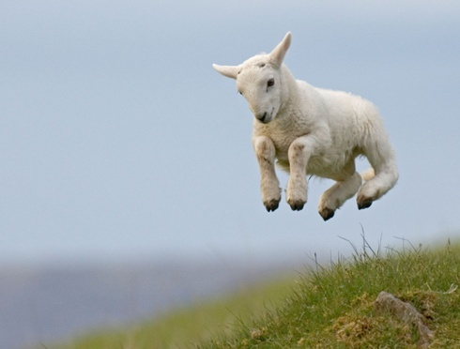
“Everyone wants to live on top of the …, but all the happiness and growth occurs while you’re climbing it.”
Andy Rooney
mountain

Slide 10
“Happiness is when what you think, what you say, and what you do are in … .”
Mahatma Gandhi
harmony

Slide 11
“Happiness is nothing more than good health and a bad … .”
Albert Schweitzer
memory

Slide 12
“The first recipe for happiness is: avoid too lengthy meditation on the … .”
Andre Maurois
past

Slide 13
“Learn to let go. That is the … to happiness.”
Buddha
key

Slide 14
“Optimism is a happiness … . If you stay positive, good things
and good people
will be drawn
to you.”
Mary Lou Retton
magnet

Slide 15
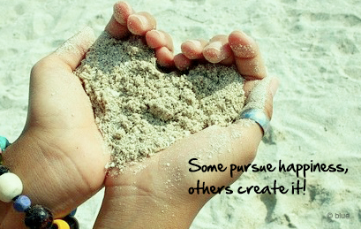
Thank You for Taking Part in the Quiz!

Slide 16
Источник
http://www.positivityblog.com/index.php/2013/08/20/happiness-quotes/
Изображения на слайдах взяты из
fotki.yandex.ru

