Slide 1
Funny Animal Poetry
Interactive Quiz for 5-7 Grades
Автор:
Ольга Михайловна Степанова
учитель английского языка
МБОУ «Цивильская СОШ №1
имени Героя Советского Союза
М.В. Силантьева»
города Цивильск Чувашской Республики
2016

Slide 2
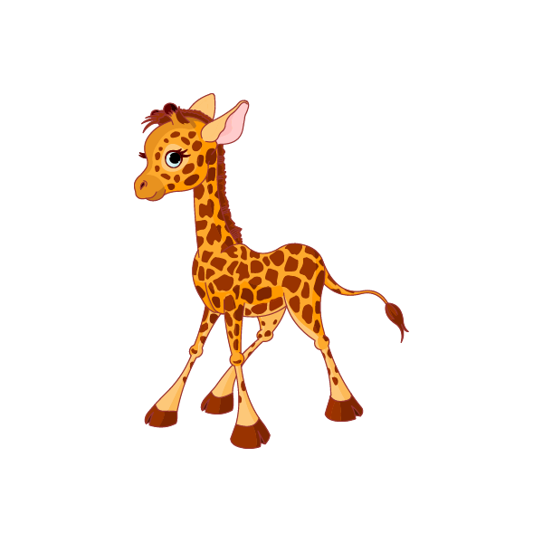
Monkeys can jump and climb trees Giraffes are tall and they eat … .
leaves

Slide 3
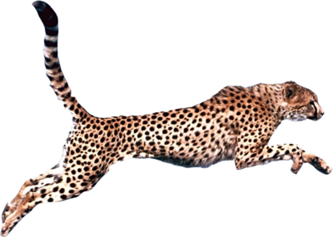
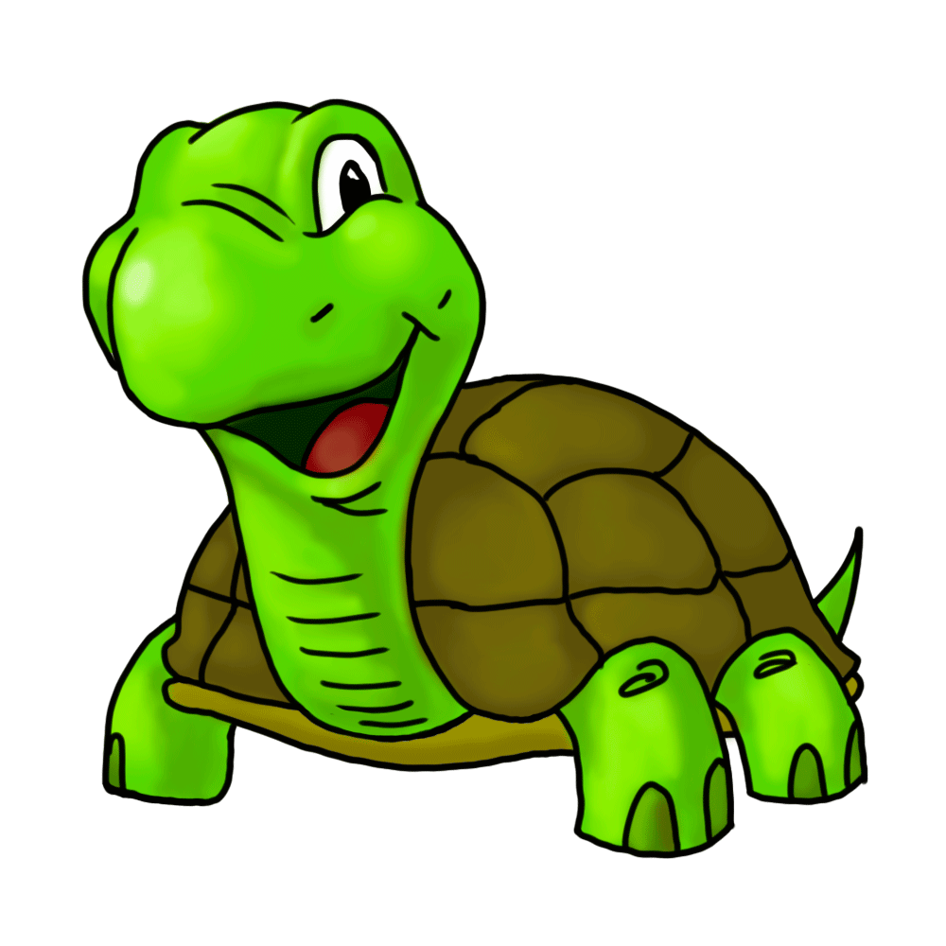
Turtles are green and they can swim Cheetahs can run and they always… .
win

Slide 4
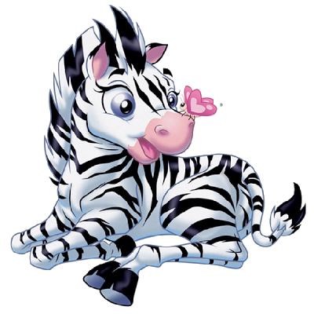
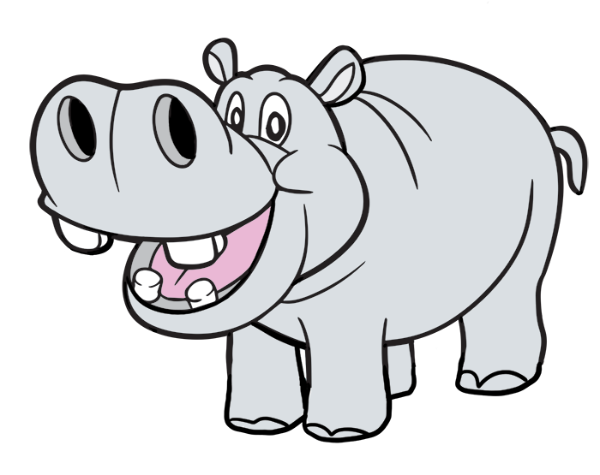
Zebras look like horses
but they are black and white Hippos are big and snore at … .
night

Slide 5
From a window in my house, I could see a little… .
mouse

Slide 6
An elephant goes like this and that: He’s terribly big and he’s terribly fat. He has no fingers, and he has no toes, But goodness
gracious,
what a … !
nose

Slide 7
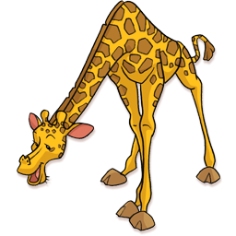
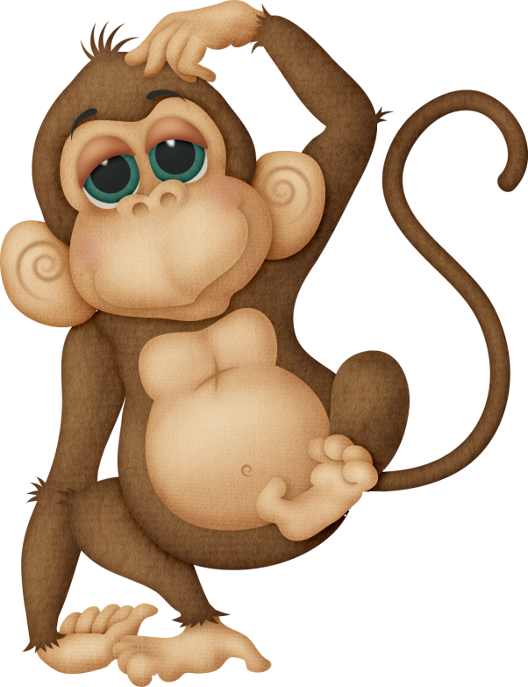
We saw the big, long-necked giraffe, And the silly monkeys made us … !
laugh

Slide 8
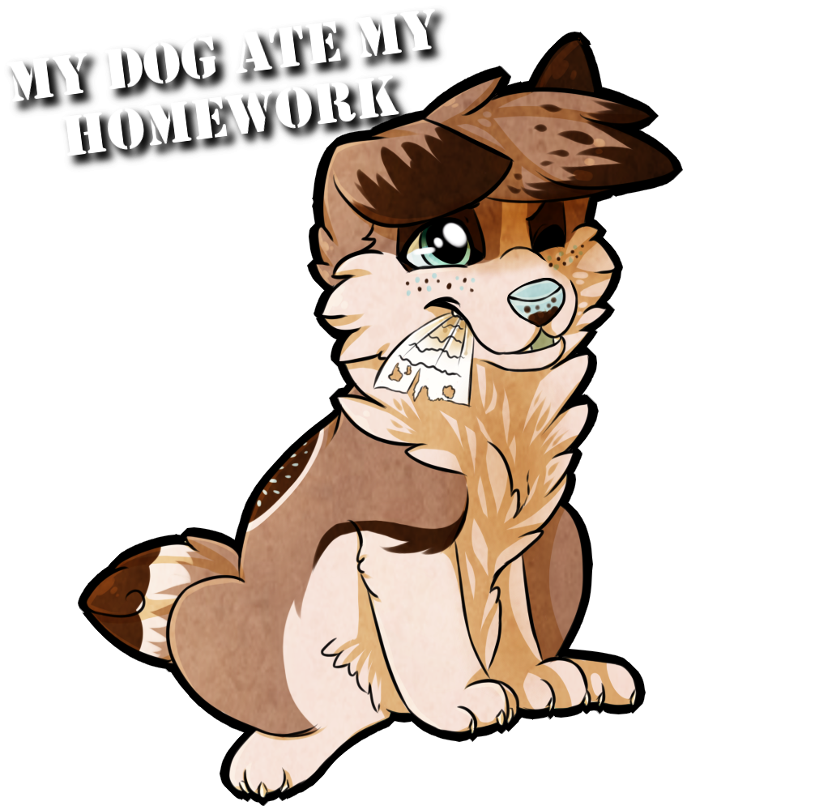
My dog ate my homework. He swallowed it whole. I shouldn't have mixed it with food in his … .
bowl

Slide 9
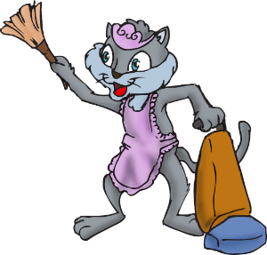
I taught my cat to clean my room, to use a bucket, brush and broom, to dust my clock and picture frames, and pick up all my toys and … .
games.

Slide 10
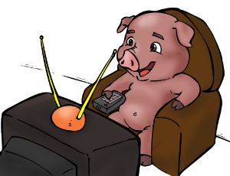
I never get to watch cartoons or anything like that. My Pig is busy watching farming shows. I should have got
a … .
cat

Slide 11
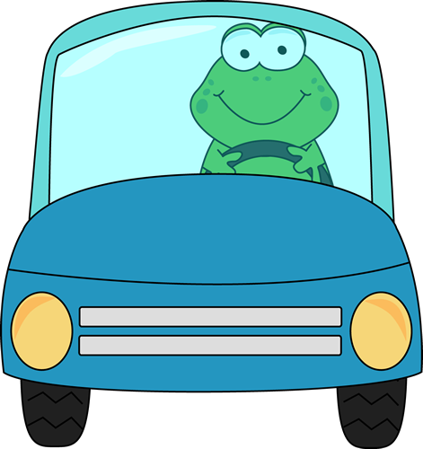
Reduce, reuse, recycle is the motto of my frog. He drives a solar-powered car to cut back on the … .
smog

Slide 12
For Taking Part in a Quiz

Slide 13
Источник
Источник
http://www.english-time.eu/for-teachers/poem/269-06.-animals/
http://www.poetry4kids.com/cat-Animal.html
Изображения в блоге взяты на сайте fotki.yandex.ru

