Slide 1
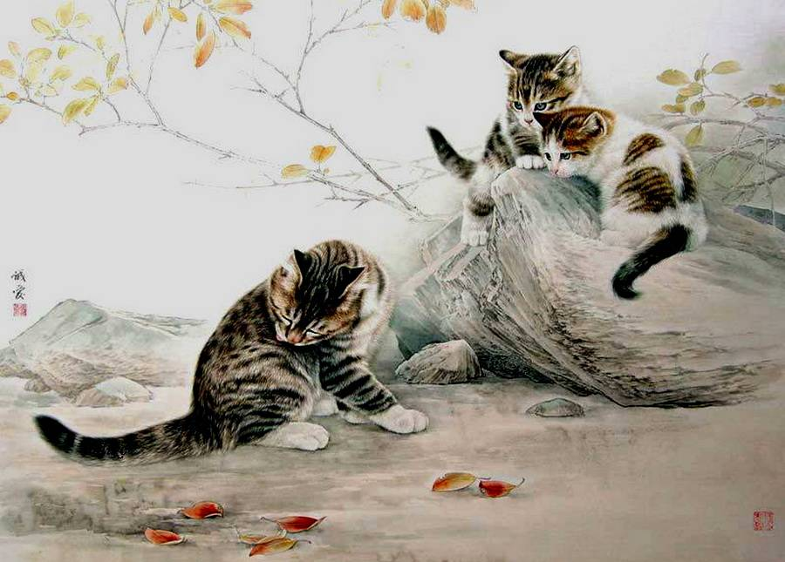
Cats
the Awesome
Pets
Интерактивная
викторина
для 7-11
классов
Автор:
Ольга Михайловна Степанова
учитель английского языка
МБОУ «Цивильская СОШ №1
имени Героя Советского Союза
М.В. Силантьева»
города Цивильск Чувашской Республики
2016

Slide 2
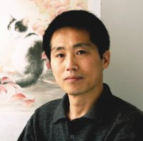
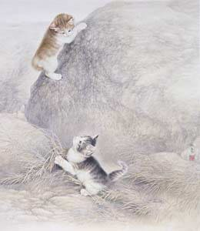
He has been interested in painting since childhood. In 1978 he graduated from the Fine Arts Academy of Hebei province, and studied painting under the guidance of master Xu Hongbin. After graduation he attended advanced studies at the Central Academy of Arts and Crafts and Lu Xun Academy of Fine Arts. Currently he is a member of the Chinese Artists’ Association, Hebei Branch.
Alias Xing Chengai (Fu Yuan) was born in 1960 in Cangzhou City, Hebei Province.

Slide 3
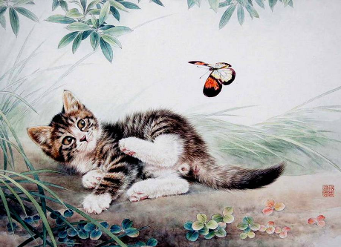
“I love cats because I enjoy my home; and little by little, they become its visible
… .”
Jean Cocteau
soul

Slide 4
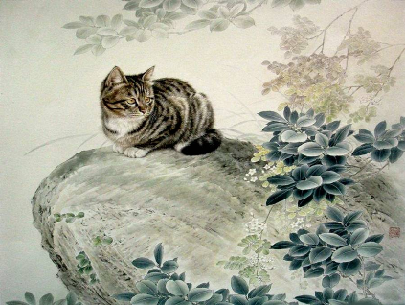
Cats are connoisseurs of … .
James Herriot
comfort

Slide 5
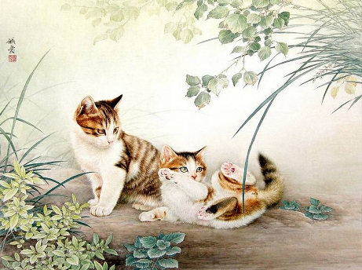
“I believe cats to be spirits come to earth. A cat, I am sure, could walk on a … without coming through.”
Jules Verne
cloud

Slide 6
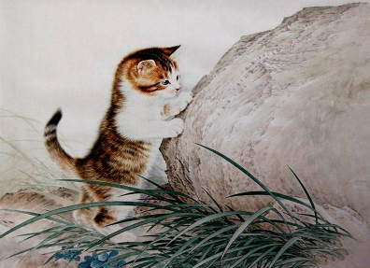
“The smallest feline is a … .”
Leonardo da Vinci
masterpiece

Slide 7
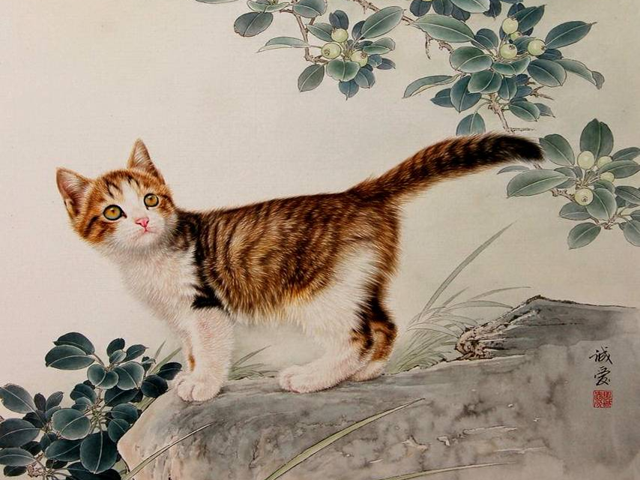
“ … killed the cat.”
Ben Johnson
Curiosity

Slide 8
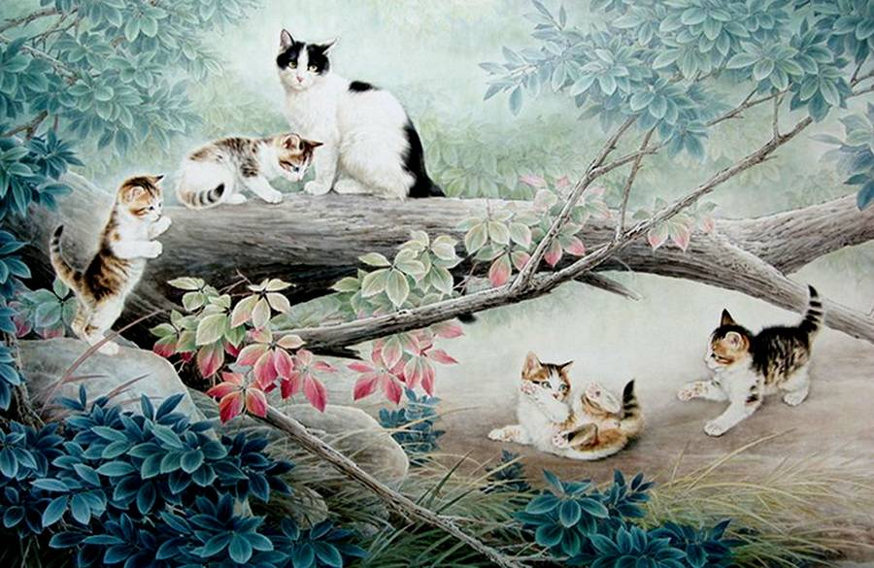
“There are two means of refuge from the miseries of life: … and cats.”
Albert Schweitzer
music

Slide 9
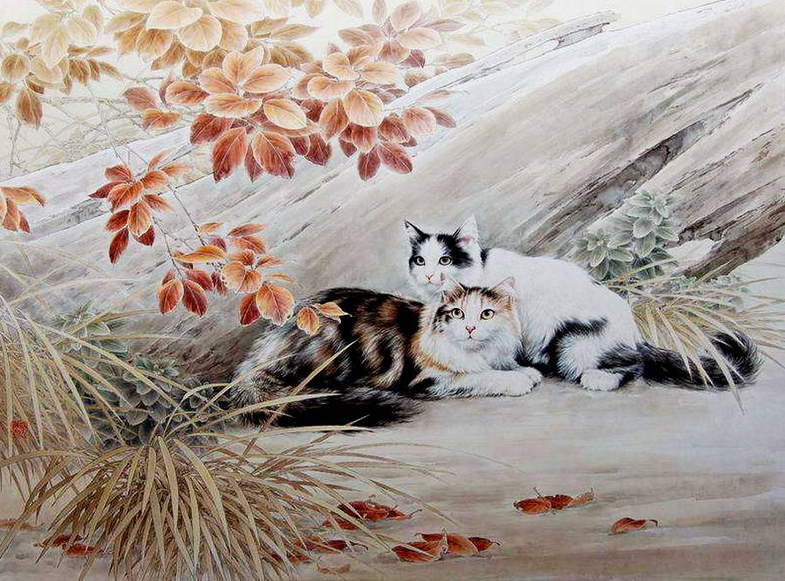
“I am as vigilant as a cat to steal … .”
William Shakespeare
cream

Slide 10
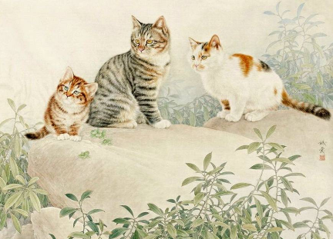
“Cats have it all — admiration, an endless … , and company only when they want it.”
Rod McKuen
sleep

Slide 11
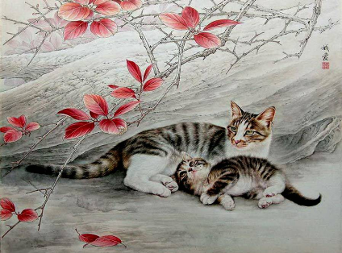
“Cats know how to obtain … without labor, shelter without confinement, and love without penalties.”
Walter
Lionel
George
food

Slide 12
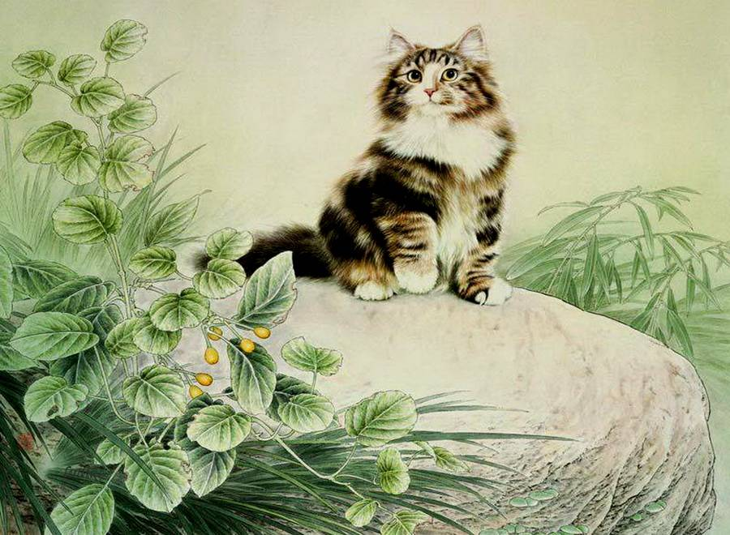
“How we behave toward cats here below determines our status in … .”
Robert A. Heinlein
heaven

Slide 13
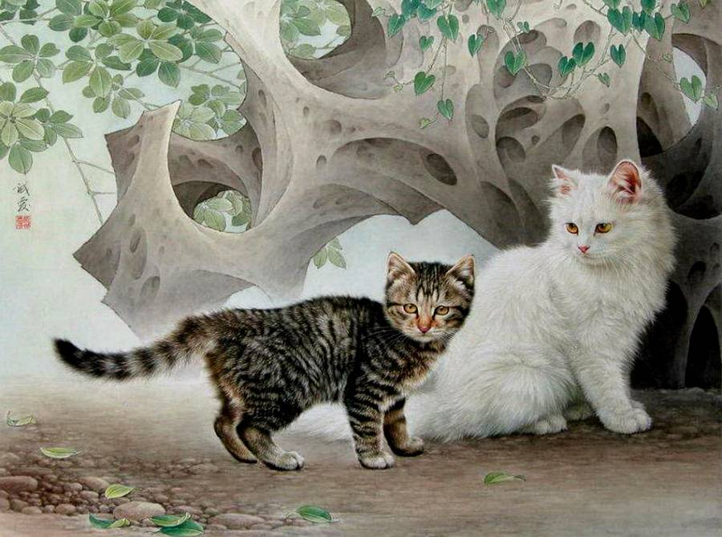
“What greater … than the love of a cat?”
Charles Dickens
gift

Slide 14
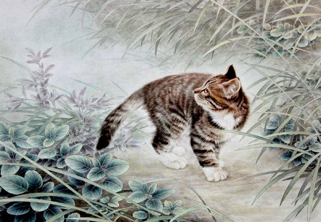
“A cat has absolute emotional … : human beings, for one reason or another, may hide their feelings, but a cat does not.”
Ernest Hemingway
honesty

Slide 15
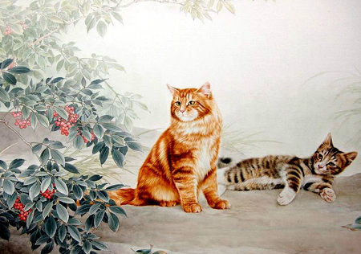
“A countryman between two lawyers is like a … between two cats.”
Benjamin Franklin
fish

Slide 16
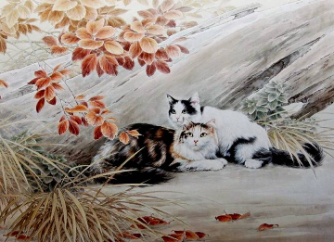
“That’s the great … of creativity. You treat ideas like cats: you make them follow you.”
Ray Bradbury
secret

Slide 17
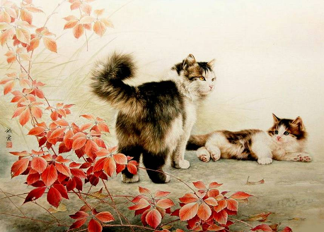
“I can’t have cats around me because they try to steal
my … .”
Roseanne Barr,
actress
energy

Slide 18
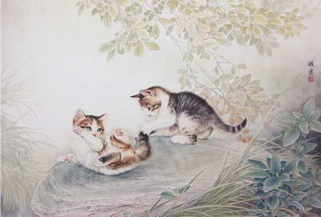
Thank You
for Taking Part in
the Quiz!

Slide 19
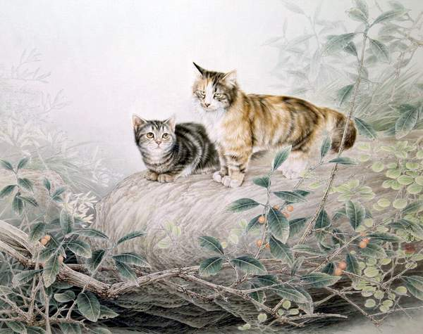
Источник
http://cattime.com/cat-facts/lifestyle/1470-25-famous-quotes-about-cats
Изображения на слайдах взяты из fotki.yandex.ru

