Slide 1
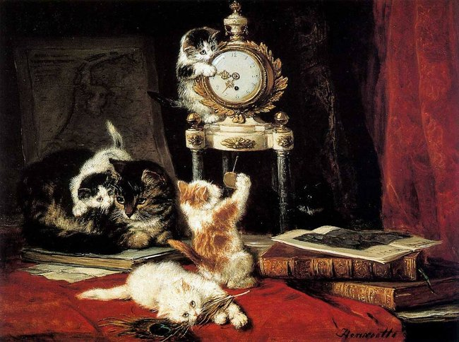
Lovely Cats
by
Henriëtte
Ronner-Knip
Picture Gallery for 8-11 Formers
Автор:
Ольга Михайловна Степанова
учитель английского языка
МБОУ «Цивильская СОШ №1
имени Героя Советского Союза
М.В. Силантьева»
города Цивильск
Чувашской Республики
2016

Slide 2
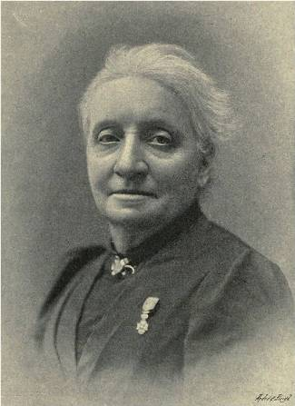
Henriëtte Ronner-Knip
(31 May 1821, Amsterdam, Holland -
28 February 1909, Ixelles)
was a Dutch-Belgian artist in the Romantic style
who is best-known for her
animal paintings,
especially cats.
At first she painted landscapes and all kinds of animals, than she gave all her attention to painting dogs and after 1870
Henriëtte Ronner-Knip only painted cats and kittens in all their different behaviour. Henriëtte Ronner Knip had exhibitions in Amsterdam and The Hague. Works in various museums, a.o. Singer Museum Laren, Museum Boymans-van Beuningen Rotterdam, Teylers Stichting in Laren, Rijksprentenkabinet Amsterdam etc. etc.

Slide 3
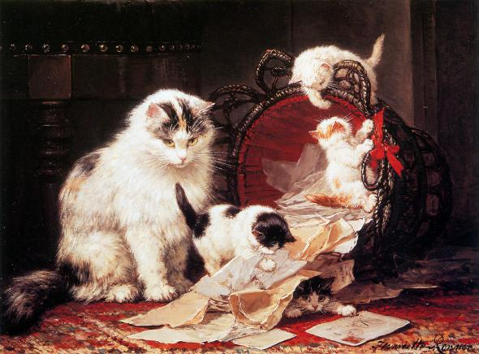
She was born into a family of artists and she received her first lessons from her father,
Josephus Augustus Knip, who also gave lessons to her aunt (his youngest sister), Henriëtte Geertruida Knip. His father, Nicolaas (1741-1808), was an artist as well.

Slide 4
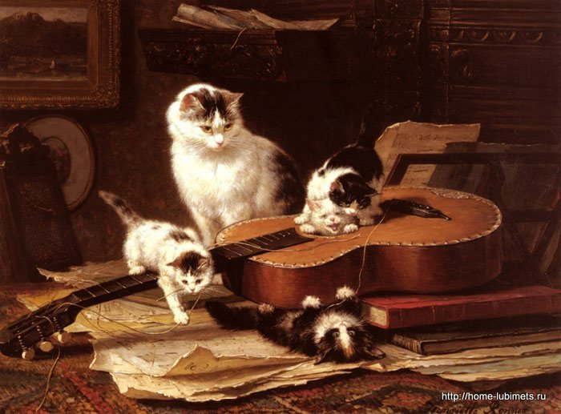
Some sources indicate that her mother was Pauline Rifer de Courcelles, a painter of birds, who was her father's first wife but, at the time of her birth,
they were apparently separated and he was living with his mistress, Cornelia van Leeuwen (1790-1848), who is also credited with being Henriëtte's mother.

Slide 5
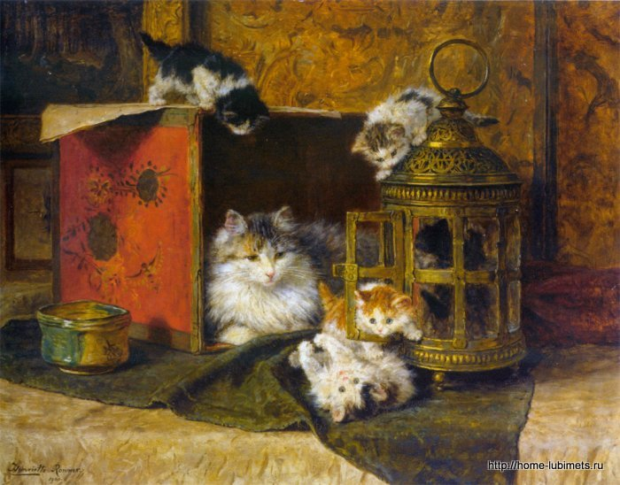
After he became
totally blind in 1832, the family continued to move about, staying for a short time in The Hague, then Beek
and 's-Hertogenbosch before settling in Berlicum
in 1840.

Slide 6
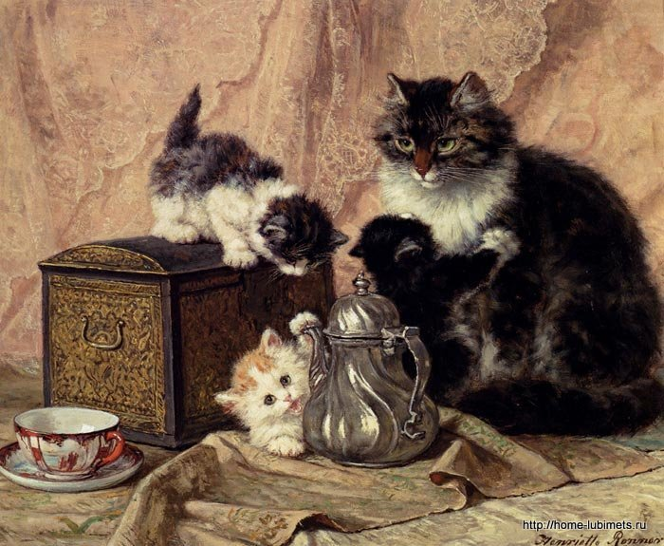
She was born into a family of artists and she received her first lessons from her father, Josephus Augustus Knip, who also gave lessons to her aunt (his youngest sister), Henriëtte Geertruida Knip. His father, Nicolaas (1741-1808), was an artist as well.

Slide 7
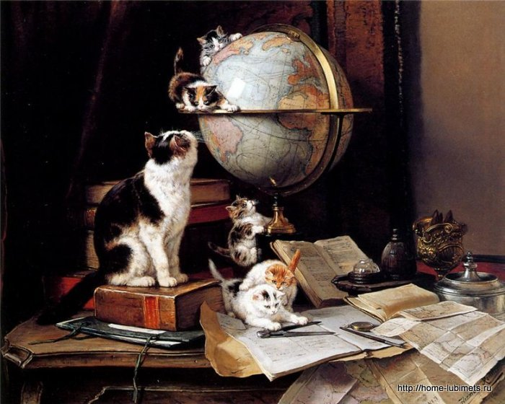
By this time, she was essentially in charge of the family's finances and legal obligations, and had begun painting seriously by 1835. She was a participant in the Exhibition of Living Masters in 1838.

Slide 8
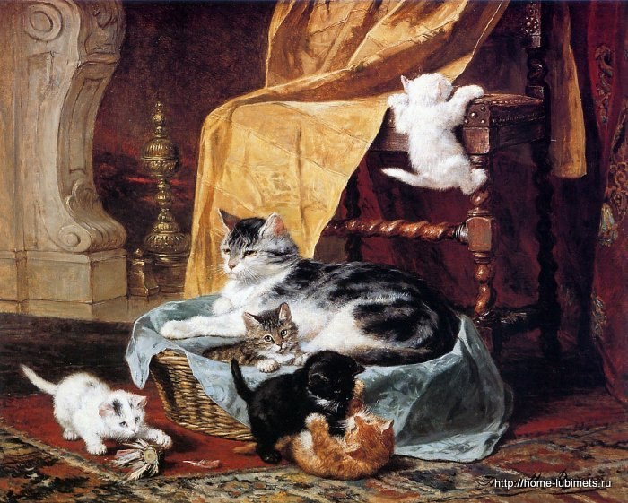
After Cornelia's death, she moved to Amsterdam where she painted
farms,
animals and forests from nature; first in watercolor, then in oils. That same year, she became the first woman admitted as an "active member" to Arti et Amicitiae.

Slide 9
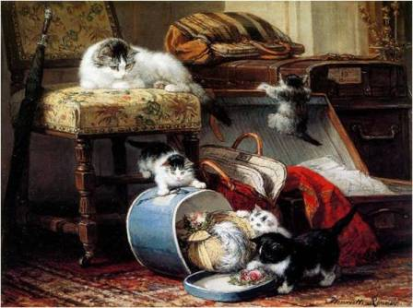
In 1850, she married Feico Ronner (1819-1883) and they moved to Brussels. He was often ill and could not be regularly employed, so he became
her manager.

Slide 10
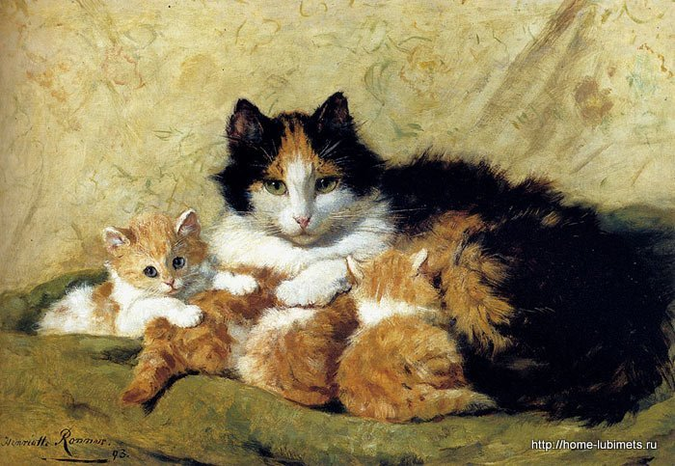
At this time, she narrowed her subject matter, focusing almost entirely on dogs and cats. After 1870, she painted her most famous works, featuring long-haired, often playful cats in bourgeois settings.

Slide 11
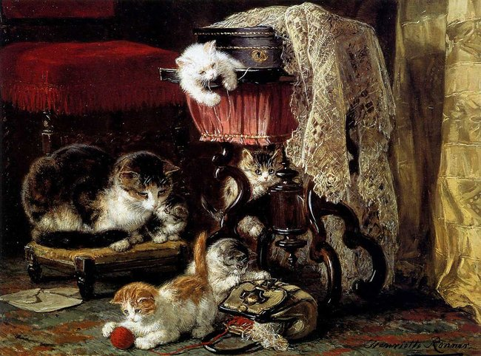
She
continued to paint
dogs too; notably lapdogs belonging to Marie Henriette of Austria and
Princess Marie of Hohenzollern-Sigmaringen.

Slide 12
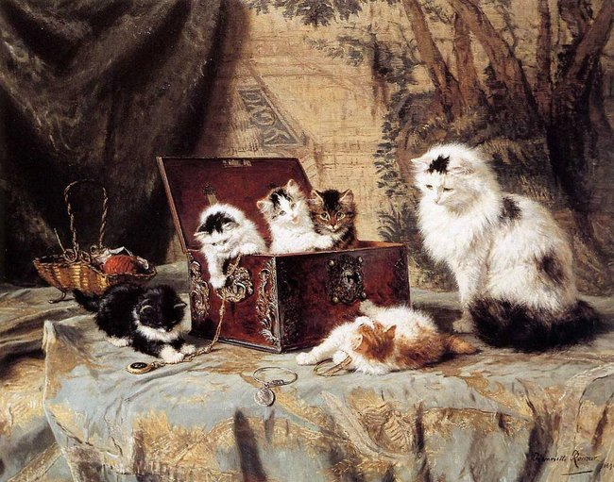
In her later years,
she had a house with a large garden, where she kept hunting dogs,
cats
and a parrot
that she used as models.

Slide 13
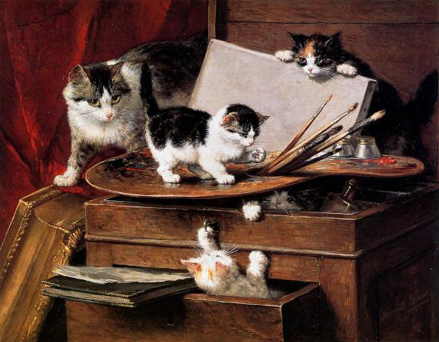
After observing them in her studio,
she
would
make
paper sculptures in the desired poses and set them together with props, such as furniture and fabrics.

Slide 14
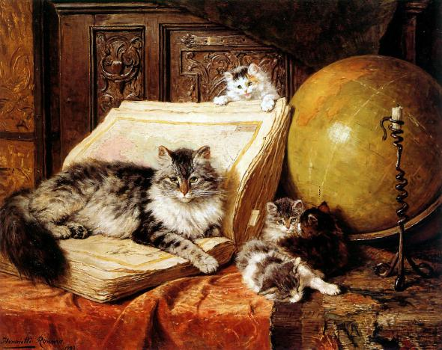
In 1887, she was awarded the Order of Leopold
and, in 1901, became a member of the Order of Orange-Nassau.

Slide 15
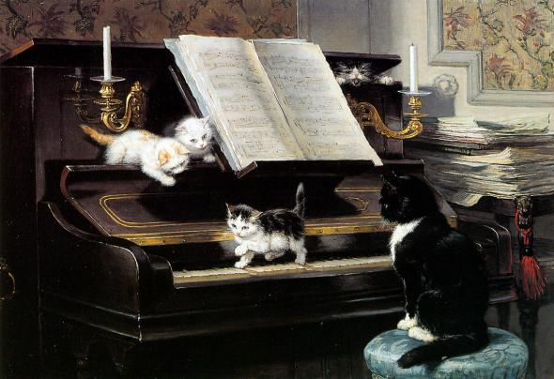
Her son Alfred and daughters Alice and Emma
also became artists.
She often exhibited with them.

Slide 16
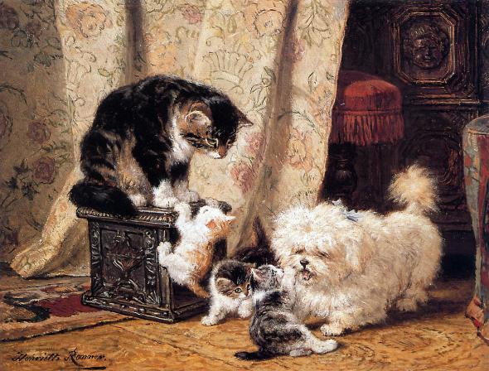
Thank you for Visiting
Henriëtte Ronner-Knip’s Cats!

Slide 17
Sources
https://en.wikipedia.org/wiki/Henri%C3%ABtte_Ronner-Knip
http://shgpi.edu.ru/biblioteka/blog/?p=5637

