Slide 1
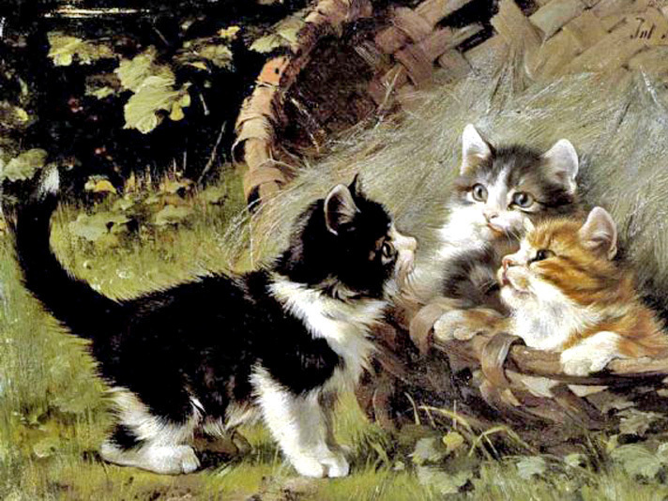
Cats Rule
Facts about why cats rule
for 8-11 Grades
Автор:
Ольга Михайловна Степанова
учитель английского языка
МБОУ «Цивильская СОШ №1
имени Героя Советского Союза
М.В. Силантьева»
города Цивильск Чувашской Республики
2016

Slide 2
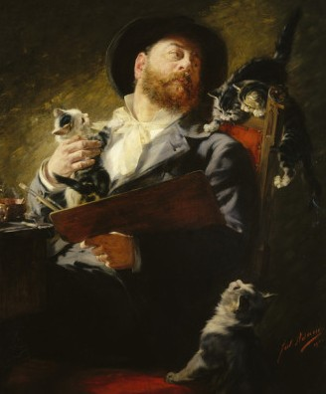
Julius Adam II
1852 - 1913
The German artist Julius Adam is noted primarily for his portrayals of cats, and in particular kittens. He also did a number of dog portraits. He studied art under his father, Julius Adam Snr., and subsequently with the teachers Echter and W. Diez. He spent six years in Rio de Janeiro before returning to Germany.

Slide 3
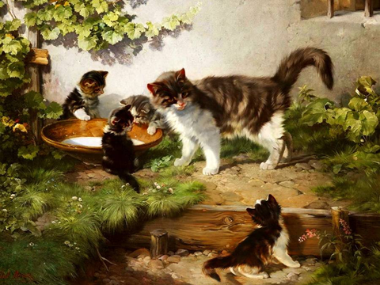
Well, why do cats rule?

Slide 4
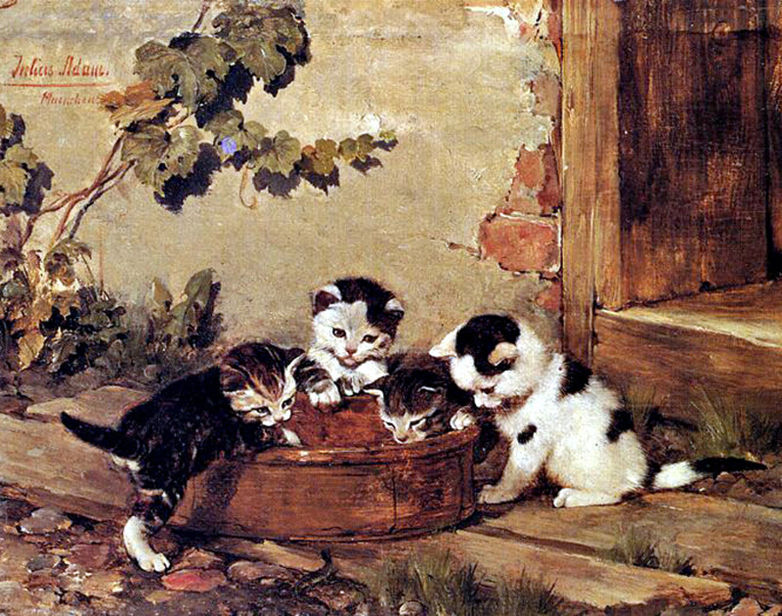
They are independent: Cats can be left by themselves for a while. You can take a short vacation and leave them at home. All they need is enough food and water to make it through. They don’t get separation anxiety and tear up your entire house like dogs do.

Slide 5
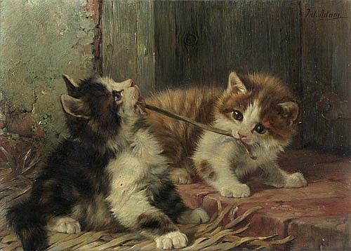
They can use the bathroom: Yeah, litter boxes can be gross, but they are much easier to deal with than poop scattered all over the house. Cats can even be taught to be potty trained on a real toilet. How cool is that?

Slide 6
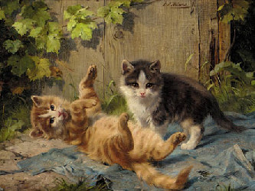
They don’t need exercise: Cats don’t need to be taken on walks, or let outside. All they need is to eat, sleep, and hang out. A lot of people don’t have time to be taking their pets on walks every day.

Slide 7
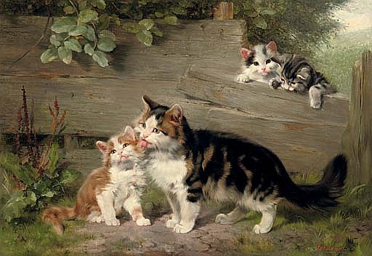
They are good with kids: The majority of cats are good with kids, and let kids carry them around. A few cats don't do well with kids, but you never have to worry about the kids getting injured or killed by a cat like you do with dogs.

Slide 8
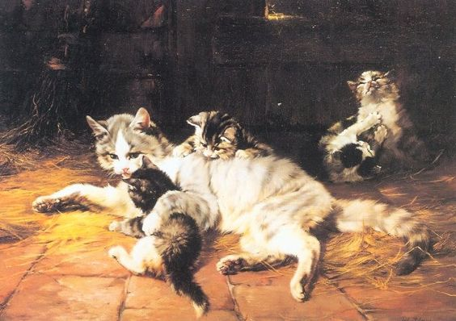
They keep quiet: Cats are pretty quiet compared to dogs. Do you ever get annoyed when a dog’s barking wakes the whole house? You don’t have this problem with cats. Cats that are vocal never meow loud enough to cause a scene,
and when you have visitors they go off and hide
rather than jump all over them.

Slide 9
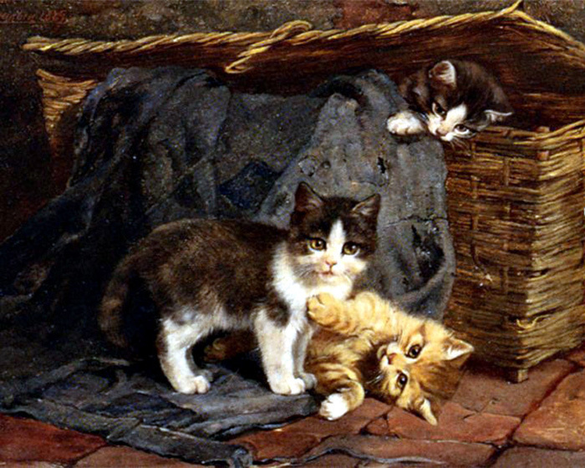
They are clean: Cats bathe themselves, and very rarely need a bath. They don’t smell bad either like dogs do. You’ll see: after you pet a cat, you don’t feel like you need to wash your hands like crazy.

Slide 10
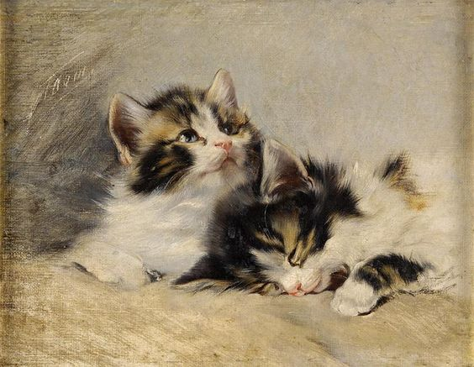
They can be inside their entire lives: Cats can stay inside their whole lives, and never get dirty and bring fleas and ticks into your home. You don’t have to worry about your pet getting attacked by a wild animal when they live inside.

Slide 11
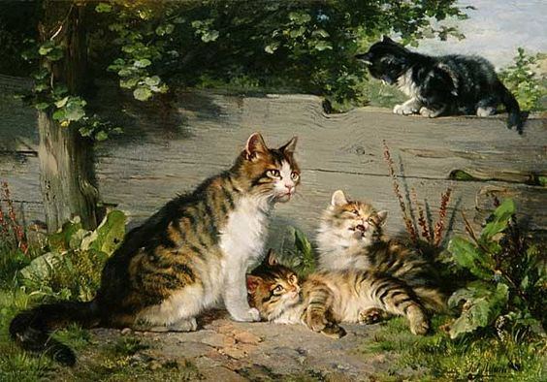
They are natural hunters: Cats are natural-born predators. Insects, bees, and spiders don’t have a chance with a cat. Cats pretty much exterminate pests from your house. You won't have a rat problem with a cat in your house. Hunting is a game for them.

Slide 12
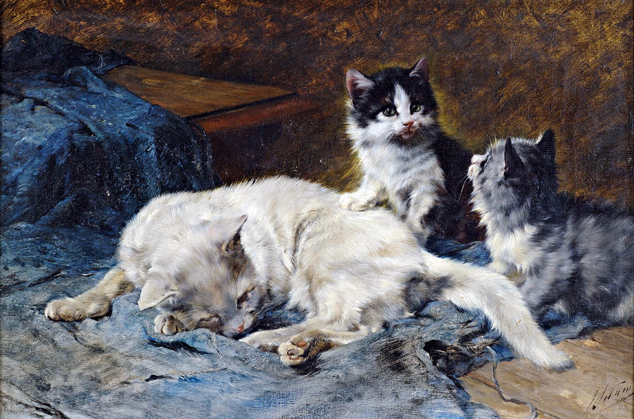
They are hilarious: Cats are funny. Everyone has seen those millions of videos on YouTube featuring cats' hilarious behaviors. They are bigger celebrities than half of the people on the Internet.

Slide 13
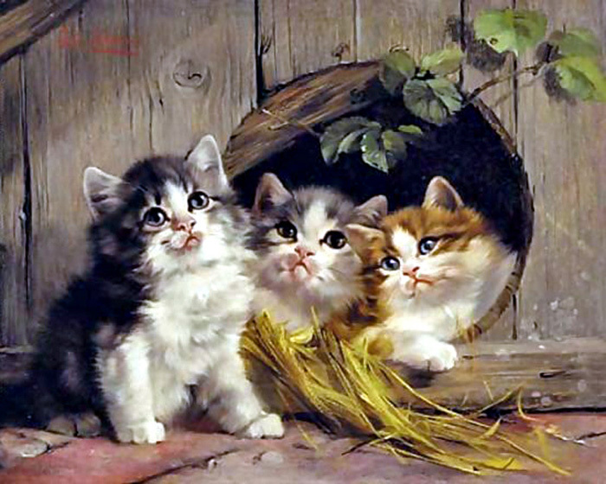
They are intuitive: Cats have a clairvoyance about them. They can feel when you are upset and they want to comfort you. Some cats know when someone is about to die. They are very emotional animals that love to be held and cuddled with.

Slide 14
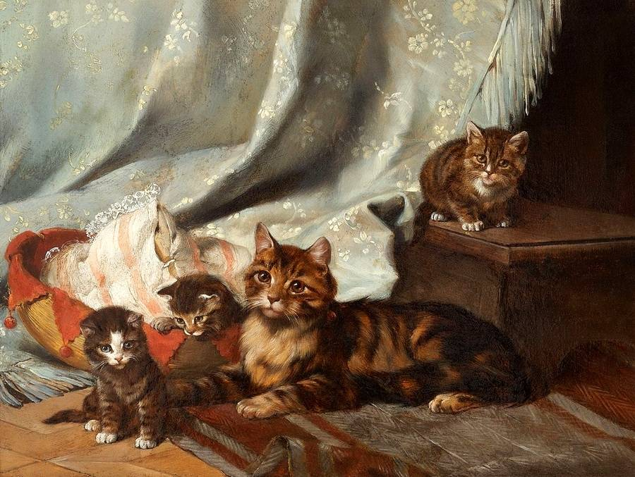
The house cat sits
and smiles and sings.
He knows a lot of
Secret things.
Annette Wynne

Slide 15
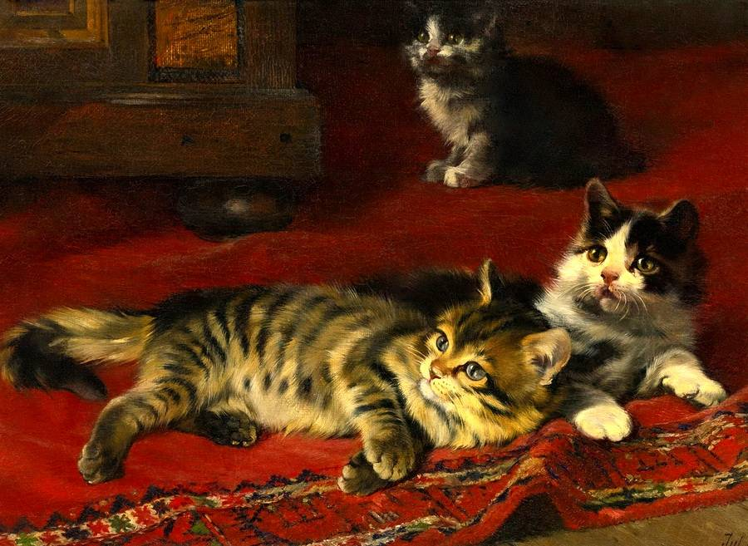
Cats sleep, anywhere,
Any table, any chair
Top of piano, window-ledge,
In the middle, on the edge,
Open drawer, empty shoe,
Anybody's lap will do,
Fitted in a cardboard box,
In the cupboard, with your frocks-
Anywhere! They don't care!
Cats sleep anywhere.
Elanor Farjeon (1881-1965)

Slide 16
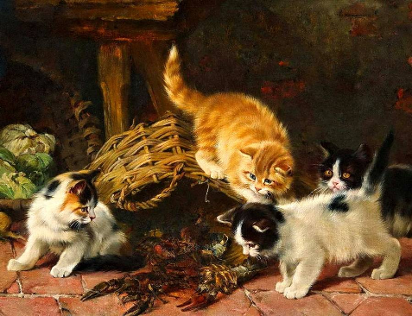
Cats love to sleep in the sunshine
Cats love to sleep in the shade
But my cat sleeps
in the middle of my bed
on the blankets
when the bed's not made.
Carole Graham

Slide 17
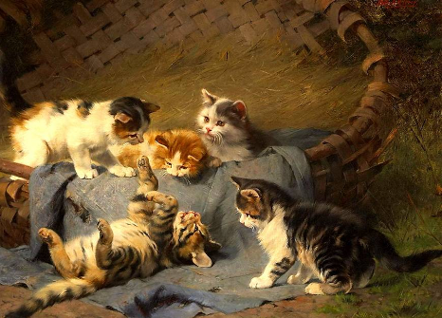
Thank You
for Being
with Julius Adam’s II cats and Kittens!

Slide 18
Sources
https://fotki.yandex.ru/users/galikos/album/109528/
http://www.burlington.co.uk/original-paintings/julius-adam-up-to-mischief-25339.html
http://www.thegreatcat.org/the-cat-in-art-and-photos-2/cats-in-19th-century-art/julius-adam-ii-1852-1913-german/

