Slide 1
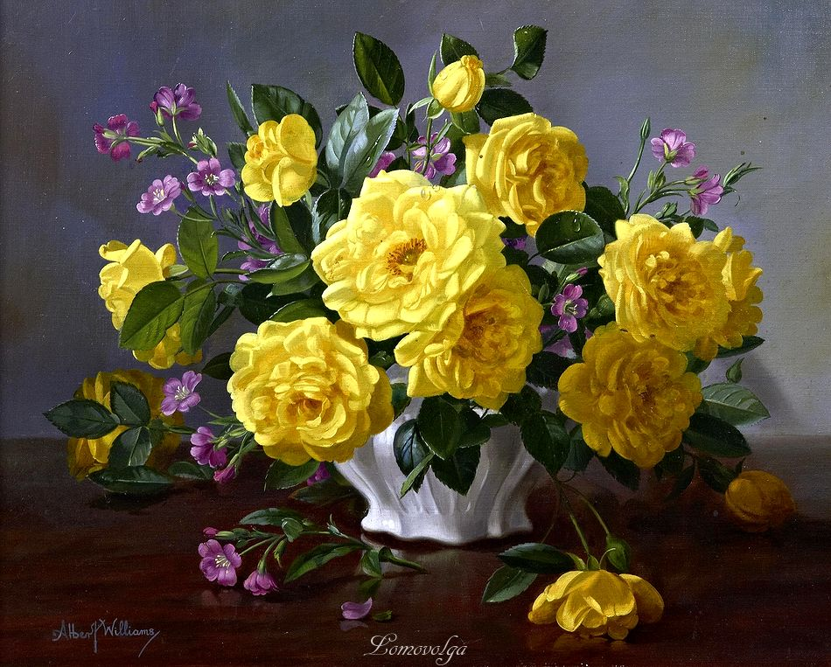
Albert Williams’ Flowers
Интерактивная
викторина
для 7-11
классов
Автор:
Ольга Михайловна Степанова
учитель английского языка
МБОУ «Цивильская СОШ №1
имени Героя Советского Союза
М.В. Силантьева»
города Цивильск Чувашской Республики
2016

Slide 2
Painting everyday, particularly during the season from Spring to late Autumn, Albert Williams brings nature indoors by means of his canvas.
Born in Sussex, in 1922, Albert studied at an early age under his Father and Grandfather, before attending Brighton College of Art as well as academic study in London and Paris.
Originally a figurative and portrait painter, Albert has specialized in floral painting for many years. Working at all times, direct from nature, each flower becomes a portrait of an individual bloom that is incorporated into a floral composition.
Discover and enjoy
the Flower World of Albert Williams!

Slide 3
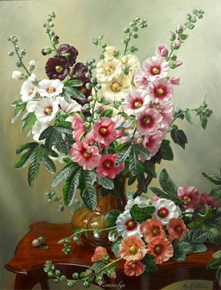
… laughs in flowers.
Ralph Waldo Emerson
Earth

Slide 4
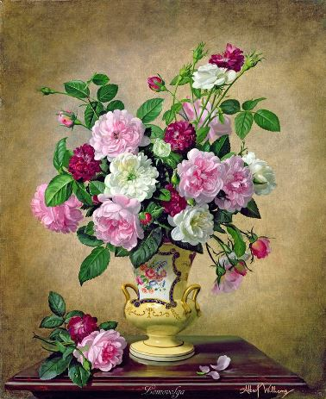
Keep love in your heart. A life without it is like a sunless … when the flowers are dead.
Oscar Wilde
garden

Slide 5
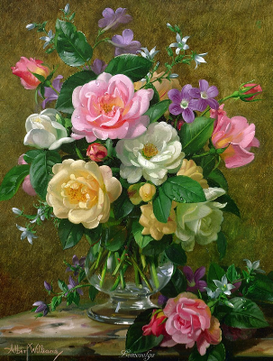
Flowers always make people better, happier, and more helpful; they are sunshine, food and medicine for the … .
Luther Burbank
soul

Slide 6
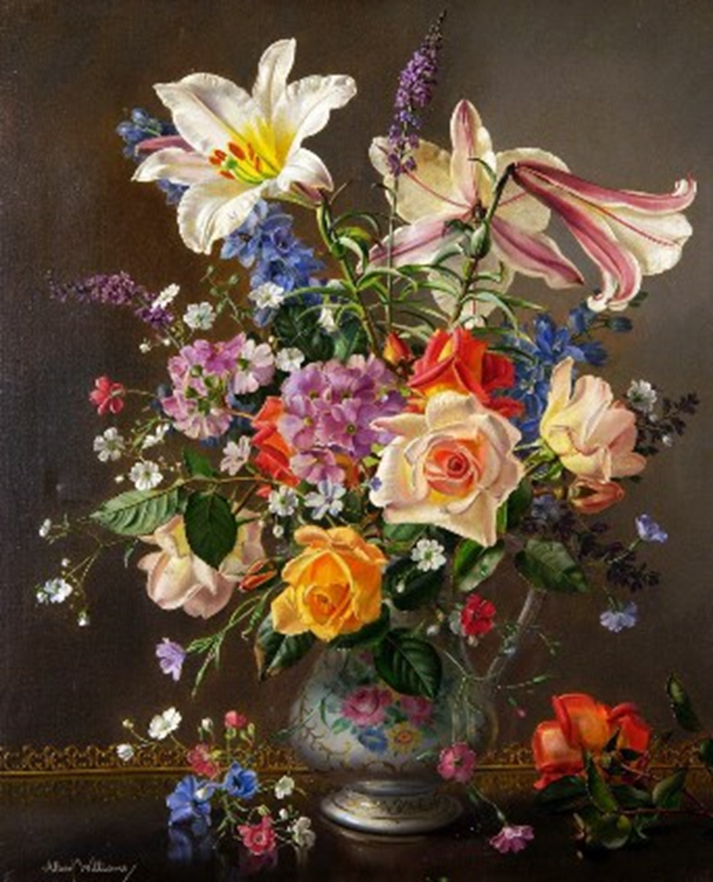
You're only here for a short visit. Don't hurry, don't worry. And be sure to smell the flowers along the … .
Walter Hagen
way

Slide 7
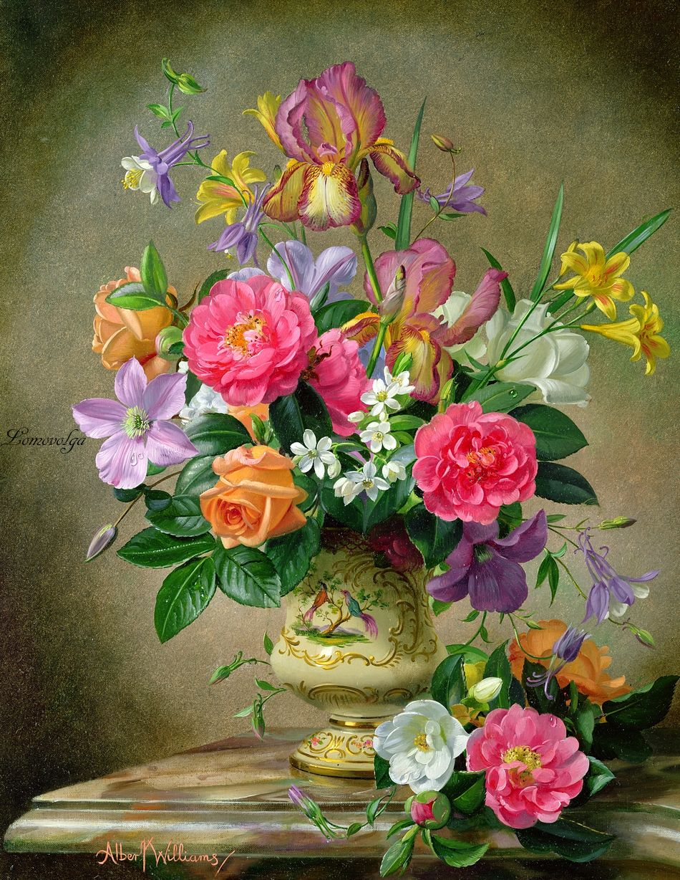
After women, flowers are the most lovely thing … has given the world. Christian Dior
God

Slide 8
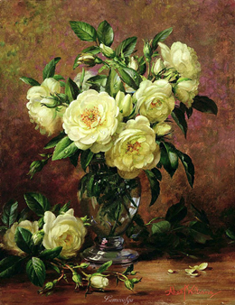
I'd rather have roses on my … than diamonds on my neck.
~Emma Goldman
table

Slide 9
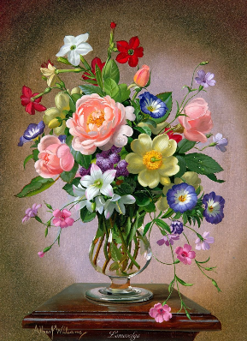
Deep in their roots, all flowers keep the … .
Theodore Roethke
light

Slide 10
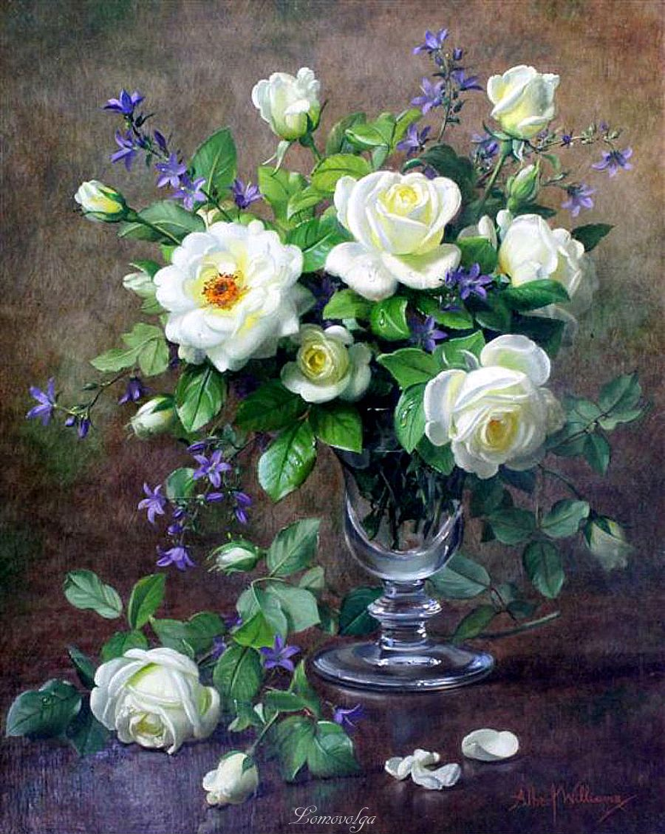
Flowers are those little colorful beacons of the sun from which we get sunshine when dark, somber skies blanket our … .
~Dodinsky
thoughts

Slide 11
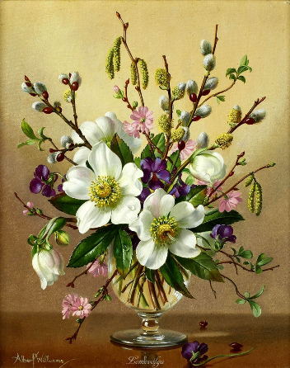
When you have only two pennies left
in the world, buy a loaf of … with one,
and a lily with the other.
~Chinese Proverb
bread

Slide 12
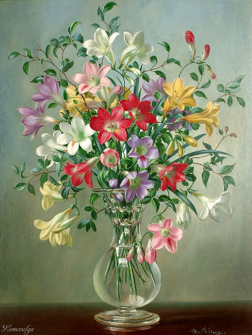
I will be the gladdest thing
Under the sun!
I will touch a hundred flowers
And not pick … .
~Edna St. Vincent Millay
one

Slide 13
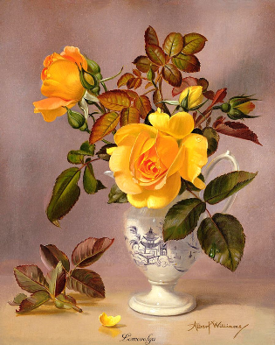
Flowers whisper “… !" to the world, even as they fade, wilt, fall.
~Dr. SunWolf
Beauty

Slide 14
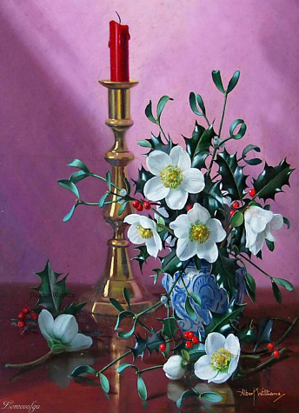
We're like a gardener with a hose and our attention is water - we can water flowers or we can water … .
Josh Radnor
weeds

Slide 15
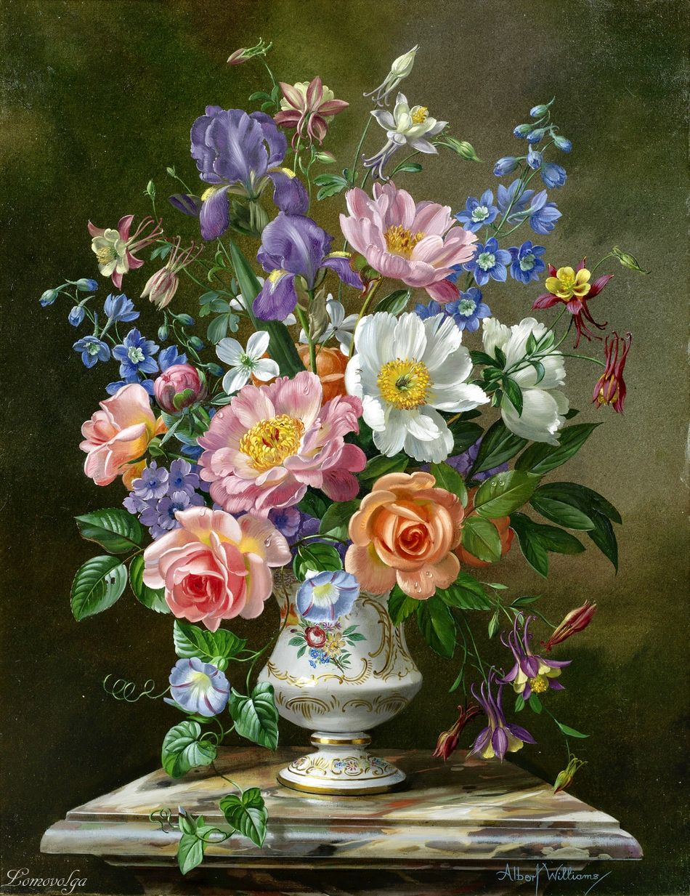
Flowers are the sweetest things God ever made and forgot to put a … into.
Henry Ward Beecher
soul

Slide 16
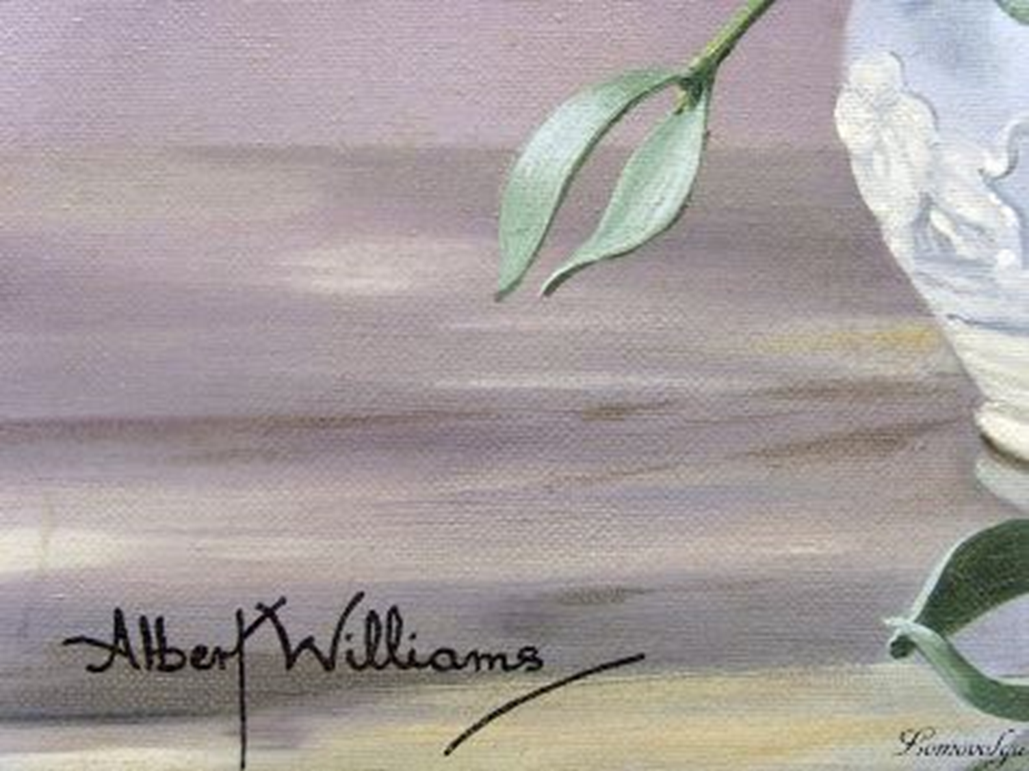
Thank you
for visiting
the Flower Gallery and Taking Part
in the Quiz!

Slide 17
Sources
http://www.brainyquote.com/quotes/keywords/flowers.html
http://www.quotegarden.com/flowers.html
https://www.kingandmcgaw.com/prints/albert-williams

