Slide 1
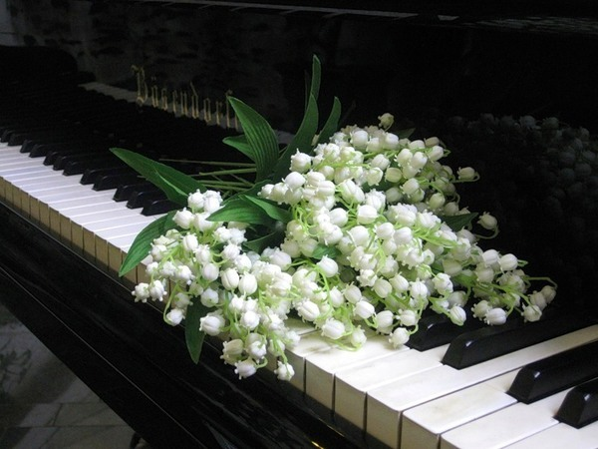
Lily of the Valley’s Parade
Fact file for the 7-11 Grades
Автор:
Ольга Михайловна Степанова
учитель английского языка
МБОУ «Цивильская СОШ №1
имени Героя Советского Союза
М.В. Силантьева»
города Цивильск Чувашской Республики
2016

Slide 2
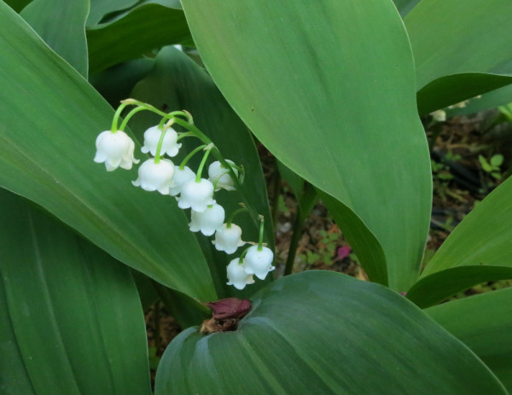
What comes to mind when one first thinks about “the Lily of the Valley” is a delicate flower that is symbolic of Easter and Weddings. It grows 15 to 30 cm tall, with only one or two leafs, and flowering stems, which have two leaves and 5 to 15 bell-shaped white flowers.

Slide 3
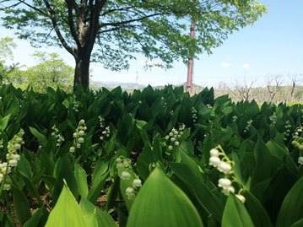
The Lily of the Valley grows in the spring of the year and comes in three varieties from China and Japan, Eurasia, and the USA. Sadly, it is a poisonous woodland flowering plant that grows predominately in cooler temperatures in the Northern Hemisphere of Asia and Europe.

Slide 4
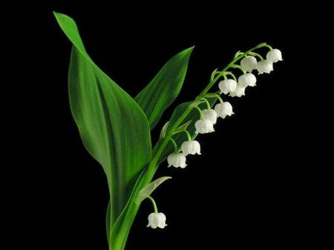
The Lily of the Valley is also known as Our Lady’s Tears or Mary’s Tears from Christian legends, which came about from Mary’s weeping when Jesus was being crucified.

Slide 5
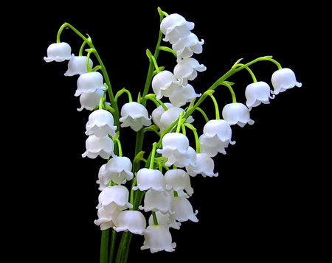
Another legend
of the
flower comes from the tears that Eve shed when she was expelled from the Garden of Eden with Adam.
Lastly, the last legend was that of Saint Leonard of Noblac during his battles with a dragon.

Slide 6
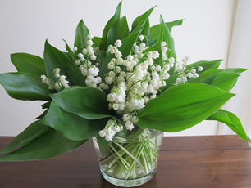
It should be of no surprise that “the Lily of the Valley” is referred to in the Bible because it is very much a part of Christ and is reflected upon as a rose. As a symbol of humility “the Lily of the Valley” is a sign of Christ’s second coming, along with being a power for men to envision
a better world.

Slide 7
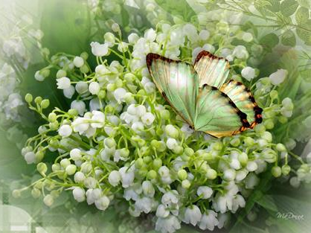
In German mythology the flower is linked to the virgin goddess of spring Ostara and symbolizes life to Pagans. Additionally, the blooming of the lily refers to the feast of Ostara. Once again, the sweet smell and whiteness of the flower remind one of humility and purity of its
patron goddess.

Slide 8
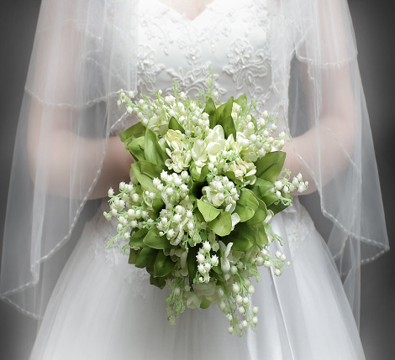
Since the Middle Ages, the blossoms are often included as traditional part of the bride’s beautiful bouquet and are considered symbolic of purity and modesty. If someone send these flowers to you, he is sending a message that he desires fortune in love or that he wishes to make the right choice.

Slide 9
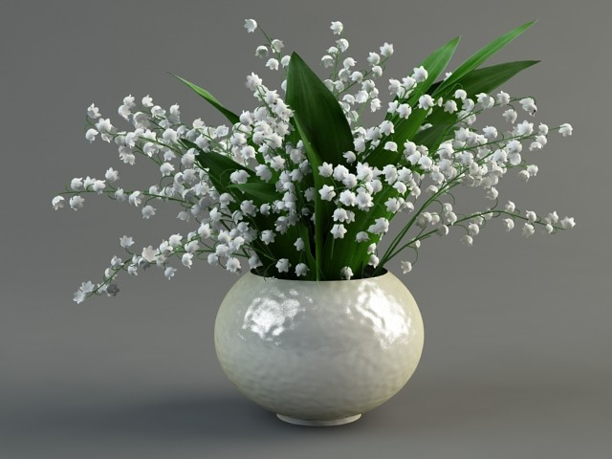
The Lily of the Valley is also known as, May Bells, Lily Constancy, Ladder-to-Heaven, Male Lily, and Muguet. Its scientific name Majalis or Maialis means “belonging to May” and is under the dominion of Mercury astrologically.

Slide 10
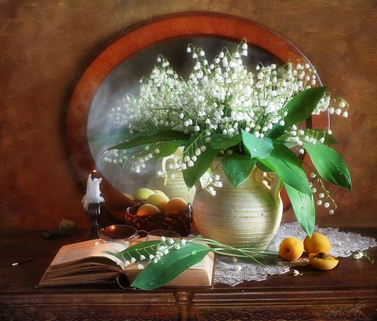
Lily of the valley is sometimes cultivated as a source of perfume. The leaves have been historically used to produce green dye. Teas and ointments from this plant are used for burns, fever and as a sedative and diuretic.

Slide 11
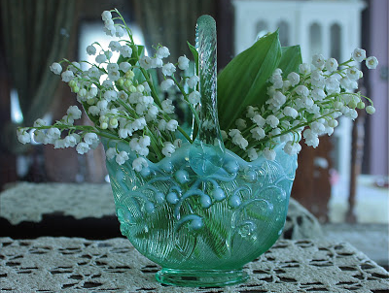
Lily of the valley has also been used in herbal medicine as a poison antidote, for the heart and epilepsy. The plant contains various toxins that stimulate the heart and, if ingested in large quantities, can cause death.

Slide 12
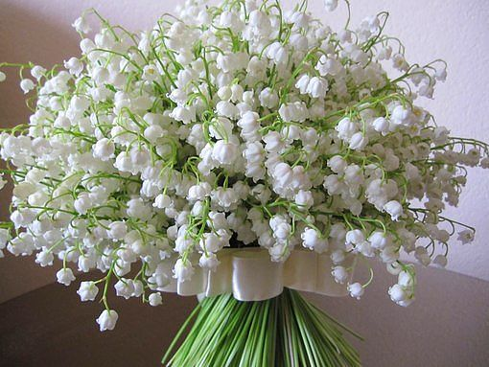
Lily of the valley is also known as "May Lily" because it blooms during the May and represents birth flower of May. Fruit of lily of the valley are orange-red berries, filled with few small seed.

Slide 13
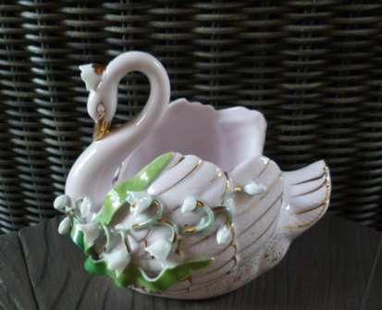
Princess Kate Middleton carried Convallaria majalis in her bouquet on her wedding day. So did Grace Kelly! Queen, the British rock band, has a song called Lily of the Valley.

Slide 14
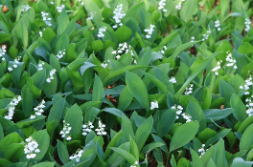
White Coral Bells
Upon a slender stalk
Lilies of the valley deck my garden walk
Oh, don't you wish that you might hear them ring?
That will happen only when the fairies sing.
W.L. Jenkins

Slide 15
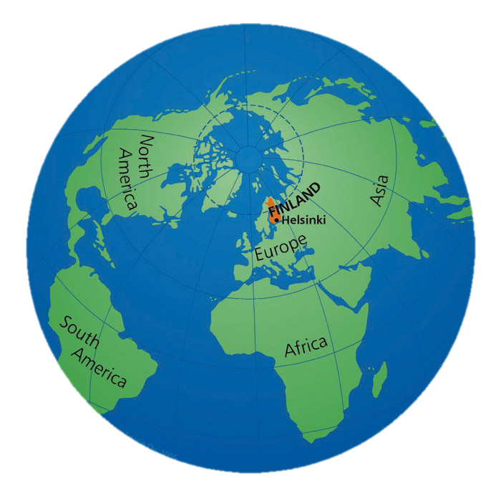
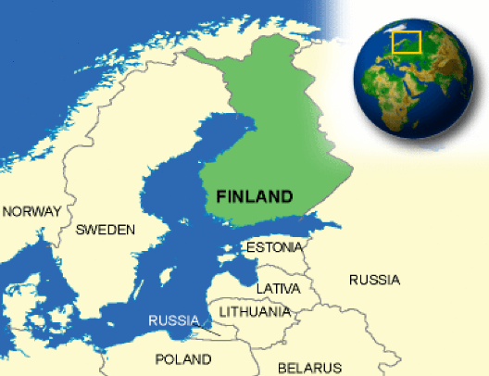
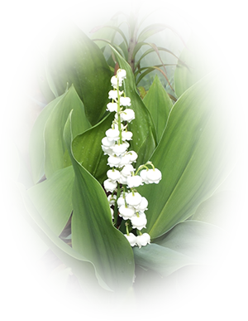
By the way, the lily-of-the valley was chosen as Finland’s national flower because its attractive and sweetly-scented flowers are very familiar to most Finns. Their Finnish name, kielo, is also a traditional girl’s name that for some reason is also often given to amiable cows.

Slide 16
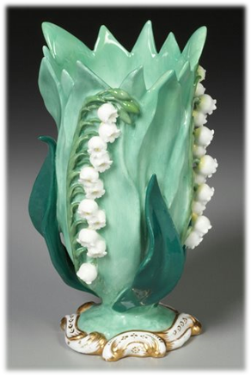
Thank you
for watching
the Lily of the Valley
Parade!

Slide 17
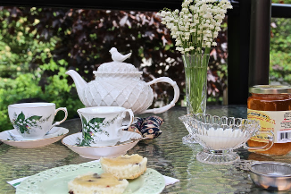
Источник
The Lily of the Valley is May's Birth Flower https://www.babiesonline.com/flowersbirthmonth/lilyofthevalley.asp
Lily of the Valley Flower Facts http://hubpages.com/relationships/lily-of-the-valley-flower-facts

