Slide 1
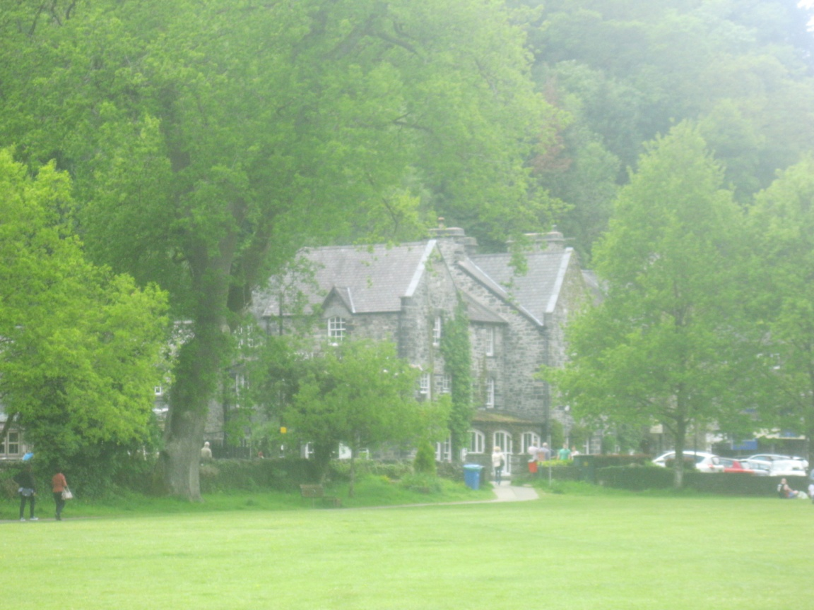
Betws-y-Coed –
"Prayer house in the wood"
Шайдурова Валентина Федоровна
Учитель английского языка
ГБОУ «Школа №106»
Санкт-Петербург
2016
Фотографии автора презентации

Slide 2
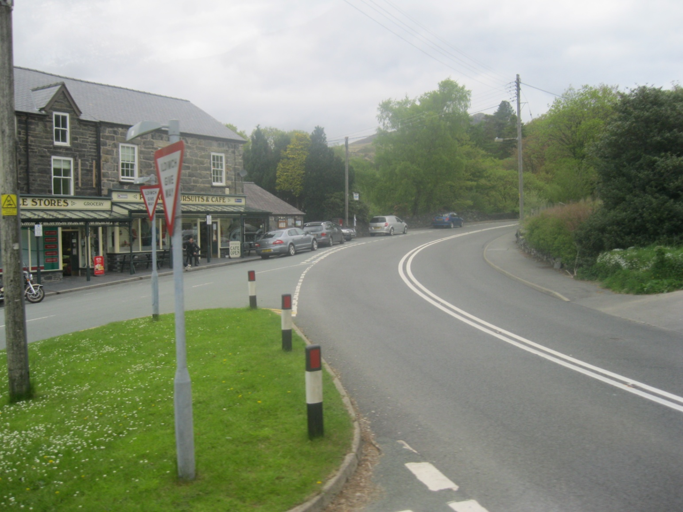
Betws-y-Coed (“Prayer house in the wood”)
is a village, Wales.

Slide 3
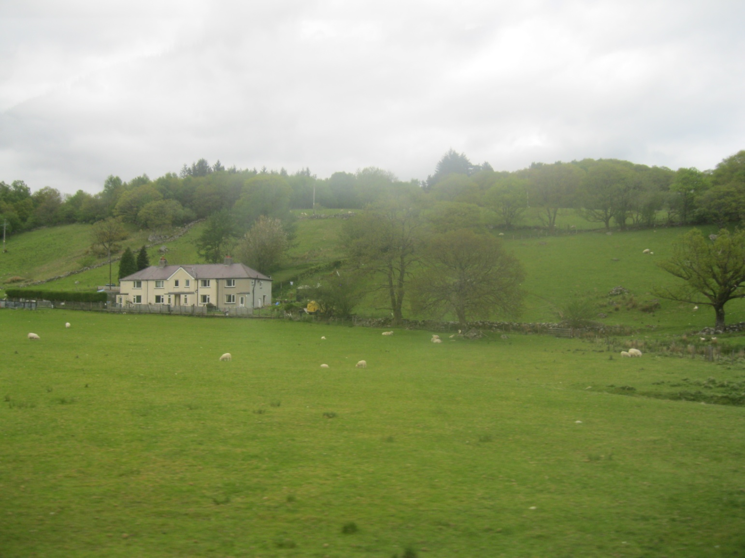
Betws-y-Coed lies in the Snowdonia National Park.

Slide 4
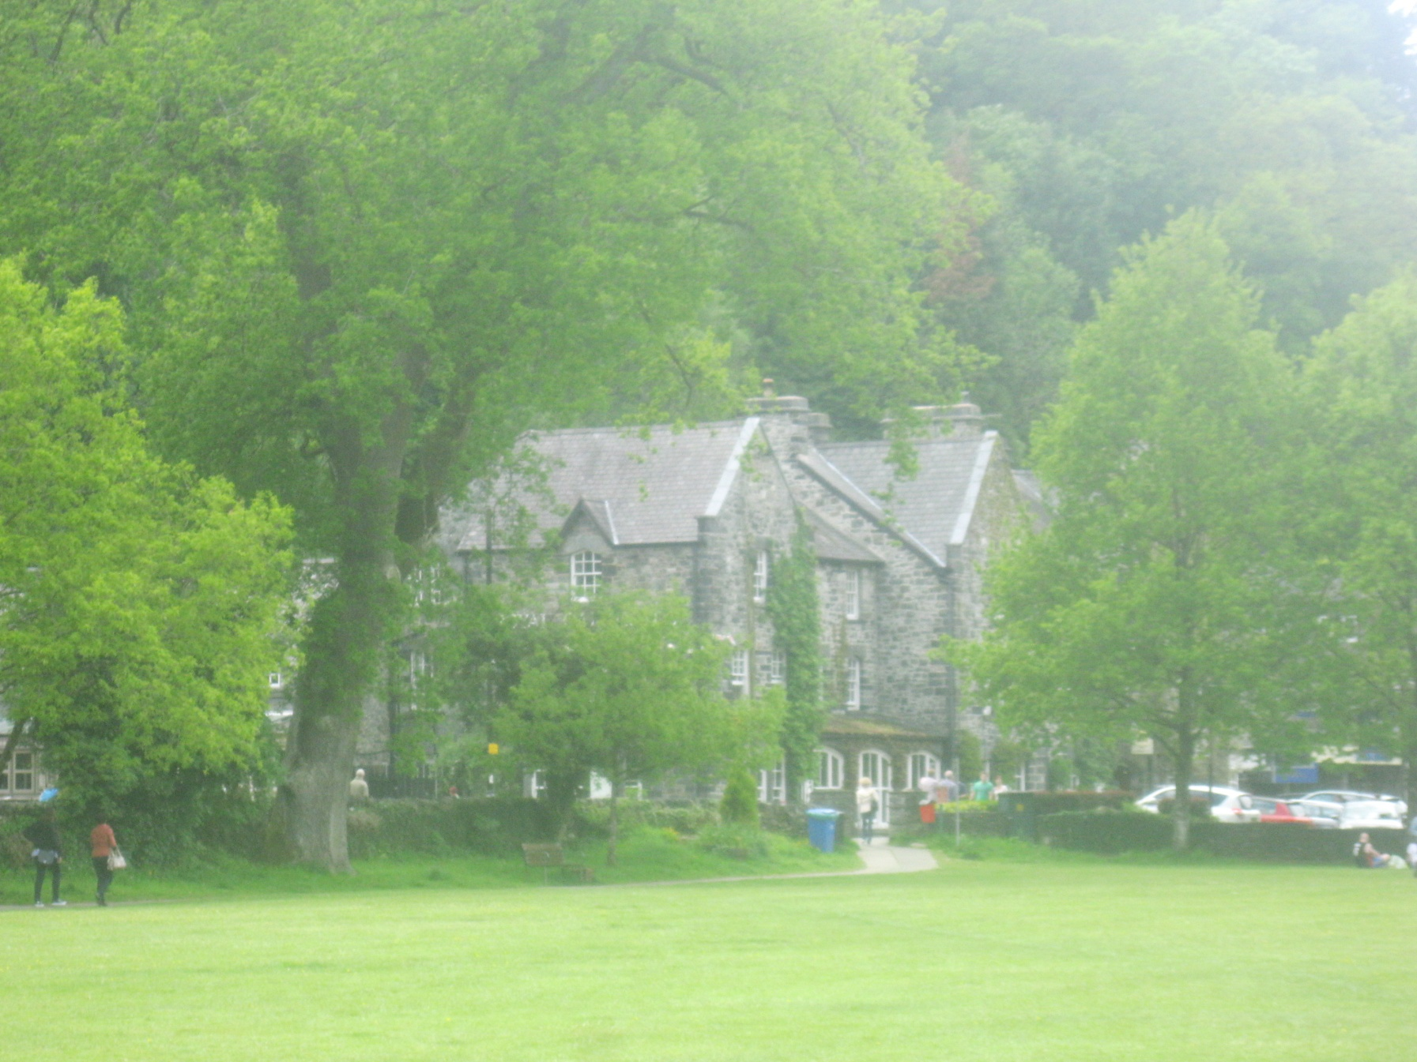
Betws-y-Coed - "Prayer house in the wood"
Betws-y-Coed [ˈbet əs i ˈkɔɪd]
It was founded around a monastery
in the late sixth century.

Slide 5
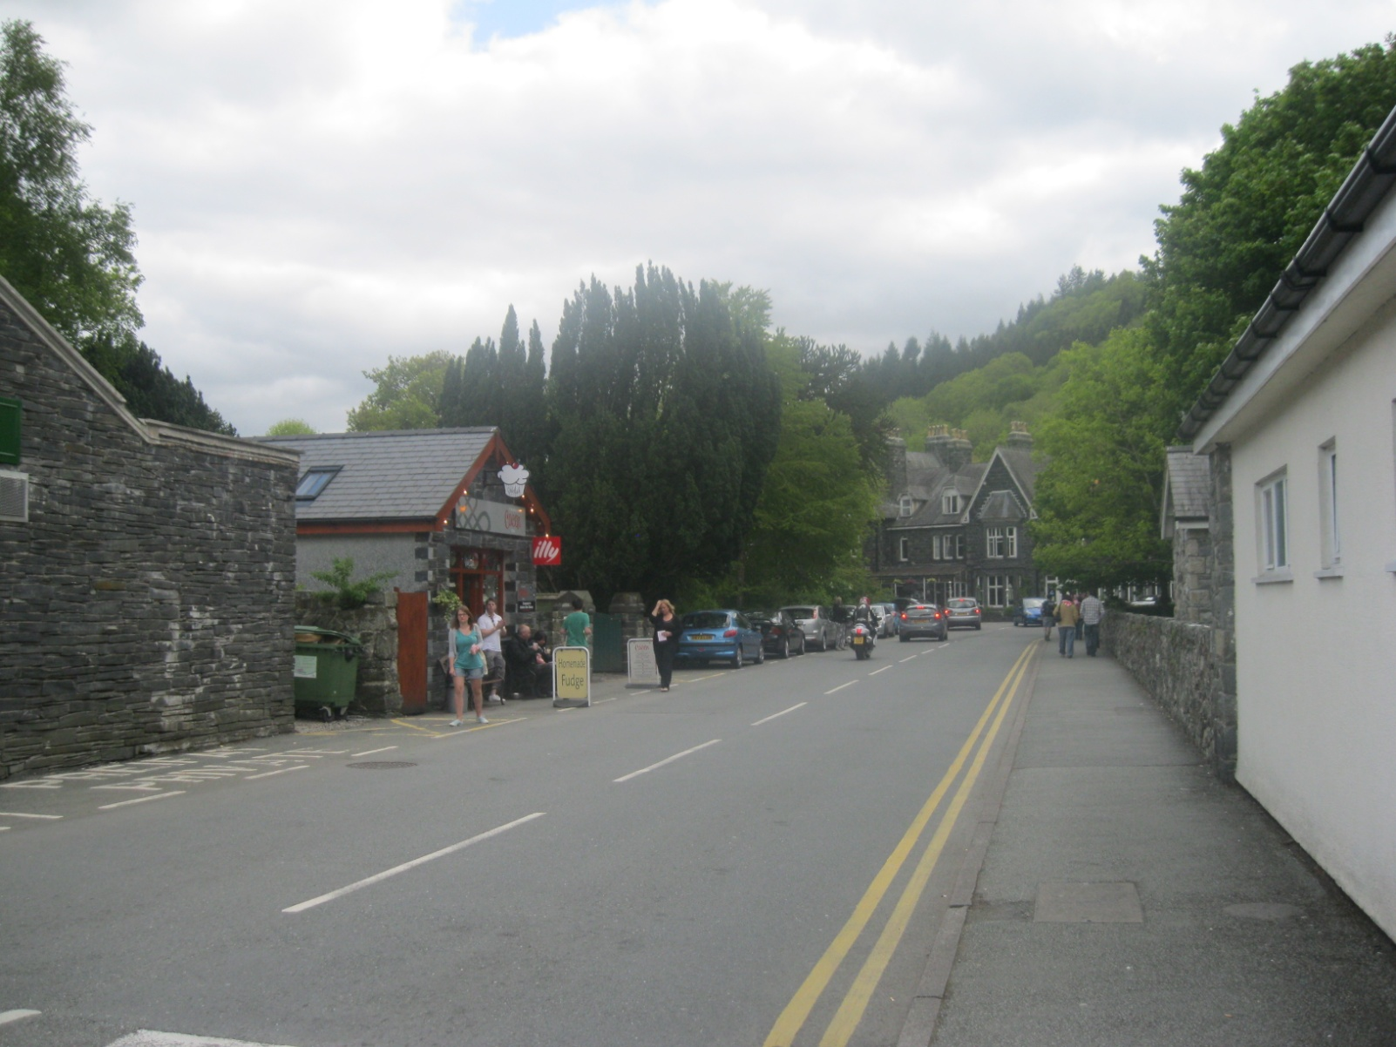
It has a population of 534.

Slide 6
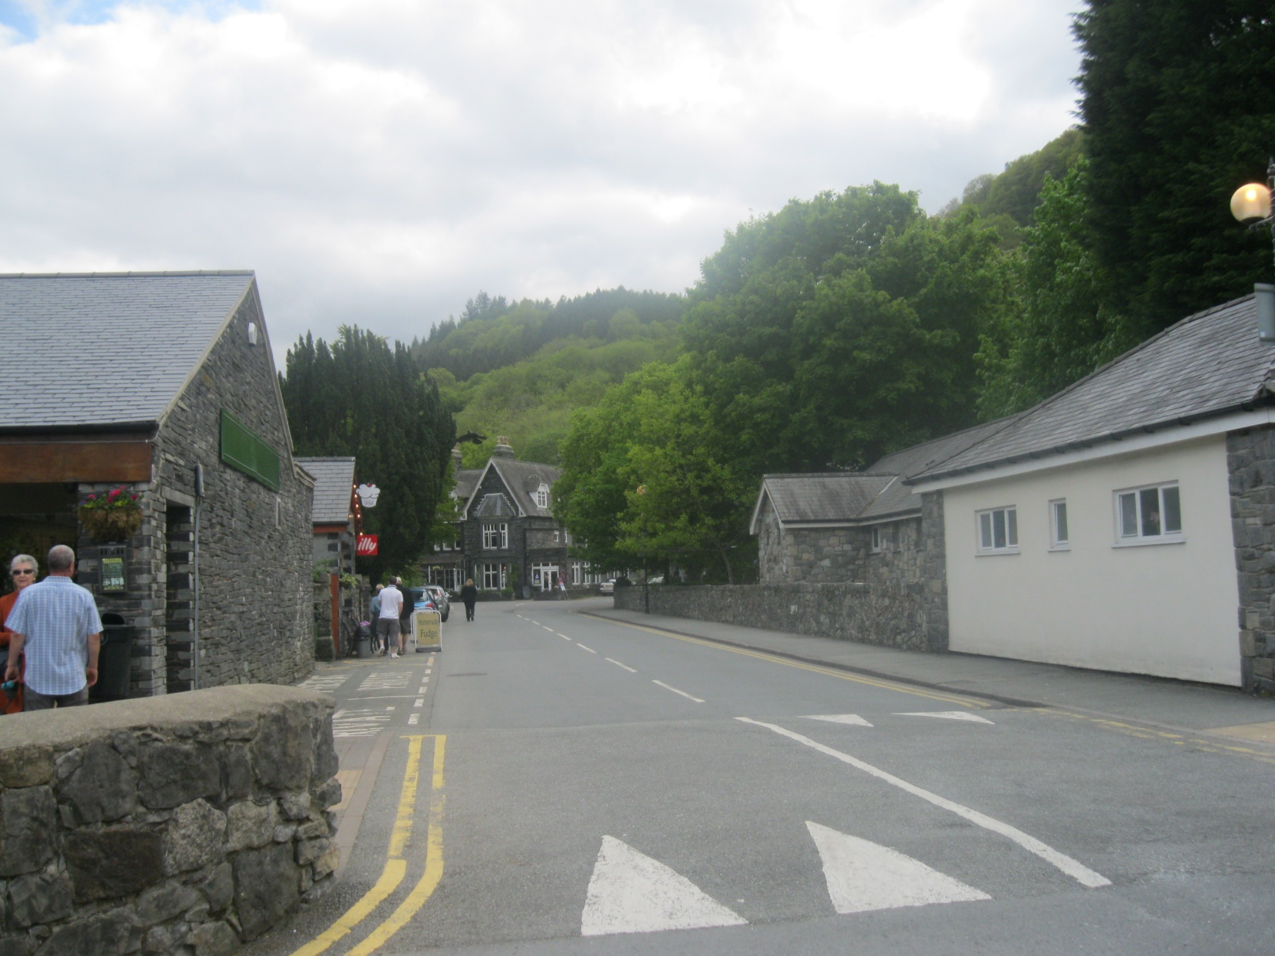

Slide 7
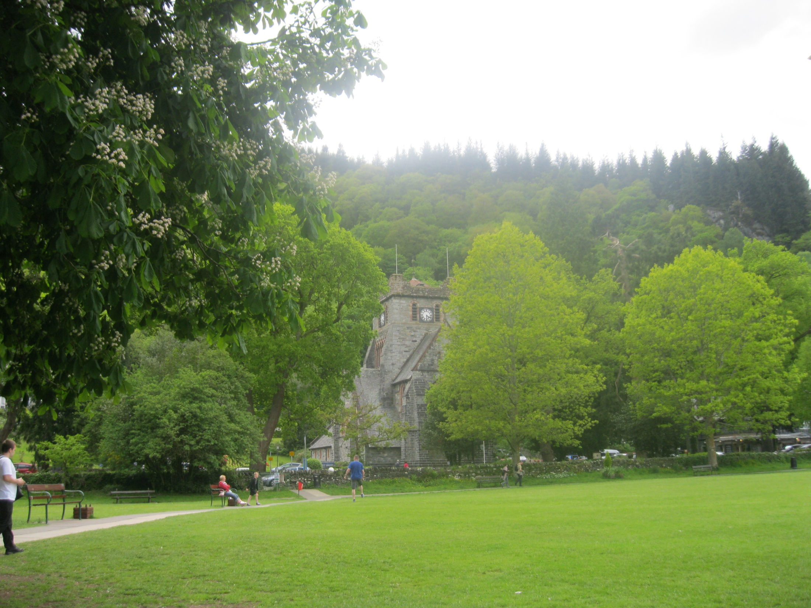
The village has a large village green which is the playing field for the local football team.

Slide 8
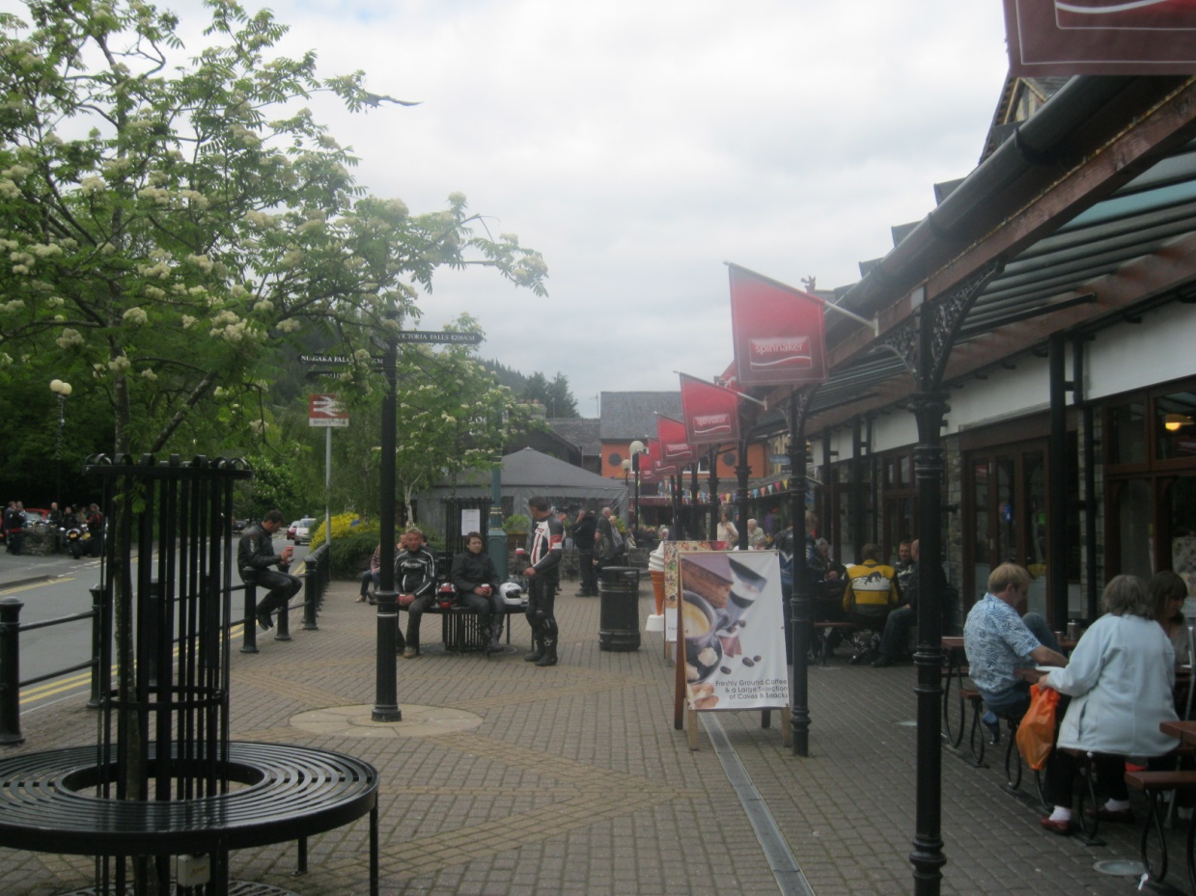
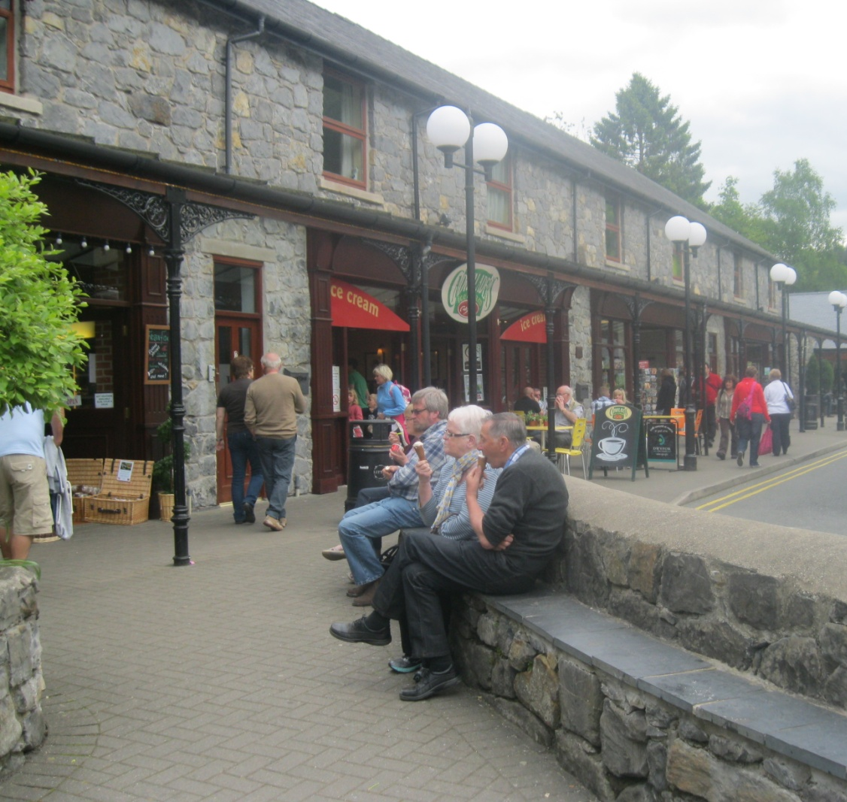
On the southern side of the green is a railway station with cafes and tourist shops.

Slide 9
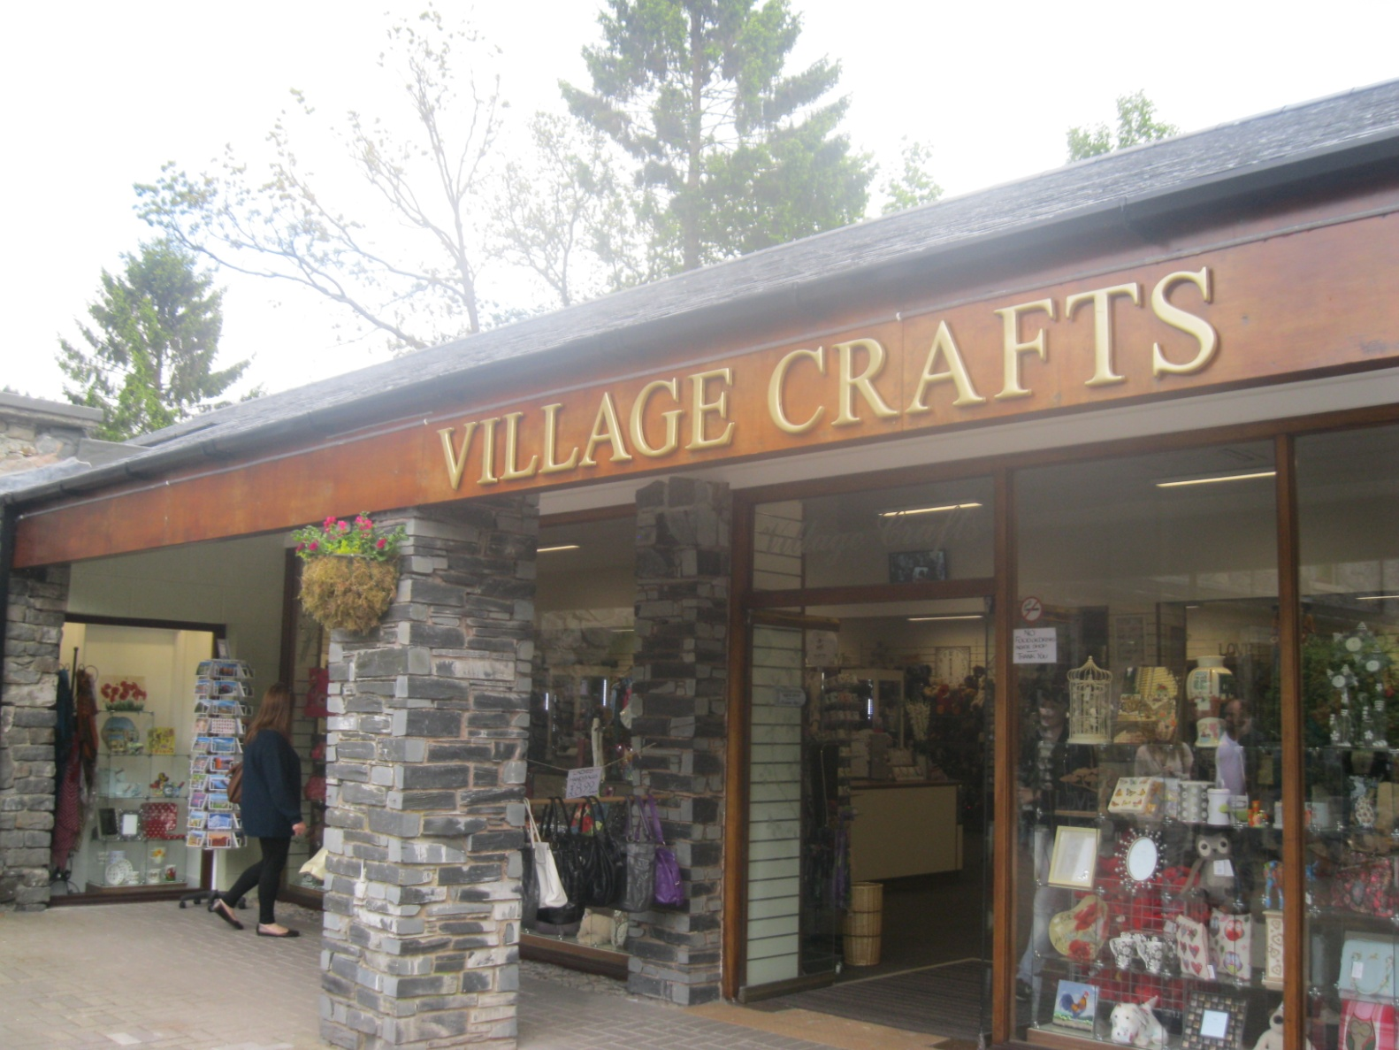
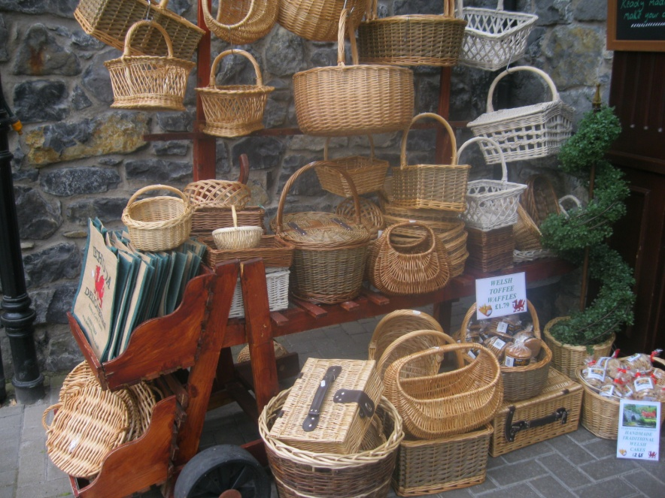
The popularity of the area with tourists
has led to a proliferation of shops,
unusual for a village of this size.

Slide 10
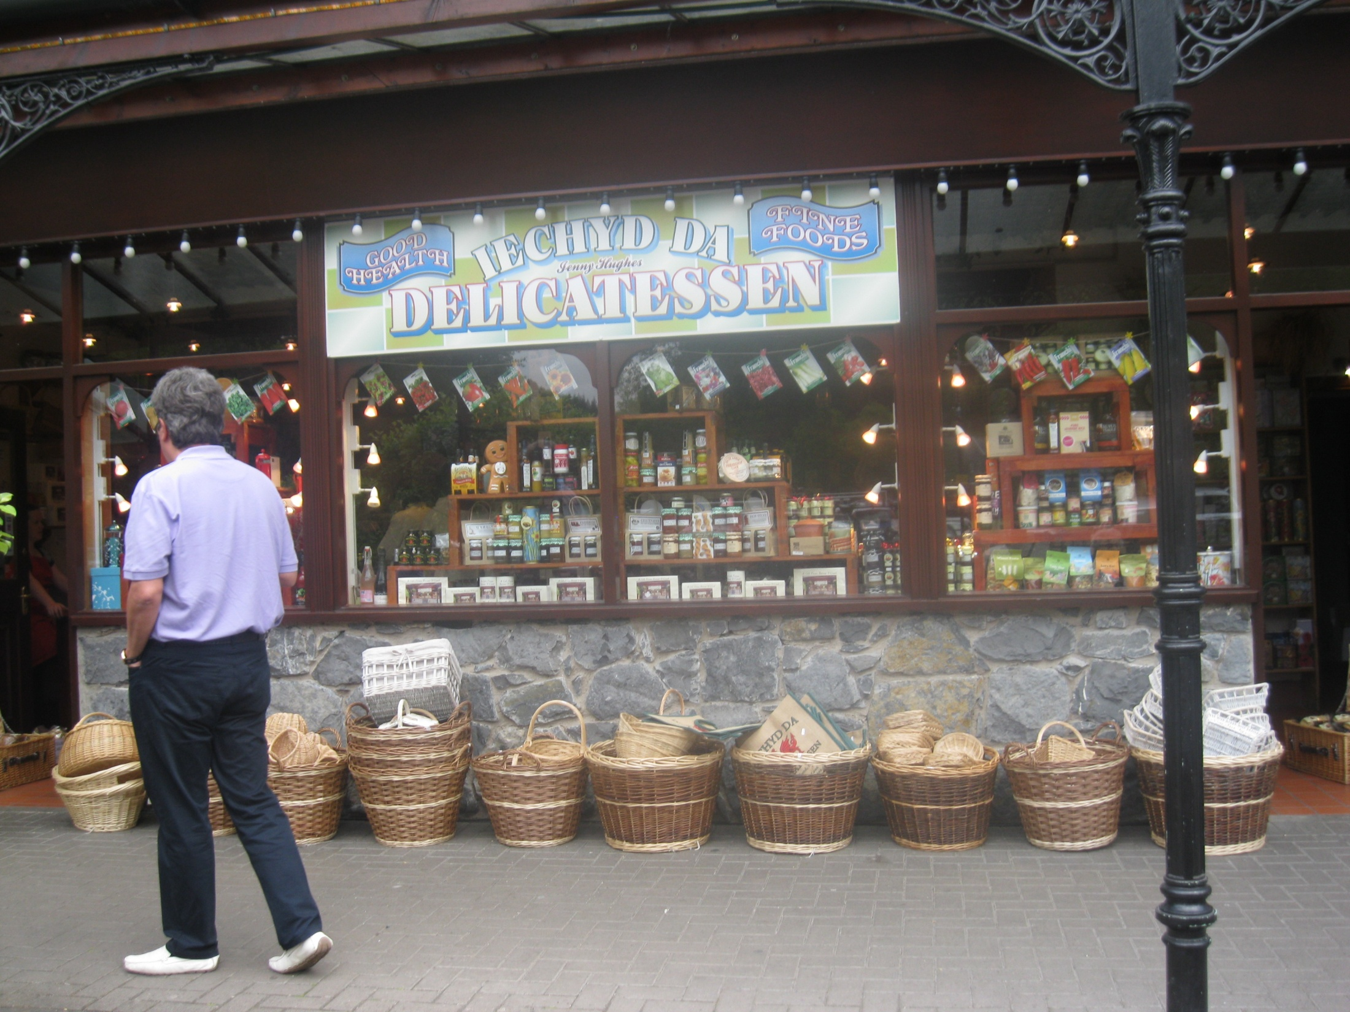

Slide 11
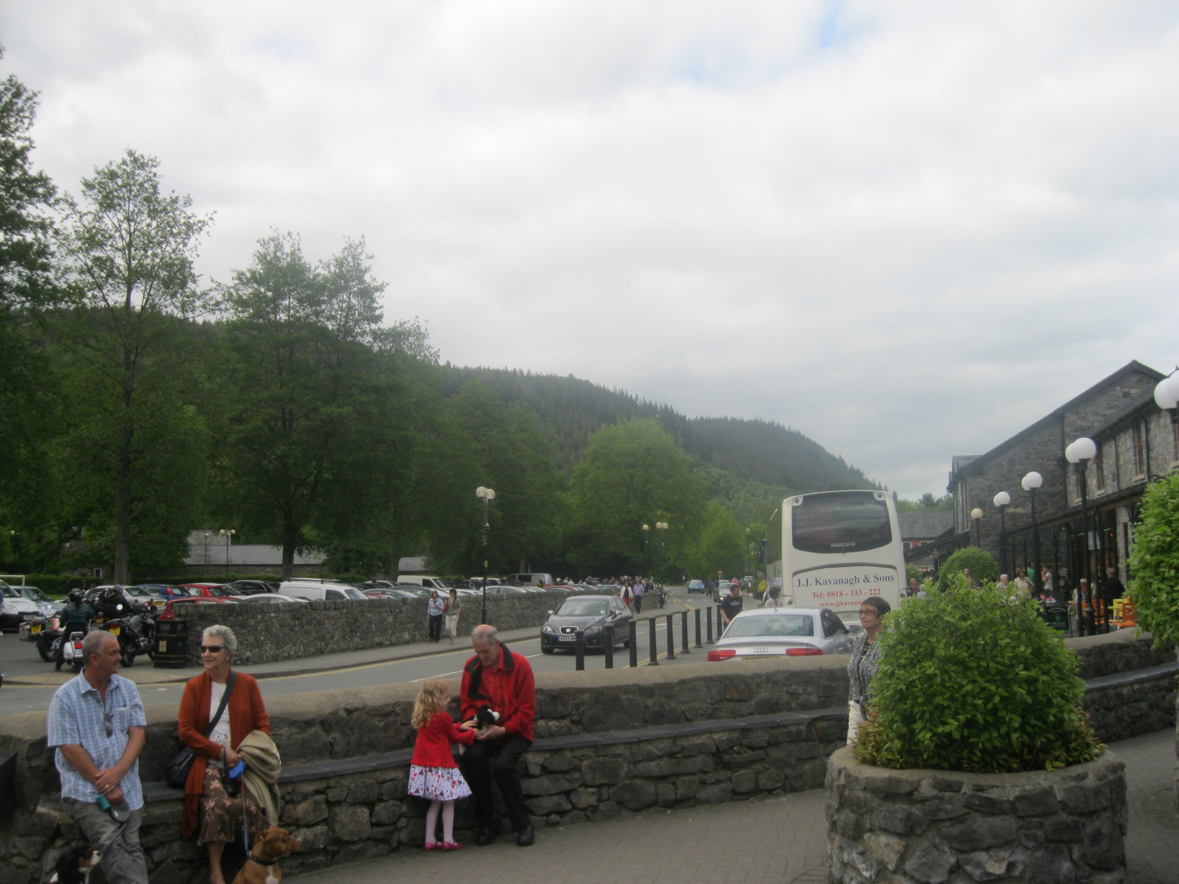
Many of these shops specialize in outdoor clothing and equipment, and tend to give the village main street
the impression of a retail outlet tastefully designed
to be in tune with the landscape, local history and culture.

Slide 12
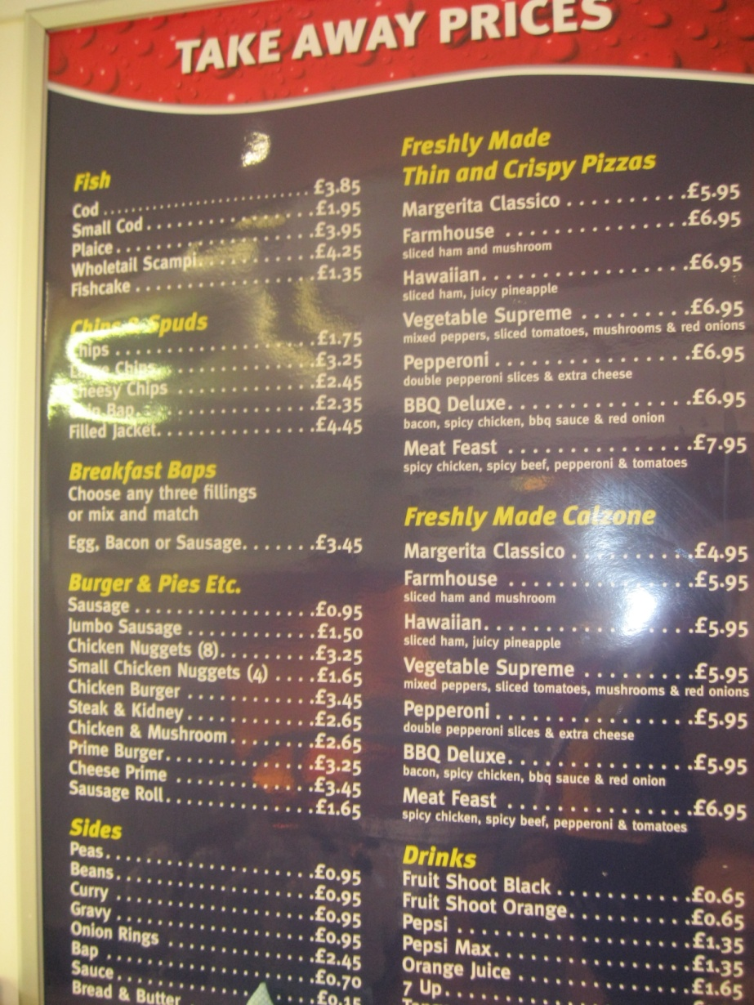

Slide 13
Фотографии автора презентации
http://betws-y-coed.blogspot.ru текст
https://en.wikivoyage.org/wiki/Betws_y_Coed текст

