Slide 1
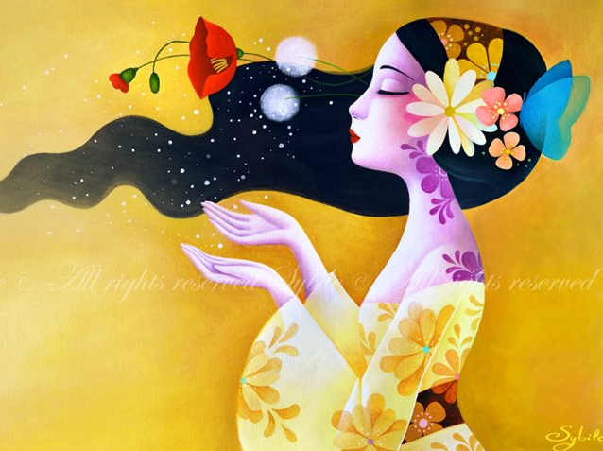
Lady Sybile’s Inviting
Interactive Quiz & Picture Gallery for 7-11 Grades
Автор:
Ольга Михайловна Степанова
учитель английского языка
МБОУ «Цивильская СОШ №1
имени Героя Советского Союза
М.В. Силантьева»
города Цивильск Чувашской Республики
2016

Slide 2
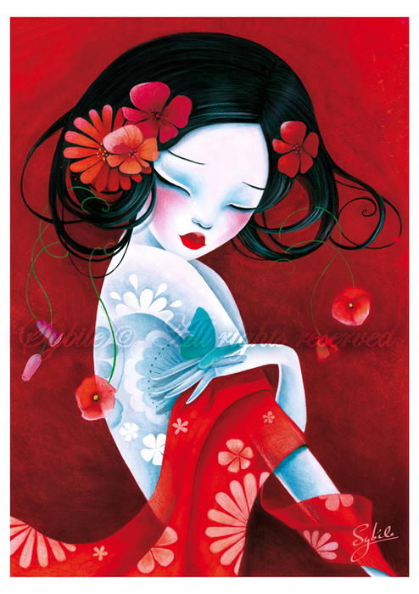
All little … should be told they are pretty, even if they aren't.”
― Marilyn Monroe
girls

Slide 3
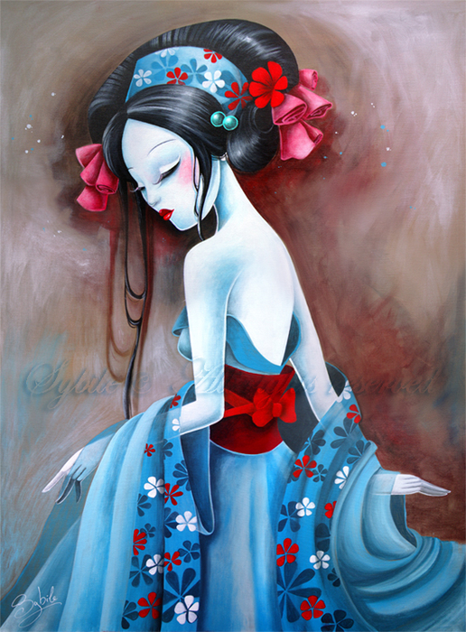
For lovely eyes, seek out the good in people.
For a slim figure, share your food with the hungry.
For attractive lips, speak words of … . Sam Levenson
kindness

Slide 4
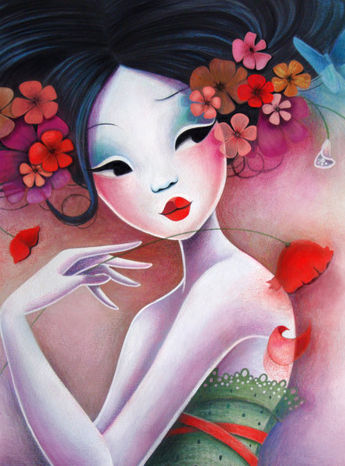
Clouds come floating into my life, no longer to carry rain or usher storm, but to add color to my sunset … .”
― Rabindranath Tagore
sky

Slide 5
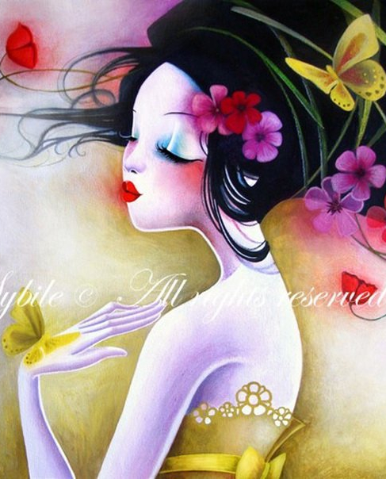
Everything has … , but not everyone sees it.
― Confucius
beauty

Slide 6
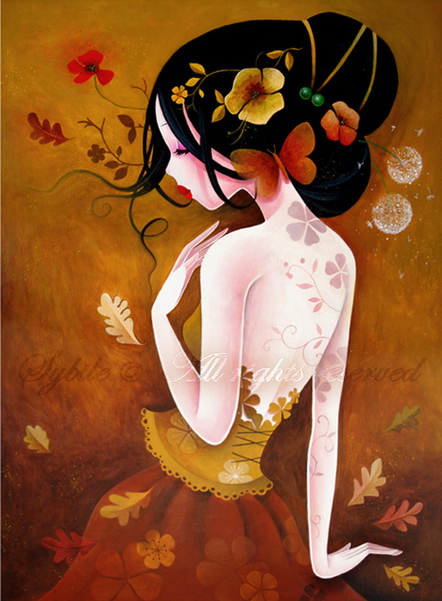
Dwell on the beauty of life. Watch the … , and see yourself running with them.”
― Marcus Aurelius
stars

Slide 7
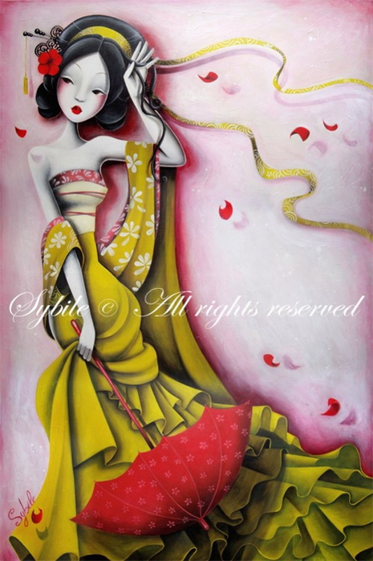
A man should hear a little music, read a little poetry, and see a fine picture every day of his life, in order that worldly cares may not obliterate the sense of the beautiful which God has implanted in the human … .”
― Johann Wolfgang von Goethe
soul

Slide 8
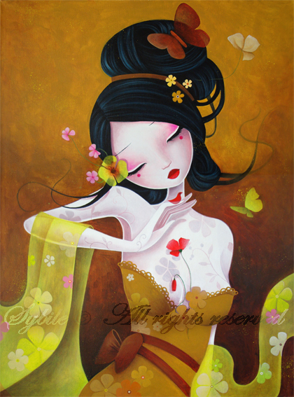
There are no bad pictures; that's just how your … looks sometimes.”
― Abraham Lincoln
face

Slide 9
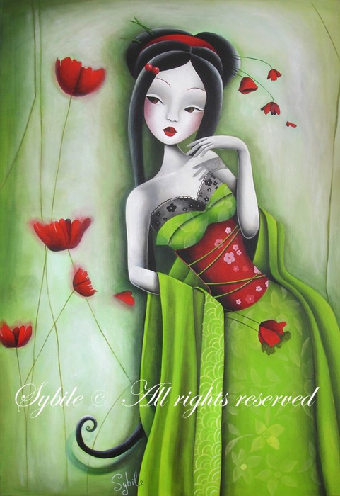
The human body is the best work of … .”
― Jess C. Scott
art

Slide 10
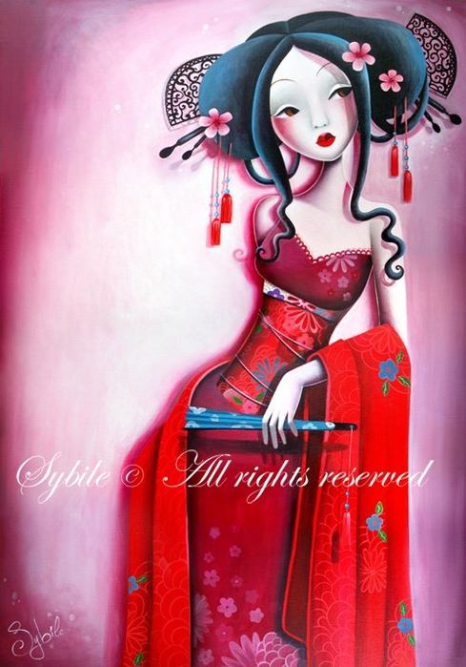
Beauty of whatever kind, in its supreme development, invariably excites the sensitive soul to … .
― Edgar Allan Poe
tears

Slide 11
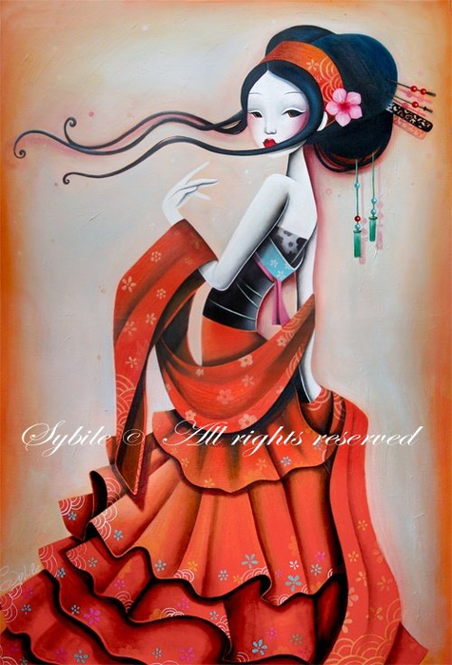
She walks in beauty, like the night
Of cloudless climes and starry skies;
And all that's best of dark and bright
Meet in her aspect and her ...”
― George Gordon Byron
eyes

Slide 12
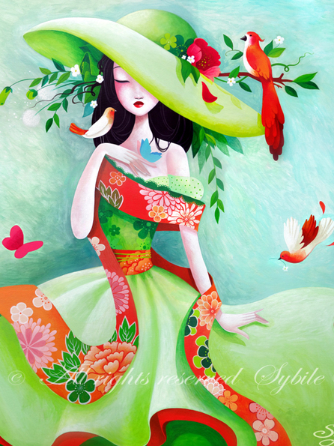
A fit, healthy body—that is the best fashion … ”
― Jess C. Scott
statement

Slide 13
It is time for parents to teach young people early on that in diversity there is beauty and there is … .”
― Maya Angelou
strength

Slide 14
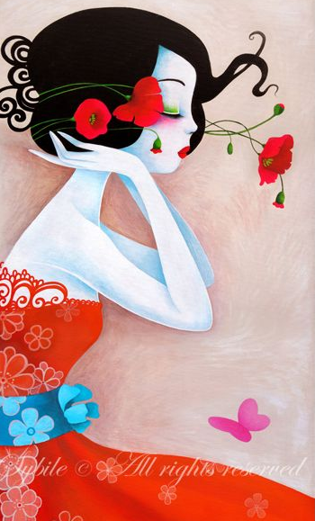
You can be gorgeous at thirty, charming at forty, and irresistible for the rest
of your … .”
― Coco Chanel
life

Slide 15
Thank you
for visiting
the Lady Sybile Gallery
and Taking Part
in the Quiz!

Slide 16
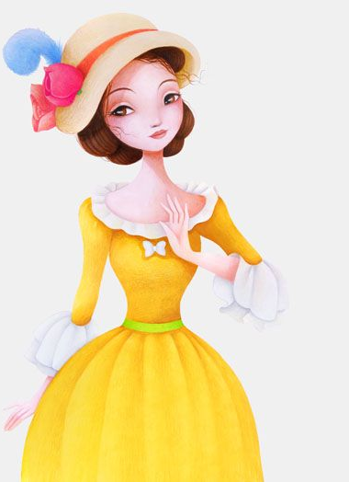
Sybile about herself:
I started drawing since I am just a little girl, I believed in my heart that I always knew that someday I would become an artist...
Interview with Lady Sybile
http://designersdepot.noelevz.com/featured-artist-for-the-week-sybile/

Slide 17
Источник
http://ladysybile.deviantart.com/
http://www.goodreads.com/quotes/tag/beauty?page=3
https://www.pinterest.com/source/sybile.net

