Slide 1
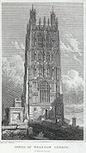
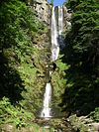
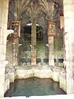
Seven Wonders of Wales
Шайдурова Валентина Федоровна
Учитель английского языка
ГБОУ «Школа №106»
Санкт-Петербург
2016

Slide 2
The Seven Wonders of Wales
is a traditional list of notable landmarks in North Wales,
commemorated in an anonymously written rhyme:
Pistyll Rhaeadr and Wrexham steeple,
Snowdon's mountain without its people,
Overton yew trees, St Winefride's well,
Llangollen bridge and Gresford bells.

Slide 3
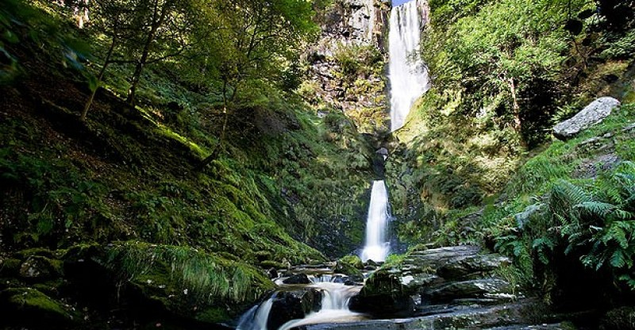
Pistvyll Rhaeadr
A tall waterfall, falling 240 ft (73 m) in three stages

Slide 4
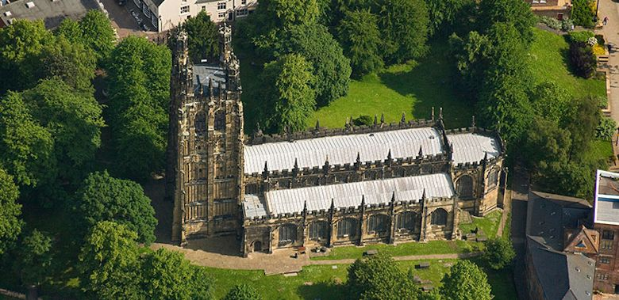
Saint Giles’ Church
The 16th-century tower of St Giles' Church in Wrexham can be seen for miles

Slide 5
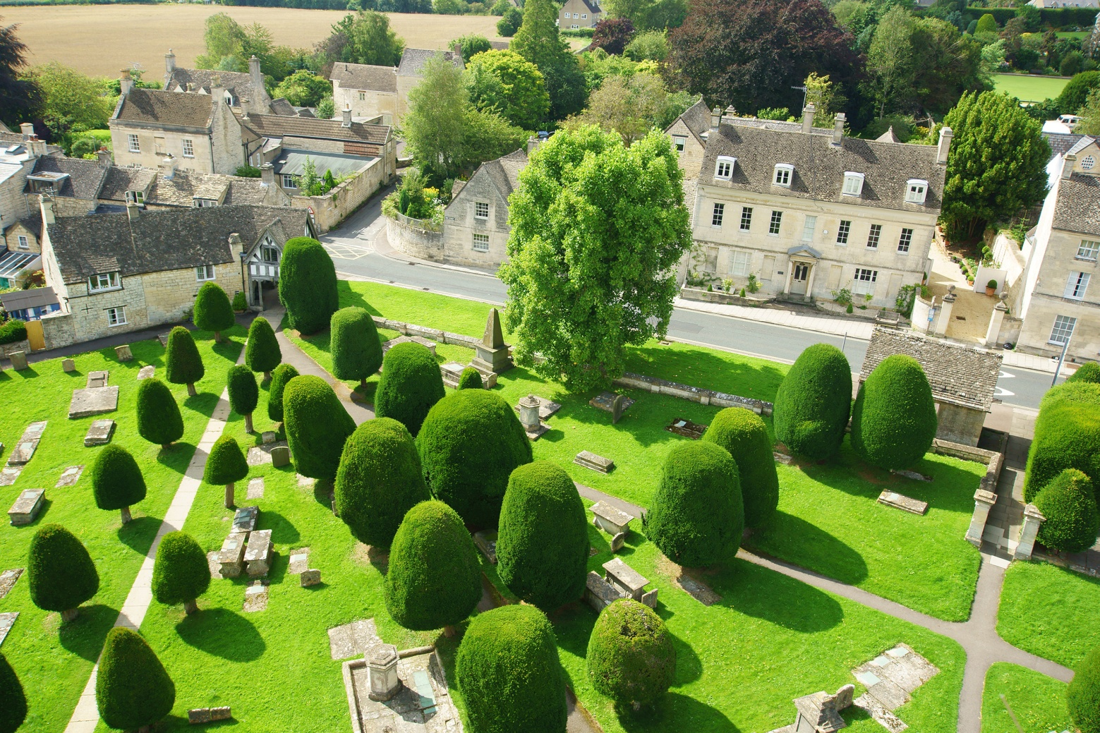
Overton yew trees
Yew trees at St Mary's Church
planted at different times, ~3rd–12th century

Slide 6
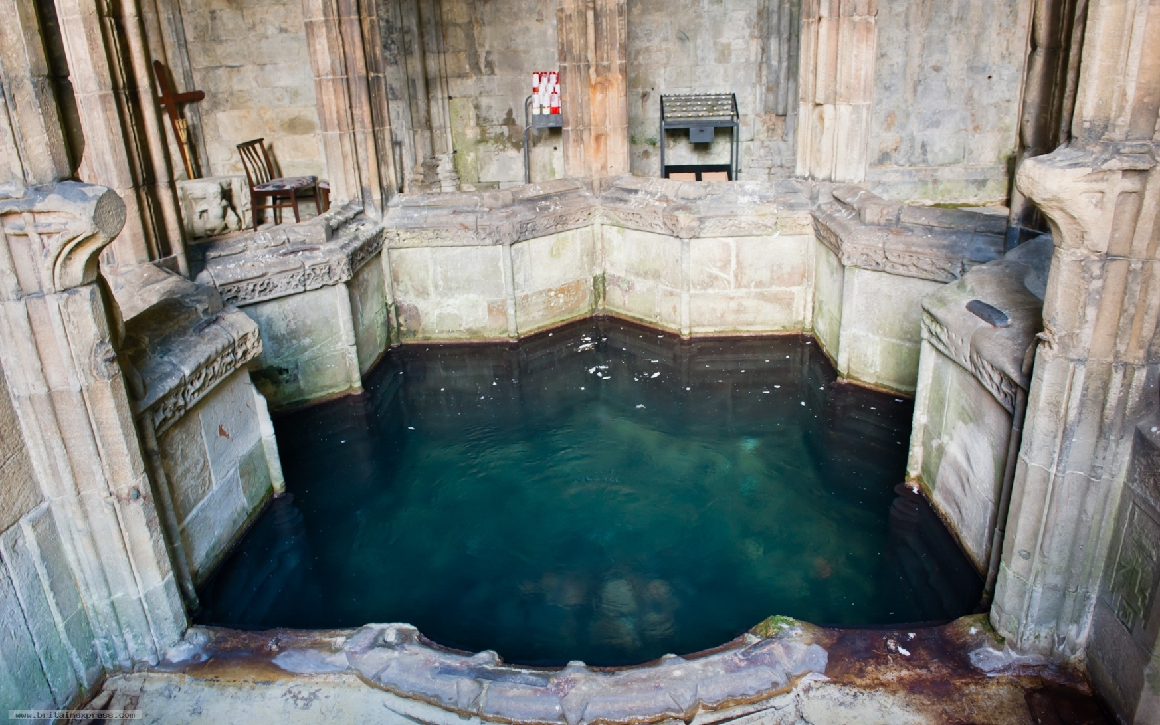
Saint Winefride’s Well
Historically claimed to have healing waters

Slide 7
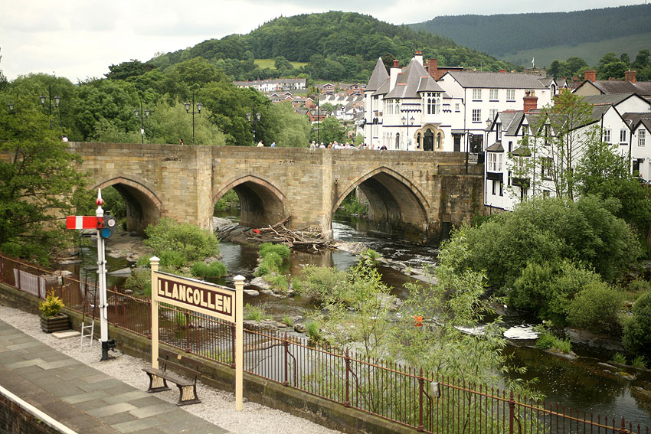
Llangollen Bridge
The first stone bridge to span the Dee

Slide 8
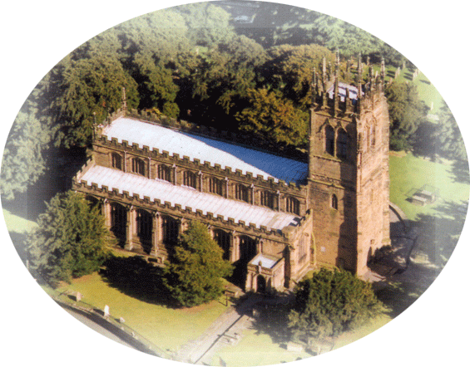
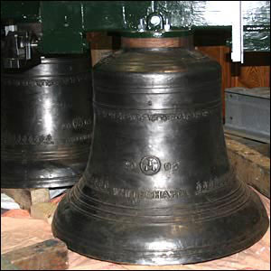
Gresford bells
The church bells are listed for their purity and tone (13century)

Slide 9
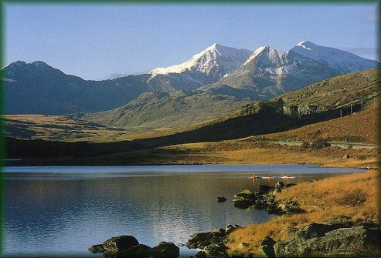
Snowdon
Highest mountain in Wales
at 3,560 ft (1,085 m)

Slide 10
https://yandex.ru/images/search?text=Gresford%20bells%20&img_url=http%3A%2F%2Fnews.bbc.co.uk%2Fnol%2Fshared%2Fspl%2Fhi%2Fpop_ups%2F06%2Fuk_gresford_bells%2Fimg%2F1.jpg&pos=0&rpt=simage&_=1458746516167
https://yandex.ru/images/search?text=snowdon&img_url=http%3A%2F%2Fox.mx5oc.co.uk%2Fevents%2F3peaks%2Fsnowdon.jpg&pos=8&rpt=simage&_=1458746516173
https://en.wikipedia.org/wiki/Seven_Wonders_of_Wales

