Slide 1
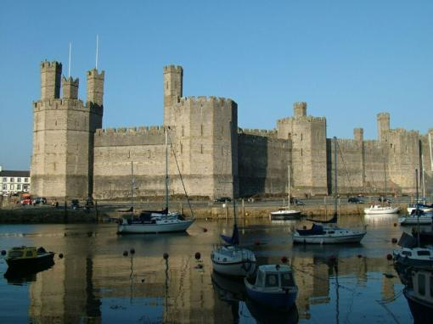
Caernarfon Castle:
10 Amazing Facts About This Incredible Welsh Castle
Шайдурова Валентина Федоровна
Учитель английского языка
ГБОУ «Школа №106»
Санкт-Петербург
2016

Slide 2
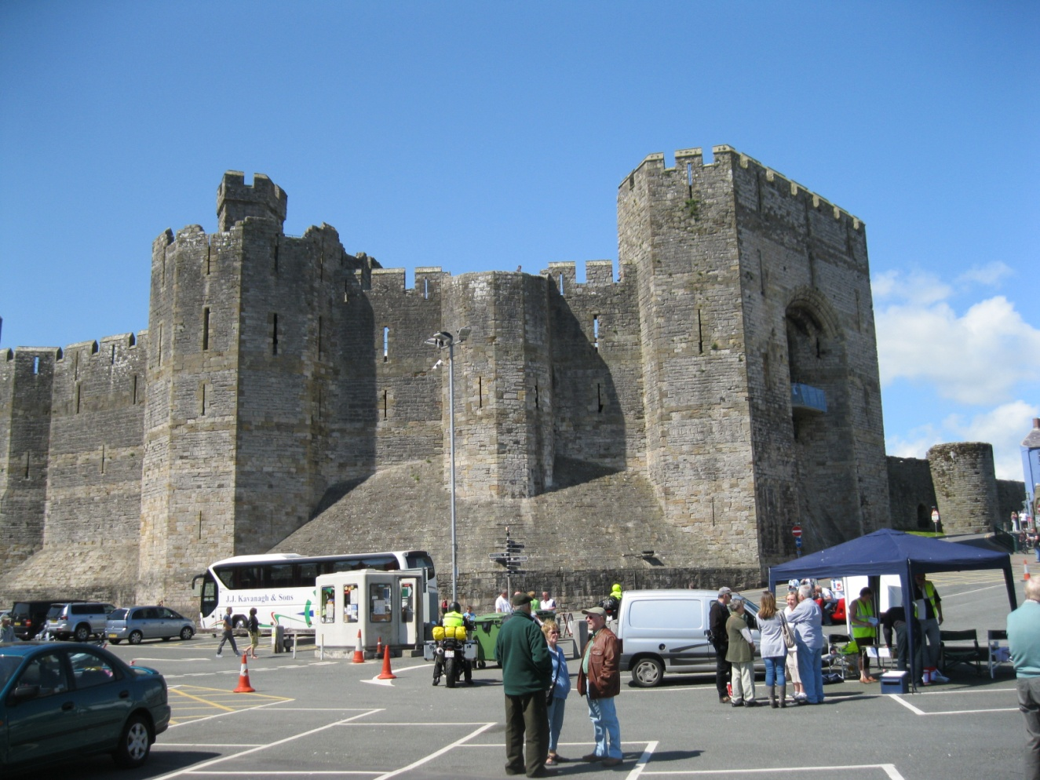
Caernarfon Castle (English spelling Caernarvon) is one of the top tourist attractions in the whole of Wales - and one of the most impressive castles in the whole of the UK.

Slide 3
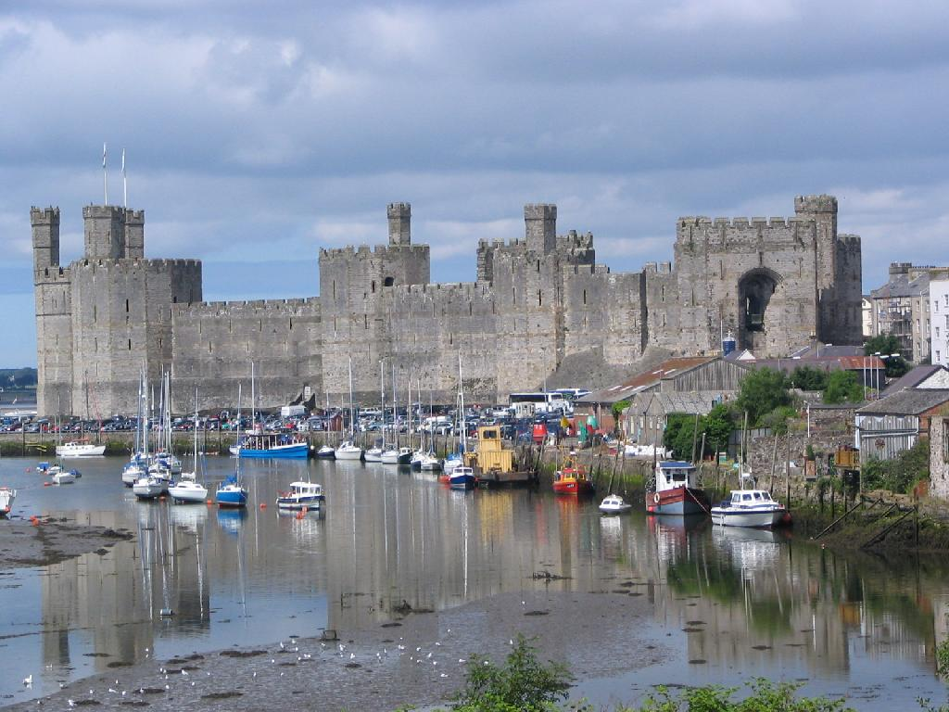
10. Caernarfon Castle was the most ambitious project of Edward I.
The elaborate town-walls, alongside the sheer size of Caernarfon,
meant that it was Edward's 'definitive' castle
in a string of important works.

Slide 4
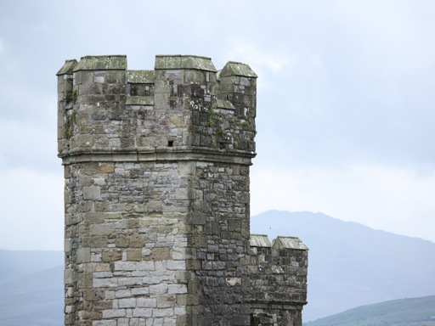
9. Caernarfon was enshrined in Roman myth
and Edward I wanted to stamp his mark on ancient legends

Slide 5
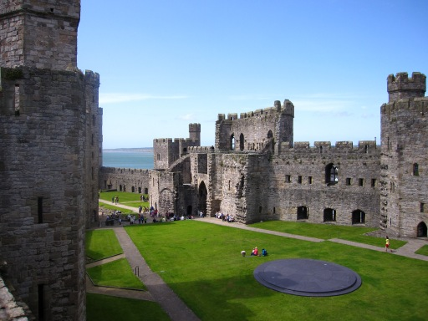
8. Caernarfon has an unusual 'hourglass' design
However, it's best to imagine the castle looking a bit like a 'figure of 8'.

Slide 6
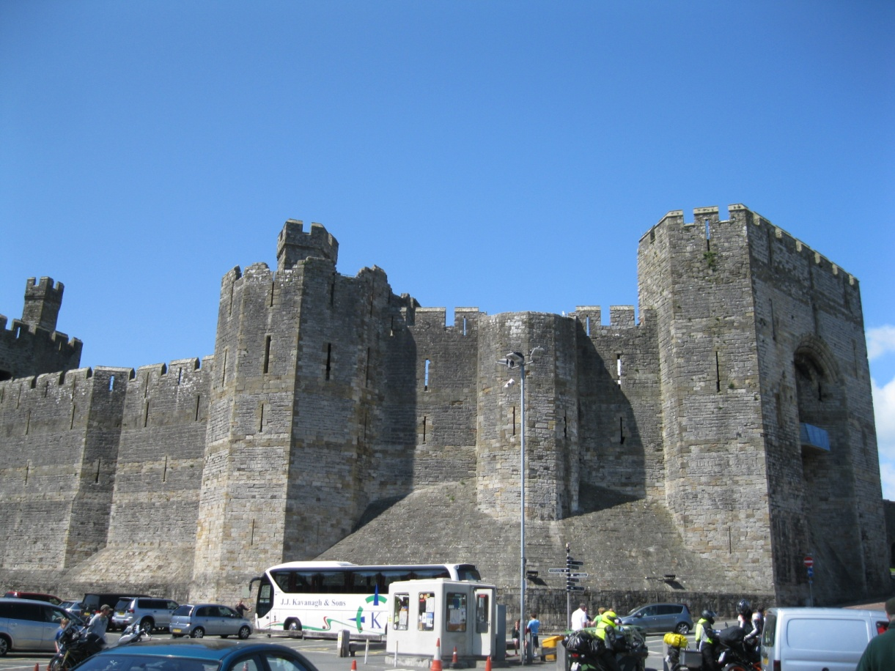
7. Caernarfon Castle was a project of phenomenal
expense and scale
Records at his time show an expenditure of £22,000 - a huge sum

Slide 7
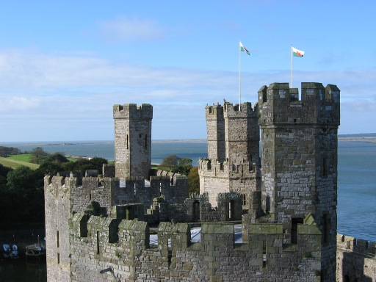
6. The octagonal towers of Caernarfon
give away its lofty status

Slide 8
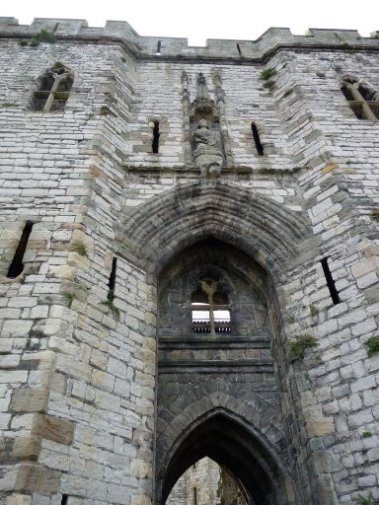
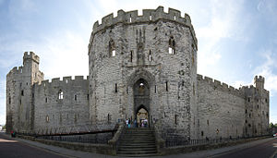
5. The huge gatehouses display
the true might of the castle

Slide 9
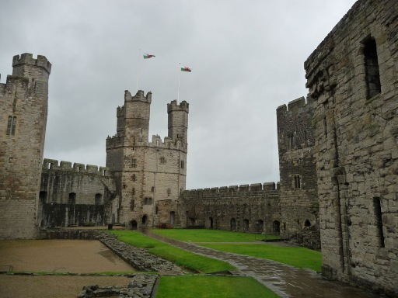
4. Caernarfon Castle was still attacked and
overcome by Welsh rebels

Slide 10
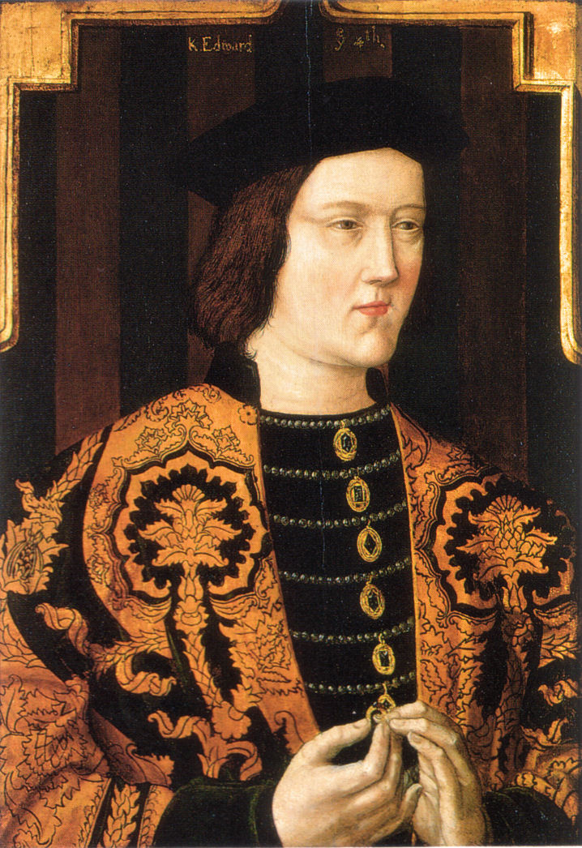
3. Caernarfon was the birthplace of the first Prince of Wales –
a man who could 'never speak a word of English'
Edward of Caernarfon
became King of England
(Edward II of England) in 1307.

Slide 11
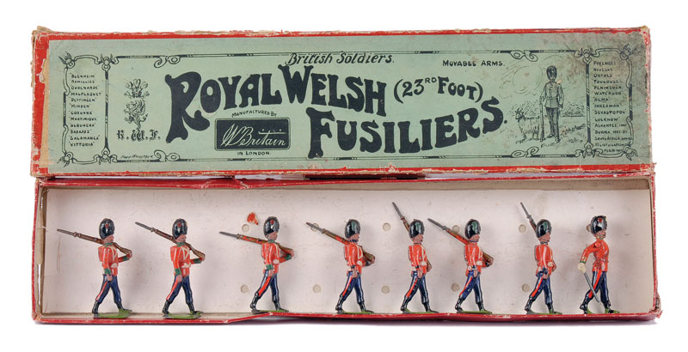
2. Nowadays, it houses some unusual attractions –
including the Museum of the Royal Welsh Fusiliers

Slide 12
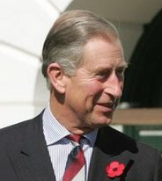
1. Even today, Princes are 'crowned' inside the castle
The ceremony of 'investiture' (effectively a 'crowning', or giving the Prince his formal title) takes place in Caernarfon Castle.
Charles, Prince of Wales, received his title here in 1969
Edward VIII was granted his title in 1911.

Slide 13
https://en.wikipedia.org/wiki/Caernarfon_Castle
http://www.britainexpress.com/wales/anglesey/castles/caernarfon.htm
http://www.caernarfon.com/
http://www.exploring-castles.com/caernarfon_castle.html
http://www.exploring-castles.com/caernarfon_castle.html

