Slide 1
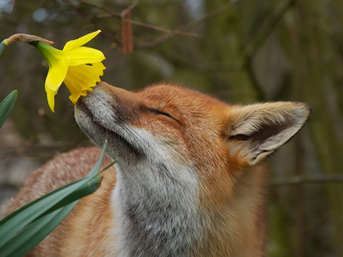
Animals Adoring Flowers
Интерактивная
викторина
для 7-11
классов
Автор:
Ольга Михайловна Степанова
учитель английского языка
МБОУ «Цивильская СОШ №1
имени Героя Советского Союза
М.В. Силантьева»
города Цивильск Чувашской Республики
2016

Slide 2
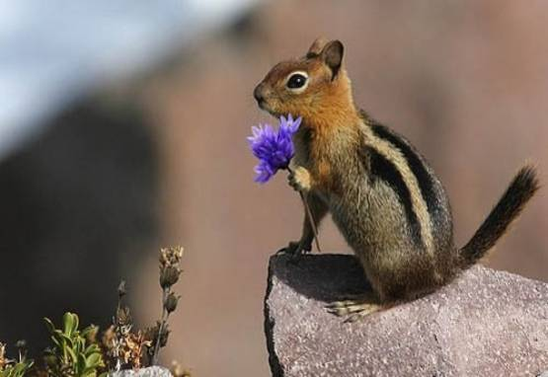
Earth laughs in flowers.
And there are
some
flowers which
attract animals.
May be, there are
some animals that
love some flowers with special Love. Well, watch the animals
who adore flowers!

Slide 3
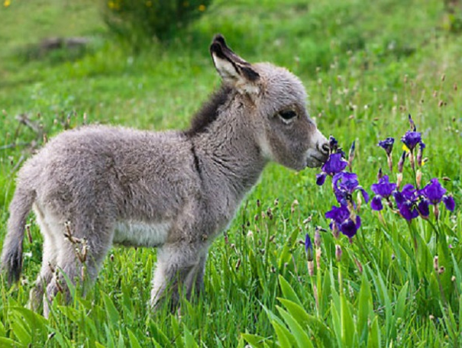
Our little Spaceship Earth is only eight thousand miles in diameter, which is almost a negligible dimension in the great vastness of … .
R. Buckminster Fuller
space

Slide 4
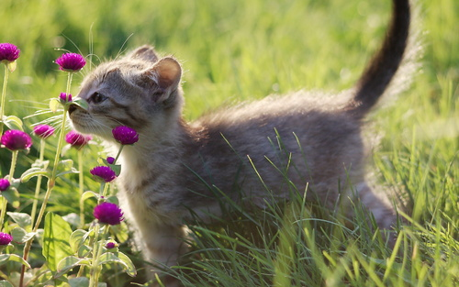
“Animals are such agreeable friends―they ask no … ,
they pass no criticisms.” ― George Eliot
questions

Slide 5
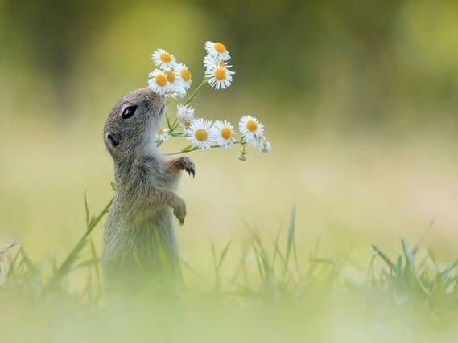
The more clearly we can focus our attention on the wonders and realities of the universe about us, the less … we shall have for destruction. Rachel Carson
taste

Slide 6
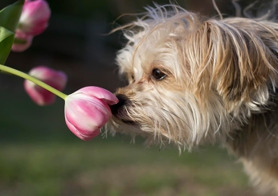
“Animals are the … between us and the beauty of all that is natural.” ― Trisha McCagh
bridge

Slide 7
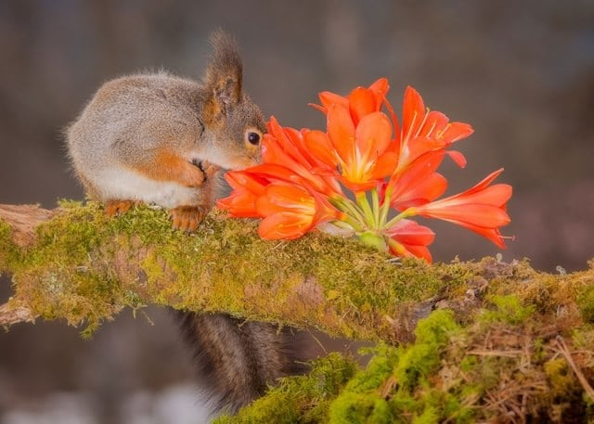
The first … of ecology is that everything is related to everything else.
Barry Commoner
law

Slide 8
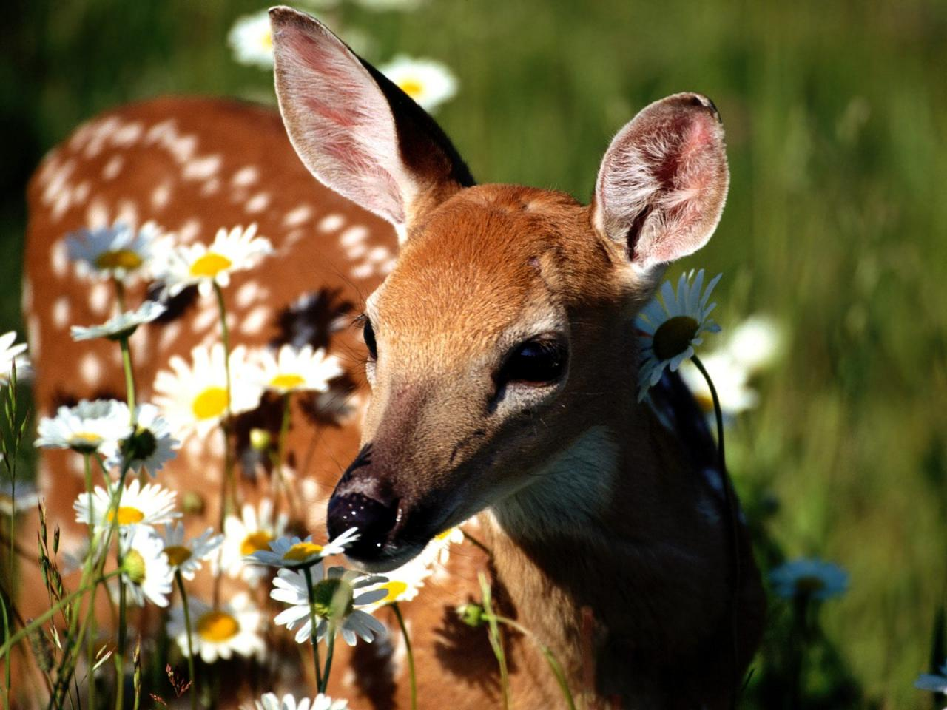
What we most need
to do is
to hear
within
us the … of the Earth crying. Thich
Nhat Hanh
sound

Slide 9
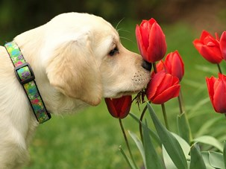
Deep in their roots, all flowers keep the … .
Theodore Roethke
light

Slide 10
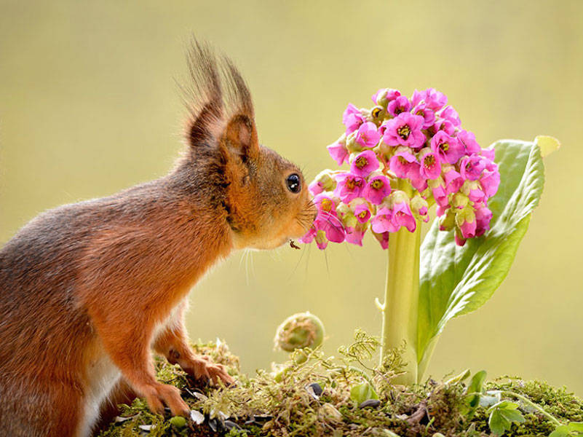
Nature has been for me, for as long as I remember, a source of solace, inspiration, adventure, and delight; a home, a companion,
a … .
Lorraine Anderson
teacher

Slide 11
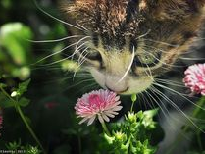
We have forgotten the earth, forgotten it in the sense that we fail to regard it
as a source of our … .
Fairfield Osborn
life

Slide 12
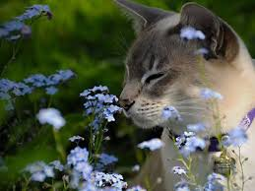
I am in favor of animal rights as well as human rights. That is the … of a whole human being.
Abraham Lincoln
way

Slide 13
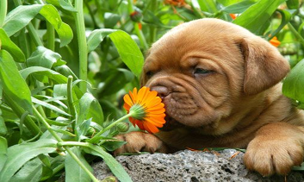
The greatness of a … and its moral progress can be judged by the way its animals are treated. Mahatma Gandhi
nation

Slide 14
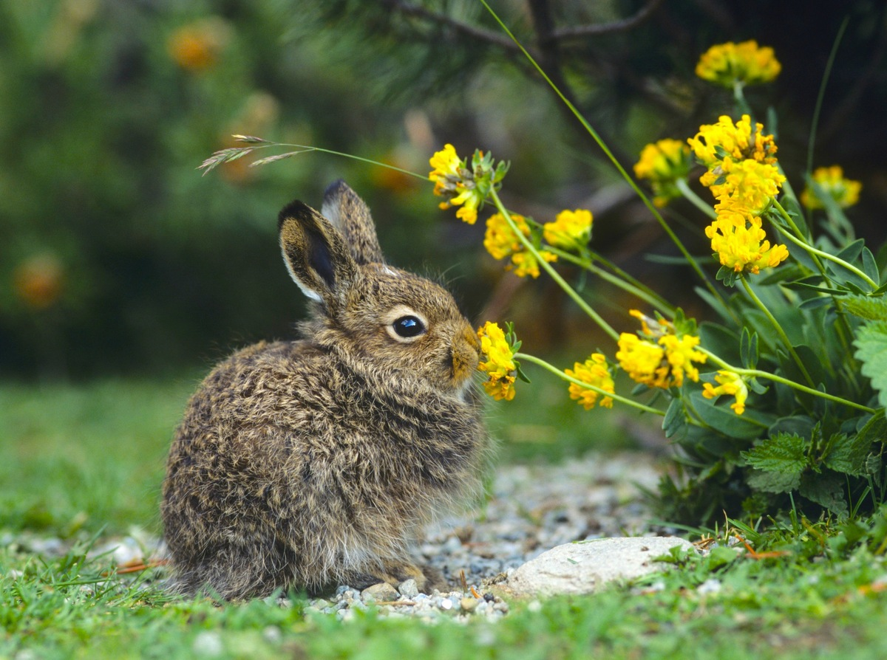
Love the animals: … has given them the rudiments of thought and untroubled joy.
God

Slide 15
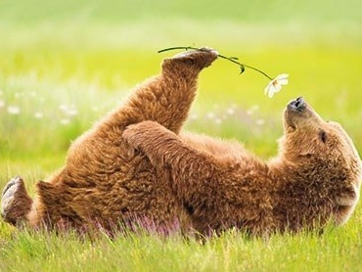
An animal's eyes have the power to speak a great … . Martin Buber
language

Slide 16
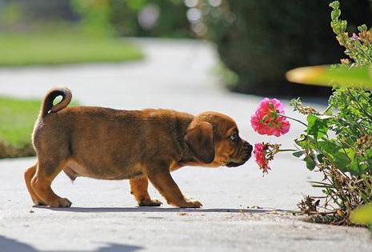
Thank you
For Taking Part
in the Quiz!

Slide 17
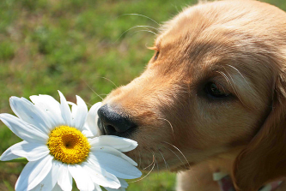
Sources
http://www.globalstewards.org/nature-animal-quotes.htm
http://www.buzzfeed.com/alanamassey/animals-quotes-to-make-you-human#.lcbYkZ476M

