Slide 1
Tulips Beauty
Интерактивная
викторина
для 7-11
классов
Автор:
Ольга Михайловна Степанова
учитель английского языка
МБОУ «Цивильская СОШ №1
имени Героя Советского Союза М.В. Силантьева»
города Цивильск Чувашской Республики
2016

Slide 2
“A tulip doesn’t strive to impress anyone. It doesn’t struggle to be different than a … .
It doesn’t have to.
It is different. And there’s room in the garden for every flower.
Marianne Williamson
rose

Slide 3
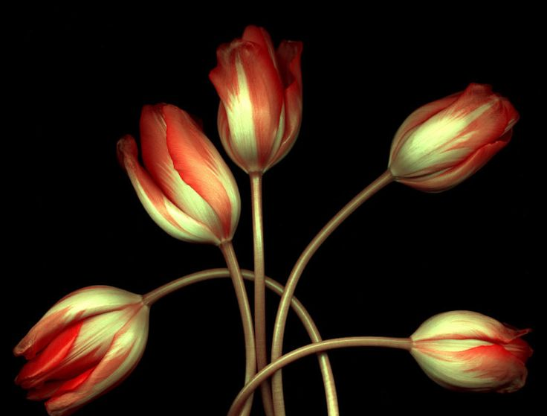
Flowers heal me. Tulips make me happy. I keep myself surrounded by them as soon as they start coming to the island from … , and after that when they come from the fields in La Connor, not far from where I live.
Rebecca Wells
Canada

Slide 4
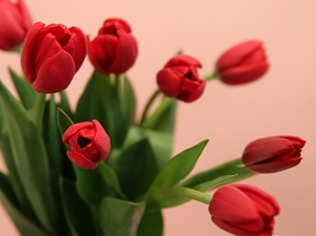
The Tulips strength is in it's stem
It holds it's head so strong and straight
Into the soil it sinks so deep
There it stays til it's … to reap.
Thomas B Davies
time

Slide 5
The Tulips … is in it's head
It's colour varies from yellow to red
Find a colour, find a room
Leave it there and it will bloom. Thomas B Davies
beauty

Slide 6
The Tulips … is in it's petals
They overlap and keep so tight
When it's dark they close right up
And open up when it is light.
Thomas B Davies
warmth

Slide 7
When uncut in fields of plenty
Dancing to the winds own beat
Watch them swaying in the breeze
You'll think this sight is such a … .
Thomas B Davies
treat

Slide 8
"Life isn't a … through the tulips."
Shannon Hoon
tiptoe

Slide 9
The spring is here.
The flowers have come!
There’s the beautiful Tulips
that wake up to the … .
sun

Slide 10
Tulips welcome the new season of spring;
the wonder and beauty that new … brings.
love

Slide 11
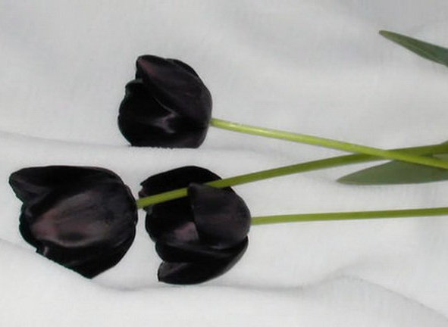
The image of a tulip,
of a crocus, a daffodil
must be in the heart of each cell
coming from the … rising so well.
earth

Slide 12
The stars hang thick
in the apple tree,
The south wind smells of the pungent sea,
Gold tulip cups are heavy with … .
The night's for you, Sweetheart, for you!
dew

Slide 13
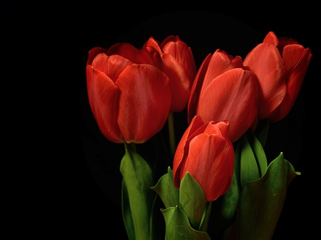
While nodding in fields of new grass,
And blooming in beauty to last
For only the briefest of hours,
Sweet tulips! Your rainbow of flowers
Has brightened this … of ours.
~Amanda Barrickman
landscape

Slide 14
The tulips are dancing in the cool … breeze.
Would you hold me and dance with me, please?
Bonnie Gail Carter
summer

Slide 15
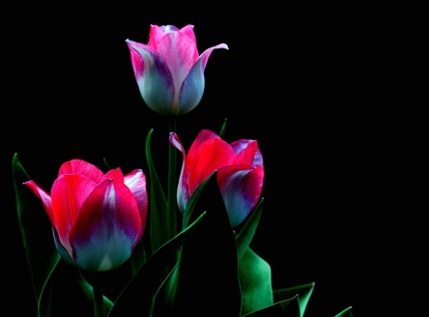
“By the pixies’ magic power
Do my tulips always flower,
By the pixies’ magic spell
Do they give so sweet a smell!
Tulips, tulips, red and white,
Fill the pixies with … !
Maud Keary
delight

Slide 16
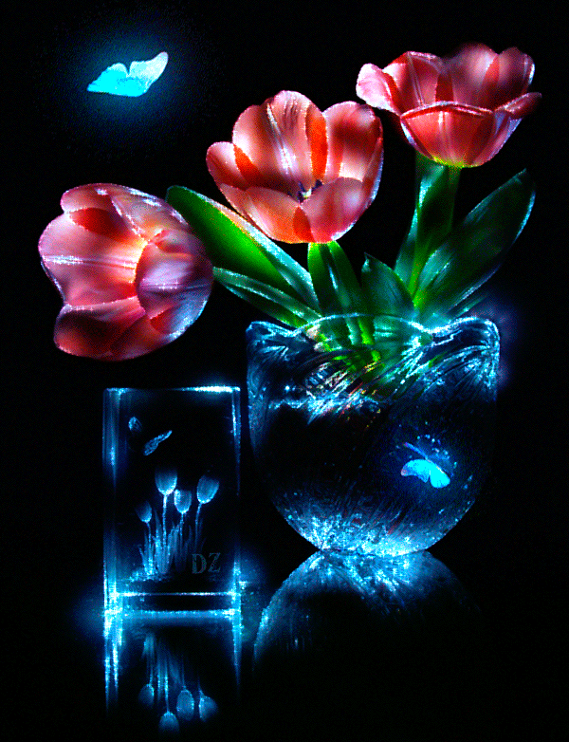
In rainbow colours, brilliant and stately, a vision to surely yield a sigh,
Ponder thus upon the regal tulip, it has pure … , you cannot deny.
Ernestine Northover
beauty

Slide 17
Thank you
For Taking Part
in the Quiz!

Slide 18
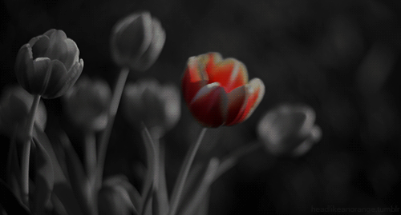
Sources
http://allpoetry.com/poem/10491183-Tulip-Love-by-Carlstromct
http://www.inspirationalstories.com/poems/hora-stellatrix-amy-lowell-poem/
http://www.inspirationalstories.com/poems/the-image-of-a-tulip-raymond-a-foss-poem/
http://webapp1.dlib.indiana.edu/vwwp/view?docId=VAB7182&chunk.id=d1e6067&brand=vwwp&doc.view=0&anchor.id=#VAB7182-104
https://www.google.com/search?q=The+tulips+are+dancing+in+the+cool+summer+breeze&oq=The+tulips+are+dancing+in+the+cool+summer+breeze&sourceid=chrome&ie=UTF-8&gws_rd=ssl
http://faeriefae.50megs.com/enchanted_tulips.htm

