Slide 1
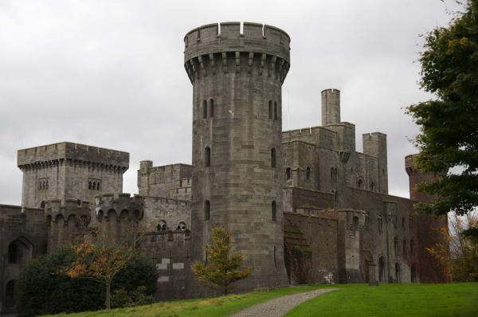
Penrhyn Castle, Wales
Шайдурова Валентина Федоровна
Учитель английского языка
ГБОУ «Школа №106»
Санкт-Петербург
2016
Фотографии автора презентации

Slide 3
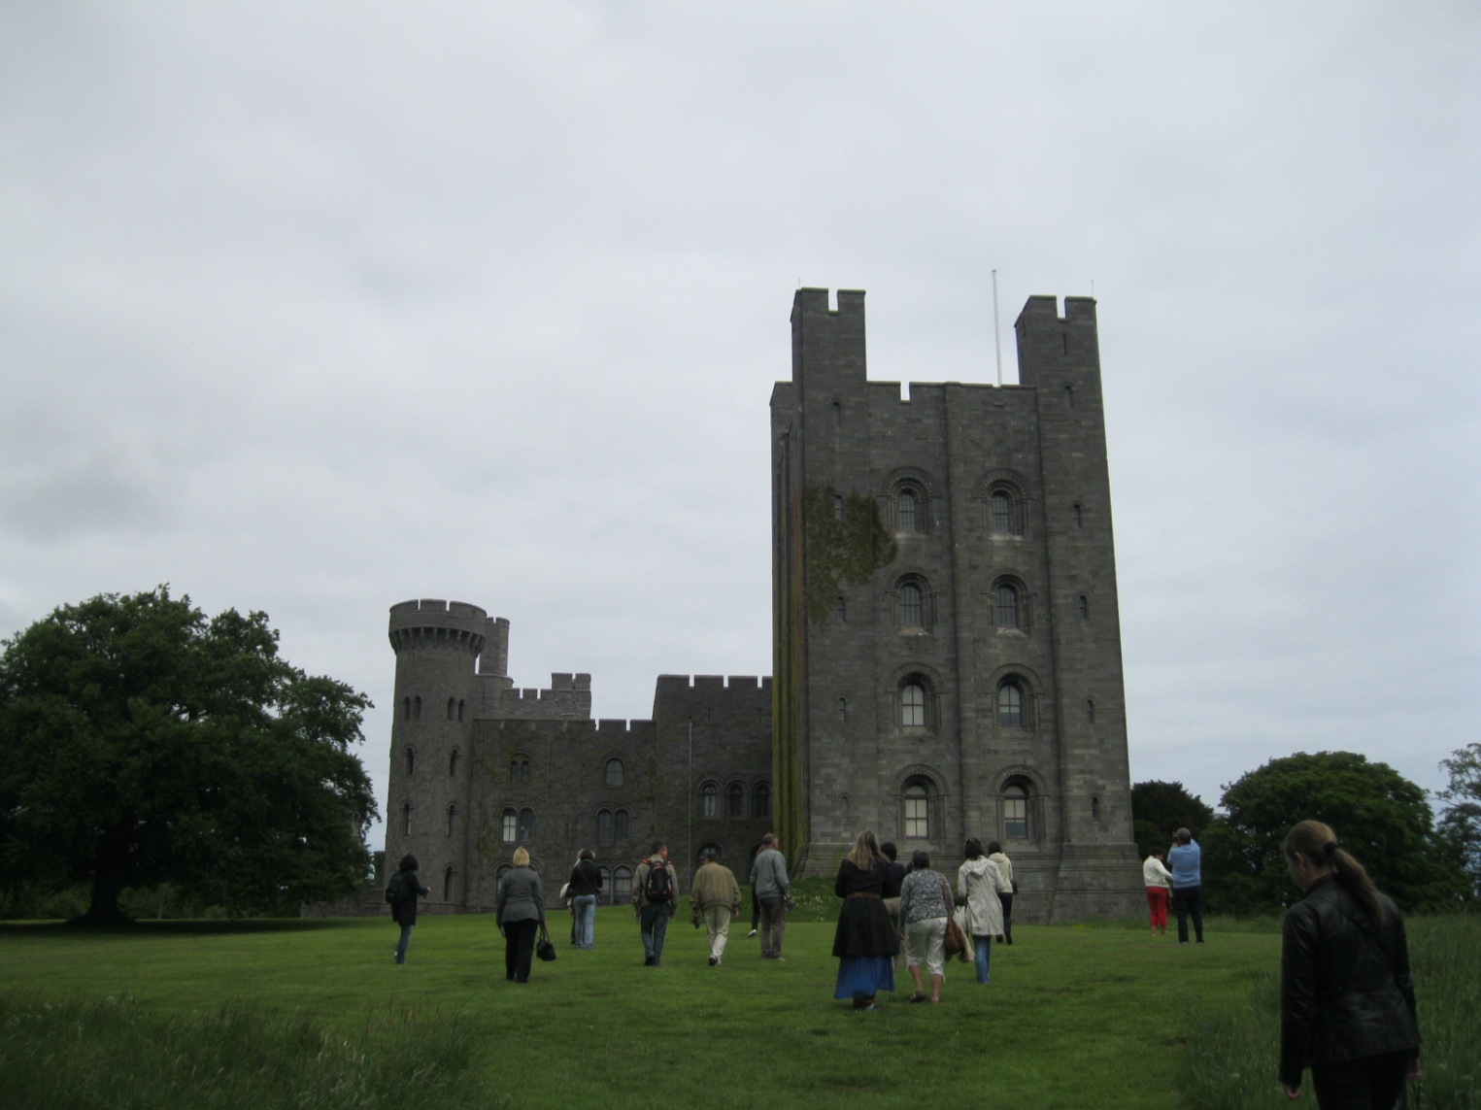
1820-1845
Penrhyn Castle is a country house in Llandegai, Bangor, Gwynedd, Wales,

Slide 4
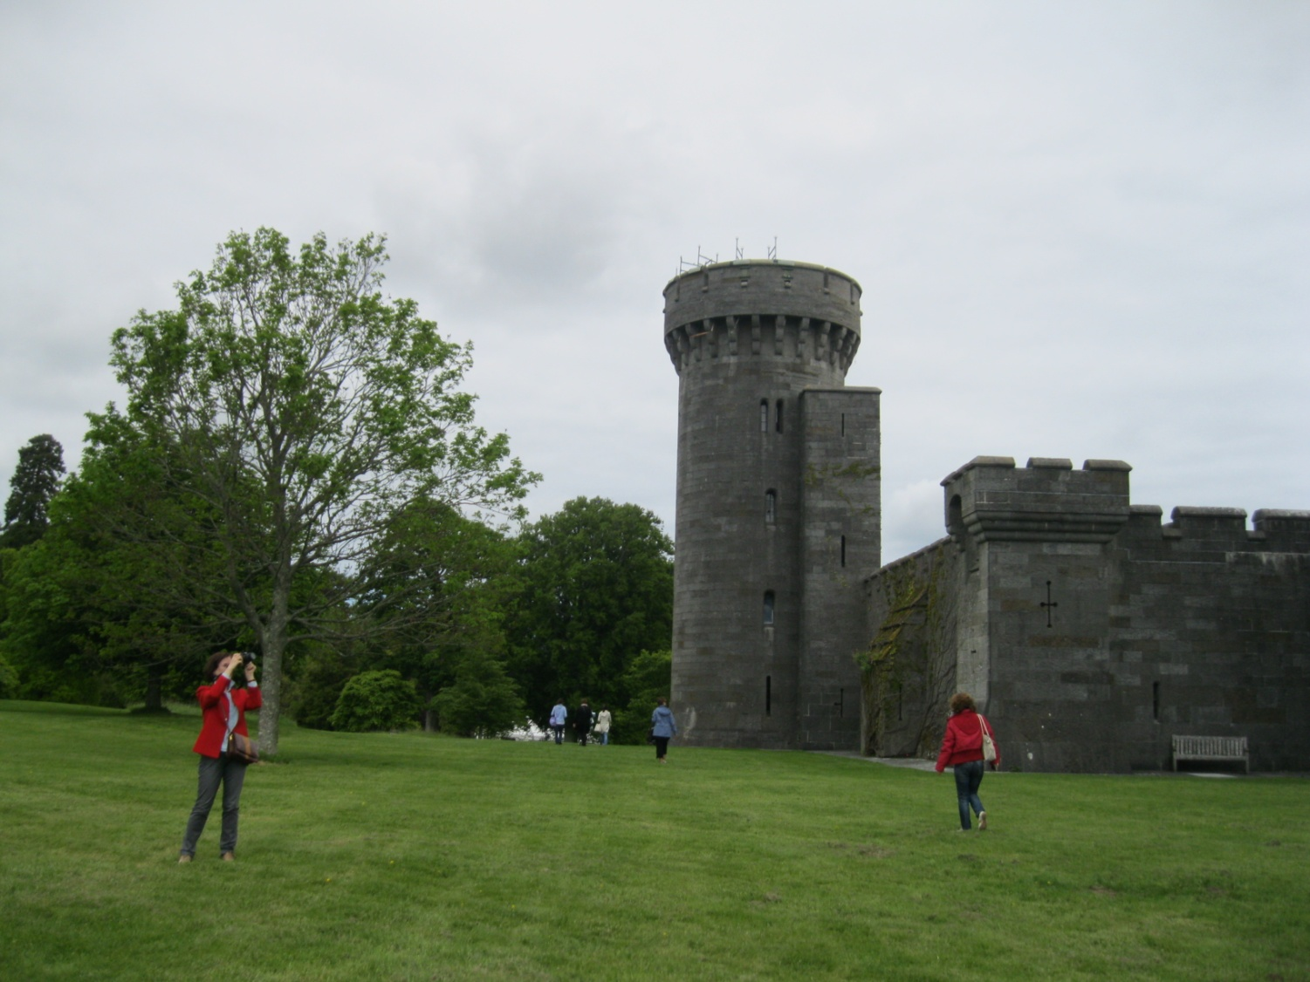
Christopher Hussey called it, "the outstanding instance of Normal revival."

Slide 5
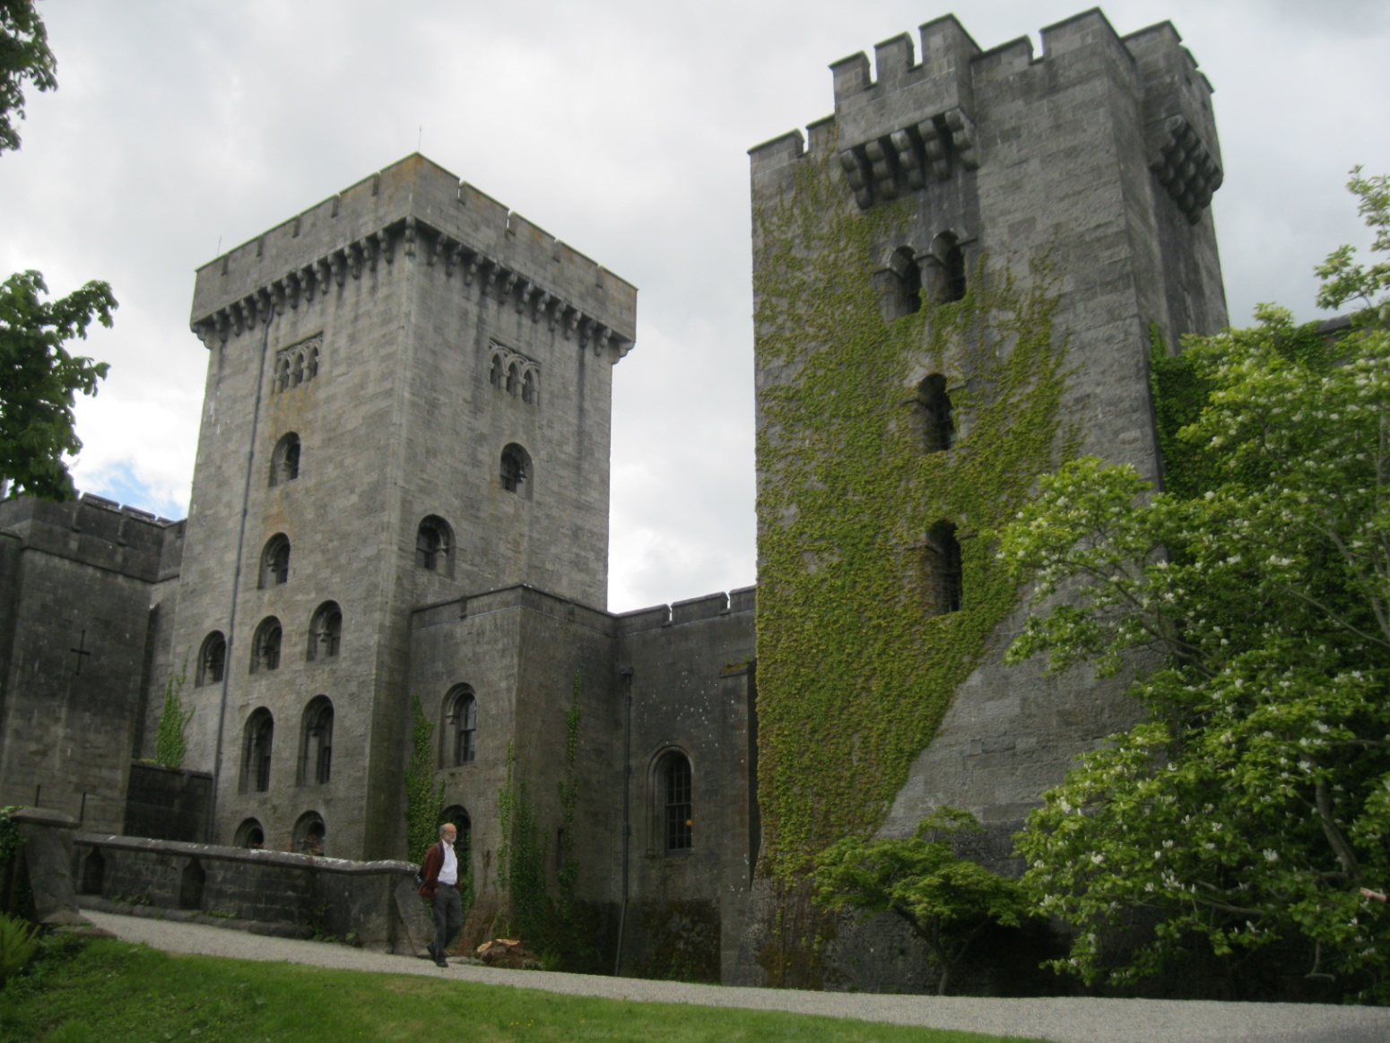
The castle is a picturesque composition that stretches over 600 feet from a tall donjon containing family rooms, through the main block built around the earlier house, to the service wing and the stables.

Slide 6
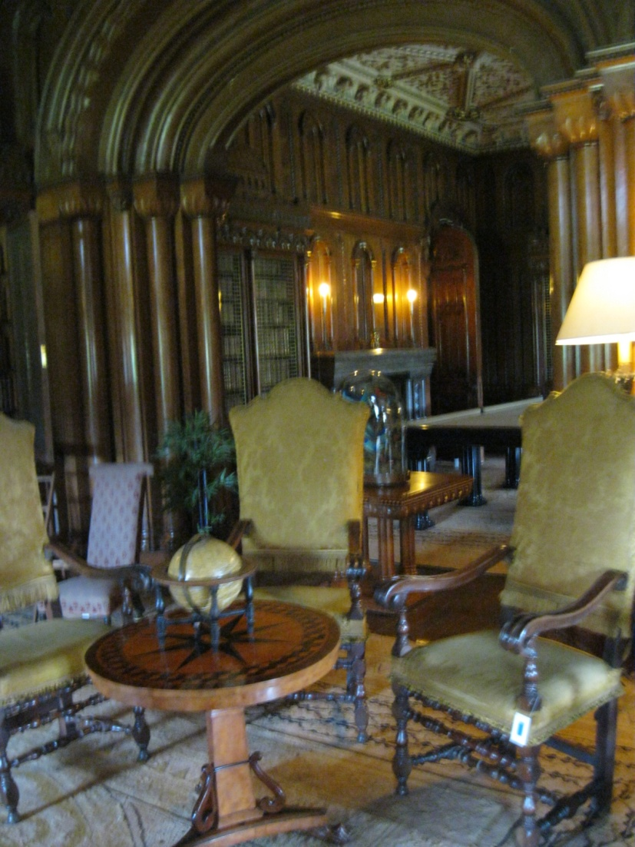
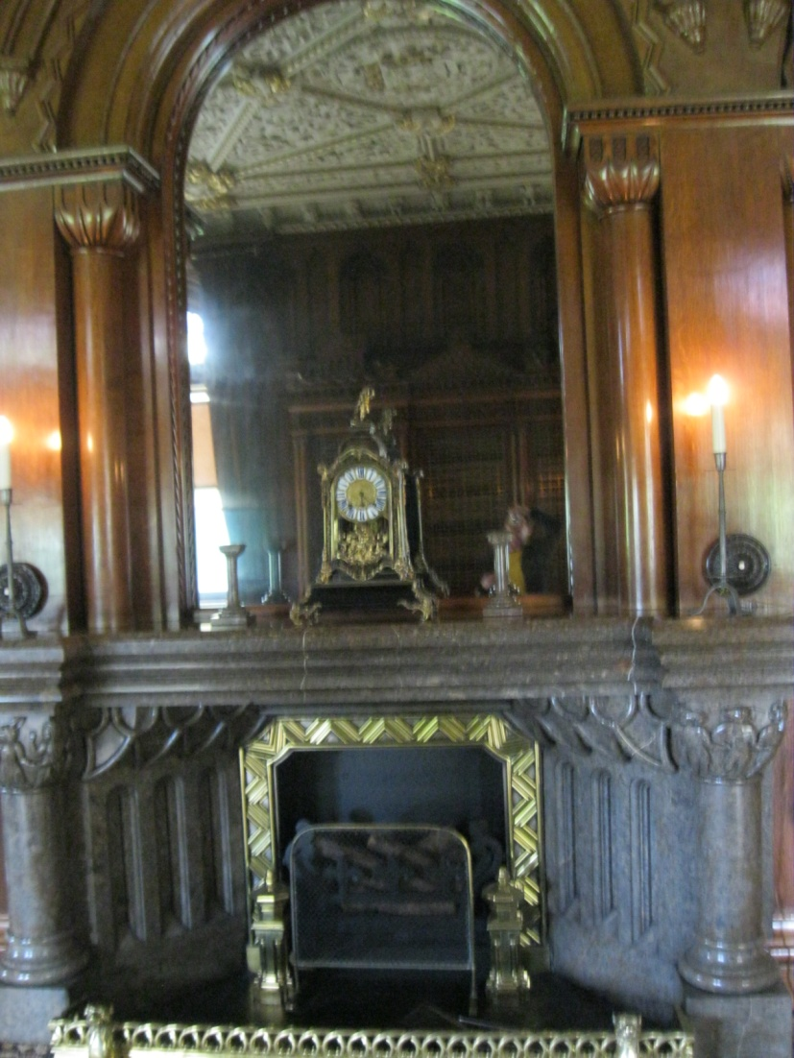
Hopper designed all the principal interiors in a rich but restrained Norman style, with much fine plasterwork and wood and stone carving.

Slide 7
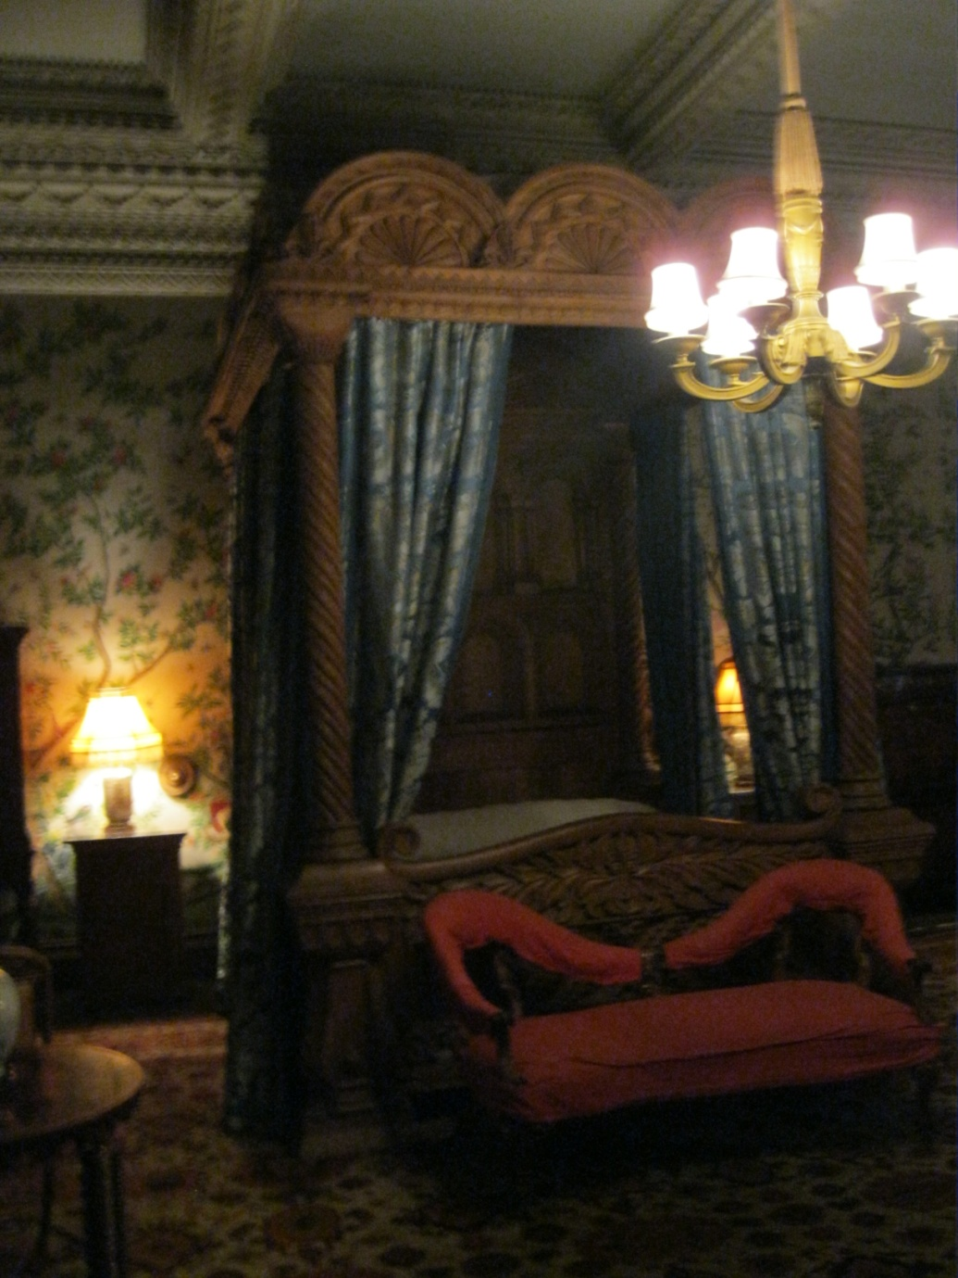
The castle also has some specially designed Norman style furniture, including a one ton slate state bed used by Queen Victoria when she visited in 1859.

Slide 8
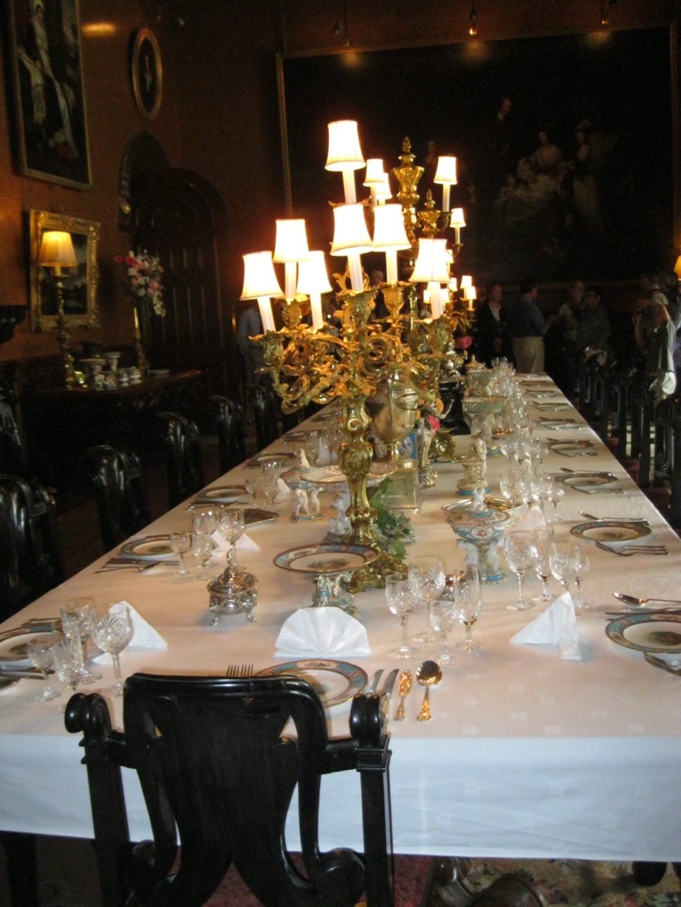
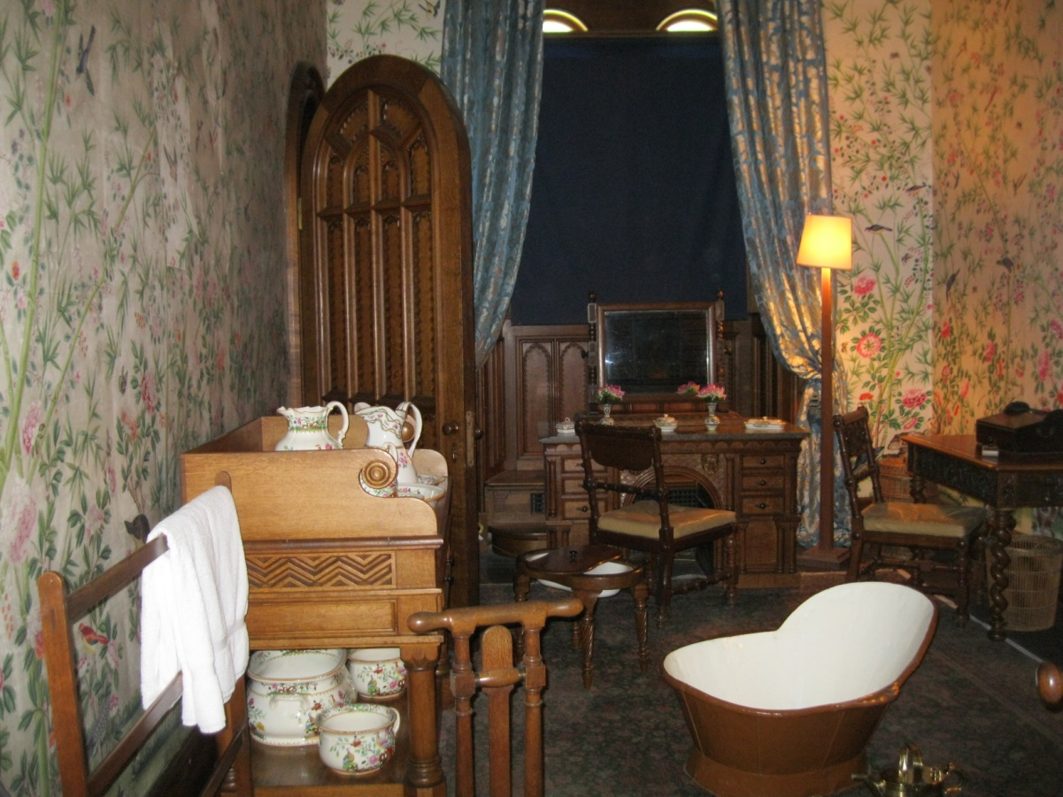
a grand hall
a drawing room

Slide 9
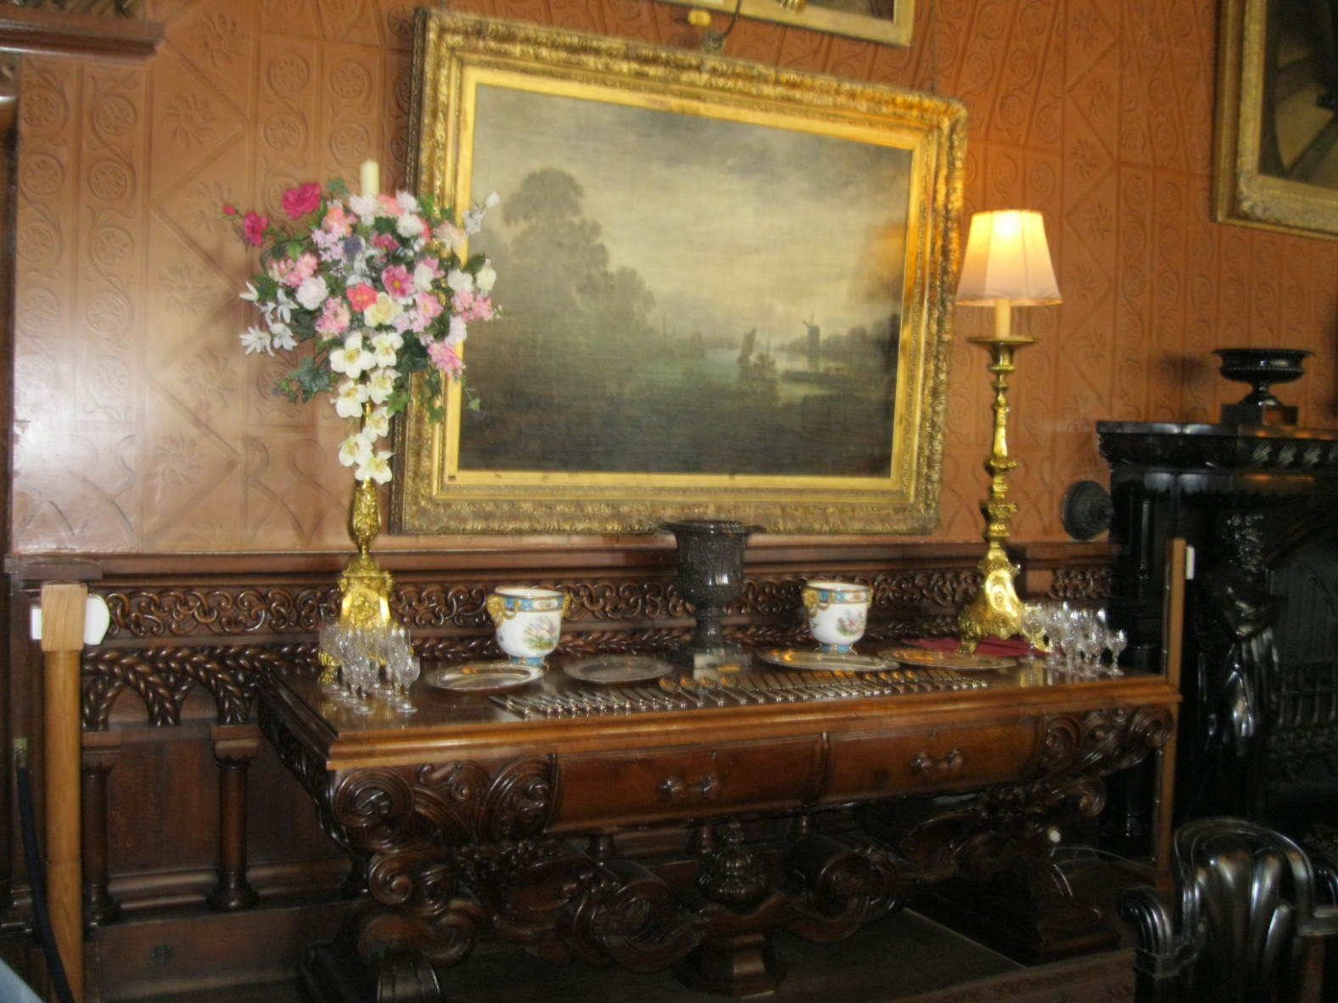
A collection of Old Masters paintings is part of the castle's treasures.

Slide 10
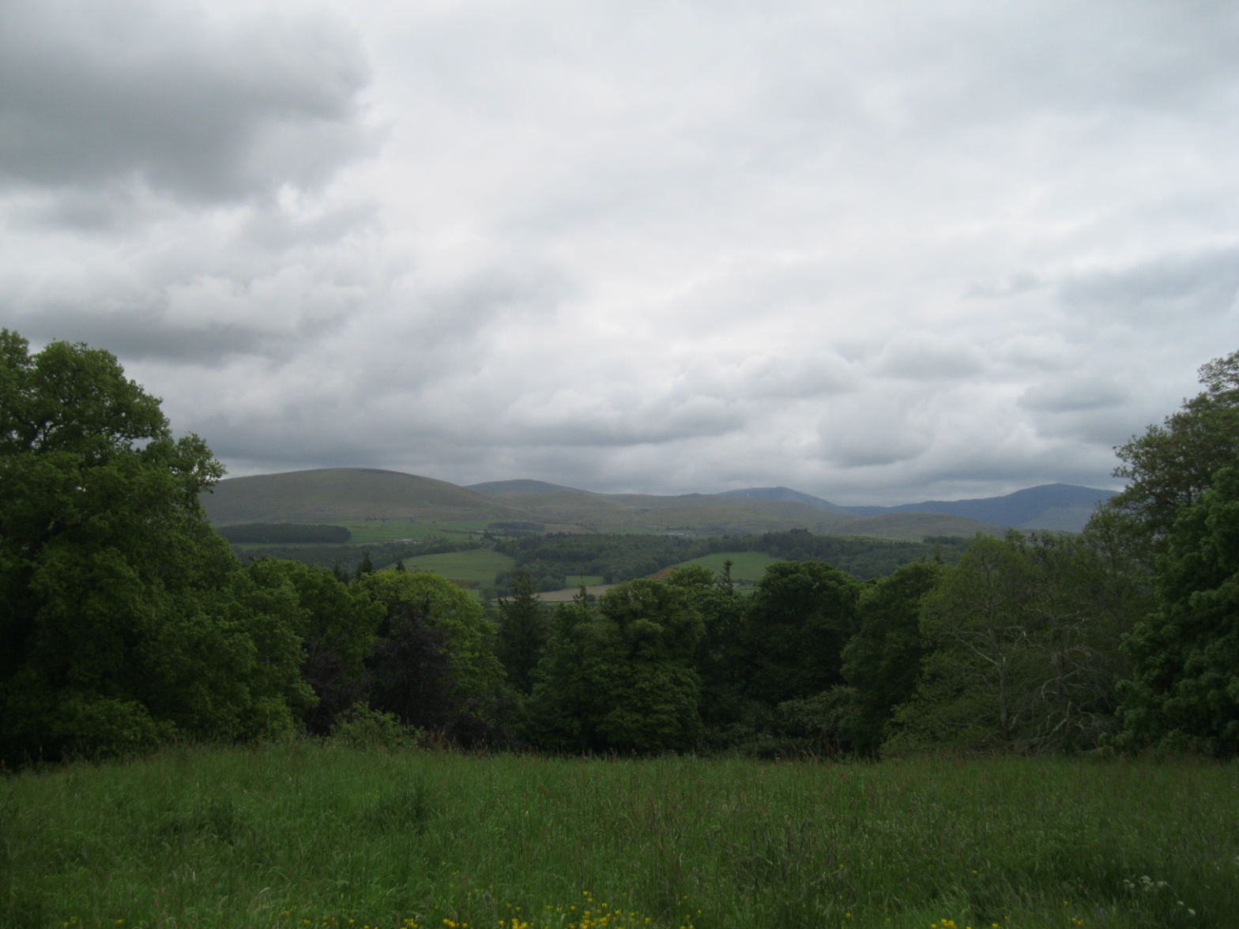
In 1951 the castle and 40,000 acres (160 km²) of land were accepted by the Treasury in lieu of death duties.

Slide 11
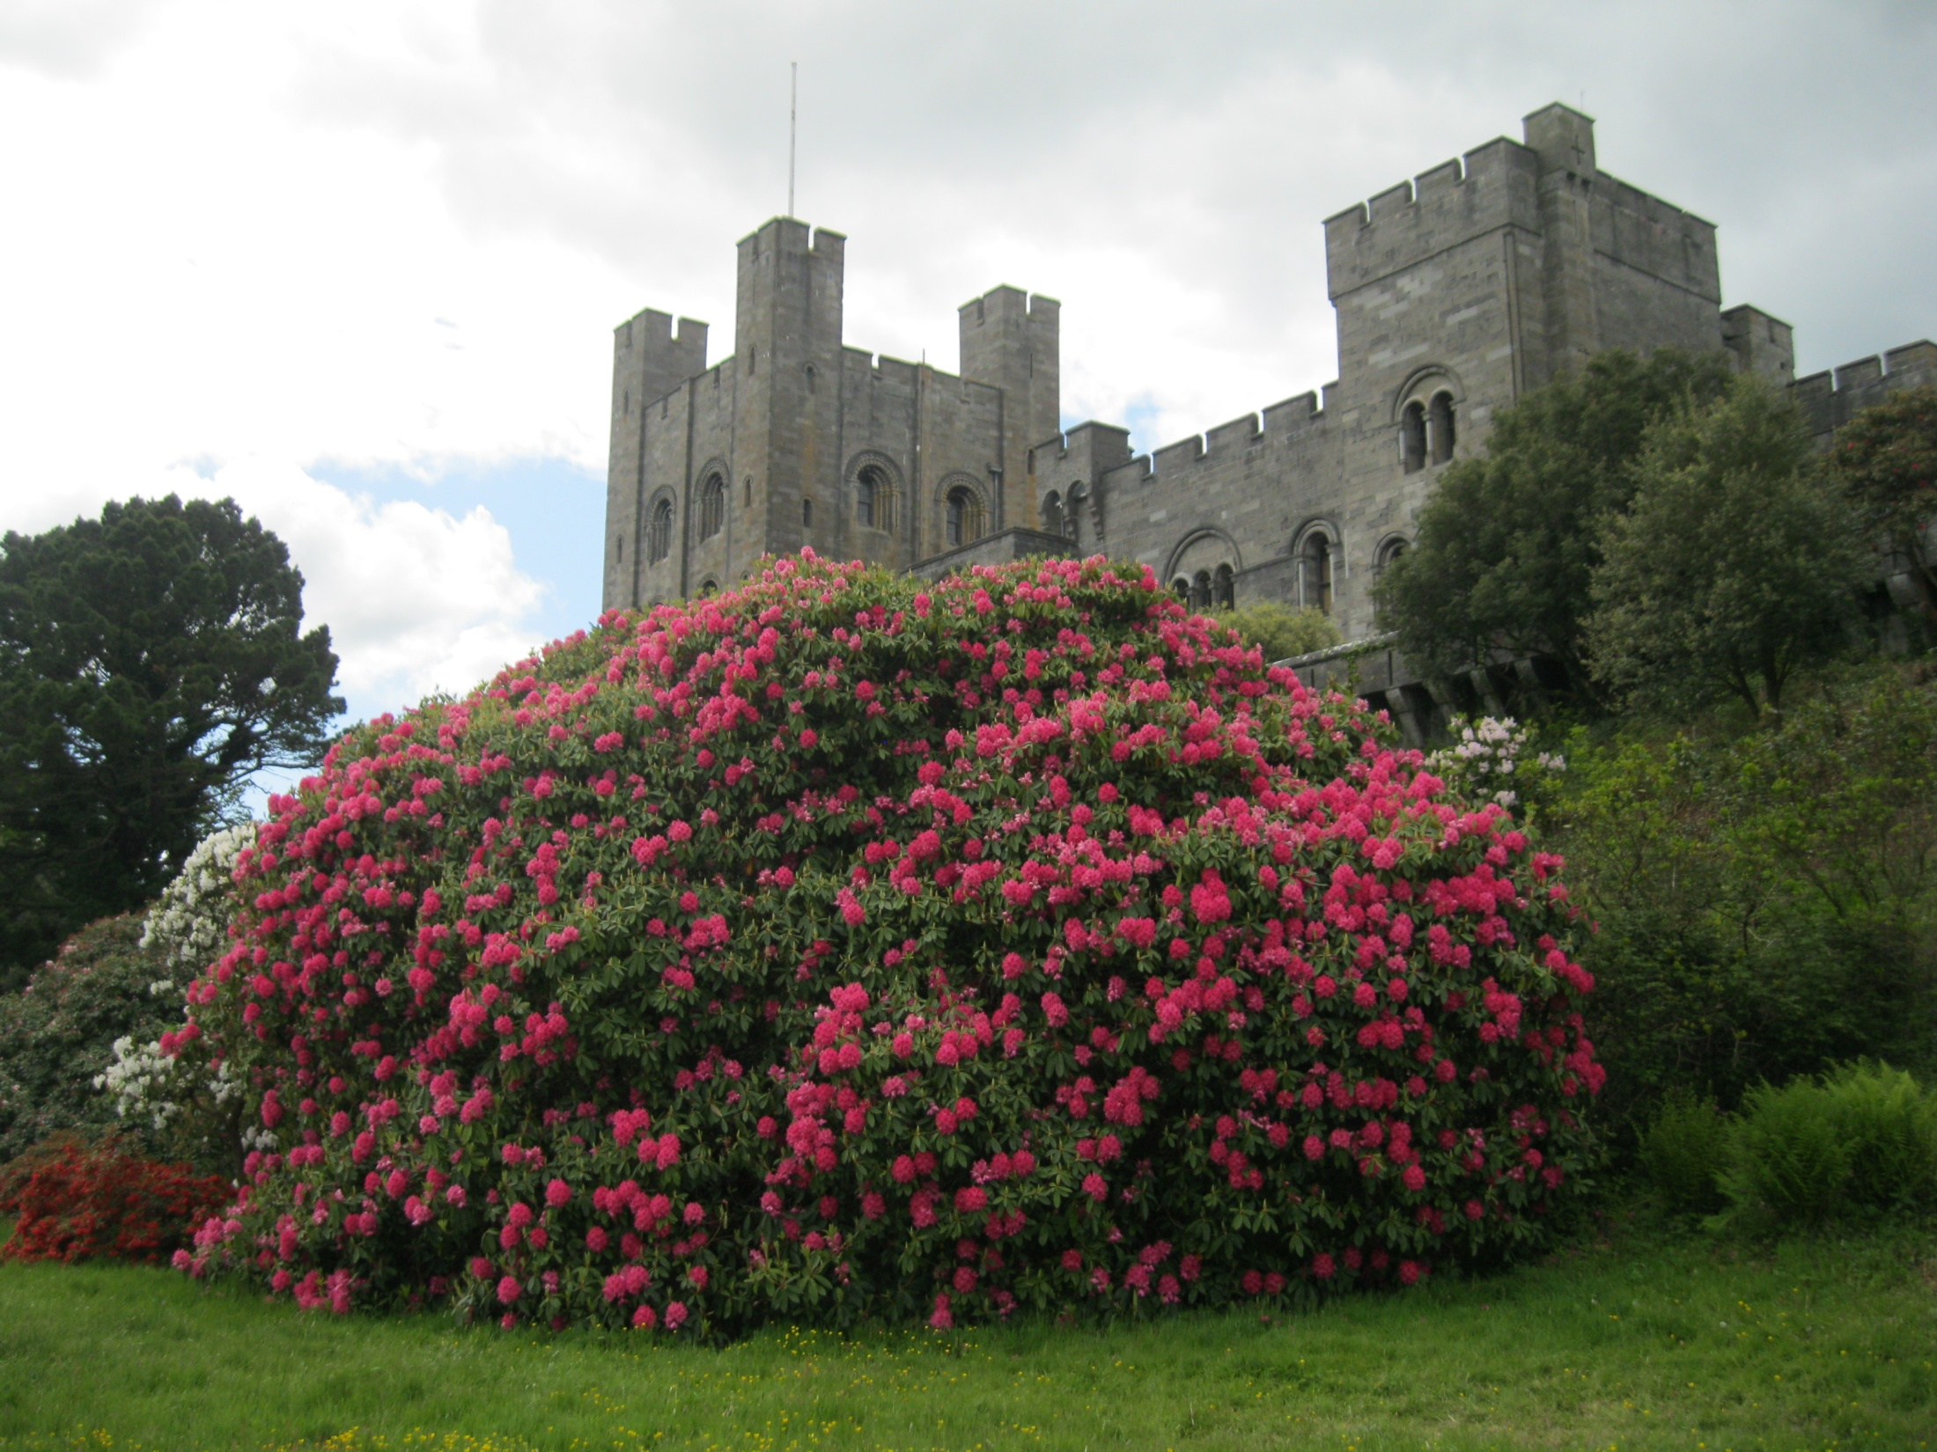

Slide 12
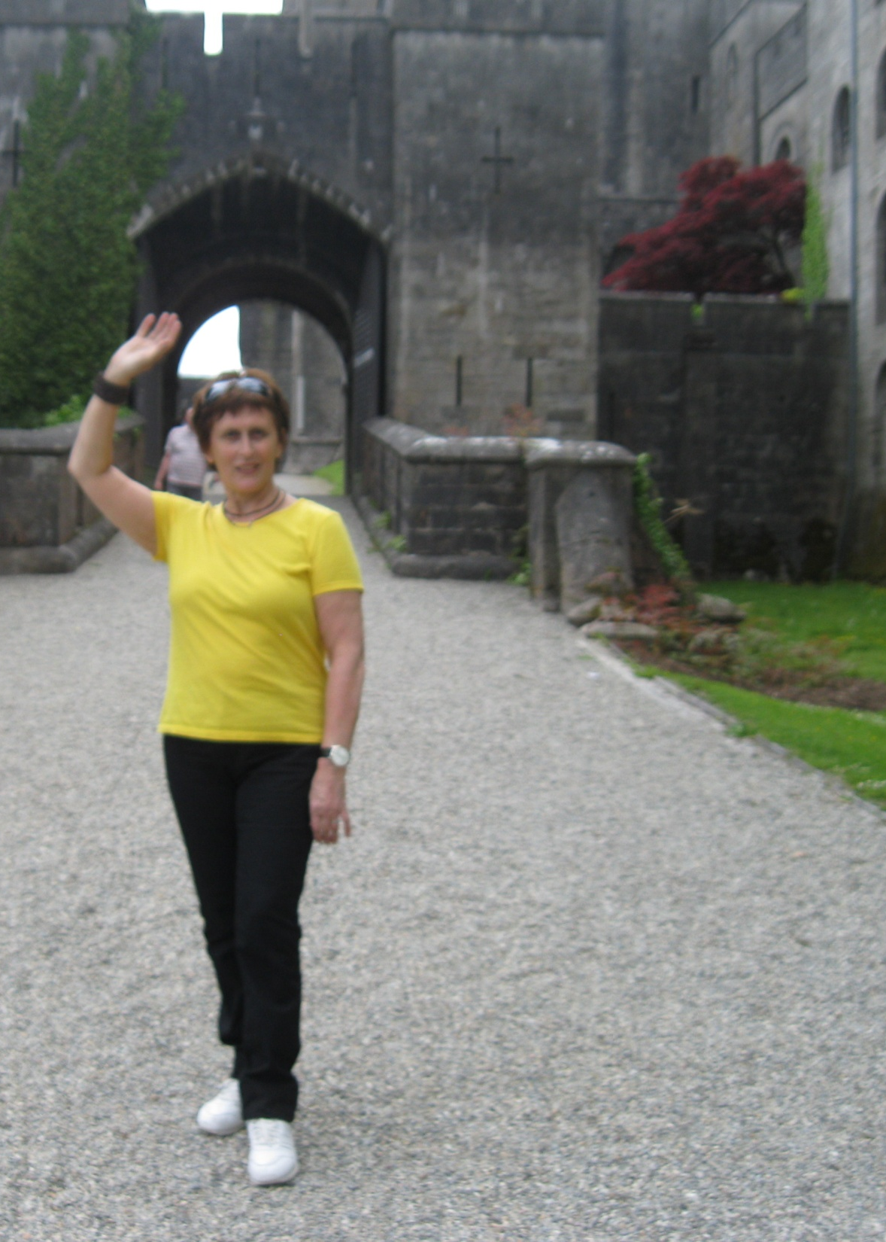
Фотографии
автора презентации
http://victor.com.ua/UK/
Wales/Caernarfon/index-
Caernarfon.html
http://www.votpusk.ru/country/
dostoprim_info.asp?ID=2755#ixzz
445QYmHax

