Slide 1
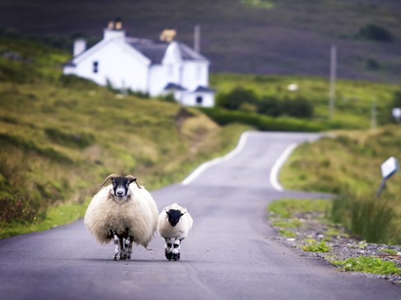
Английский язык
УМК “Spotlight” 7 класс Теst
Scotland’s Natural World Spotlight 7-Page 81
Автор:
Ольга Михайловна Степанова
учитель английского языка
МБОУ «Цивильская СОШ №1
имени Героя Советского Союза М.В. Силантьева»
города Цивильск Чувашской Республики
2016

Slide 2
1. The St Kilda islands are in the most … part of Britain.
a) distant
b) exotic
c) remote
d) dangerous

Slide 3
2. St Kilda has the highest cliffs in Britain, over one million seabirds and … species of sheep and fieldmice.
unique
unusual
c) beautiful
d) special

Slide 4
3. St Kilda is also one of the best places in Britain for diving because of its … waters.
pretty
neat
c) deep
d) clear

Slide 5
4. There are some … underwater caves and tunnels on the St Kilda islands as well.
a) adorable
b) amazing
c) enjoyable
d) surprising

Slide 6
5. Loch Lomond is a beautiful lake in the west of Scotland and is famous for its … wildlife and woods.
peaceful
fantastic
generous
d) interesting

Slide 7
6. When wisiting Loch Lomond you can see the woods full of bluebells and … garlic.
wild
mild
c) purple
d) sweet

Slide 8
7. You may even see some deer or a … Golden Eagle.
a) pale
b) poor
c) rare
d) strange

Slide 9
8. The Insh Marshes are in the North of Scotland and are one of the most … wetlands in Europe.
a) impossible
b) impressive
c) impatient
d) important

Slide 10
9. When the marshes flood in winter, you’ll see flocks of … swans and geese.
a) foreign
b) beautiful
c) miraculous
d) magic

Slide 11
10. Do not miss the fantastic bird watching hikes and … trails here!
nature
role
c) national
d) environmental

Slide 12
Key to the test
Ключи к тесту
1 | 2 | 3 | 4 | 5 | 6 | 7 | 8 | 9 | 10
c | a | d | b | b | a | c | d | b | a

Slide 13
Критерии оценивания
Оценка «5» – 9-10 правильных ответов
Оценка «4» – 7-8 правильных ответов
Оценка «3» – 5-6 правильных ответов
Оценка «2» – 0-4 правильных ответов

Slide 14
Source
УМК Spotlight-7 Учебник - стр 81

