Slide 1
Тезисы в цитатах
к дискуссии для 8 - 11 классов
Автор:
Ольга Михайловна Степанова
учитель английского языка
МБОУ «Цивильская СОШ №1
имени Героя Советского Союза М.В. Силантьева»
города Цивильск Чувашской Республики
2016

Slide 3
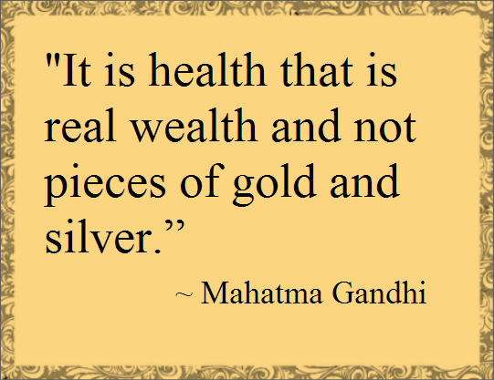

Slide 8
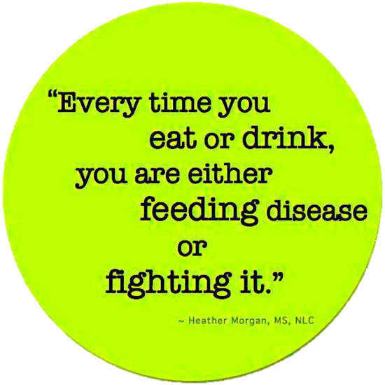

Slide 19
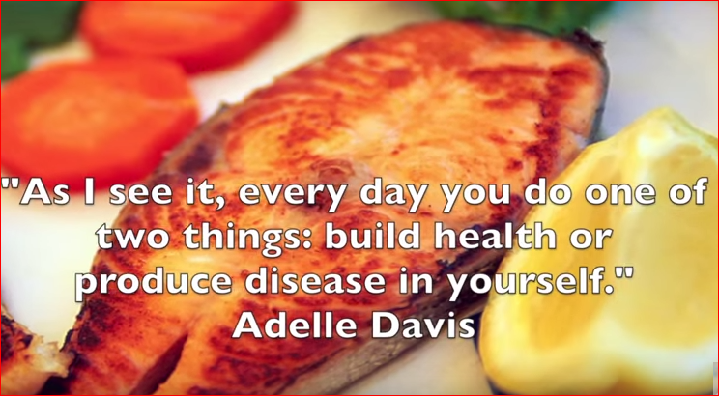

Slide 22
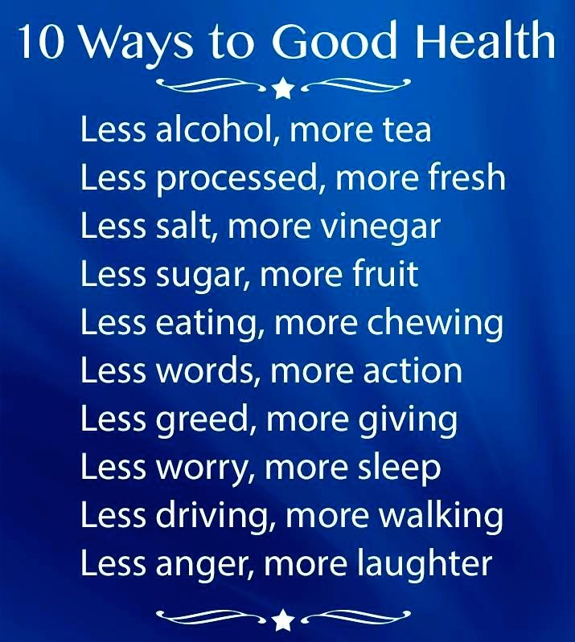

Slide 25
Источник
http://www.oye.global/beta/wp-content/uploads/Chose-Health-trimmed.jpg
http://rosiebank.com/wp-content/uploads/2014/12/Health-quote-1.jpg
http://www.relatably.com/q/img/health-quotes/hope-and-health-picture-quote.jpg
https://s-media-cache-ak0.pinimg.com/736x/ba/b3/58/bab358da8d7d72e9b1784e15accfdf7a.jpg
http://impfashion.com/wp-content/uploads/2014/01/Health-Quotes.jpg
http://impfashion.com/wp-content/uploads/2014/01/Health-Quotes-9.jpg
http://www.goodfoodmama.com/wp-content/uploads/2014/03/Quotation-Joel-Fuhrman-living-health-Meetville-Quotes-257949.jpg
http://www.knowledgeoverflow.com/wp-content/uploads/2013/08/health.png
http://4.bp.blogspot.com/-VxMlTJgV4sQ/UAPmB4E6IhI/AAAAAAAAAcU/Zf9epfkFqJg/s1600/health-quotes-sayings.jpg
https://s-media-cache-ak0.pinimg.com/736x/22/2d/79/222d79890c096606d1290b5ddae46d42.jpg
http://www.brainyquote.com/photos/t/thomasdekker204715.jpg
http://commentsmeme.com/wp-content/uploads/2014/03/Health-Quotes-15.jpg
http://www.sagewoodwellness.com/wp-content/uploads/2015/02/Health-Wellness-Quotes-Best-6-Doctors-Sagewood-Wellness-Center.jpg
http://www.webmastergrade.com/wp-content/uploads/2015/04/Good-Health.jpg
http://media.braintrainingtools.org/wp-content/uploads/2015/08/health-quotes-many-die-of-eating.jpg
http://www.thequotepedia.com/images/58/the-secret-of-health-for-both-mind-and-body-is-not-to-mourn-for-the-past-health-quote.jpg
https://www.youtube.com/watch?v=Mo4gz7OnAWc
http://www.brainyquote.com/photos/f/franklinpierceadams158165.jpg

