Slide 1
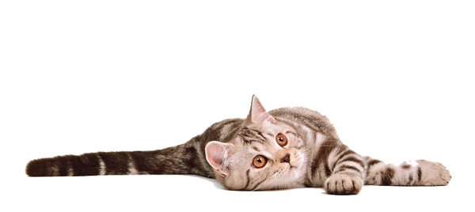
Lesley Anne Ivory
and her Cats
Cats’ Horoscope Guide
Автор:
Ольга Михайловна Степанова
учитель английского языка
МБОУ «Цивильская СОШ №1
имени Героя Советского Союза М.В. Силантьева»
города Цивильск Чувашской Республики
2016

Slide 2
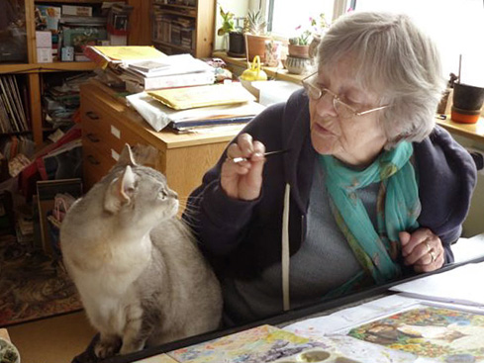
One of Britain's most beloved wildlife artists, Lesley Anne Ivory and her imaginative feline artwork are phenomenally popular the world over. Her artwork graces calendars, greeting cards, and ceramics.
Lesley has illustrated more than 40 children's books, and her wildlife wood engravings were exhibited at the Summer Exhibition of the Royal Academy for a consecutive decade.
Lesley's predominately watercolor and gouache artwork is heavily influenced by her love of pattern - from Indian and Persian tapestry and design to the mosaics and friezes of antiquity. For Lesley, cats are handsome, consoling, and magical."

Slide 3
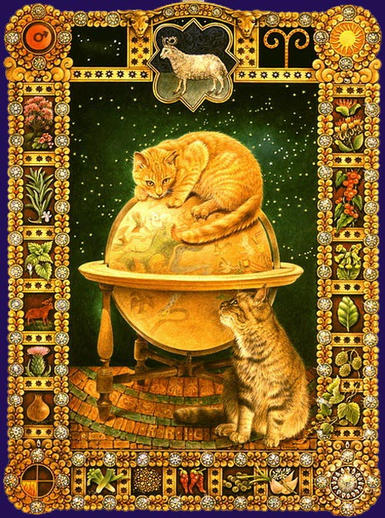
Aries
(March 21 - April 19)
Active Aries kitties love to chase and stalk prey, fired up by that go-go-go Aries energy. Naturally aggressive, Aries cats ain't the cuddling type -- but they will show affection by delivering you little "gifts" they've chased down. Reward them with some extra attention and playtime, and they may get so tuckered out they'll actually sit on your lap for a spell!

Slide 4
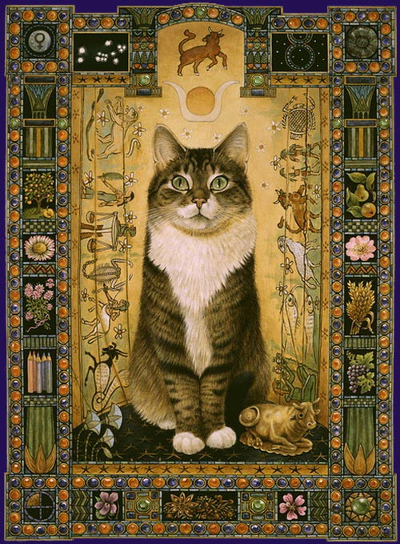
Taurus
(April 20 - May 20)
This kitty sure can haz cheeseburger! Pleasure loving Taurus cats are all about being indulged. They'll eat every bit of kibble you put out -- the stinky, wet kind is best -- and then they'll beg for your human scraps, too. When and if your Taurus kitty is full, they'll plop their chubby little bodies on your lap for a purring and petting session that won't be over until they meow it's over, which might be never. Rub their full tummies, they'll love it!

Slide 5
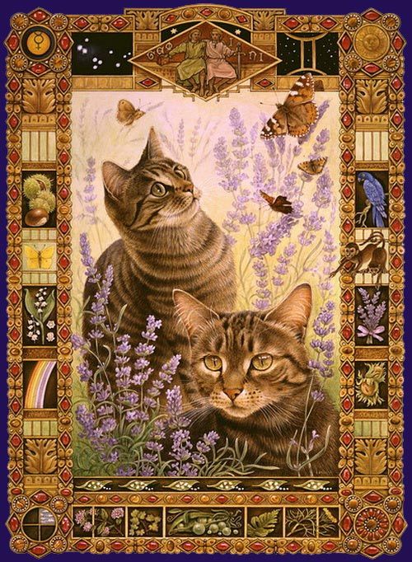
Gemini
(May 21 - June 20)
This kitty sure can haz cheeseburger! Pleasure loving Taurus cats are all about being indulged. They'll eat every bit of kibble you put out -- the stinky, wet kind is best -- and then they'll beg for your human scraps, too. When and if your Taurus kitty is full, they'll plop their chubby little bodies on your lap for a purring and petting session that won't be over until they meow it's over, which might be never. Rub their full tummies, they'll love it!

Slide 6
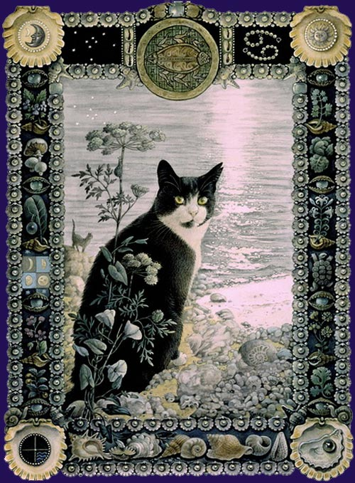
Cancer
(June 21 - July 22)
This kitty sure can has cheeseburger! Pleasure loving Taurus cats are all about being indulged. They'll eat every bit of kibble you put out -- the stinky, wet kind is best -- and then they'll beg for your human scraps, too. When and if your Taurus kitty is full, they'll plop their chubby little bodies on your lap for a purring and petting session that won't be over until they meow it's over, which might be never. Rub their full tummies, they'll love it!

Slide 7
Leo
(July 23 - Aug. 22)
I am kitty, hear me roar! Your loving little Leos are the most attention demanding cats of the zodiac, and as such they need to be pampered and lavished with lots of love and toys or they will turn on you fast. Living with a Leo cat is highly dramatic -- they'll prance around the house looking for attention, and the rest of the time they'll lounge about waiting for you to turn up to serve them like royalty. And if you don't pay enough attention, watch out -- little Leo will punish you by peeing on the bed or clawing your new sofa. Then you'll be the one roaring!

Slide 8
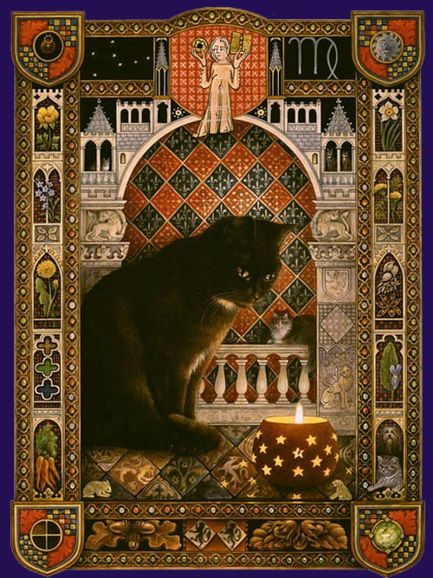
Virgo
(Aug. 23 - Sept. 22)
Cats who are finnicky are most likely Virgos, and you've got your hands full trying to please them. If you don't, they'll wimper and bite and hiss to let you know they're mad. But it's actually not that difficult to make a Virgo kitty happy. Just be sure to buy their favorite food every time, and keep their litter box and dishes clean. They'll reward you by doing the same -- they're very tidy eaters and love to keep themselves clean -- so if you like a tidy home then Virgo cat's for you!

Slide 9
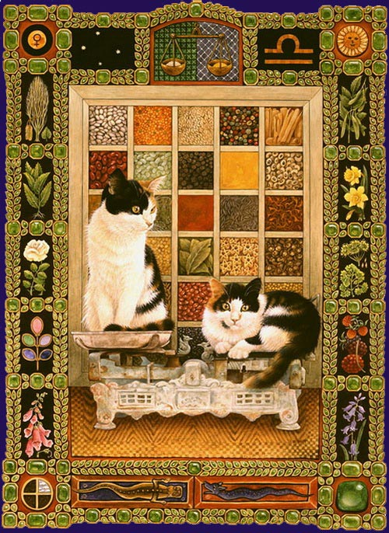
Libra
(Sept. 23 - Oct. 22)
Hello, pretty kitty! Ruled by Venus, planet of beauty, your Libra kitty likely has the prettiest eyes and gorgeous, silkly fur. Libra kitty will spend lots of time preening, and even more time socializing -- so be sure your Libra kitty isn't an only cat. Libra kitties need companionship, so adopt another cat (preferably a compatible Gemini kitty) that can keep them company as they play, wrestle and preen each other when you're not home. And when you are home, go ahead and invite lots of people over. Libra kitty will greet them all, and loves the attention from your guests.

Slide 10
Scorpio
(Oct. 23 - Nov. 21)
You know that black cat that shows up on Halloween, following the witch and sneaking around in the night? That's your typical dark, mysterious Scorpio cat, for sure. Scorpio kitty is intense -- unpredictable and vengeful, especially if you make them jealous by petting another cat. Scorpio kitty can be full of love one minute, then quick to hiss the next -- and sometimes you won't even know why. Secretive Scorpio cats love to hide from you when you call almost as much as they love hiding things from you -- like burying a dead mouse in the back of your closet or stealing your keys so you can't leave them alone at home.

Slide 11
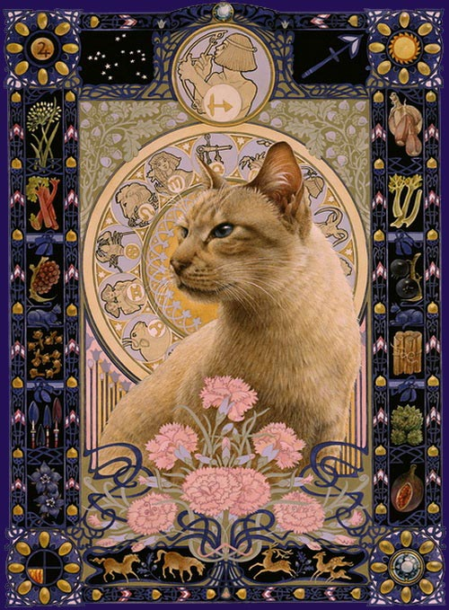
Sagittarius
(Nov. 22 - Dec. 21)
You know those cats who disappear for days, then turn up again looking slightly worse for the wear? That's your typical Sagittarius adventure cat, always wandering around looking for excitement. Sag kitties love to roam and explore, even if it puts them in harm's way -- so perhaps finding a safe outdoor enclosure for your kitty would be the best compromise for their sense of adventure and safety. It'll also help keep your house cleaner, as Sagittarius cats are known for recklessly knocking things over and leaving a mess of toys in their wake.

Slide 12
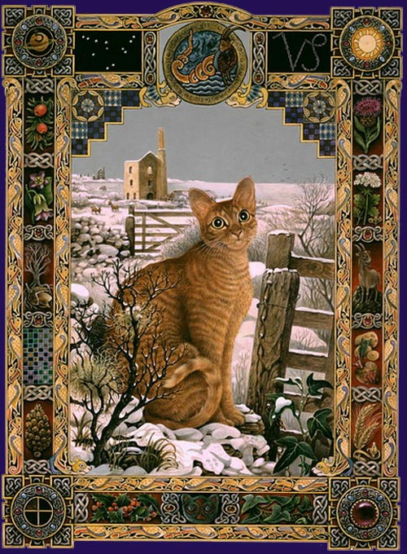
Capricorn
(Dec. 22 - Jan. 19)
Capricorn kitty knows
who's boss. Shy and serious, your Cap cat will express devotion to you and demand the same in return. Capricats won't take no for an answer, either. They are diligent and determined to achieve their goals, so if
you lock them out of the bedroom at night and they want to get in, you can expect to hear yowling and scratching at the door all night until you cave to their demands. And you will, cuz Cap kitty is persuasive like that.

Slide 13
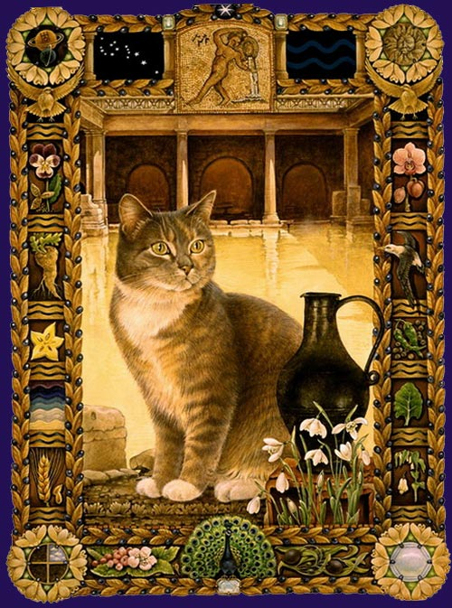
Aquarius
(Jan. 20 - Feb. 18)
Got yourself a quirky cat? You know, one of those crazy furballs who's always getting tangled up in things or who has a strange taste for food that no other cat would eat? Well your kitty is probably an Aquarius, and all those crazy adventures are driven by Aquakitty's combination of intelligence, independence and eccentricity. Aquarian cats can't stand to feel bored, so you'll want to keep them entertained. If you don't, their natural curiosity could lead to trouble -- um, you know what they say about curiosity and cats. Instead, try teaching them tricks, like how to fetch or jump on command. People say you can't herd cats, but you could if they were all Aquarian.

Slide 14
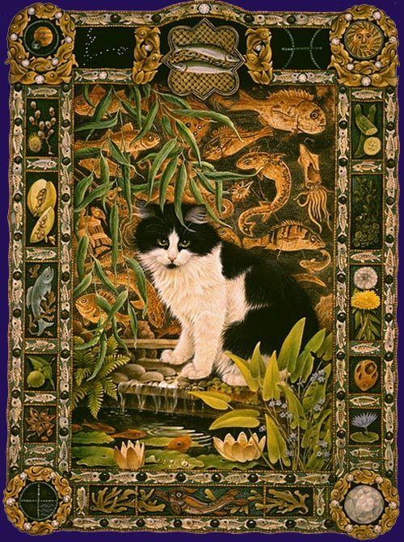
Pisces
(Feb. 19 - March 20)
Imaginative Pisces cats are
an owner's dream!
Affectionate and happy, Pisces cats are usually a calm and peaceful influence in any household. They don't demand too much attention because they have a vast internal world to keep them amused at all times, and they love to sleep a lot so they can chase mice and bugs in their dreams. Pisces cats also have the most psychic abilities, so when you're having a rough day your Pisces kitty will intuitively understand and give you a great big love cuddle until you feel better.

Slide 15
Source
http://www.dailyhoroscope.com/horoscope-headlines/astrology-pets-cats-horoscope-signs
http://img00.deviantart.net/f51e/i/2012/171/0/f/png_cat_by_eross_666-d5457c8.png
http://zoocats.ru/?state=british&link=zodiac&dir=space&space=12&image=012.jpg&index=11
http://www.cathappy.net/ivory.htm
http://www.ivorycats.co.uk/web_images/photos/octopussy/lesleyIvorySTUDIOCAT.jpg

