Slide 1
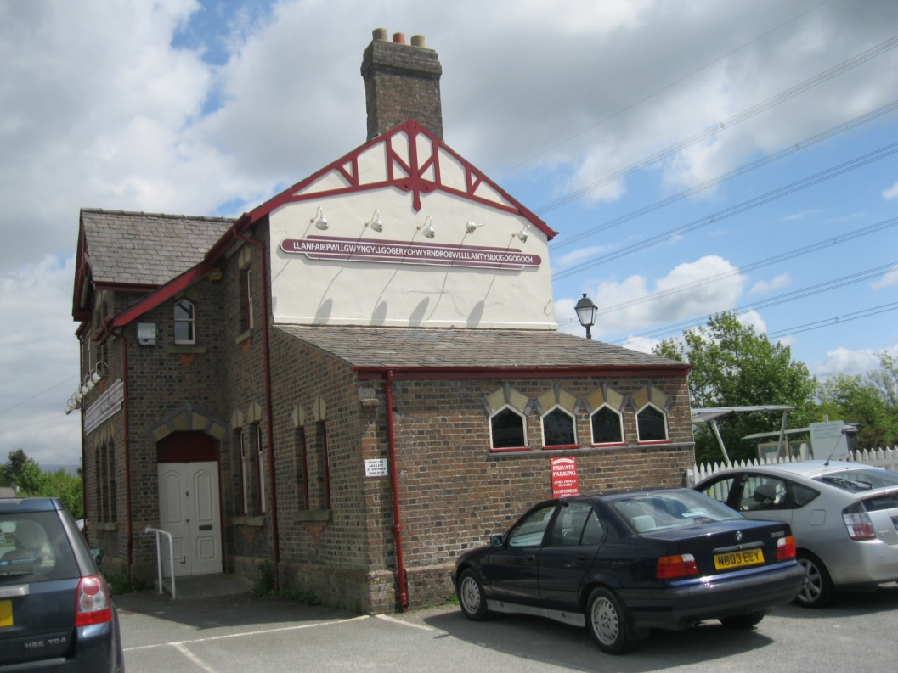
The Longest
Place Name in Wales
Шайдурова Валентина Федоровна
Учитель английского языка
ГБОУ «Школа №106»
Санкт-Петербург
2016
Фотографии автора презентации

Slide 2
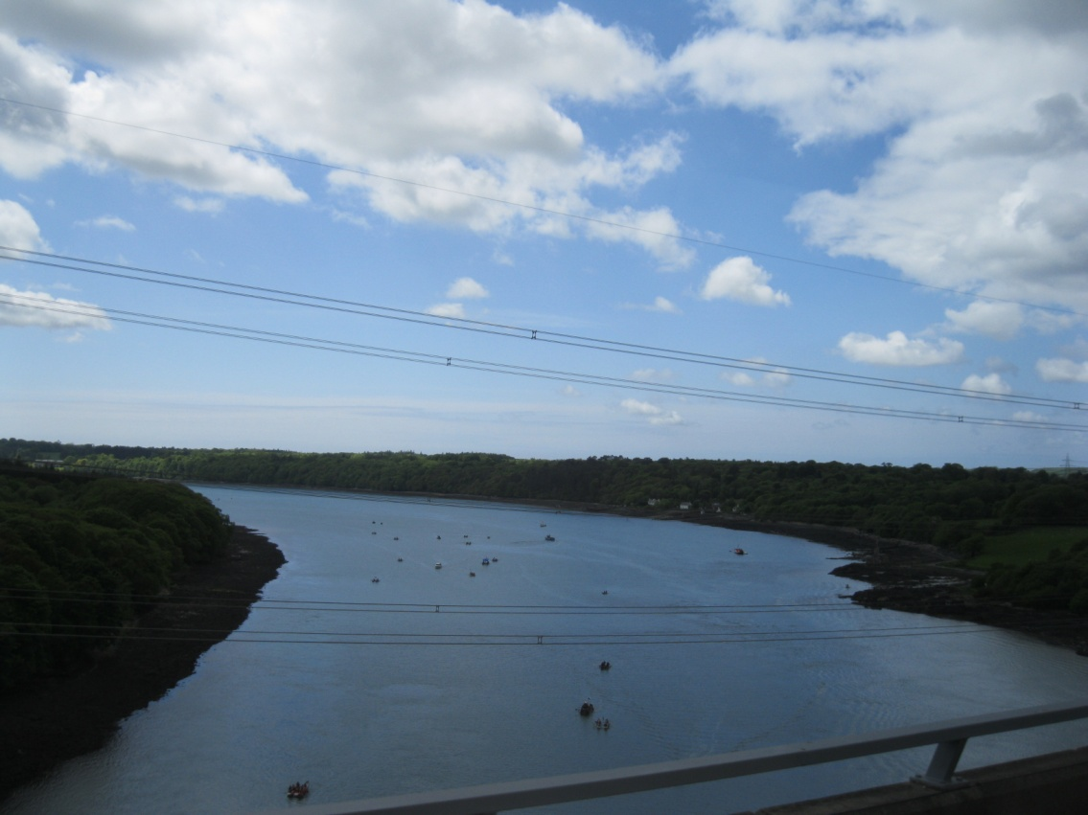
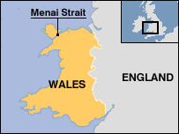
The Menai Strait - the way to Anglesey
“White Knight says to Alice, 'I heard him then, for I had just completed my design. To keep the Menai Bridge from rust. By boiling it in wine.”
Lewis Carrol, Through the Looking Glass

Slide 3
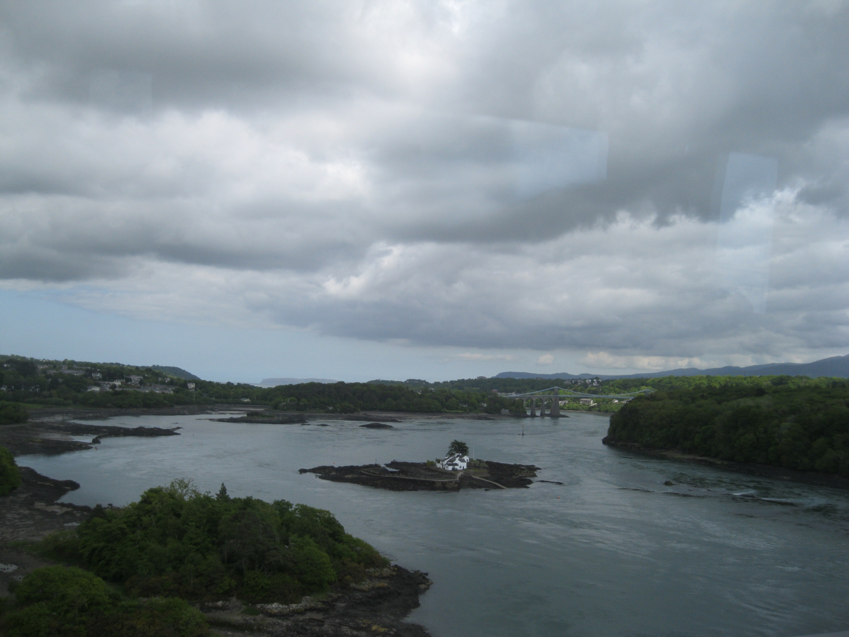
In 1826, Anglesey was connected to the rest of Wales by the construction of the Menai Suspension Bridge by Thomas Telford

Slide 4
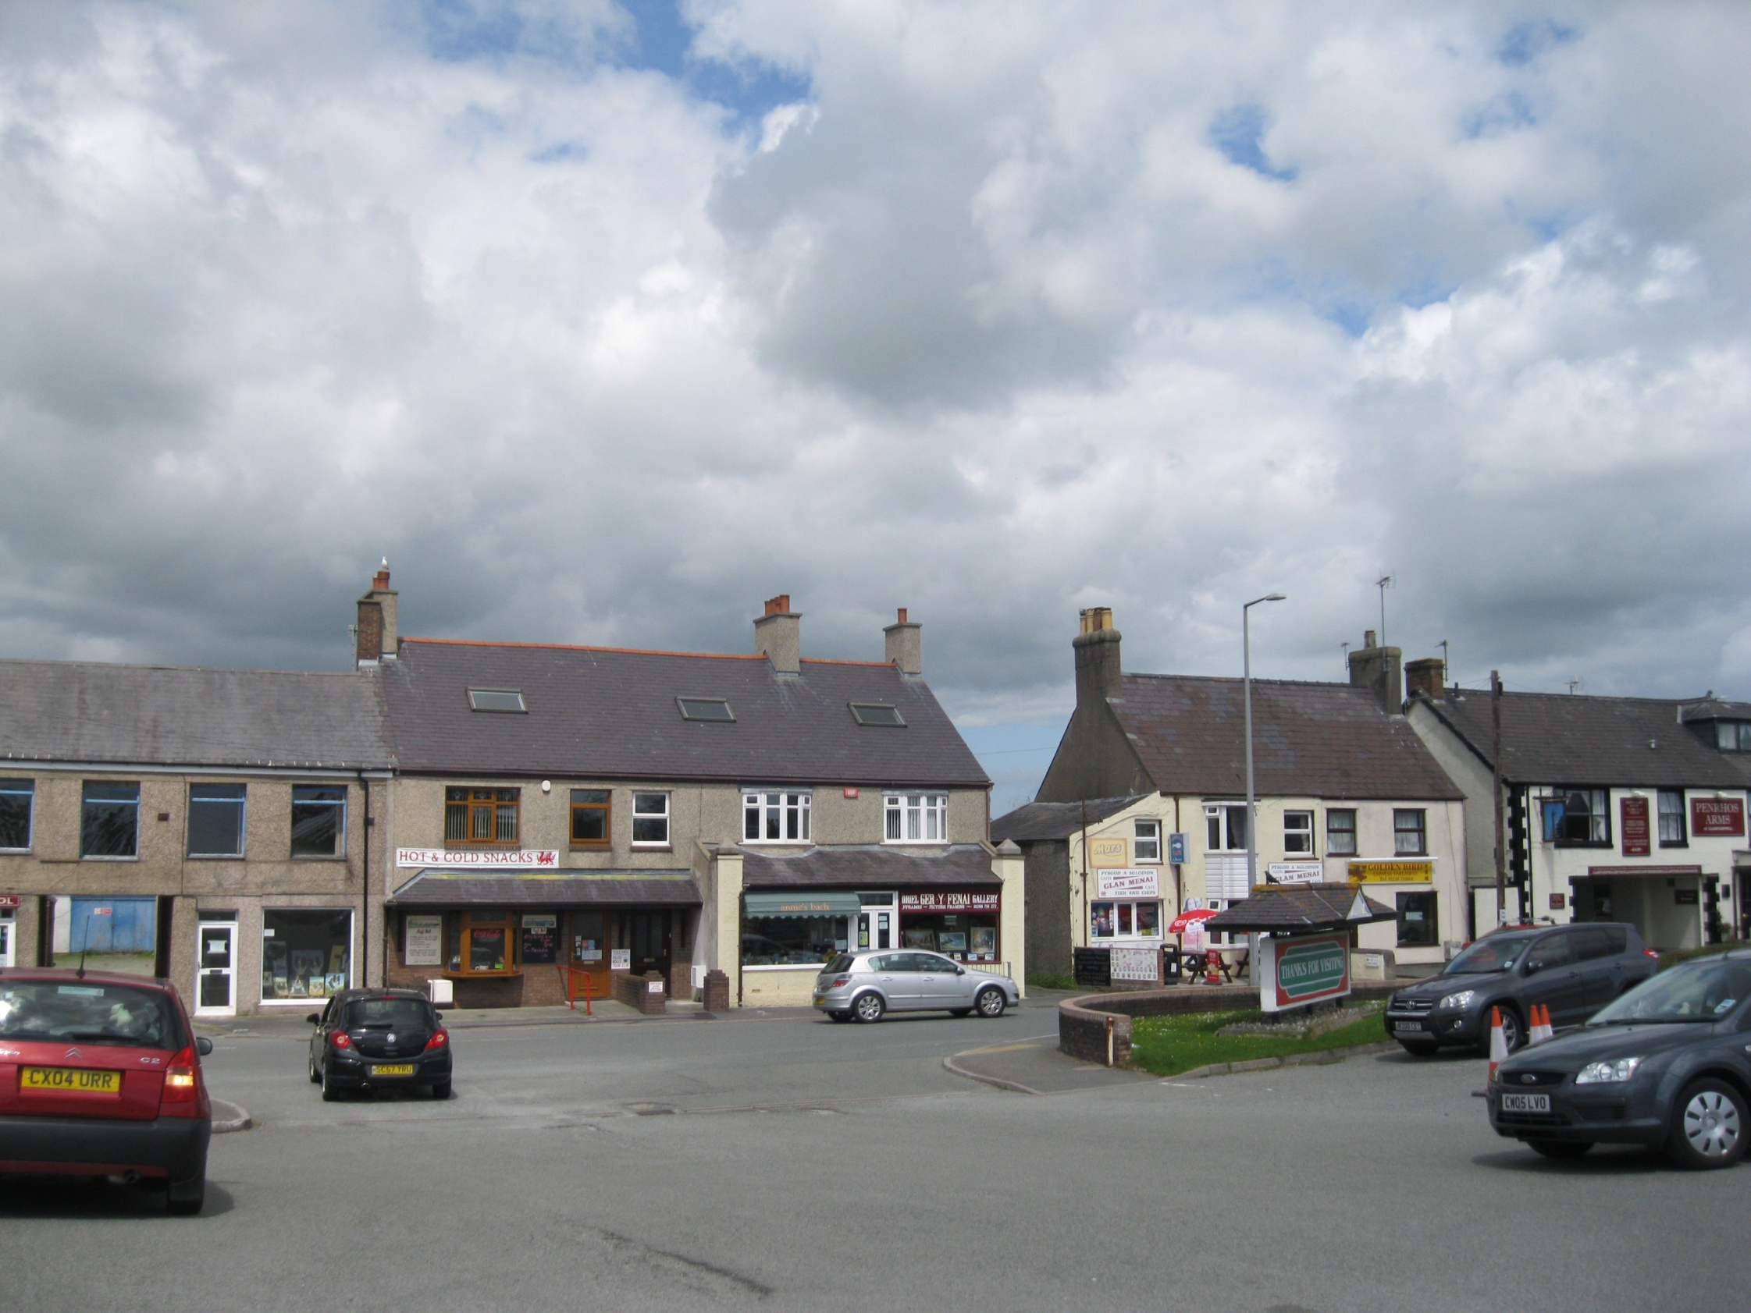
Llanfairpwllgwyngyll or Llanfair Pwllgwyngyll
(pronounced [ɬanˌvair puɬˈɡwɨ̞nɡɨ̞ɬ]) is
a large village on the island of Anglesey in Wales

Slide 5
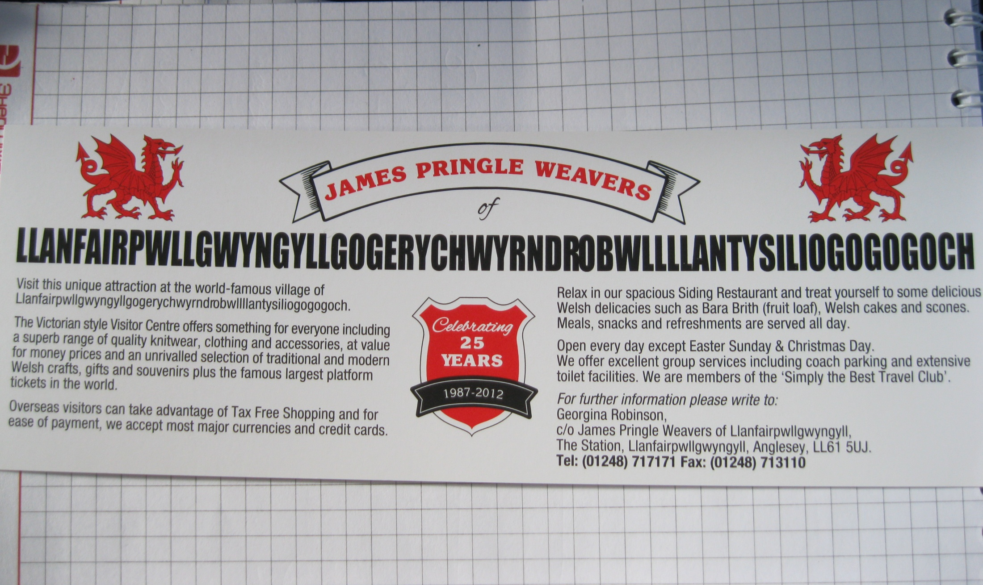
It is known as
Llanfair­pwllgwyngyll­gogery­chwyrn­drobwll­llan­tysilio­gogo­goch.
At 58 letters long,
it is the longest official one-word place name in Europe.

Slide 6
In English it means:
St Mary's Church in the hollow of white hazel near a rapid whirlpool and the Church of St Tysilio near the red cave.

Slide 7
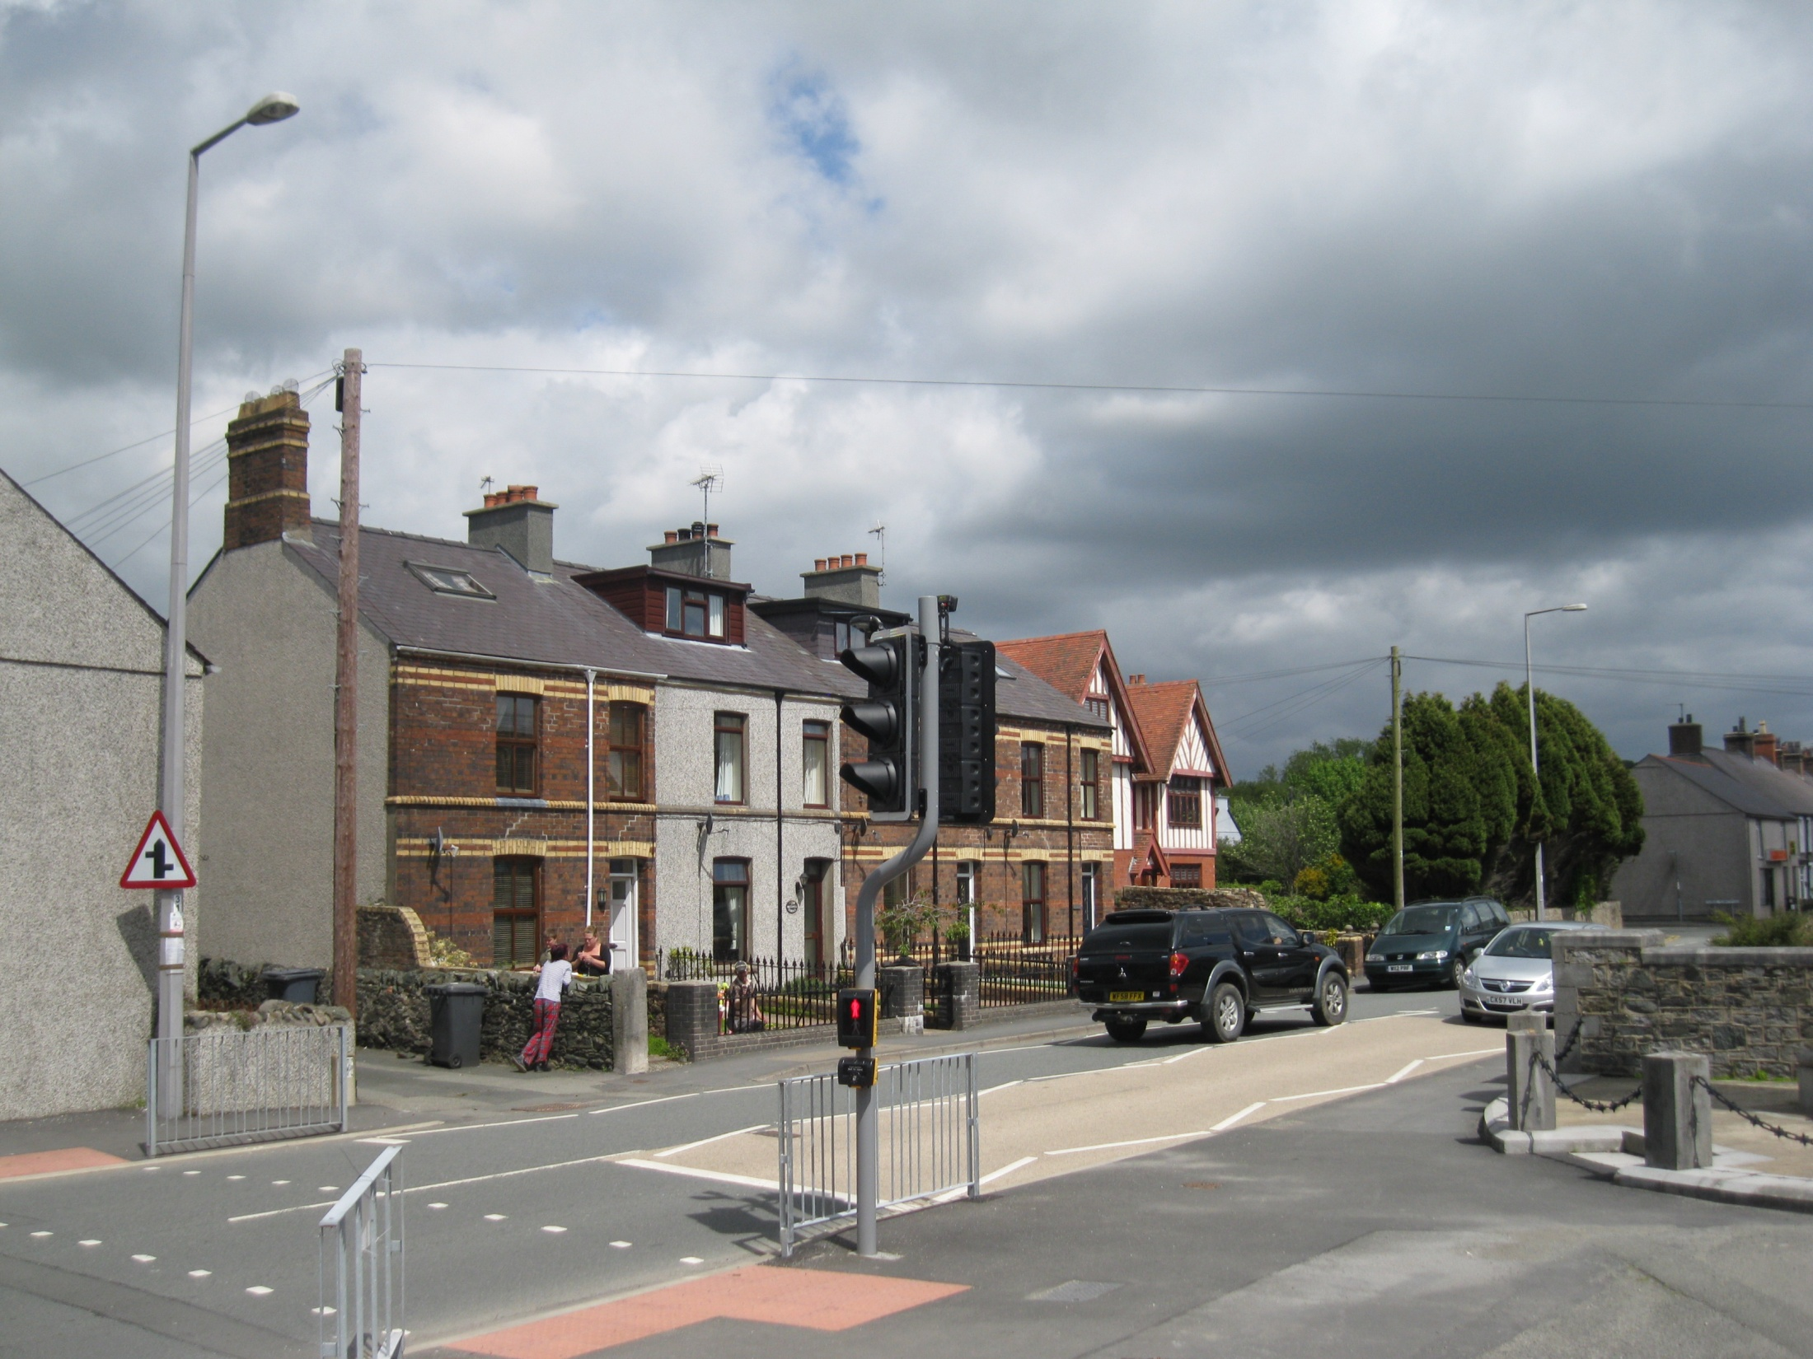
The long name was contrived in the 1860s to bestow upon the station the feature of having the longest name of any railway station in Britain, an early example of a publicity stunt.

Slide 8
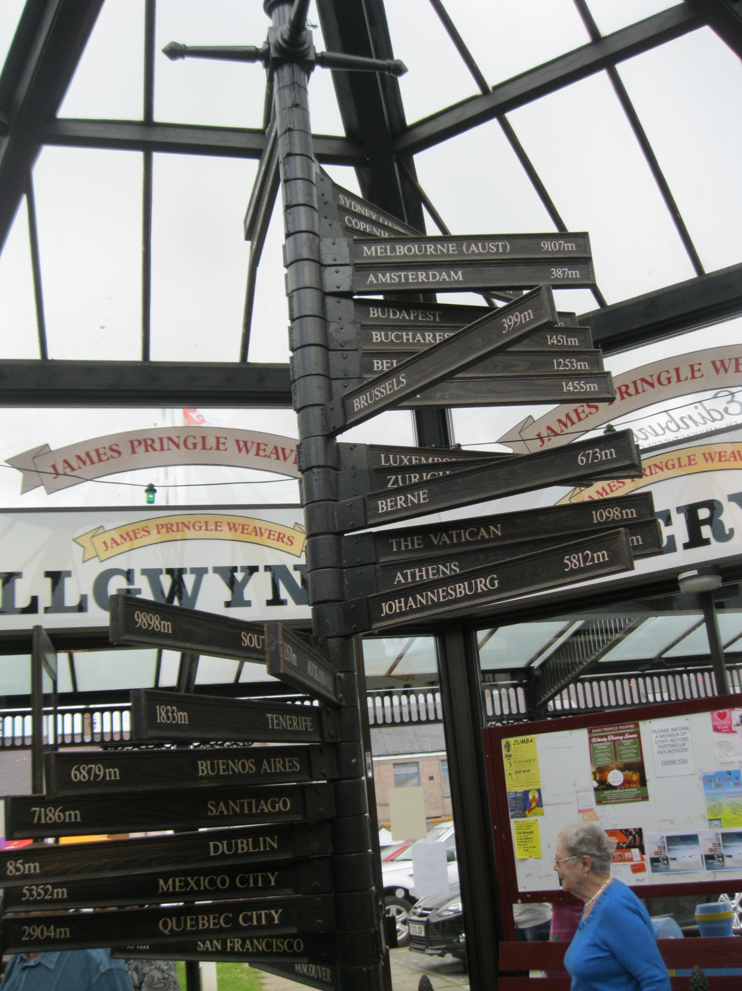

Slide 9
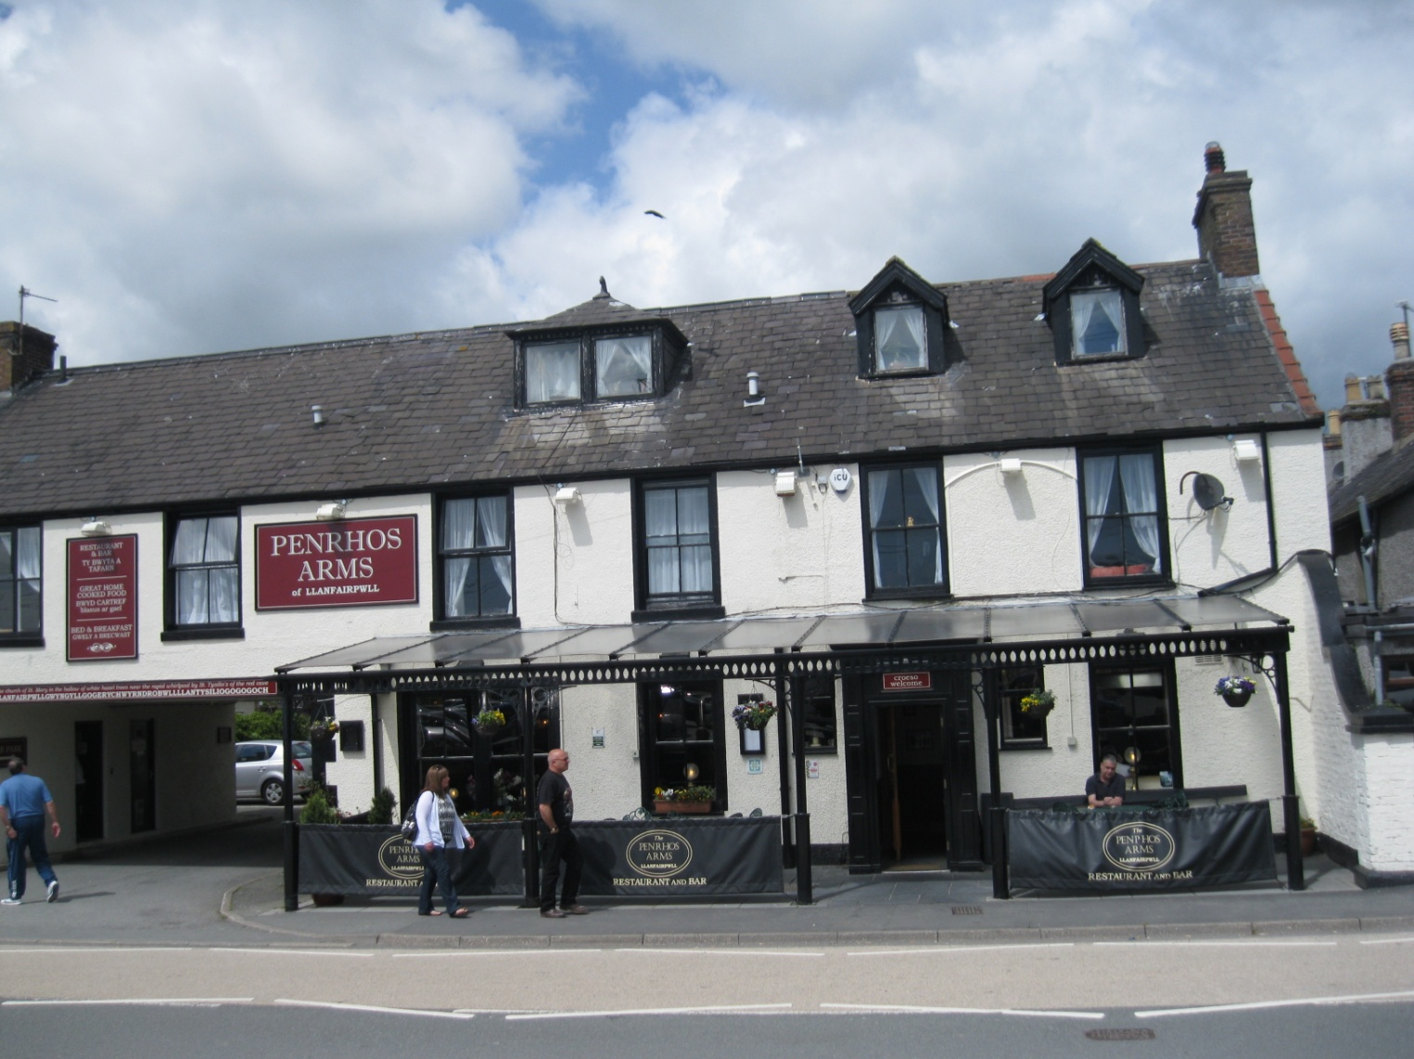
By the time of the 2011 Census the population had increased to 3,107, of whom 70.62% were able to speak Welsh.

Slide 10
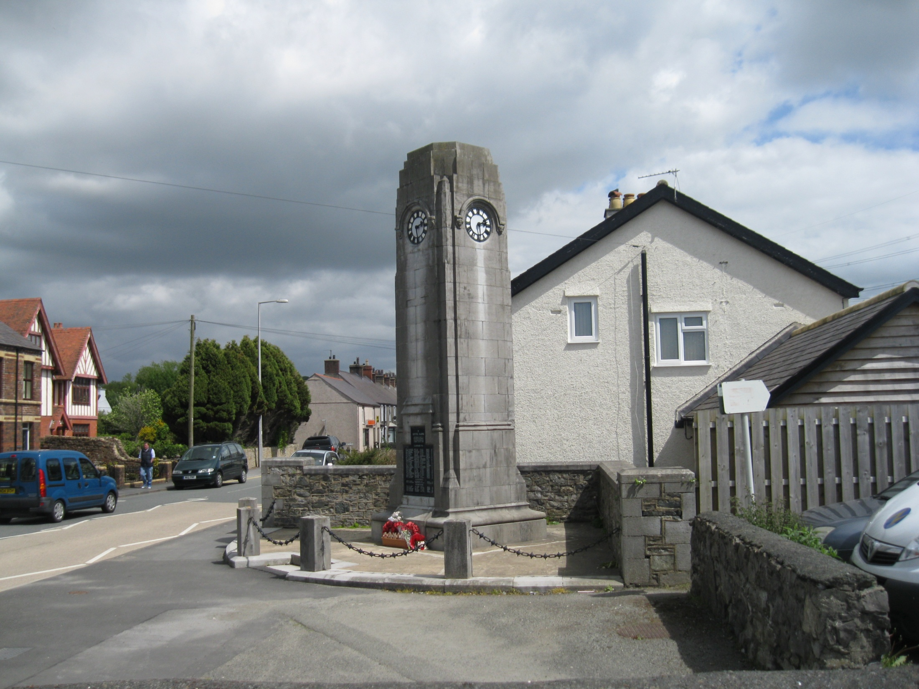
The village is divided into two sections. The upper village has mostly older residences and the lower village has newer commercial buildings and the train station.

Slide 11
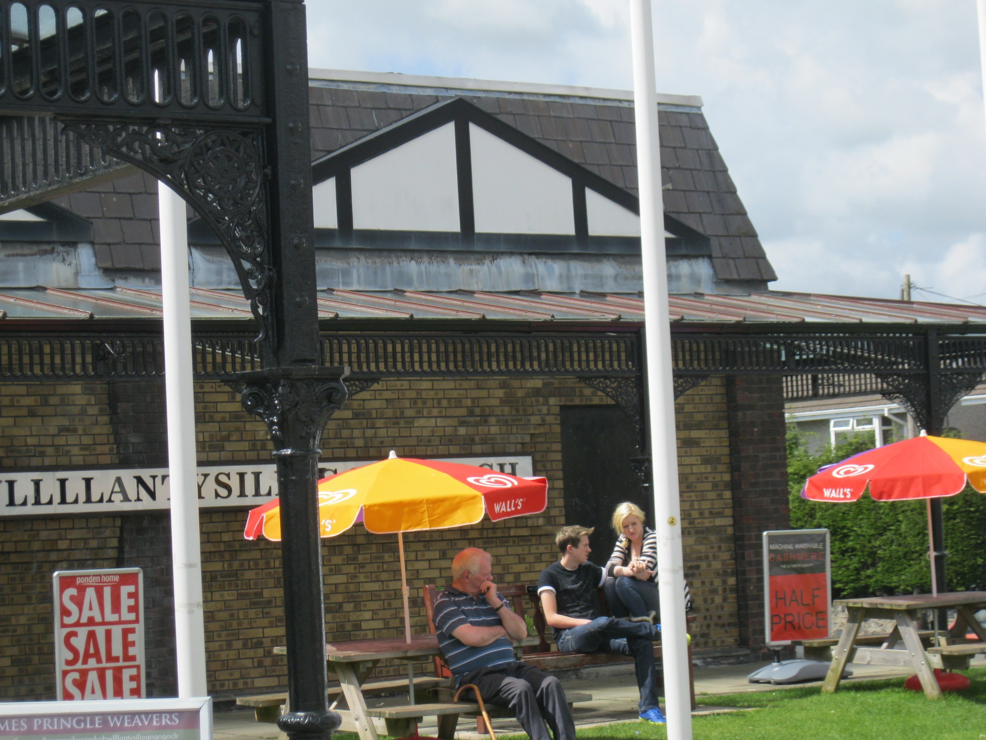

Slide 12
Фотографии автора презентации
http://www.dailymail.co.uk/news/article-3405192/Hotpoint-refuse-deliver-dishwasher-Welsh-village-Britain-s-longest-place-don-t-think-exists.html#ixzz44fa4KuJi
https://en.wikipedia.org/wiki/Llanfairpwllgwyngyll
http://www.anglesey-history.co.uk/places/bridges/
http://wikitravel.org/en/Llanfairpwllgwyngyllgogerychwyrndrobwyllllantysiliogogogoch

