Slide 1
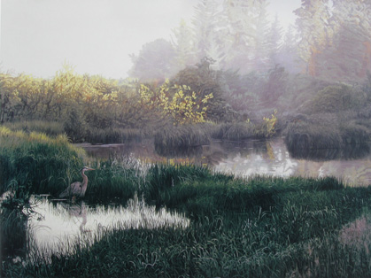
Terry Isaak and his Wild World
Art Gallery
Автор:
Ольга Михайловна Степанова
учитель английского языка
МБОУ «Цивильская СОШ №1
имени Героя Советского Союза М.В. Силантьева»
города Цивильск Чувашской Республики
2016

Slide 2
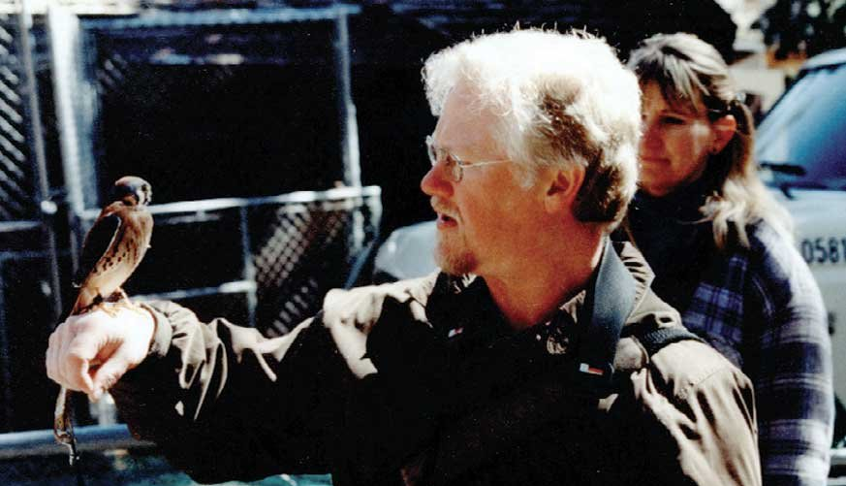
Terry Isaak
“When it is my time to leave this world,
I wish to do so knowing
that I have left paintings that inspire others to appreciate the true wonder and beauty of the natural world.”

Slide 3
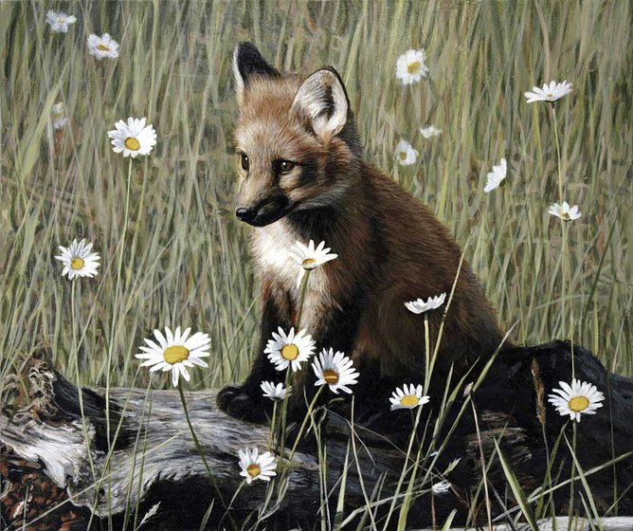
Terry Isaac (born 1958) is an American painter from Salem, Oregon who is known for his realism paintings of wildlife.

Slide 4
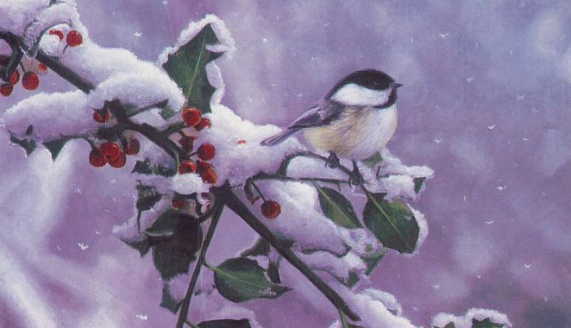
In 2007, he moved to Canada.
Internationally acclaimed wildlife artist, Terry Isaac, grew up in the Willamette Valley of Oregon, and it is there that he began his love affair with wildlife.

Slide 5
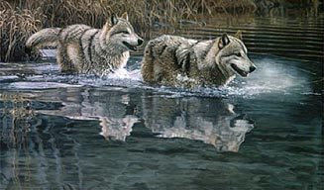
He now calls Penticton, British Columbia, Canada “home” and, since moving, has continued to create paintings capturing unique characteristics of wildlife and their habitat.

Slide 6
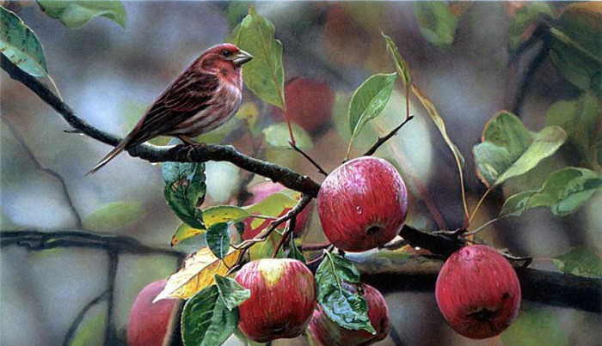
Terry travels around the world to capture exciting images, but his main painting focus continues to be on North American birds and mammals.

Slide 7
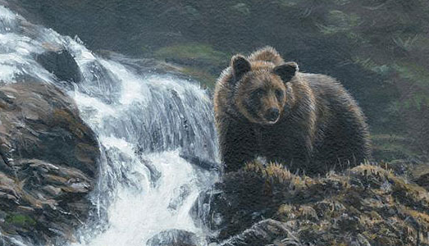
Terry’s formal art began with an interest in animation and drawing cartoons. After art college, he was interested in children’s book illustration but soon re-discovered his childhood passion for wildlife.

Slide 8
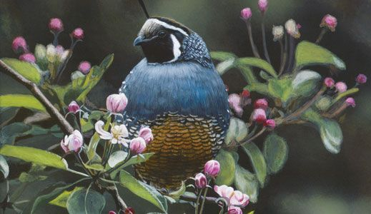
Since the mid 1980’s, he has created realistic wildlife art with a focus on particularity and dramatic light. He is inspired by large panoramas as well as close-up views, and by subjects ranging from whales to hummingbirds.

Slide 9
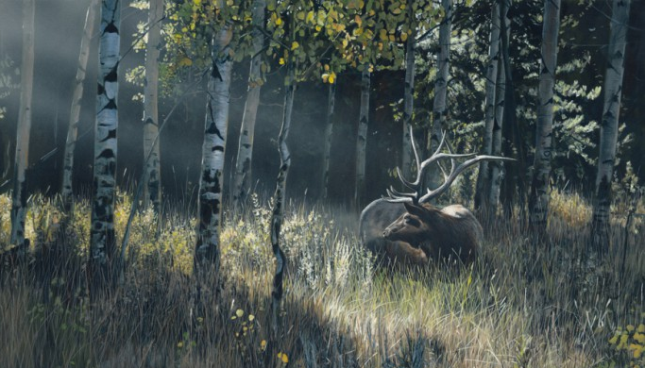
During his successful professional career Terry has been the featured “Artist of the Year” at a number of prestigious art shows/expos, placed in 12 stamp and print competitions, been commissioned to create for the Audubon Society handbooks and hired to develop the main character in a Walt Disney production.

Slide 10
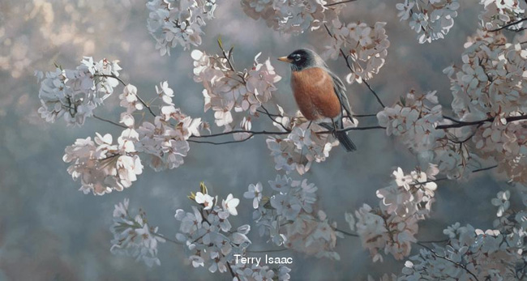
His works are housed in prominent permanent collections such as Leigh Yawkey Woodson Art Museum, Bennington Center For The Arts, American Airlines, First National Bank of South Africa and in many private and corporate collections around the world.

Slide 11
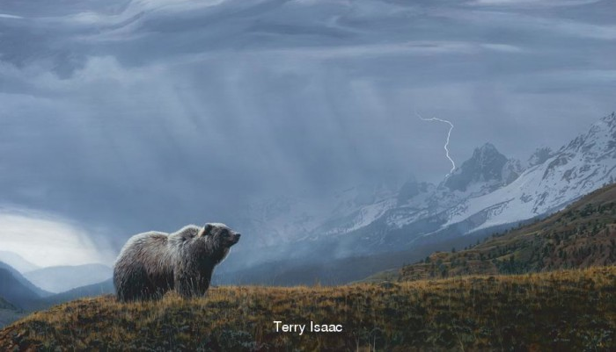
In 1999 he was named Friend of the National Zoo "Artist of the Year" and was named Special Guest Artist at the Southeastern Wildlife Expo in 2000.

Slide 12
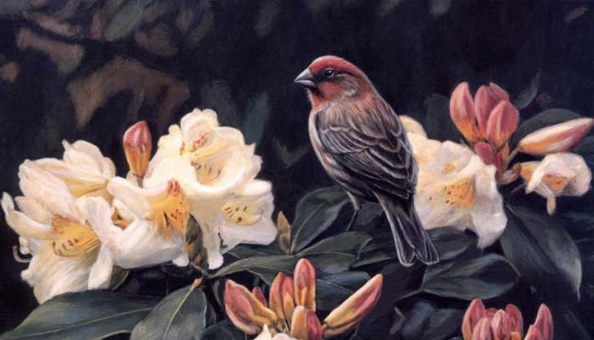
I draw my inspiration from observing nature, always on the look out for “magical moments”. Usually seeing a particular setting is what initially inspires me.
-Isaak Terry

Slide 13
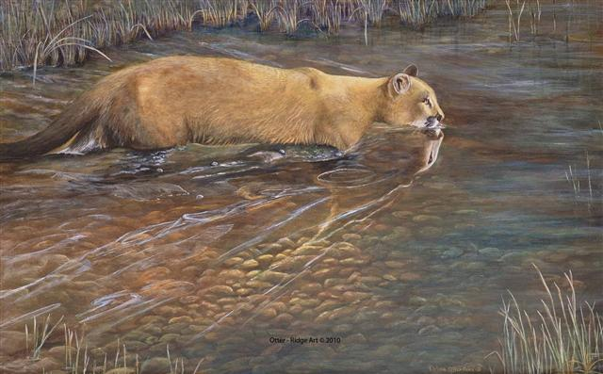
‘I usually paint in my studio during the day, every
day
of the
week.
There are
Times when my painting is not flowing right and I get uncomfortable and feel uncertain,’ he says.

Slide 14
‘I feel incredibly blessed to be able to do something I have such a passion and love for…’

Slide 15
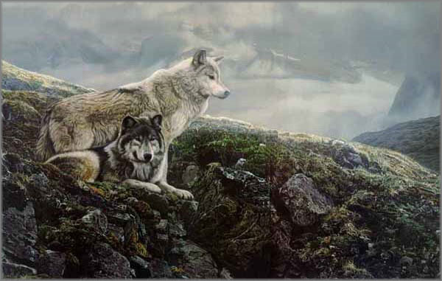
Isaac is also a teacher and his approach to painting is outlined in his own book
Painting the Drama
of Wildlife, Step by Step now
in its second edition.
Terry continues to teach annual workshops, with students attending from all over the world.

Slide 16
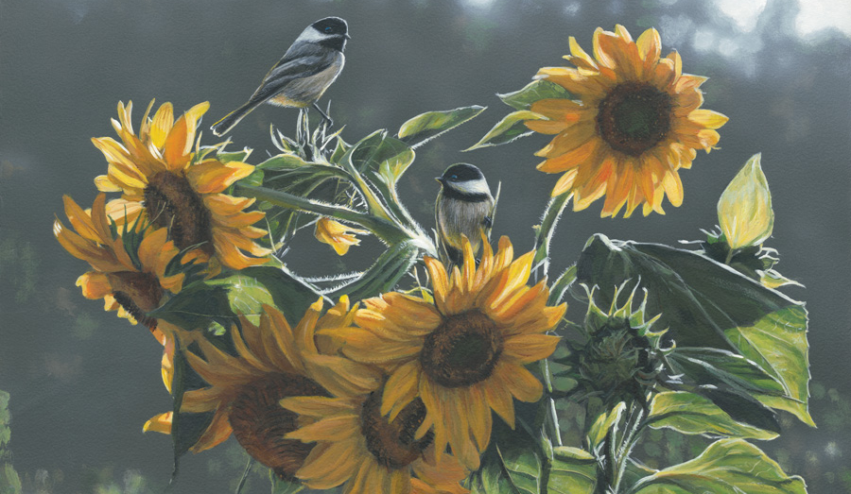
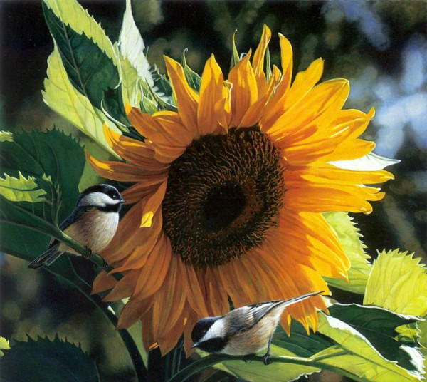
I
currently live
in Penticton, British Columbia, Canada with
my
family.
- Isaak Terry

Slide 18
Source
http://www.terryisaacsart.com/about-terry/artists-statement/
https://en.wikipedia.org/wiki/Terry_Isaac

