Slide 1
Outstanding Memorials
to William Shakespeare
The Gallery of the monuments to William Shakespeare
for the 7th – 11th Formers
Автор:
Ольга Михайловна Степанова
учитель английского языка
МБОУ «Цивильская СОШ №1
имени Героя Советского Союза М.В. Силантьева»
города Цивильск Чувашской Республики
2016

Slide 2
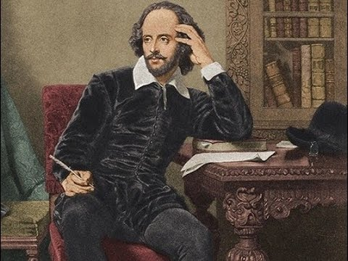
William Shakespeare has
been commemorated in
a number
of different statues
and
memorials around the world.

Slide 3
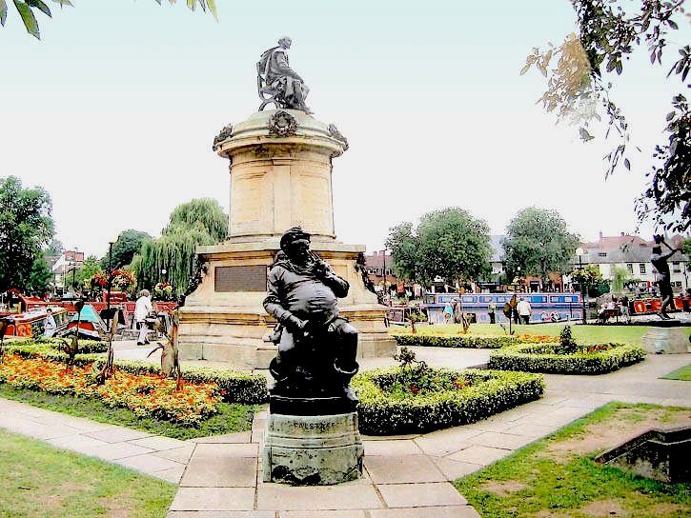
The Shakespeare Memorial by Lord Ronald Gower. Bronze and stone. 1888. Bancroft Gardens, Stratford-upon-Avon. At each corner of the Memorial, the sculptor has placed a representative Shakespearean character: “Hamlet, Prince Hal, Lady Macbeth and Falstaff. These characters were intended to be emblematic of Shakespeare's creative versatility: representing Philosophy, Tragedy, History, and Comedy”

Slide 4
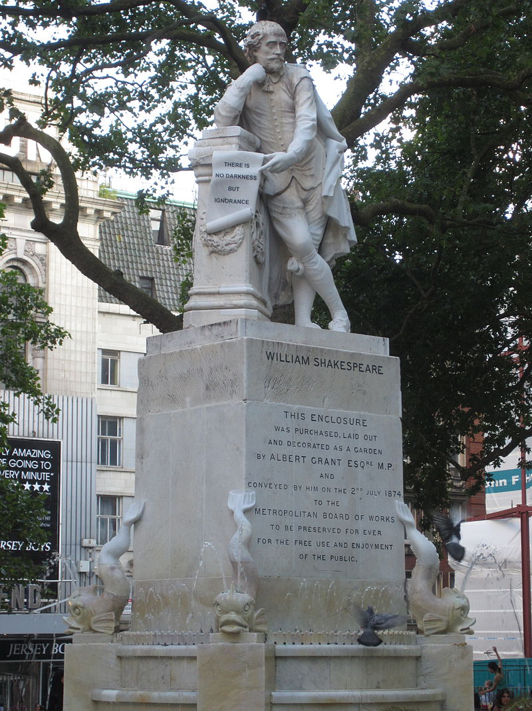
A statue of William Shakespeare, sculpted by Giovanni Fontana after an original by Peter Scheemakers, has formed the centrepiece of Leicester Square Gardens, London, since 1874. The marble figure, copied from Scheemakers' 18th-century monument to Shakespeare in Poets' Corner, Westminster Abbey, stands on a pedestal flanked by dolphins at the centre of a fountain.
The scroll held by Shakespeare is inscribed with a quotation from Twelfth Night THERE IS NO DARKNESS BUT IGNORANCE.

Slide 5
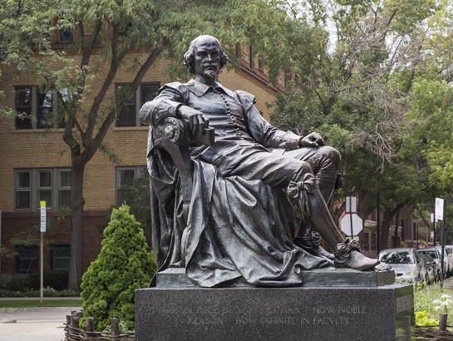
William Shakespeare is fancy and fun—he knows it, the people of Lincoln Park , Chicago where he lives know it, and Jack McBrayer of 30 Rock fame knows it. he watches as the people of Lincoln Park continue to play their parts—young lovers strolling hand-in-hand, children flying kites, and some of the city’s most well-off citizens walking the streets with tiny dogs.

Slide 6
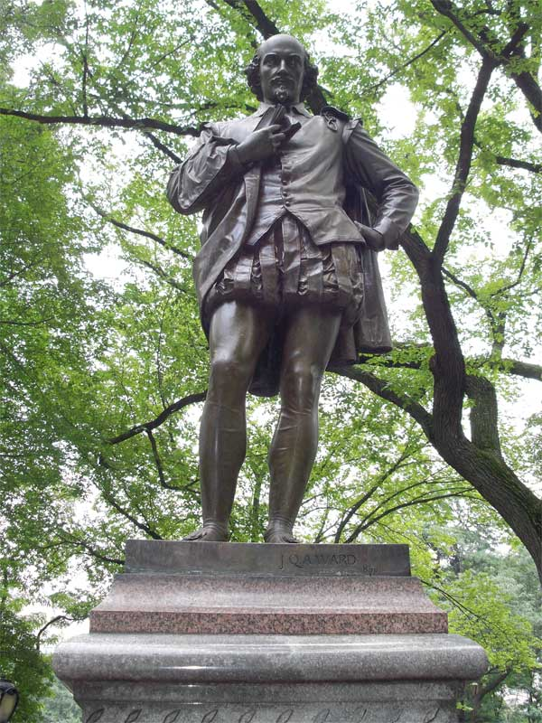
William Shakespeare was the first sculpture of a writer to be placed on the Mall, known informally as Literary Walk, Central Park, New York. The sculpture was donated by the citizens of New York, led by a committee to honor the 300th anniversary of the birth of the poet and dramatist in Stratford-upon-Avon in 1564.

Slide 7
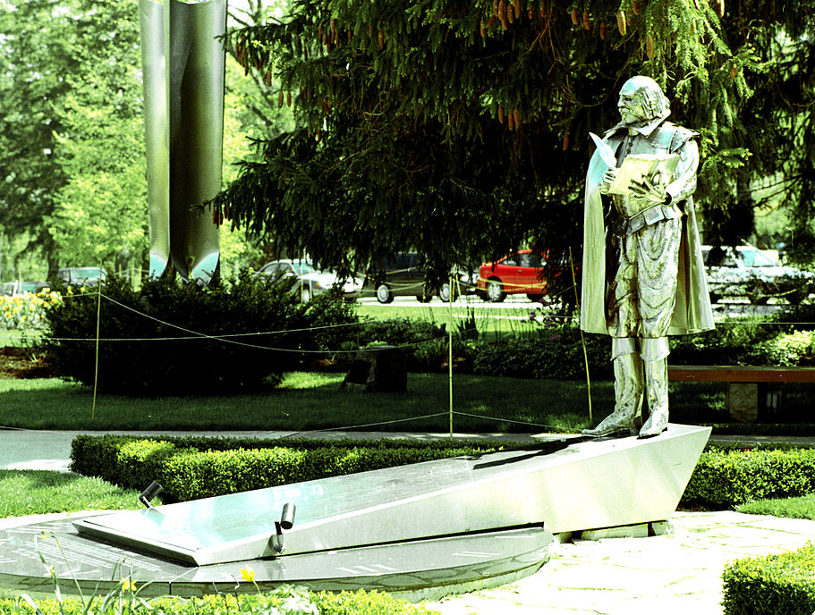
William Shakespeare in aluminum
at the Festival Theatre in Stratford, Ontario.

Slide 8
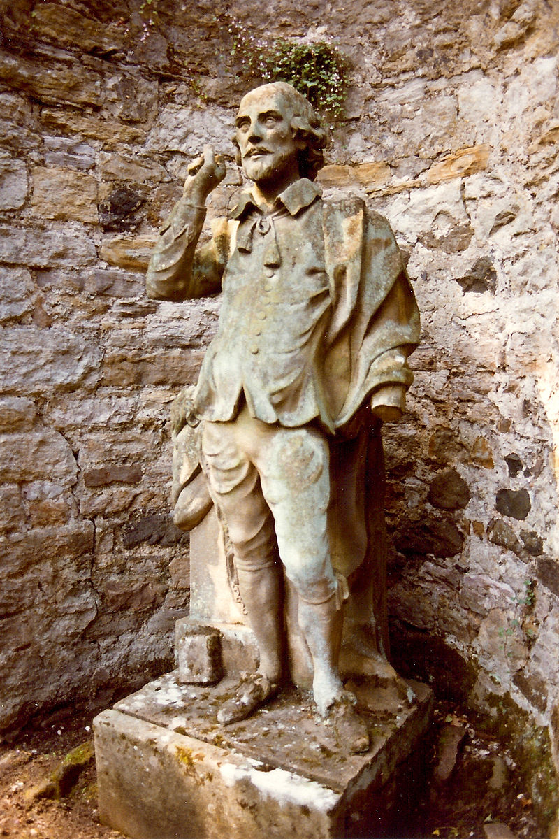
Coade stone statue of William Shakespeare which advocate and writer Lord Henry Cockburn installed in the garden at Bonaly Tower, Edinburgh. It is in a curved recess in the boundary wall at west end of garden. It came from the Theatre Royal at Shakespeare Square at the east end of Princes Street after it was demolished in 1860. It was originally acquired by John Jackson in the 1780s, along with accompanying figures of tragedy and comedy, for the theatre which had its last performance on May 25th. 1859. Photograph taken in the summer of 1981.

Slide 9
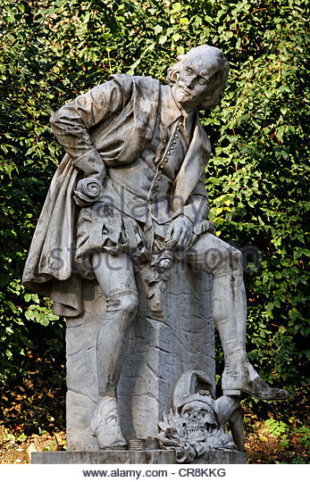
Monument of William Shakespeare, Weimar
Germany
This is the only statue of the English poet on the European mainland. In 1904, the German Shakespeare Association constructed it from a draft of professor Otto Lessing to celebrate the 40th anniversary of the association. It shows Shakespeare with a scroll in his right hand and a rose in his left. Lying at his feet, there are the symbols of his dramas (a skull and dagger) and his comedies (a fool´s cap).

Slide 10
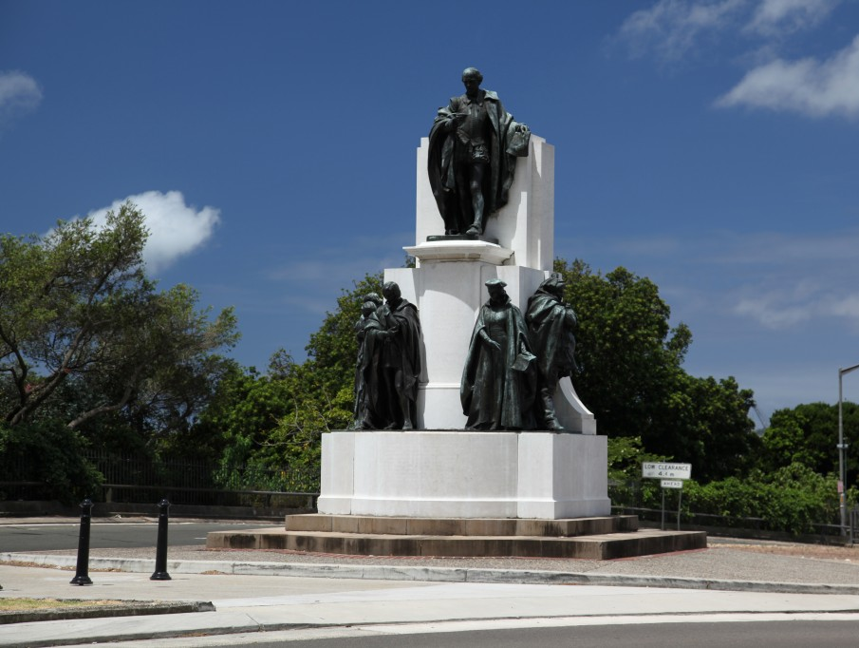
This bronze memorial statue features a life-sized figure of William Shakespeare, who stands with pen in hand at the apex of a supporting marble pedestal. He is surrounded by a selection of characters: Romeo and Juliet, Othello, Portia and Falstaff. Shakespeare Memorial 1926 Sir Edgar Bertram Mackennal - photo City of Sydney, Australia

Slide 11
Breaking News!
Конкурс на создание памятника английскому драматургу Уильяму Шекспиру в Москве объявят во второй половине 2016 года. Об этом сообщил на пресс-конференции в ТАСС специальный представитель президента РФ по международному культурному сотрудничеству Михаил Швыдкой. По словам Швыдкого, возможность установки памятника они обсуждали с британскими коллегами в рамках подготовки перекрестного Года языка и литературы Великобритании и России, который пройдет в 2016 году, и британская сторона не будет против, если проект создадут молодые российские скульпторы. Специальный представитель президента РФ по международному культурному сотрудничеству напомнил, что в Великобритании уже есть памятники Александру Пушкину и
Юрию Гагарину.

Slide 12
Source
https://en.wikipedia.org/wiki/Memorials_to_William_Shakespeare
http://tass.ru/kultura/2532609

