Slide 1
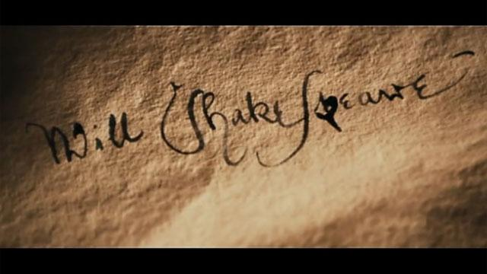
Brundage and Shakespere
Picture Gallery for the 8-11 Grades
Автор:
Ольга Михайловна Степанова
учитель английского языка
МБОУ «Цивильская СОШ №1
имени Героя Советского Союза М.В. Силантьева»
города Цивильск Чувашской Республики
2016

Slide 2
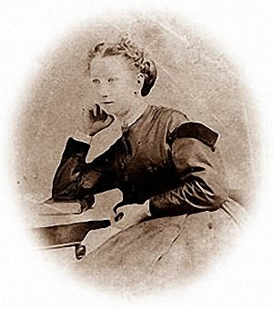
Born | Frances Isabelle Lockwood 1854 Newark, New Jersey
Died | March 28, 1937
Residence | Washington, D.C. Cape Ann, Massachusetts Brooklyn, New York
Nationality | American
Citizenship | American
Frances Isabelle
Brundage

Slide 3
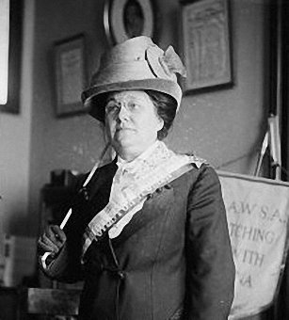
Frances Isabelle Lockwood Brundage was an American illustrator best known for her depictions of attractive and endearing children on postcards, valentines, calendars, and other ephemera published by Raphael Tuck & Sons, Samuel Gabriel Company, and Saalfield Publishing. She received an education in art at an early age from her father, Rembrandt Lockwood.
Her professional career in illustration began at seventeen when her father abandoned his family and she was forced to seek a livelihood.
In addition to ephemera, Brundage illustrated children's classics such as the novels of Louisa May Alcott, Johanna Spyri, and Robert Louis Stevenson, and traditional literary collections such as The Arabian Nights and the stories of King Arthur and Robin Hood. She was a prolific artist, and, in her late 60s, was producing as many as twenty books annually. Her work is highly collectible.

Slide 5
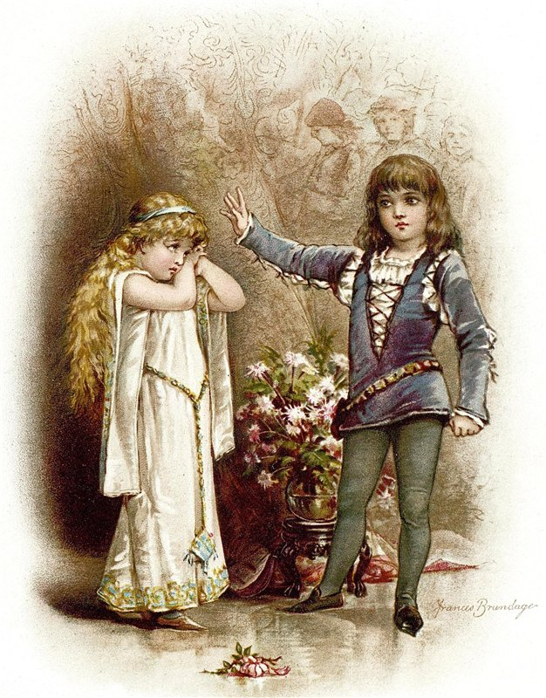
Frances Brundage Hamlet and Ophelia.
Гамлет и Офелия (Гамлет)

Slide 6
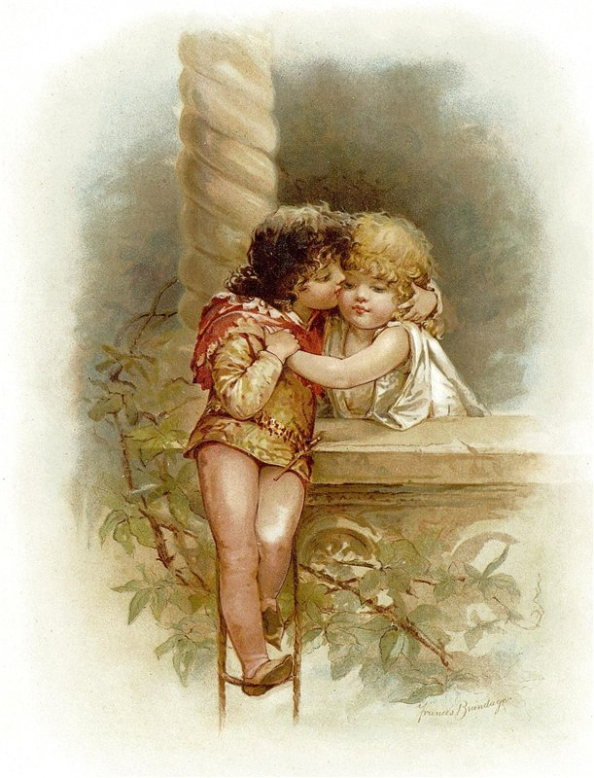
Frances Brundage Romeo and Juliet.
Ромео и Джульетта (Ромео и Джульетта)

Slide 7
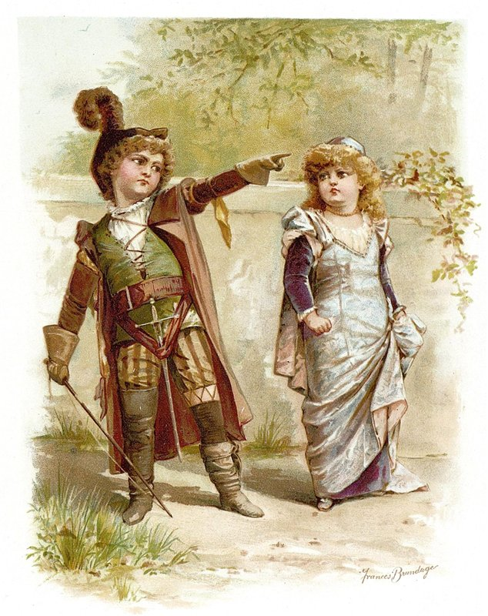
Frances Brundage Petruchio and Katharina.
Петручио и Катарина (Укрощение строптивой)

Slide 8
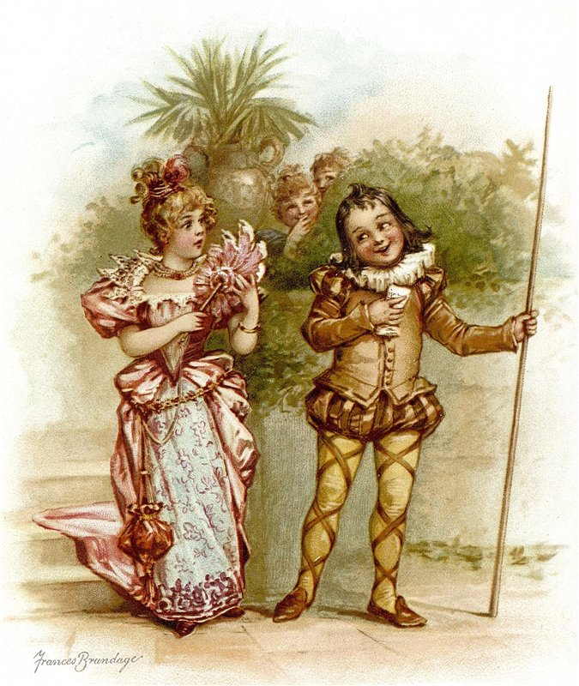
Frances Brundage Olivia and Malvalio.
Оливия и Мальволио (Двенадцатая ночь)

Slide 9
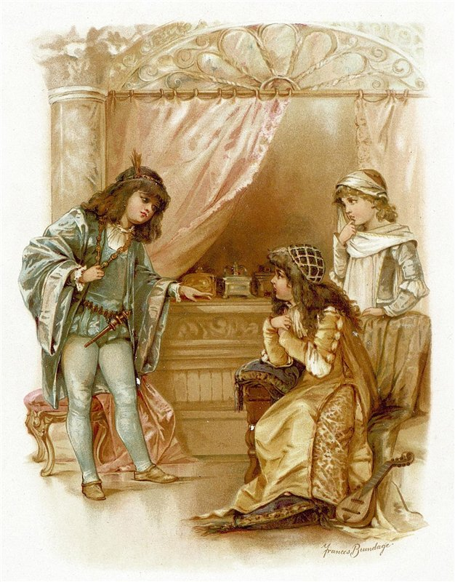
Frances Brundage Choosing the Casket.
Выбор шкатулки (Венецианский купец)

Slide 10
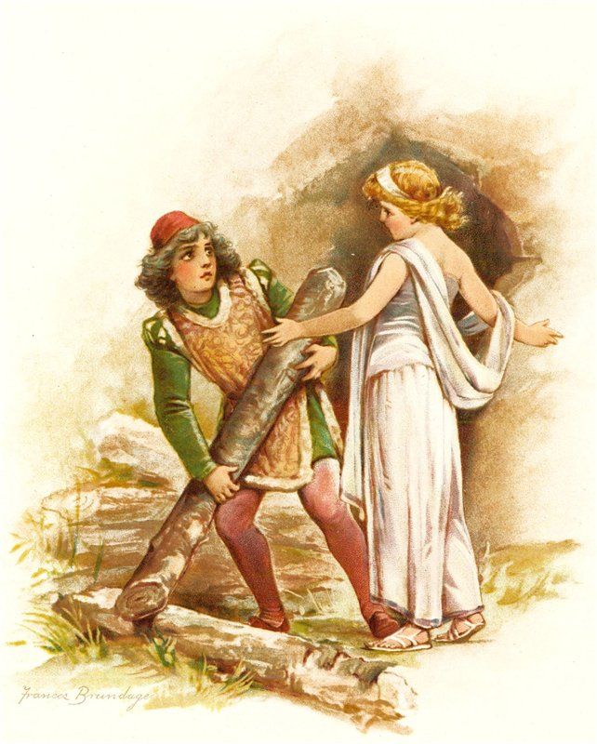
Frances Brundage Ferdinand and Miranda.
Фердинанд и Миранда (Буря)

Slide 11
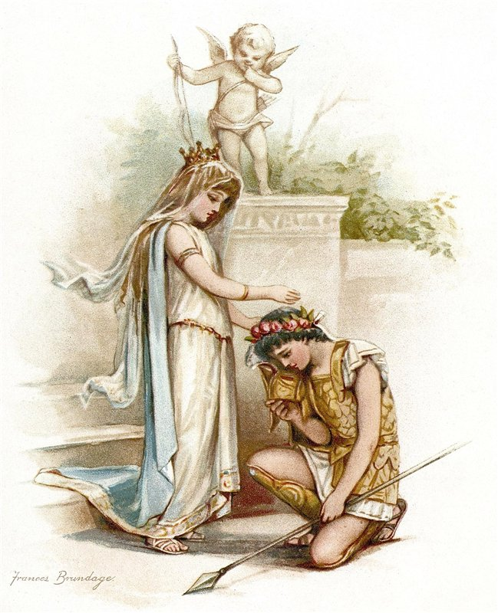
Frances Brundage Princess Thaisa and Pericles.
Принцесса Таиса и Перикл, царь Тирский (Перикл)

Slide 12
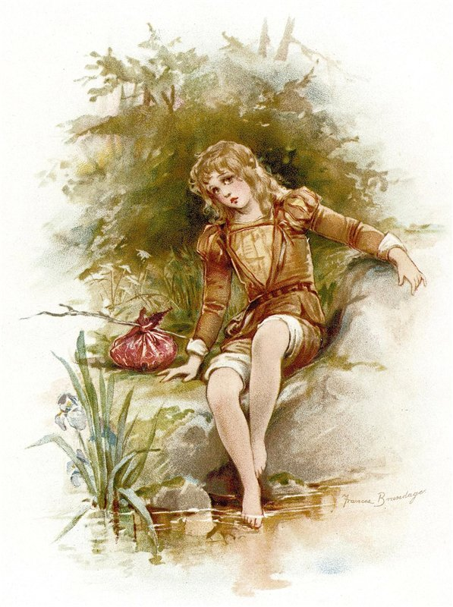
Frances Brundage Imogen
Имогена, дочь короля Британии Цимбелина (Цимбелин)

Slide 13
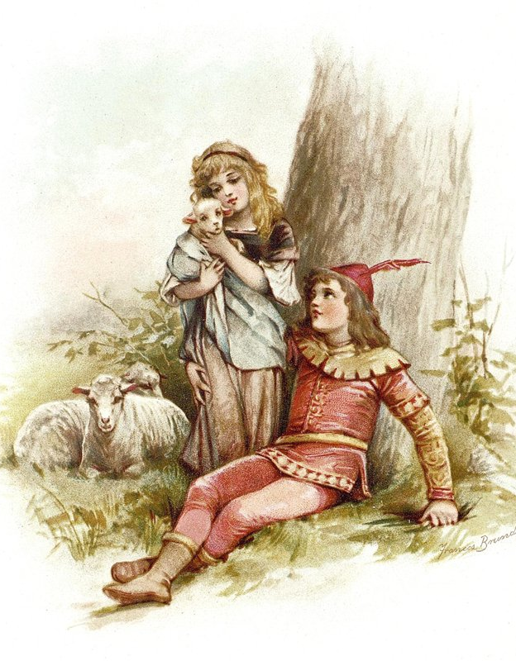
Frances Brundage Prince Florizel and Perdita.
Принц Флоризель и Пердита (Зимняя сказка)

Slide 14
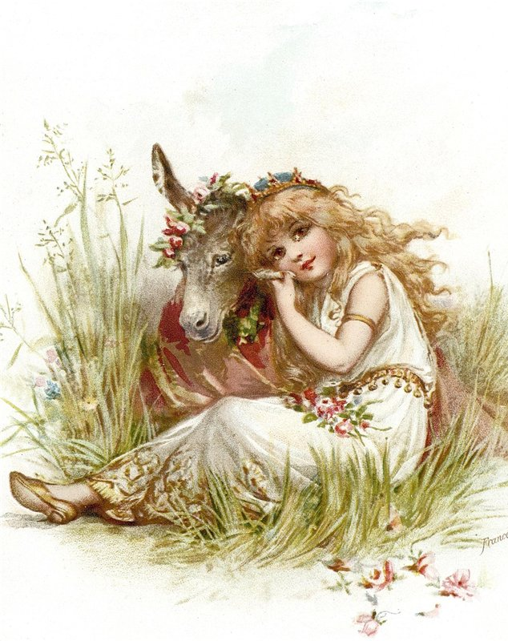
Frances Brundage Titania and the Clown.
Царица фей Титания и шут (Сон в летнюю ночь)

Slide 16
Source
https://en.wikipedia.org/wiki/Frances_Brundage
http://www.emotionscards.com/museum/francesbrundage.html
http://s48.radikal.ru/i121/1202/00/315e9bed6ae7.jpg
http://s017.radikal.ru/i421/1202/83/09047022bc93.jpg
http://s017.radikal.ru/i419/1202/4c/a0d11f0257e2.jpg
http://s017.radikal.ru/i436/1202/d2/8968d8cfff36.jpg
http://s52.radikal.ru/i136/1202/dc/f14e615cf0c3.jpg
http://i061.radikal.ru/1202/06/2d9969243237.jpg
http://s017.radikal.ru/i418/1202/0f/846a6899af92.jpg
http://i047.radikal.ru/1202/67/75e61793a04e.jpg
http://i051.radikal.ru/1202/36/60693187fa20.jpg

