Slide 1
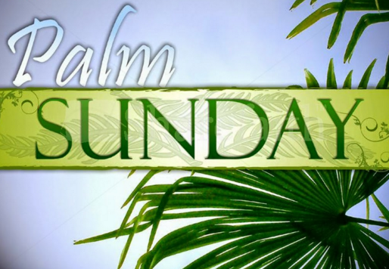
Thematic Digest for 8-11 Formers
Автор:
Ольга Михайловна Степанова
учитель английского языка
МБОУ «Цивильская СОШ №1
имени Героя Советского Союза
М.В. Силантьева»
города Цивильск
Чувашской Республики
2016

Slide 3
Palm Sunday
This occasion is related to easter Sunday and celebrated week before easter Sunday.Christians celebrate palm Sunday. It is a holy festival of Christians. They celebrate triumphal entry of Jesus christ into Jerusalem. It is celebrated the week before his death and resurrection. Palm Sunday is also known as passion Sunday in many churches. It is referred to as the beginning of the holy week. When Jesus entered Jerusalem, the crowd waved palm branches to greeted him. The path of Jesus was covered with palm branches. By the fifth century, this occasion had spread very far. After the time, some changes were made in 6th and 7th centuries. These changes seeded into two new traditions-the ritual blessing of the palms and the morning procession.

Slide 5
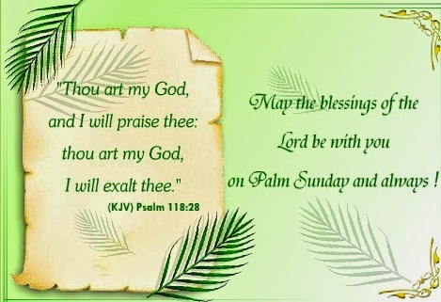

Slide 12
Palm Sunday Top Events and Things to Do
Go to a Palm Sunday church service and get palm branches.
Offer somebody a palm as an act of reconciliation or forgiveness. It is a common tradition among many Italian Catholics.
Create a work of art with palm leaves. Some American and Latin Roman Catholics weave the palm leaves into crosses
or other symbols.

Slide 14
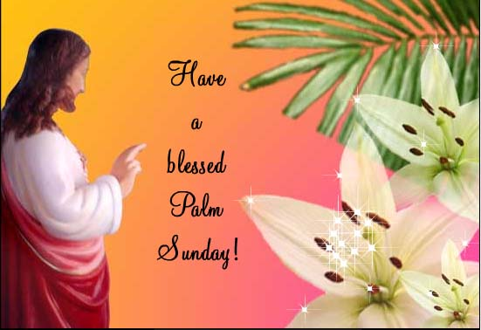

Slide 15
Palm Sunday is the final Sunday of Lent, the beginning of Holy Week, and commemorates the triumphant arrival of Christ in Jerusalem, days before he was crucified.
Palm Sunday is known as such because the faithful will often receive palm fronds which they use to participate in the reenactment of Christ's arrival in Jerusalem. In the Gospels, Jesus entered Jerusalem riding a young donkey, and to the lavish praise of the townspeople who threw clothes, or possibly palms or small branches, in front of him as a sign of homage. This was a customary practice for people of great respect.
Palm branches are widely recognized symbol of peace and victory, hence their preferred use on Palm Sunday.
The use of a donkey instead of a horse is highly symbolic, it represents the humble arrival of someone in peace, as opposed to arriving on a steed in war.
A week later, Christ would rise from the dead on the first Easter.
During Palm Sunday Mass, palms are distributed to parishioners who carry them in a ritual procession into church. The palms are blessed and many people will fashion them into small crosses or other items of personal devotion. These may be returned to the church, or kept for the year.
Because the palms are blessed, they may not be discarded as trash. Instead, they are appropriately gathered at the church and incinerated to create the ashes that will be used in the follow year's Ash Wednesday observance. The colors of the Mass on Palm Sunday are red and white, symbolizing the redemption in blood that Christ paid for the world.

Slide 17
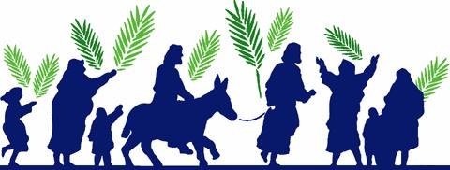
Source
http://womensdayimages.com/palm-sunday-2016-quotes-wishes-facebook/
http://happyeaster2016wishesquotesimages.com/palm-sunday-best-wishes-quotes-thoughts-sayings-messages-pics/
http://www.wincalendar.com/Palm-Sunday
http://www.timeanddate.com/holidays/common/palm-sunday

