Slide 1
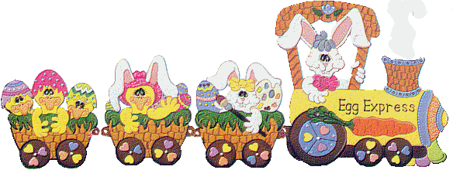
Egg Express
Interactive Quiz for 5-9 Formers
Автор:
Ольга Михайловна Степанова
учитель английского языка
МБОУ «Цивильская СОШ №1
имени Героя Советского Союза М.В. Силантьева»
города Цивильск Чувашской Республики
2016

Slide 2
Eggs come in many sizes
Eggs hold some big surprises
Speckled, brown, white, or blue
Eggs hold babies that are new
Chicks from eggs are funny fellows!
Chicks from eggs are fluffy … !
yellow

Slide 3
Five little Easter eggs, lovely colors wore
Mother ate the blue one,
then there were four
Four little Easter eggs, two and two you see
Daddy ate the red one, then there were … !
three

Slide 4
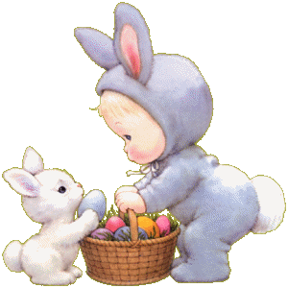
Here’ are lots of colored eggs
All for me and you.
Easter eggs! Easter eggs!
Eggs of orange and … .
blue

Slide 5
Aren’t these the most beautiful eggs
That you have ever seen?!
Chocolate eggs colored brown,
Jelly beans bright … !
green

Slide 6
Easter eggs,
Pink, green and blue,
Easter eggs, For me and you.
Easter eggs, Candy sweet,
Easter eggs, Are good to … .
eat

Slide 7
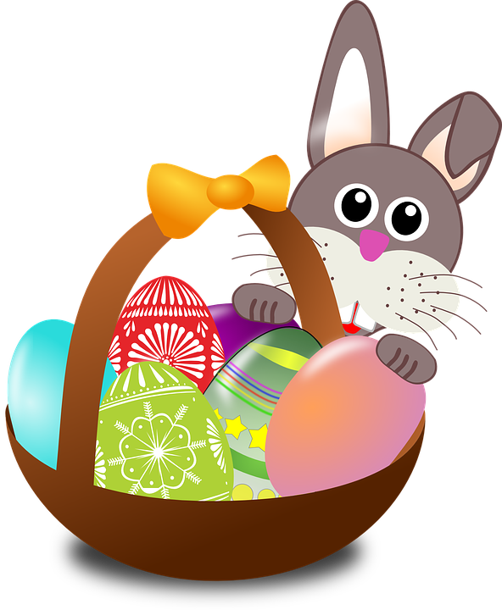
Easter Bunny brings the eggs
And leaves them in my yard,
And I will find them Easter morn,
If I look very … .
hard

Slide 8
Eggs with diamonds,
Eggs with stars,
Eggs with twinkly-winkly bars!
Some of them with rainbow showers!
And some of them with … !
flowers

Slide 9
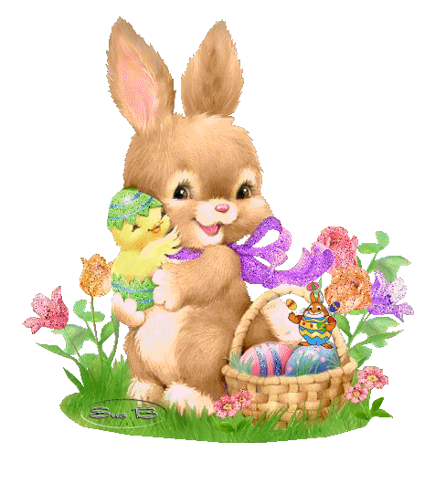
Easter morning, Easter morning,
Easter morning dawning fine!
Have to find the Easter eggs now,
I've already picked up … !
nine

Slide 10
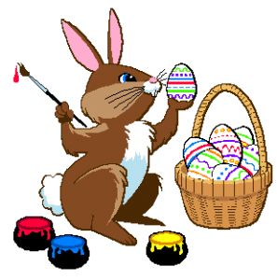
Yellow eggs and blue and red
In the grass and flower bed!
We will hunt them everywhere
But who? Who put them … ?
there

Slide 11
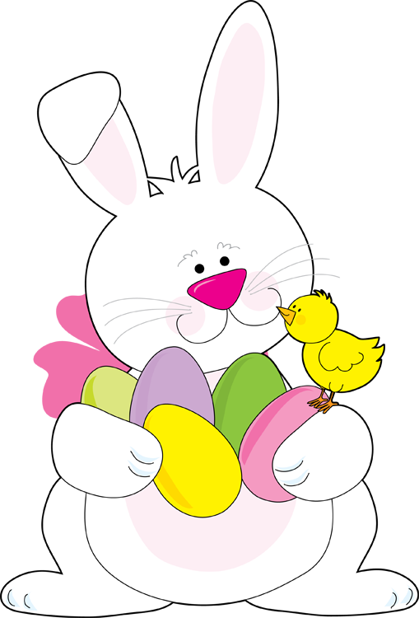
Easter eggs, Easter eggs
They're a sight to see.
One for her and one for him
And a special one for … !
me

Slide 12
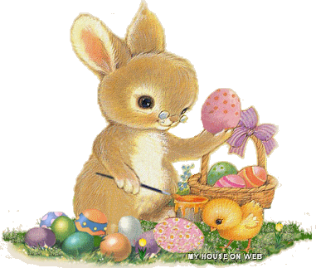
This morning, what do you suppose
I found beside my door?
A nest of colored Easter eggs--
Five or six or … !
more

Slide 13
Look over here and look over there
Little candy Easter eggs are every where
Who's the one who hides them there?
Little Easter bunny hides them … !
everywhere

Slide 14
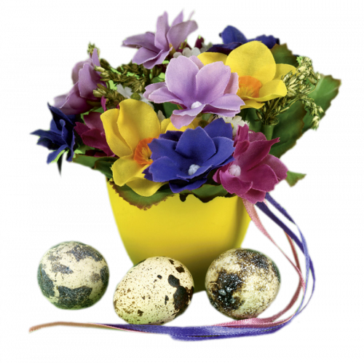
Easter Chocolate candy eggs
Most delicious sweet to eat!
Easter Chocolate candy eggs
It's my favorite … !
treat

Slide 15
One Easter Rabbit hopped away
To hide the Easter eggs one … !
day

Slide 16
A time for change, a time for change!
There is so much to do!
So gather the eggs one by one
And paint them all
And have some … !
fun

Slide 17
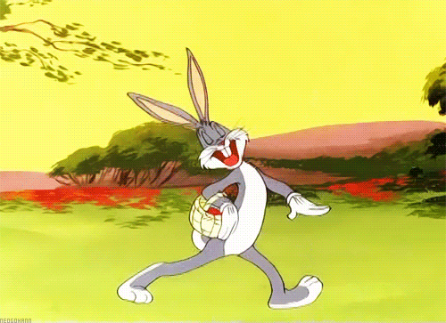
Easter bunny soft and white
Hopping quickly out of sight.
Thank you for the eggs you bring
At Easter time to welcome … !
spring

Slide 18
Source
http://www.canteach.ca/elementary/songspoems15.html
http://www.childfun.com/holidays/easter/songs-fingerplay/
http://www.tooter4kids.com/classroom/easter_poems.htm

