Slide 1
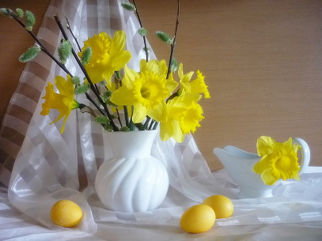
This Sweet Easter
Still Life Gallery
for the 5-11 Formers
Автор:
Ольга Михайловна Степанова
учитель английского языка
МБОУ «Цивильская СОШ №1
имени Героя Советского Союза М.В. Силантьева»
города Цивильск Чувашской Республики
2016

Slide 2
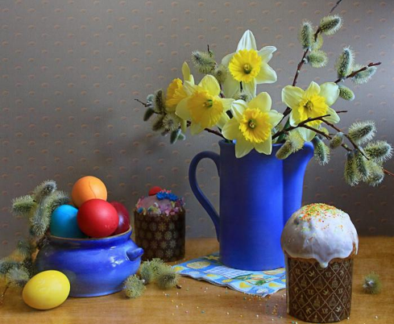
Easter is a wonderful day to celebrate all Christ has done for us.
Have
a Blessed Easter!

Slide 3
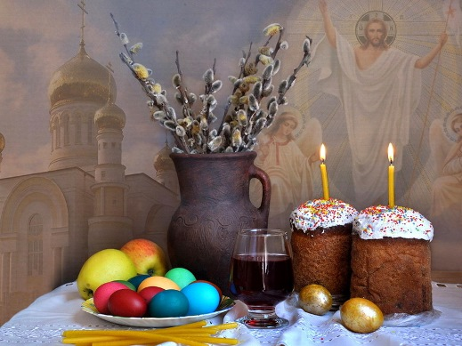
I hope you have colorful eggs, candy, bunnies and chocolate in your Easter basket this year.

Slide 4
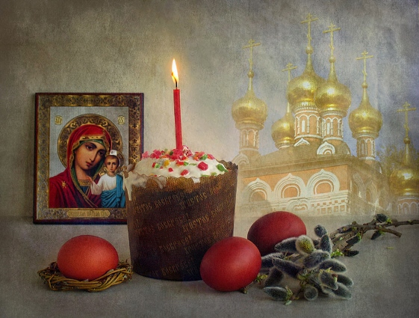
Let the resurrection joy lift us from loneliness and weakness and despair to strength and beauty and happiness. -Floyd W. Tomkins

Slide 5
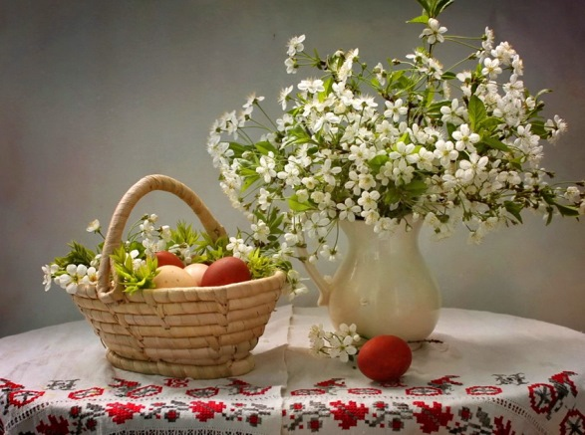
A Happy Easter is all about:
Find eggs
2. Eating chocolate
3. Celebrate with
family

Slide 6
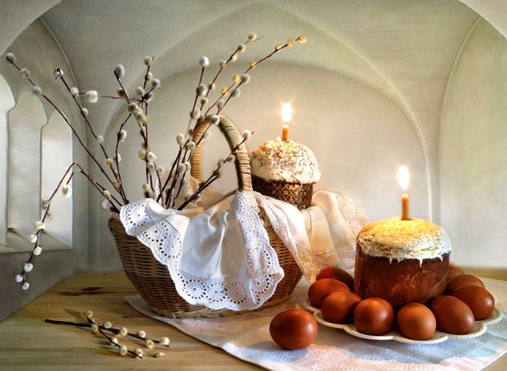
We hope your celebration of Easter fills you with the joy Christ offers us.

Slide 7
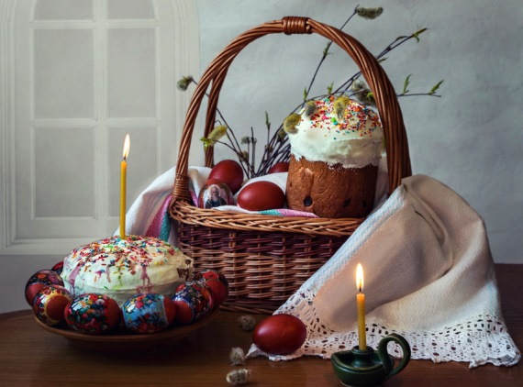
Celebrate this Easter with a heart filled with love and peace. Have a blessed and wonderful Easter!

Slide 8
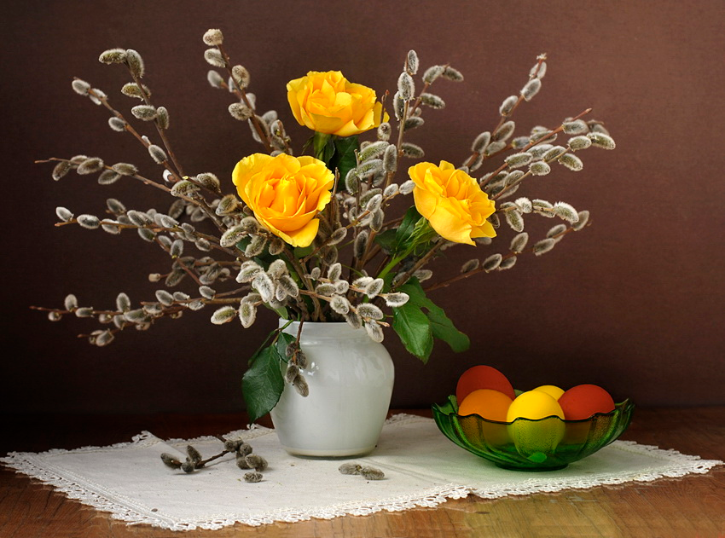
Easter is about being with all the people you love…

Slide 9
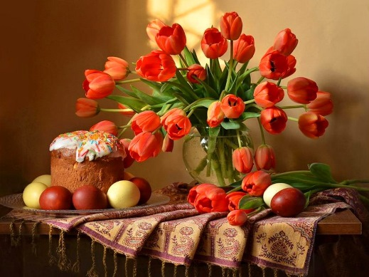
The story of Easter is the story of God's wonderful
window of
divine
surprise.
Carl Knudsen

Slide 10
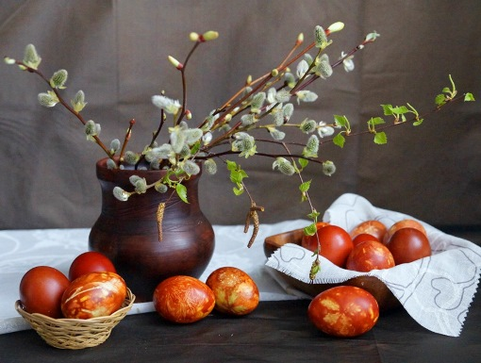
May the Lord’s face shine upon you this Easter.

Slide 11
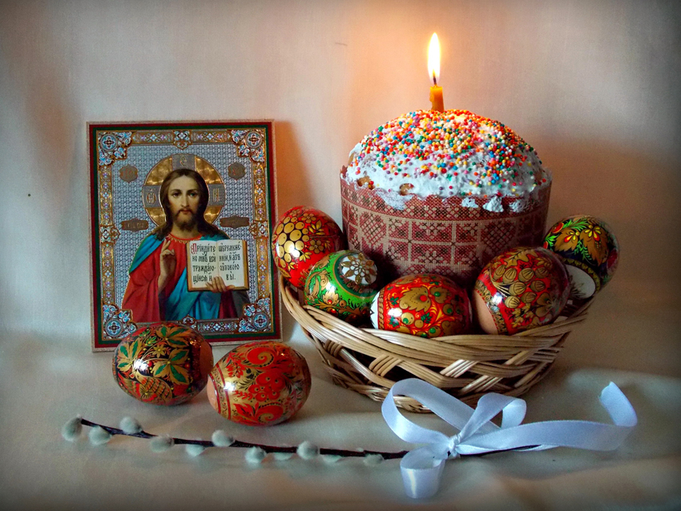
Easter spells out beauty,
the rare beauty of new life.
S.D. Gordon

Slide 12
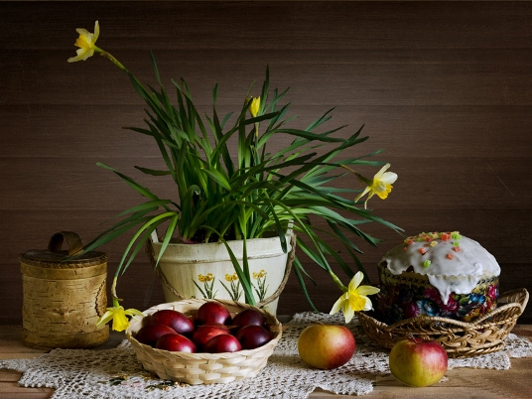
Where man sees but withered leaves, God sees sweet flowers growing.-Albert Laighton

Slide 13
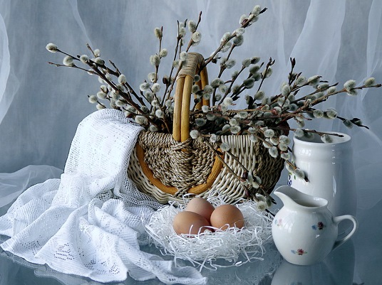
The great gift of Easter is hope – Christian
hope which makes us have that confidence in God, in his ultimate triumph, and in his goodness and love,
which nothing can shake.
– Basil Hume

Slide 14
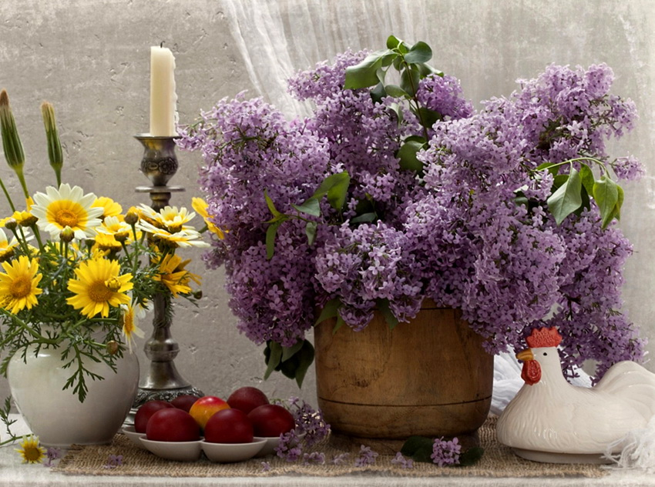
Our old history ends with the cross; our new history begins with the resurrection.

Slide 15
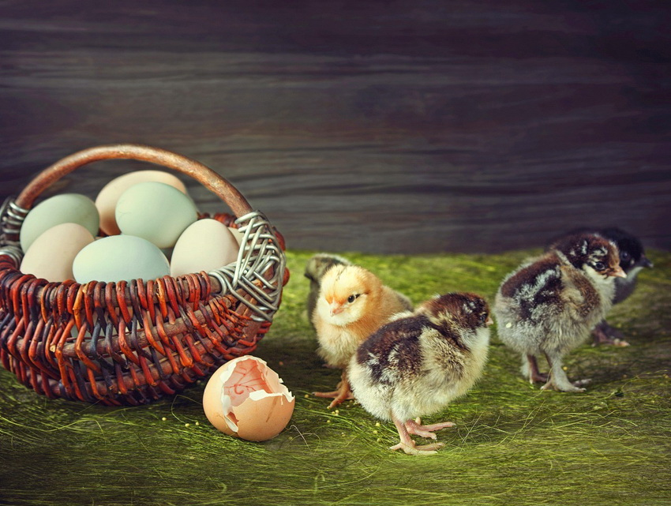
Let the whole world join the happy lay, Let the hills and vales break forth in singing, Christ,
the Lord of Life, is ris’n today.
– Lizzie Akers

Slide 16
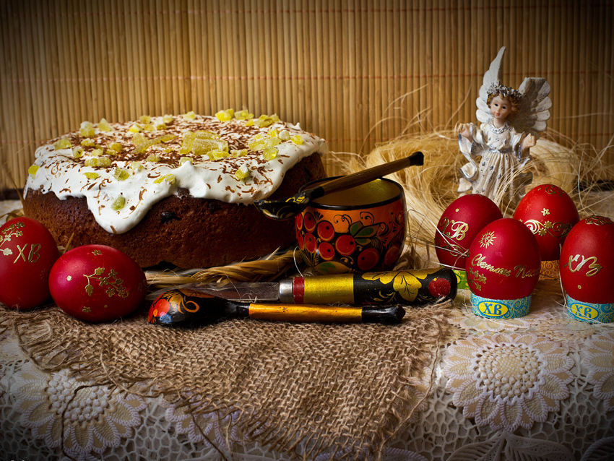
Easter is meant to be a symbol of hope, renewal, and new life.
– Janine di Giovanni

Slide 17
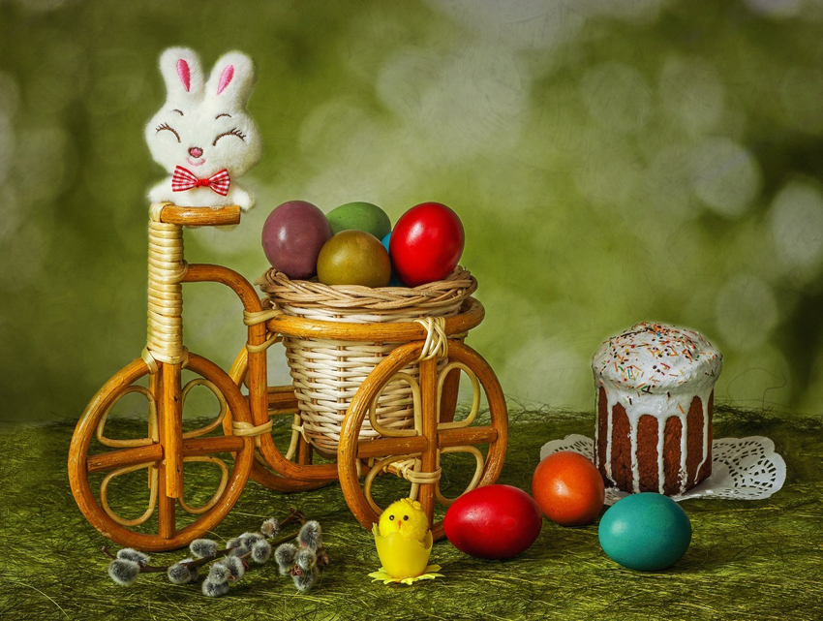
Do not abandon yourselves to despair. We are the Easter people and hallelujah is our song.
– Pope John Paul II

Slide 18
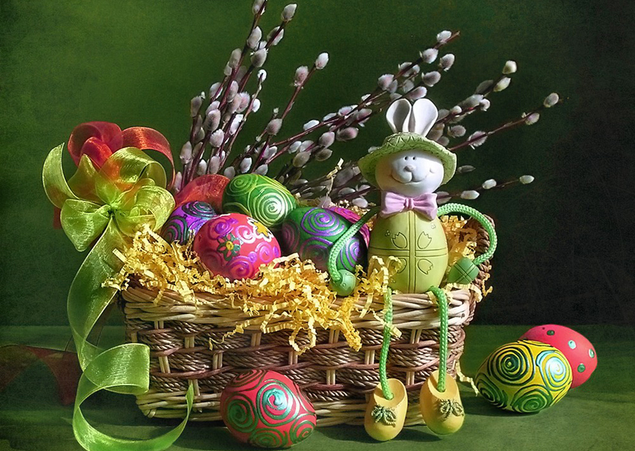
It’s the day that our God rose from the dead. And He’s
still alive today!

Slide 19
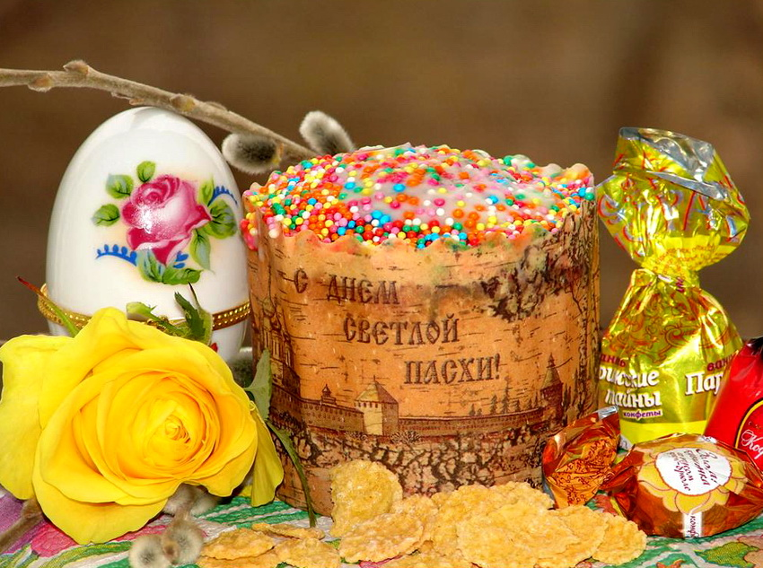
Easter brings us hope, may it linger in our hearts forever. Here’s wishing you a very Happy Easter.

Slide 20
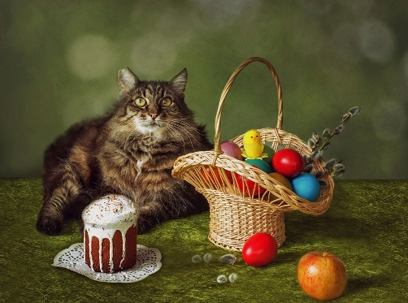
Remember the most important reasons for Easter:
new life, joy and chocolate!

Slide 22
Source
http://www.freshmorningquotes.com/happy-easter-sunday-quotes/
http://www.allgreatquotes.com/easter_quotes2.shtml
https://img-fotki.yandex.ru/get/51592/107301928.f9/0_d2b50_f456db43_orig.jpg
https://img-fotki.yandex.ru/get/54353/107301928.f9/0_d2b53_1e58931e_orig.jpg
https://img-fotki.yandex.ru/get/54353/107301928.f8/0_d2b49_98ce5438_orig.jpg
https://img-fotki.yandex.ru/get/51592/107301928.f8/0_d2b47_a887497c_orig.jpg
https://img-fotki.yandex.ru/get/44819/107301928.f8/0_d2b4e_82acdbb6_orig.jpg
https://img-fotki.yandex.ru/get/31412/107301928.f8/0_d2b43_823e70b7_orig.jpg
https://img-fotki.yandex.ru/get/51592/107301928.f8/0_d2b44_37edb2f3_orig.jpg
https://img-fotki.yandex.ru/get/51592/107301928.f8/0_d2b45_d3abde79_orig.jpg
https://img-fotki.yandex.ru/get/102061/107301928.f9/0_d2b55_ff3d8e41_orig.jpg
https://img-fotki.yandex.ru/get/44819/107301928.f8/0_d2b46_a2e5c96c_orig.jpg
https://img-fotki.yandex.ru/get/122076/107301928.f9/0_d2b4f_c53db6a9_orig.jpg
https://img-fotki.yandex.ru/get/122076/107301928.f8/0_d2b4d_c7bb21d0_orig.jpg
https://img-fotki.yandex.ru/get/54353/107301928.f8/0_d2b4c_843622e2_orig.jpg
https://img-fotki.yandex.ru/get/44819/107301928.f8/0_d2b4a_2f7c5d81_orig.jpg
https://img-fotki.yandex.ru/get/41717/107301928.f9/0_d2b51_d57f2109_orig.jpg
https://img-fotki.yandex.ru/get/6441/107301928.85/0_aec50_bd4cabaf_orig.jpg
https://img-fotki.yandex.ru/get/122076/107301928.f8/0_d2b48_8f343a51_orig.jpg

