Slide 1
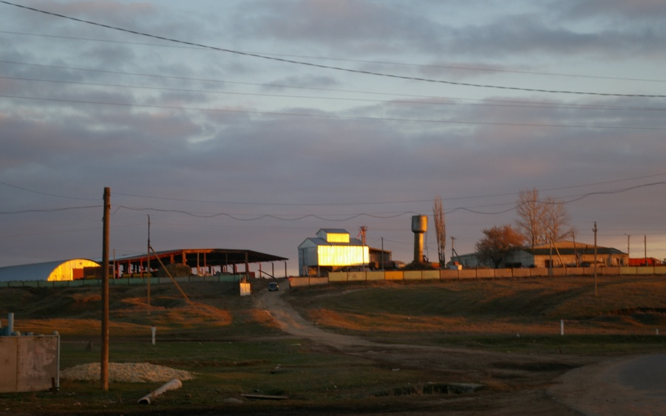
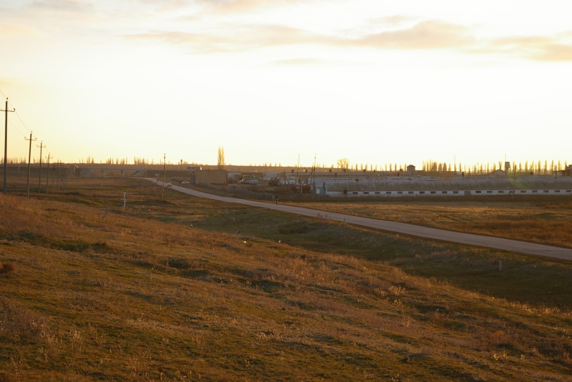
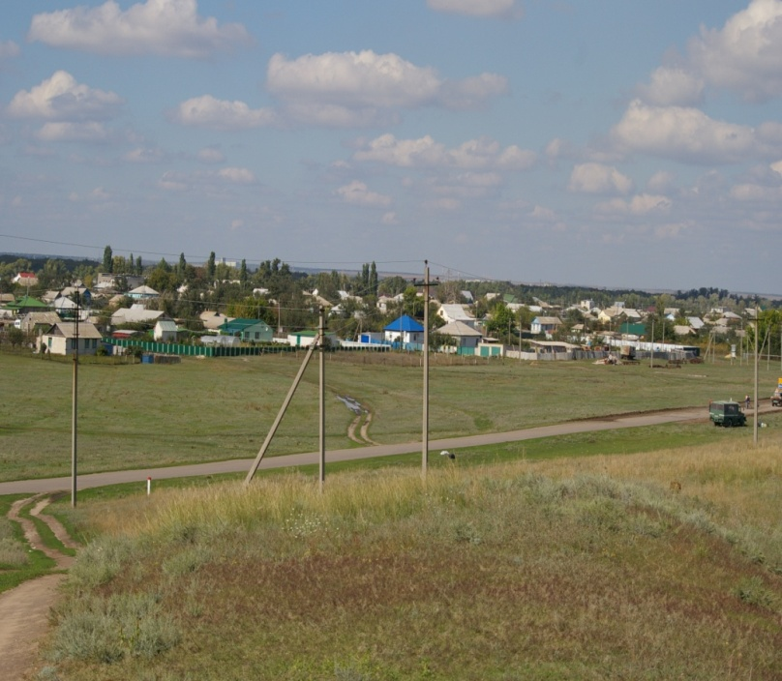
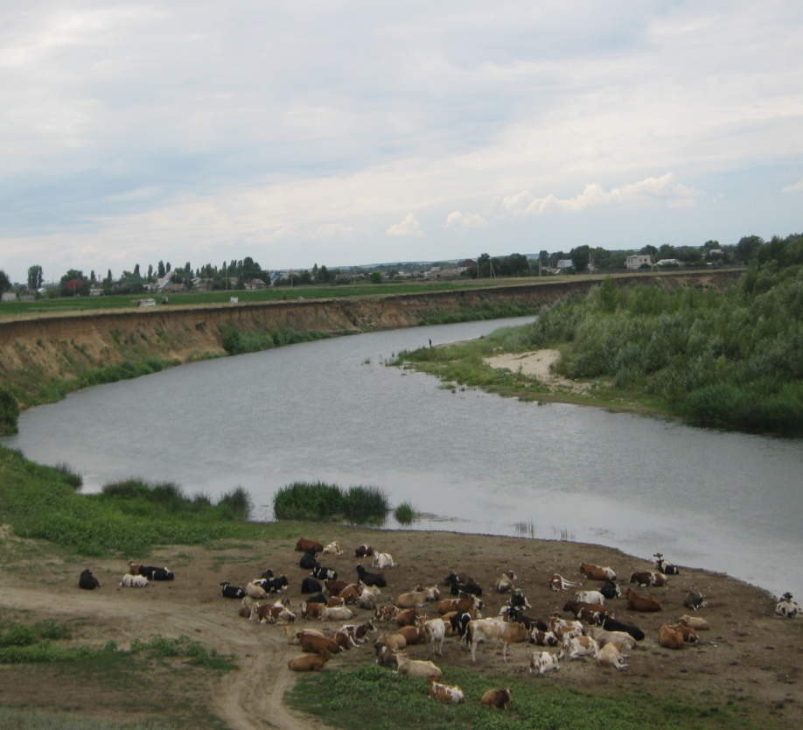
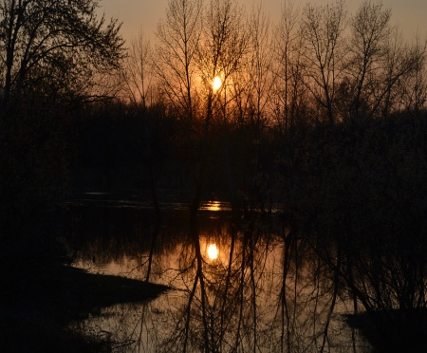
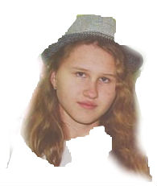
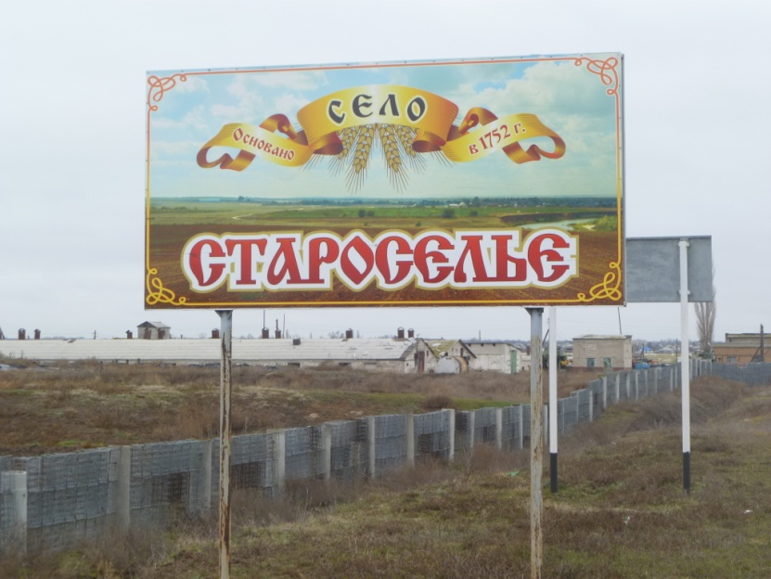
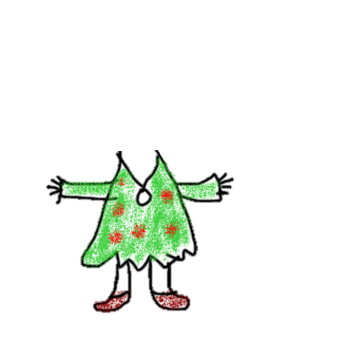
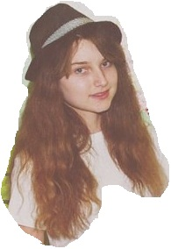
Презентация, посвященная истории Волгоградской области
«NATIVE LAND CHARM - STAROSELYE»
Авторы:
Курбанова Кристина Олеговна, ученица 9 класса
Атясова Тамара Игоревна, ученица 8 класса
Руководитель:
Жаворонкина Ирина Владимировна, учитель английского языка I квалификационной категории МКОУ «Старосельская ОШ»
с.Староселье (Волгоградская область), 2016г.

Slide 2
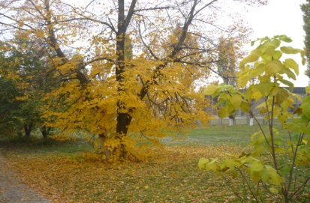
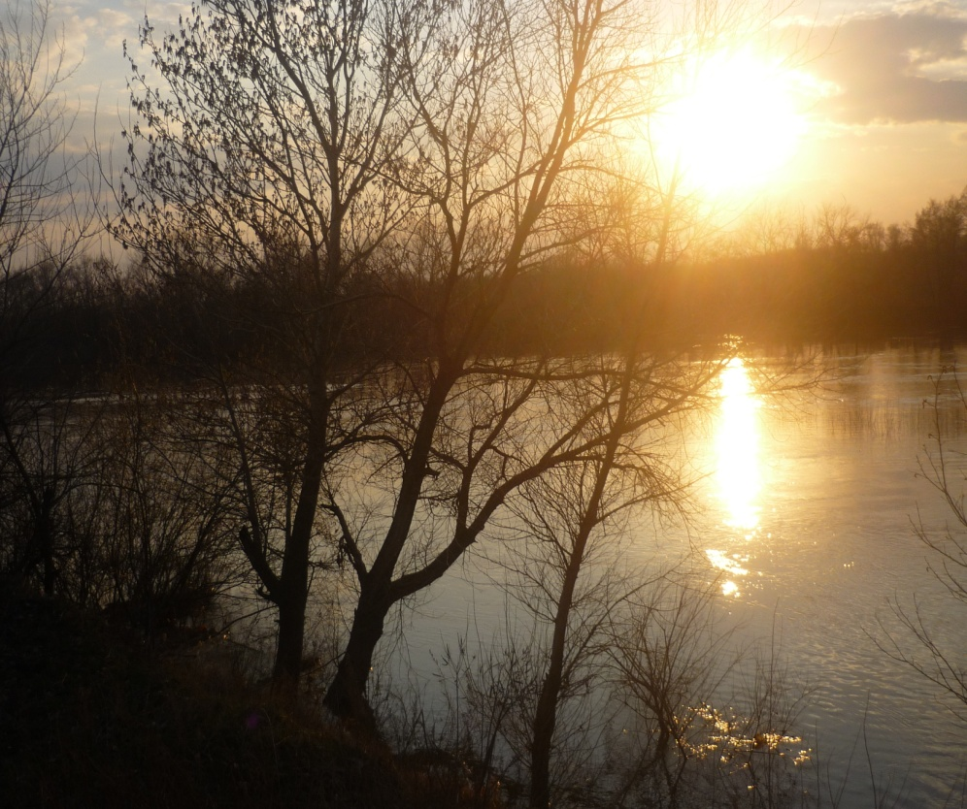
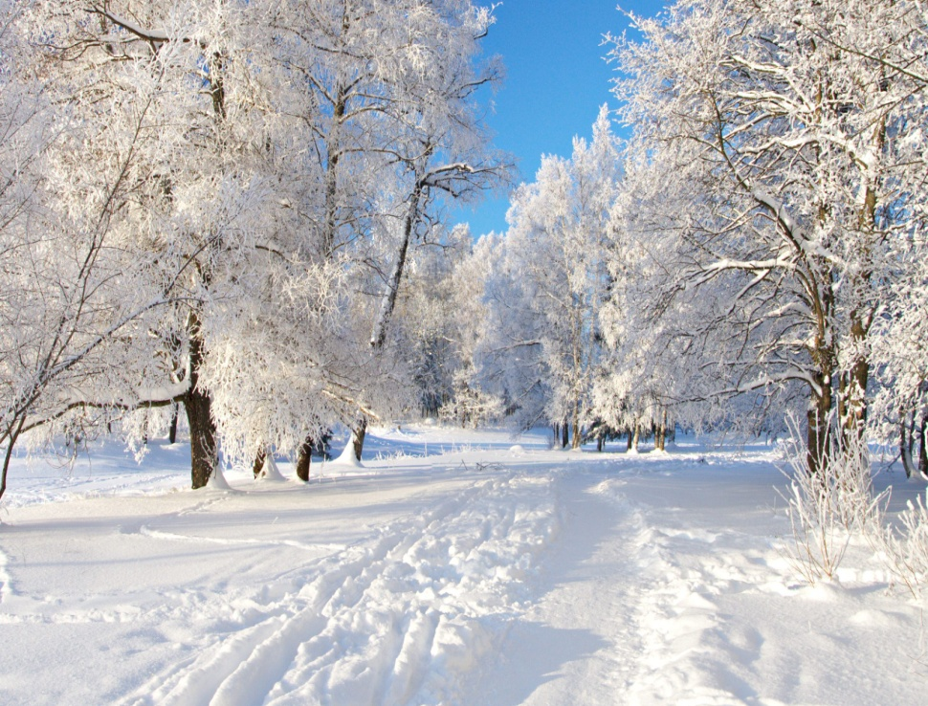
I am happy to welcome you on behalf of the citizens of the Volgograd Region and me personally. Russia is my motherland. The capital of Russia is Moscow. Unfortunately when foreign people think of Russia they usually only think of Moscow. But Russia is a great country. Every part of our country has its own history of development which is connected with the history of Russia. I’d like to tell you about my native place village Staroseley, the history of which started in the middle of the XIX century.
I’d like to tell you about my native place village Staroseley, the history of which started in the middle of the XIX century.
.
2

Slide 3
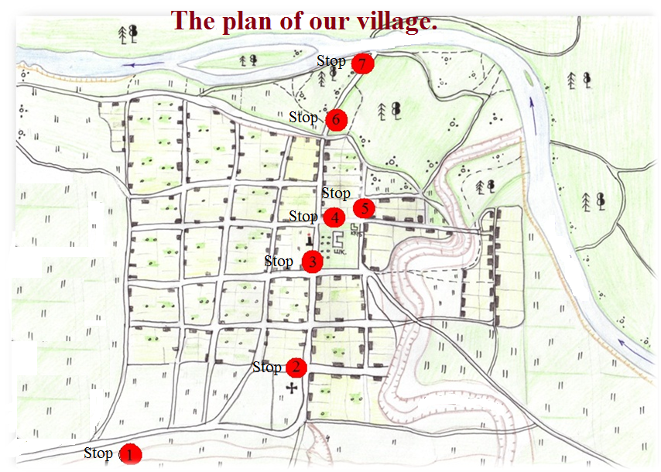
15 min.
5 min.
15 min.
5 min.
15 min.
2 min.
15 min.
2 min.
15 min.
5 min.
10 min.
5 min.
15 min.

Slide 4
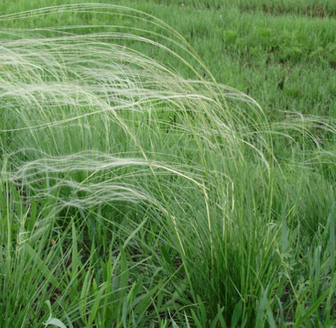
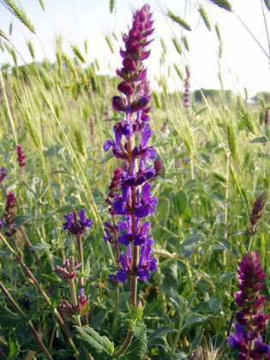
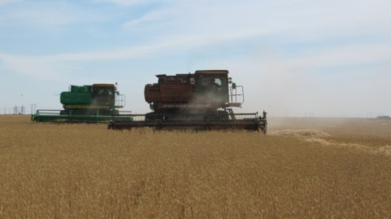
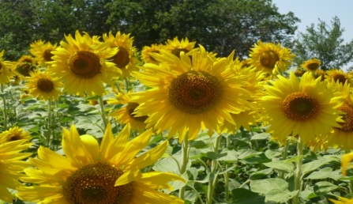
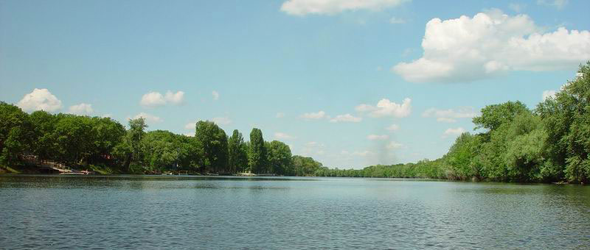
Stop 1. The history of Staroselye.
The village Staroseley is situated in the Volgograd Region. It is located on the picturesque hill, surrounded by thick forests and deep rivers. Peasants from other regions of the Central Russia moved here because there were a lot of free lands. They ran away from their landowners. Free peasants cut forest and cultivated new fields, built separated farms. They hunted animals and fished, grew corn, potato. Our small village differs from tens of other quiet provincial places of Russia. It cannot boast any unusual sights or exotic landscapes. Everything here is simple and quiet. We enjoy magnificent nature, fresh air and clear water. Our people are kind, relaxed, friendly, careful. Many remarkable people were born in our village, and we are proud of them.
4

Slide 5
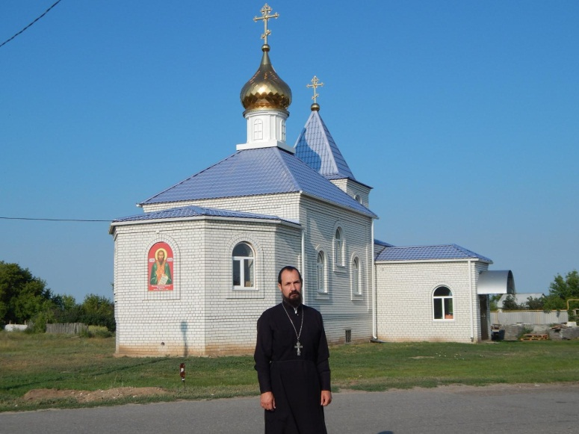
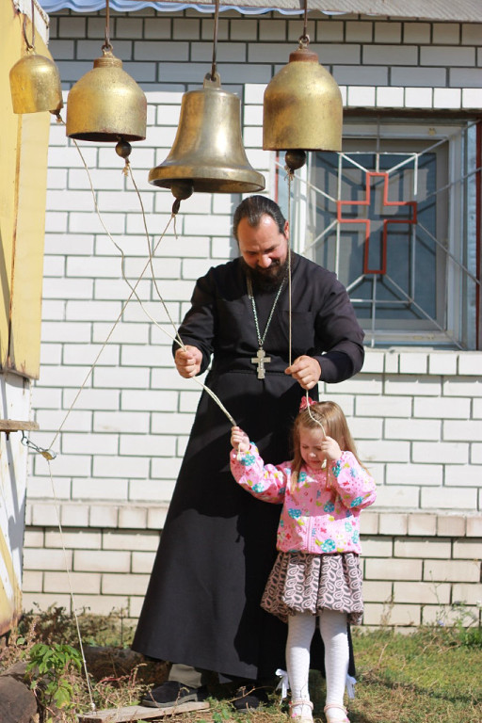
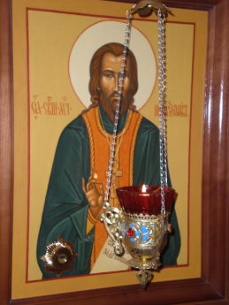
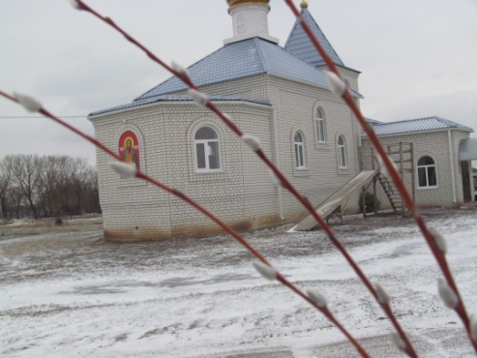
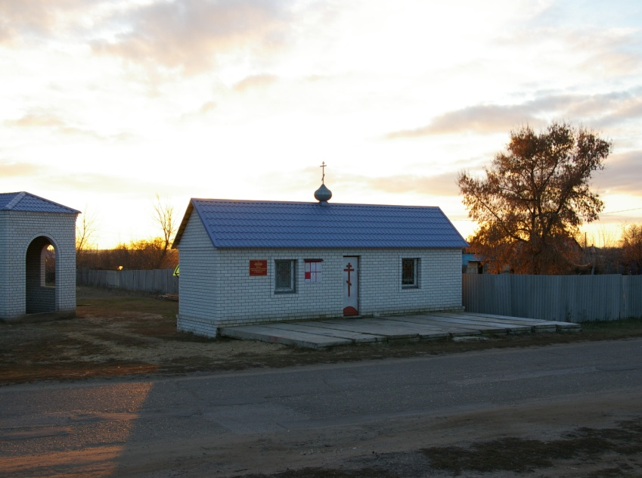
Stop 2. The road to the Church.
This is our new church. A lot of people of our village helped in building. The priest Roman organized a play – ground for children near the church.
5

Slide 6
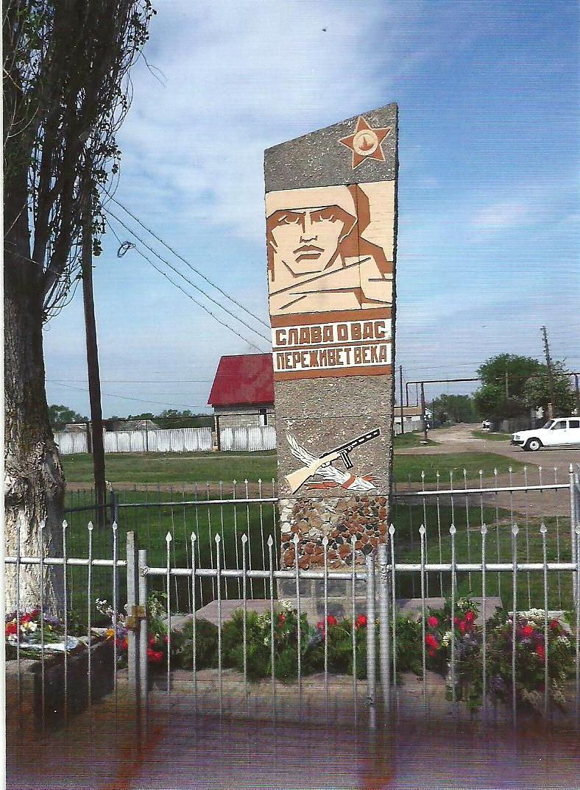
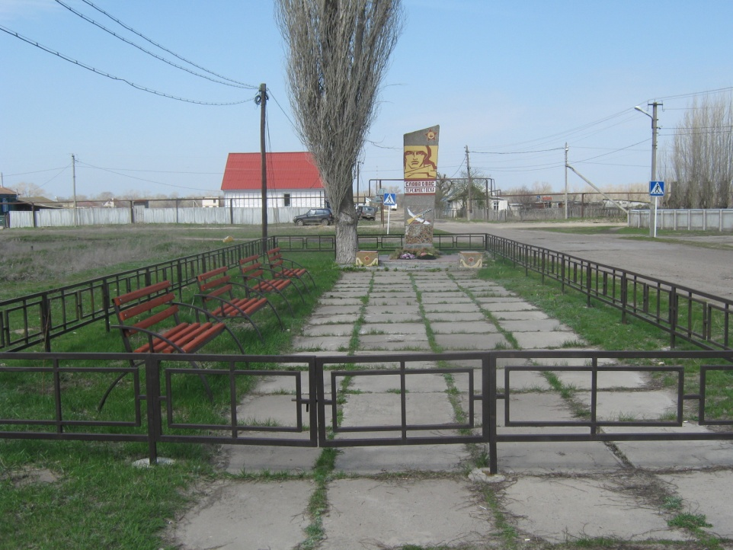
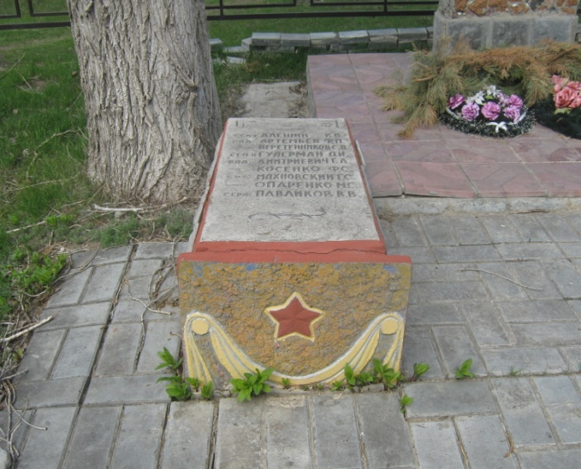
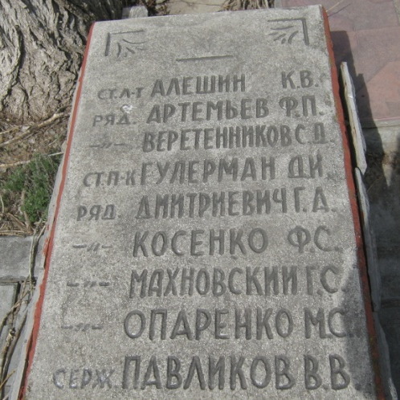
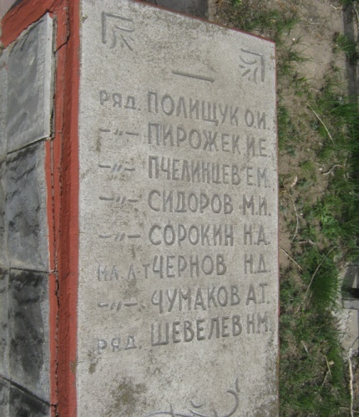
Stop 3. It is necessary not dead, it must live.
The Monument to heroes of the great Patriotic War is in the center of the village. On the 9-th of May on Victory Day citizens of Staroseley come to honour the memory of the soldiers, who didn’t come from the war.

Slide 7
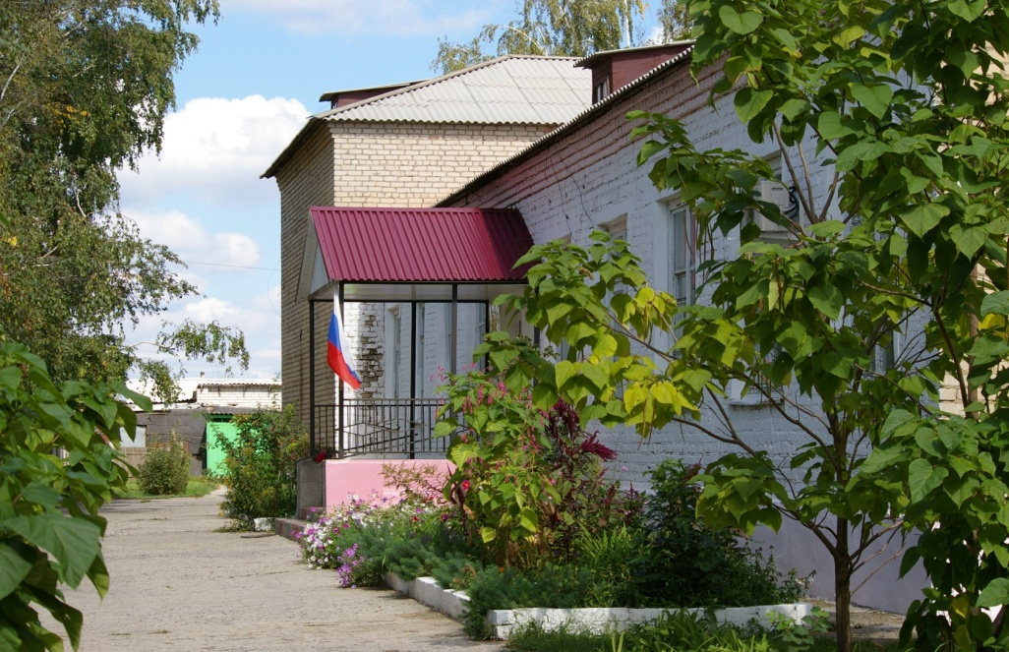
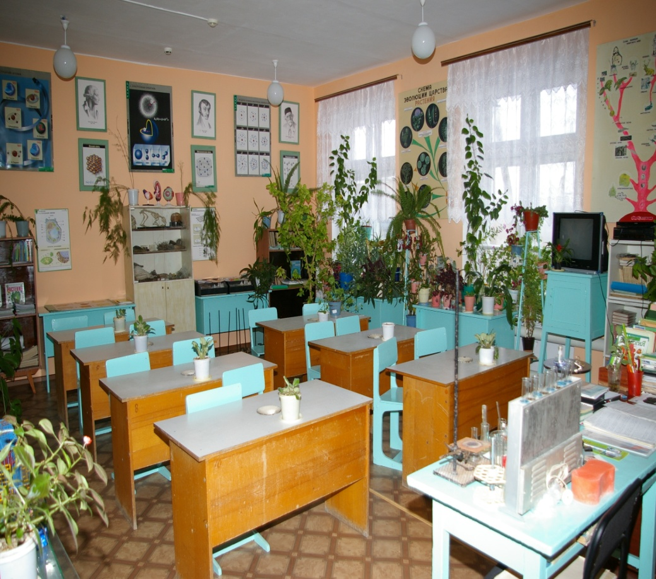
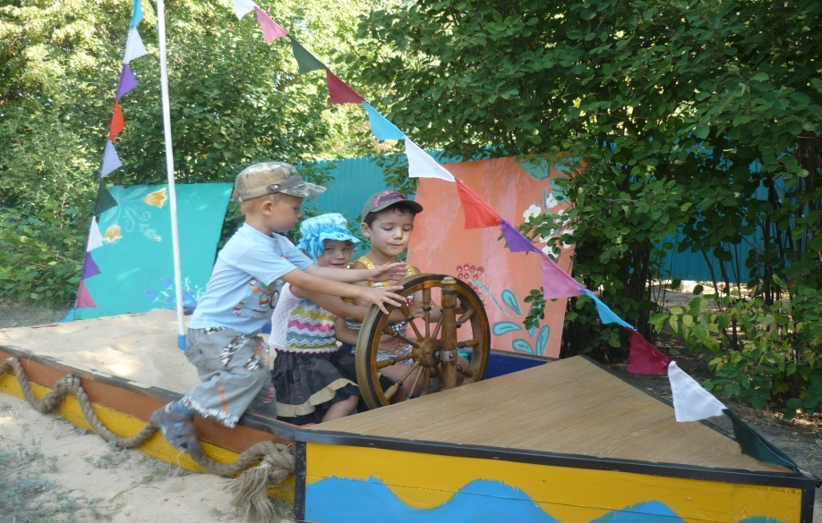
Stop 4. My favourite school.
Most schools in our region are comprehensive. There are about 100 pupils and about 15 teachers in our school. The classrooms are on the ground floor. They look cosy. The walls are decorated with pictures and there are nice curtains on the large windows. I think, children feel comfortably here. At the beginning of the corridor, on the left there are gym and the library. On the right there are the computer class and other classes, too. It's a pity we have no Assembly Hall. The school is rather well equipped. Our classes start at half past eight. Some pupils live not far from school. We study at school from Monday till Friday, so we have two days off.
7

Slide 8
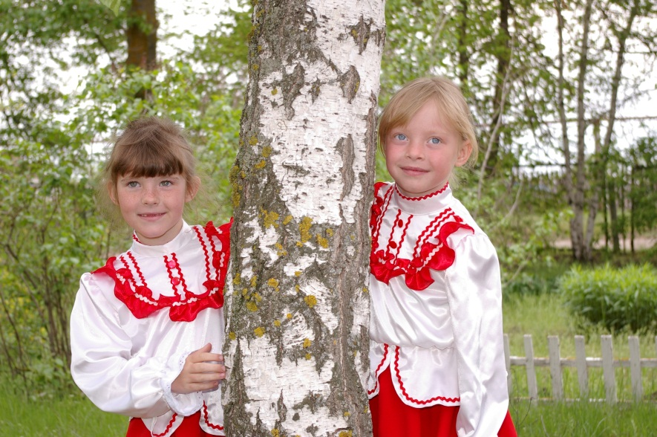
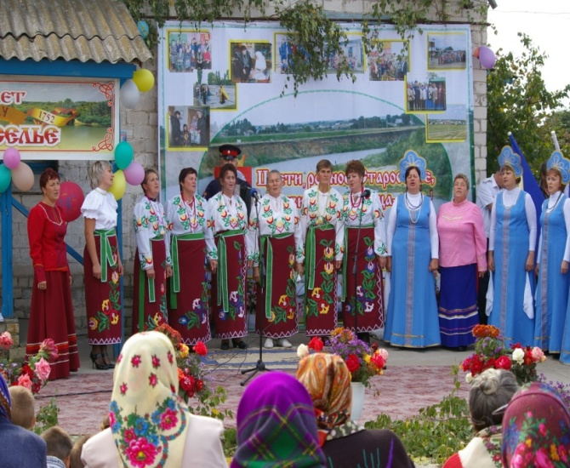
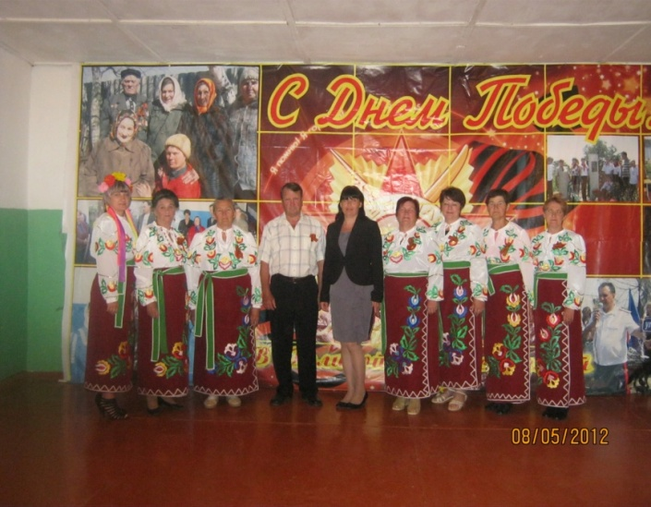
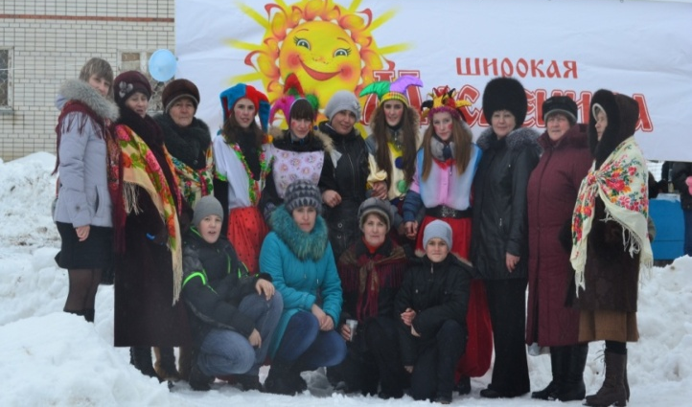
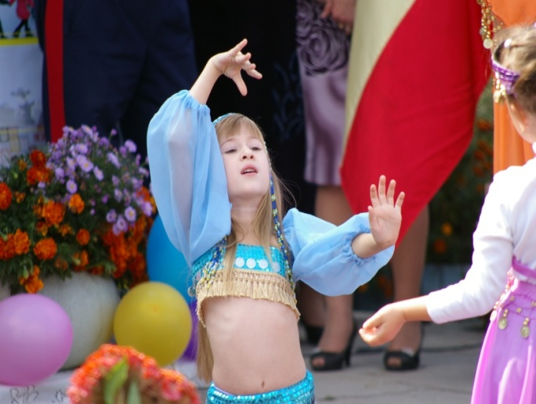
Stop 5. Our traditions.
The people of our village are very hospitable, kind, friendly. They are always glad to meet the guests. We have many interesting traditions, such as: Festivals of folk and children`s song, we celebrate the Day of the Village, Farewell Winter Festival and the Day of old people.
8

Slide 9
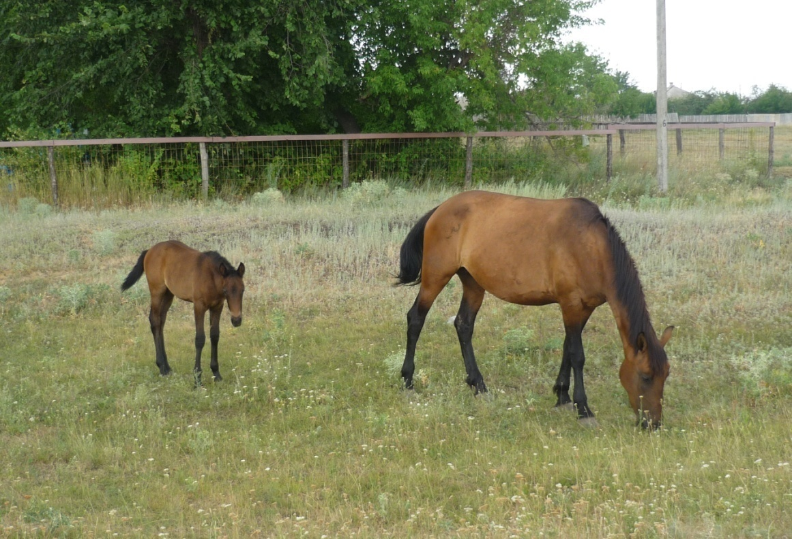
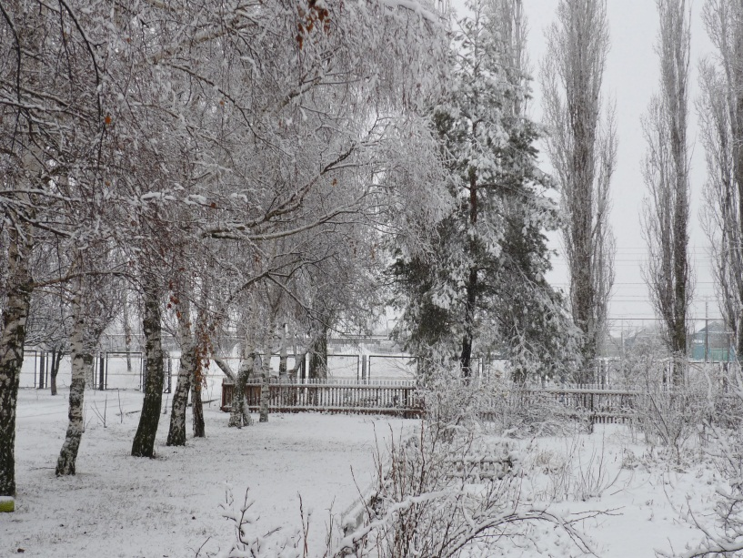
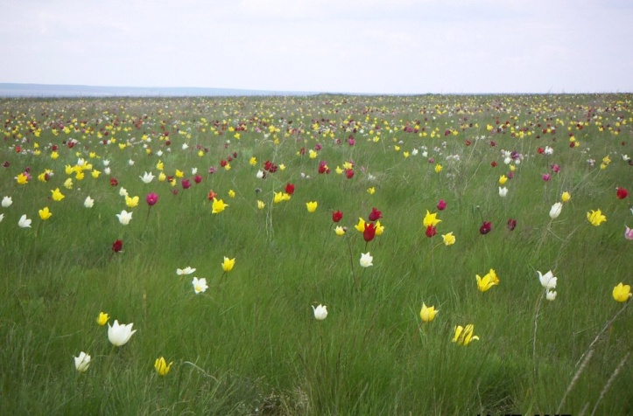
Stop 6. Our nature.
We live on a very beautiful planet – on the Earth. Our village has very rich resources: the bright blue of the sky, fresh, crystal-clear water, the rich green fields, wild flowers, picturesque views. We take care of our nature.
9

Slide 10
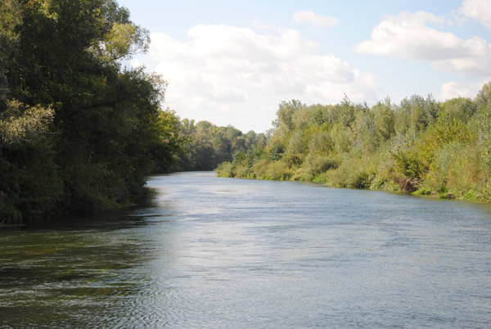
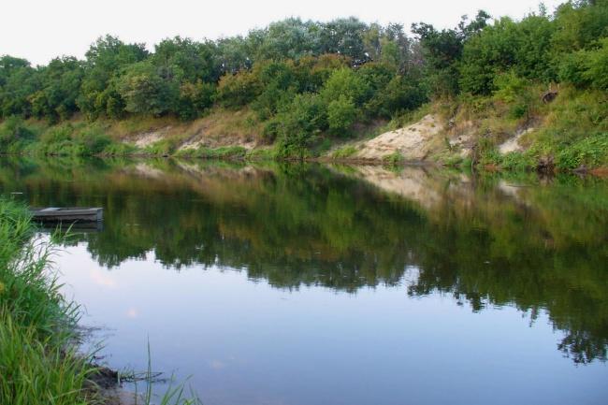
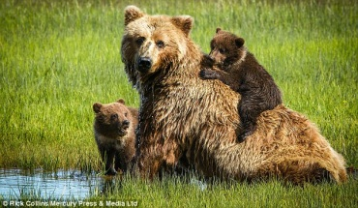
Stop 7. Our river.
My native village is a small and quiet place. You can find nothing unusual or unique here. But our river Medveditsa is unforgettable! It attracts many people from all parts of our big country. People often invited to spend their weekends and holidays on the beaches of the river. They swim, dive, and play volleyball. Everybody enjoys picturesque nature and clear water. Medveditsa is real paradise in summer.
10

Slide 11
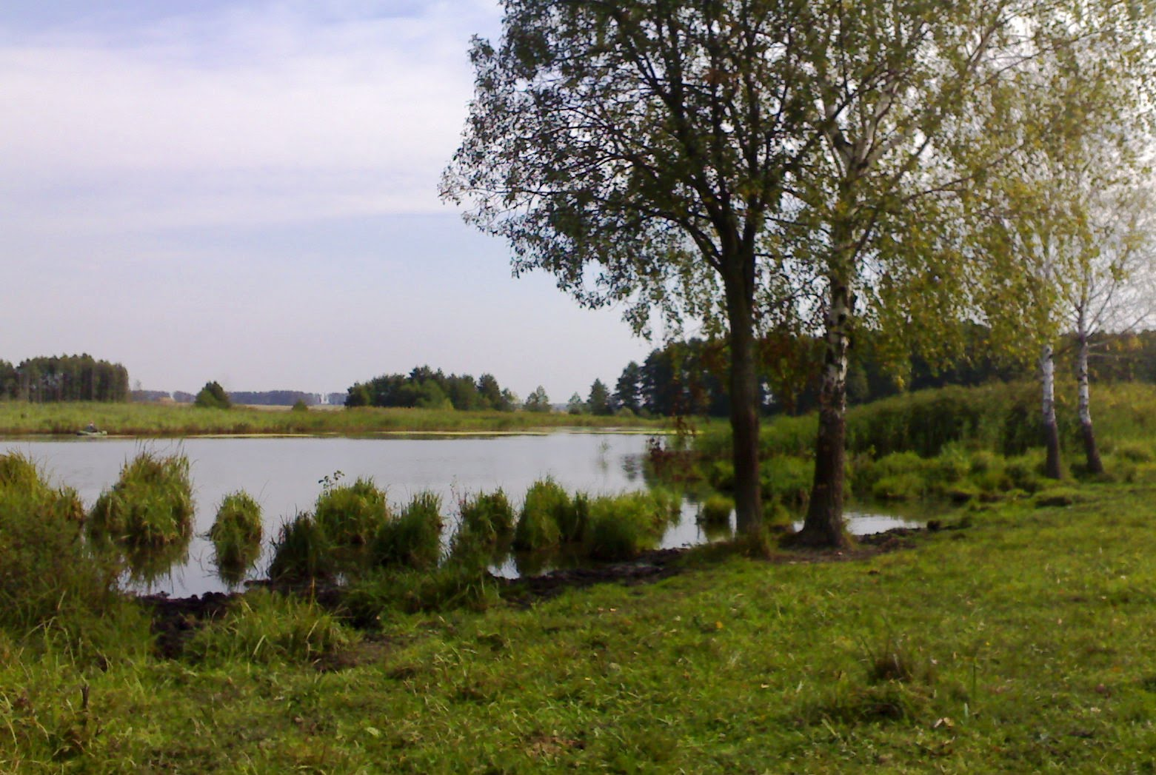
.
We can`t imagine our life without our Staroselye.
We like our village!
11

