Slide 1
We
love Tsivilsk
A Tour
around the Town
Made by
Misha Magazeev
Form 5v
together with Olga Stepanova,
the English Teacher
Tsivilsk, School #1
Chuvash Republic
2016

Slide 2
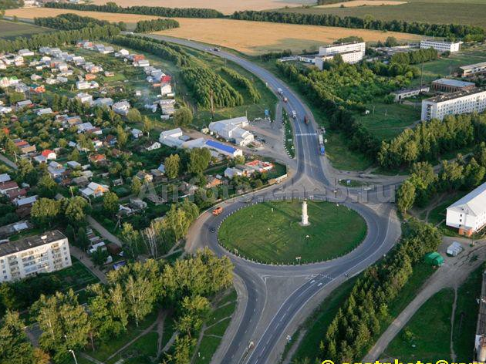
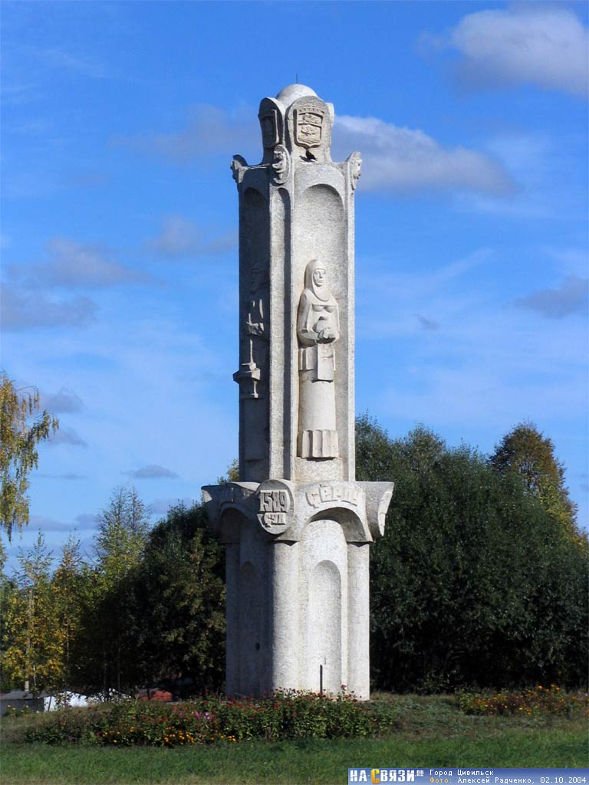
On the Way between Cheboksary and Kasan
you can visit a beautiful town .
Its name is Tsivilsk.
I live here.

Slide 3
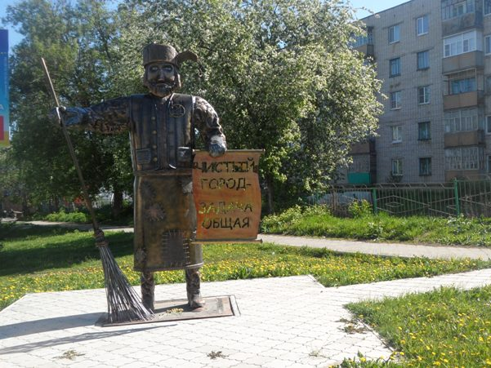
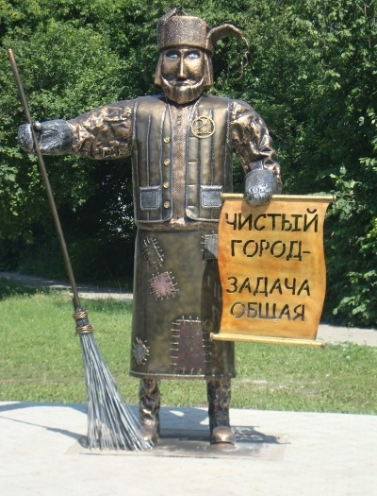
When you enter the town, an Uncle the Cleaner will meet you. He greets everyone with words: ‘The clean town is everyone’s problem’. Obviously, he offers us to keep the town
clean and beautiful.

Slide 4
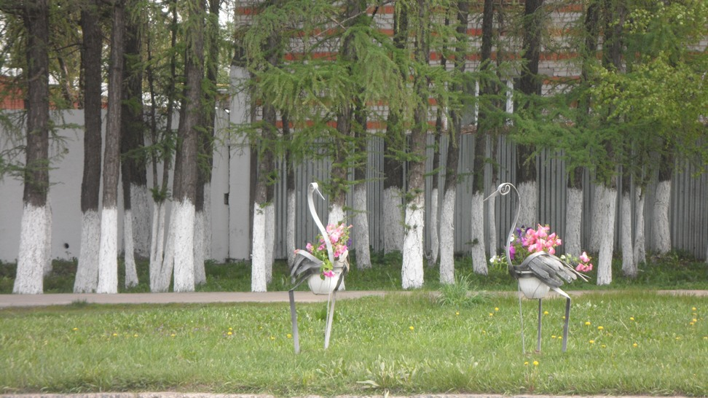
Walking straight on, we can meet beautifully designed flower beds.
These are blossoming herons.
They really look fantastic!

Slide 5
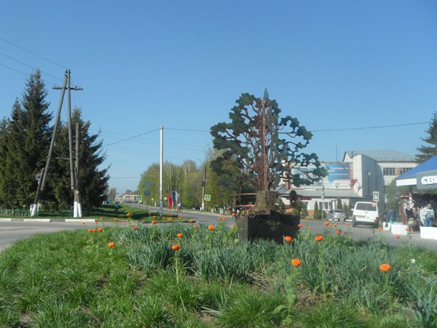
Walking down the street
you can see
this very symbolic oak tree.
It really symbolizes
the Coat of Arms
of my town.

Slide 6
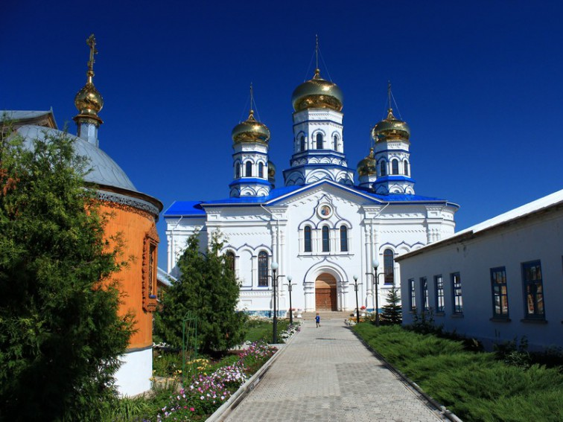
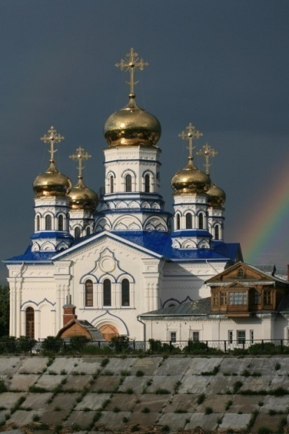
Tsivilsk is not Tsivilsk
without this beautiful church.
This is Tikhvinsky Bogoroditsky Monastery.

Slide 7
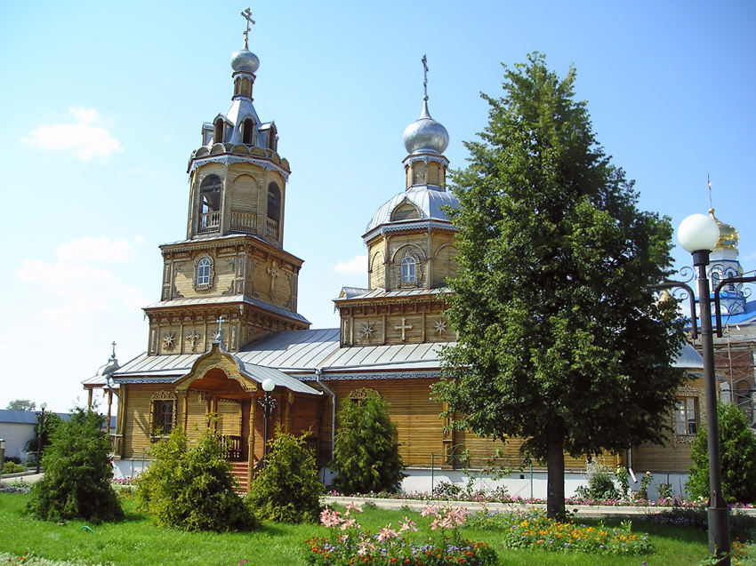
Bogoroditsky Women’s Monastery is one of the famous sights of Tsivilsk as well.

Slide 8
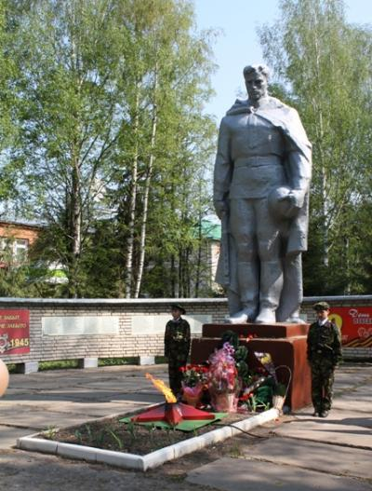
The most popular monuments of Tsivilsk are
the Monument to an Unknown Soldier and
the Monument to a Mother.
They stand in different parks in the Town.

Slide 9
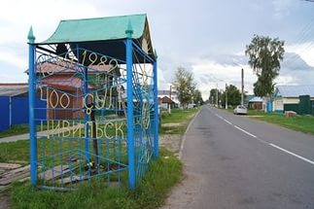
Beautifully designed wells everywhere in the streets of Tsivilsk are
the special symbols of the town that is seen by every visitor.
The fresh Tsivilsk water from the well will refresh everyone who is thirsty.

Slide 10
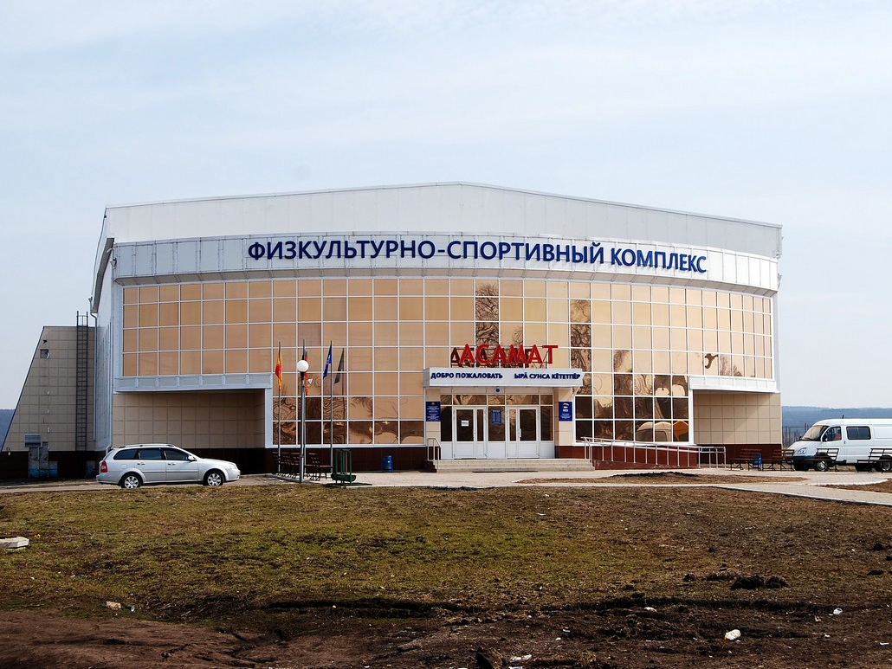
Azamat Sports Center is the most popular with all the children and adults. Here we can have a great time doing different sports.
I like swimming here very much.

Slide 11
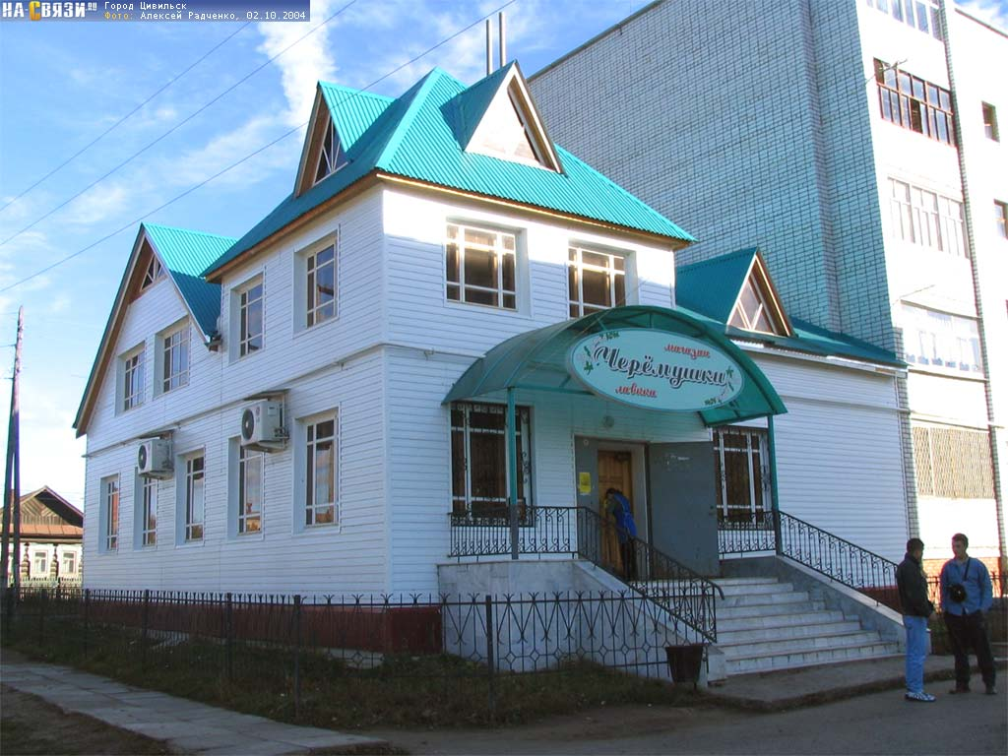
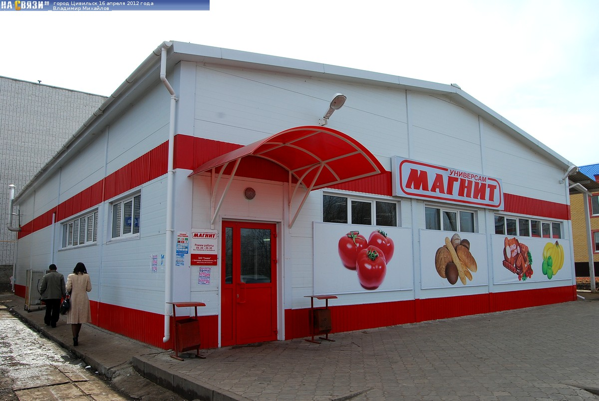
If you have to buy some food, you can easily do shopping in my town. Modern shops offer you every kind of food and every kind of tasty things.
As for me , I like to do shopping in “Cheryomushki” and “Magnit”. They always are full of fresh food ,
fresh fruit and fresh vegetables.

Slide 12
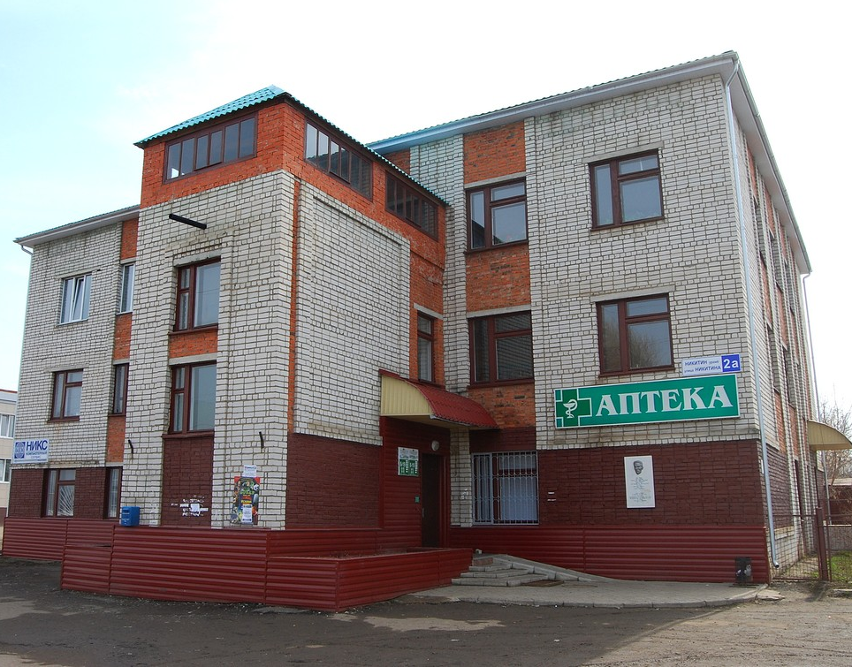
If you get ill, you can find every kind of medicine in my town. Doctors in hospitals are kind and they take care about people with love.

Slide 13
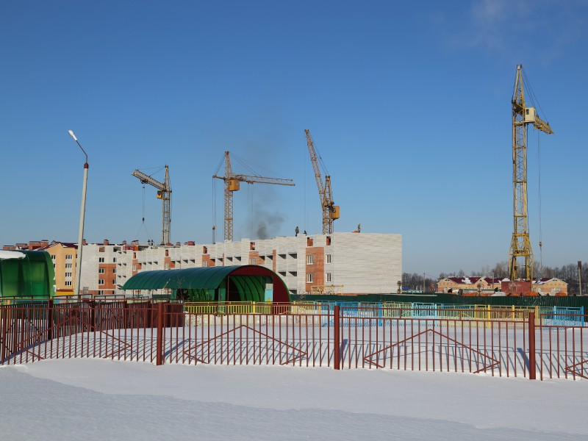
Tsivilsk gets bigger and bigger
every year. New modern buildings appear from year to year.

Slide 14
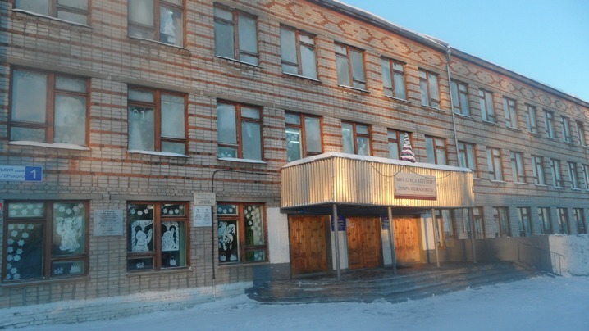
This is my school. I like to learn here.
This photo was taken in January 2016.
I am looking forward to building
a new school for us.

Slide 15
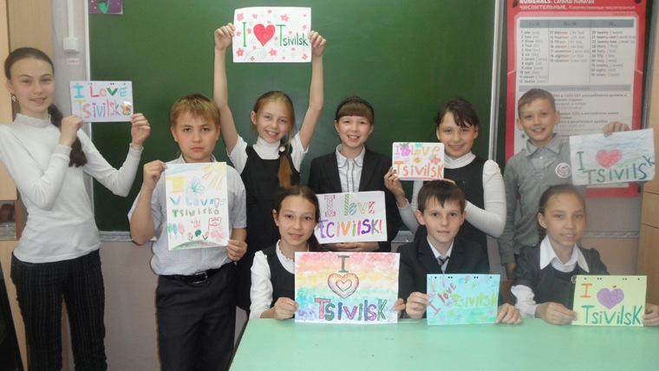
These are my classmates.
They are future doctors and teachers, designers and directors…
We love Tsivilsk!

Slide 16
for being with me!

Slide 17
Sources
http://images.vector-images.com/21/civilsk_city_coa2.gif
http://forum.na-svyazi.ru/index.php?act=Attach&type=post&id=1792732
Основная часть фотографий на слайдах – из личного архива Ольги Михайловны Степановой

