Slide 1
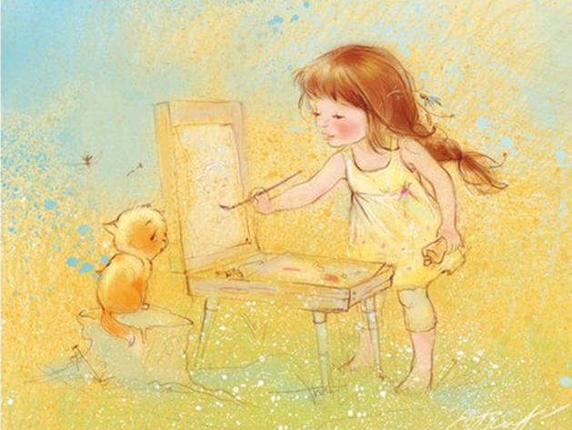
Sunny
Childhood
by
Kate
Babok
Picture
Gallery
for
5-11
Formers
Автор:
Ольга Михайловна Степанова
учитель английского языка
МБОУ «Цивильская СОШ №1
имени Героя Советского Союза М.В. Силантьева»
города Цивильск Чувашской Республики
2016

Slide 2
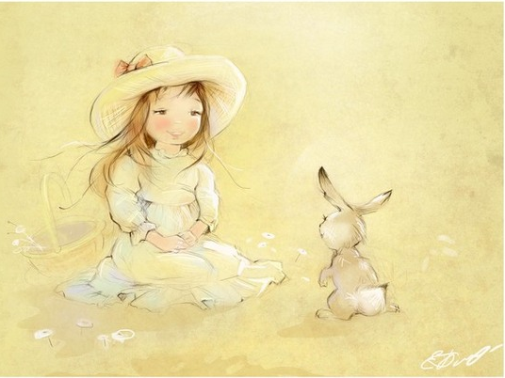
Catherine Babok is a famous Russian artist who creates watercolor illustrations for children's books.

Slide 3
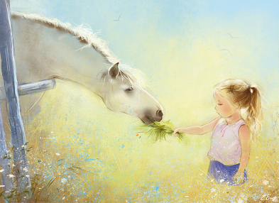
Everyone will agree that her works bring us into the magical world of childhood - the happiest time in life.

Slide 4
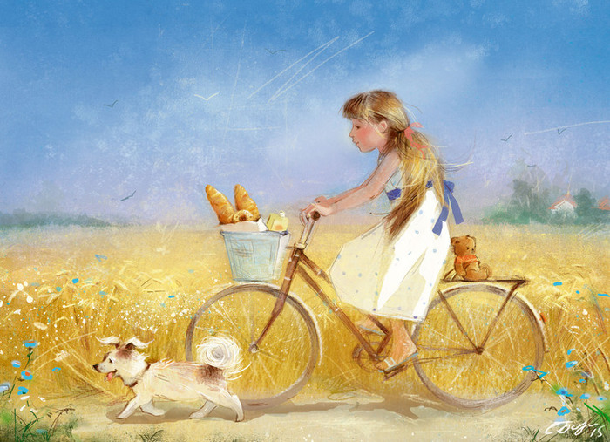
Catherine who illustrates the childhood so gently and kindly. was born in Minsk.

Slide 5
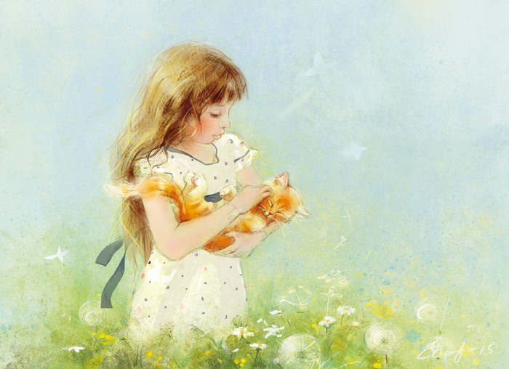
The artist has a lovely little girl who with her friends presents her art subjects. Children are an inexhaustible subject
her art.

Slide 6
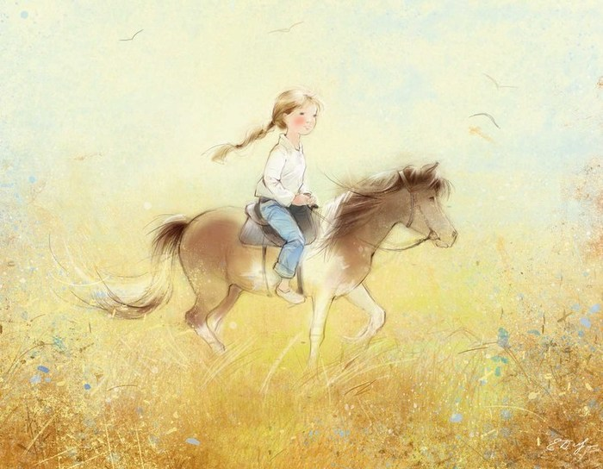
As Catherine says, "I paint about the goodness that is in everyone of us."

Slide 7
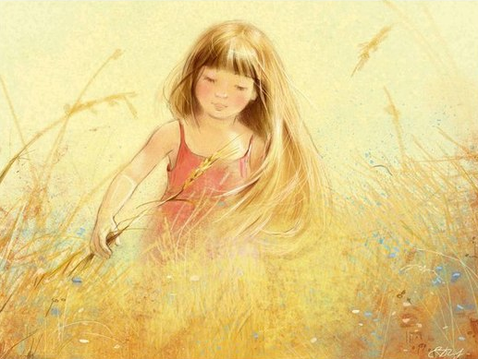
Ekaterina is interested in the Chinese qigong, Falun Gong system, and she loves to read classic literature.

Slide 8
Soft pastel tones create an atmosphere of lightness and light, which is filled with a happy childhood.
Baseball

Slide 9
Ekaterina says: I wanted to draw a little helpers, the good fairies who live somewhere nearby, and try to bring into our lives a little bit of wonder and joy.

Slide 10
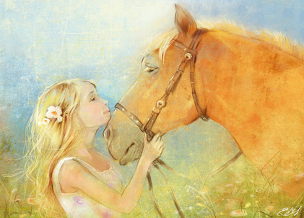
So each illustration brings some tender into everyone’s life…

Slide 11
The world would be so grey without these pictures …
Baseball

Slide 12
This wonderful world of countryside makes our life romantic and so natural…

Slide 13
When you are among the flowers you feel like a Fairy…

Slide 14
Each picture inspires everyone’s heart with its lovely topic and subject that is often connected to the nature.

Slide 15
We cannot not love those pretty creatures…

Slide 16
Walking through the fields or riding your bike on a summer day with your Puppy the Friend… What can be more adorable in this life?

Slide 17
There is a garden in every childhood, an enchanted place where colors are brighter, the air softer, and the morning more fragrant than ever again. ~Elizabeth Lawrence

Slide 18
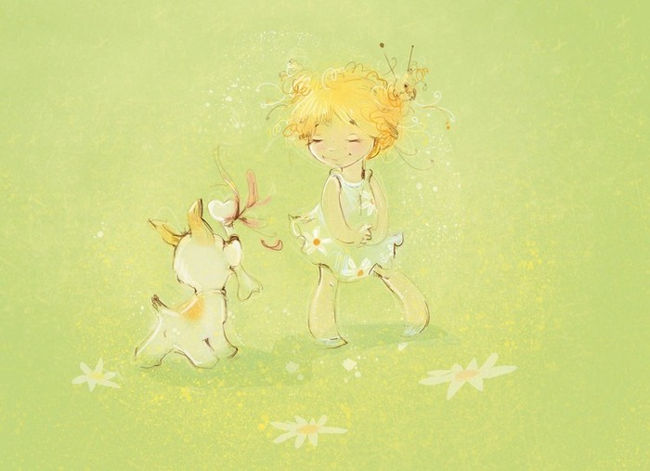
Childhood is the most beautiful of all life's seasons. ~Author Unknown

Slide 19
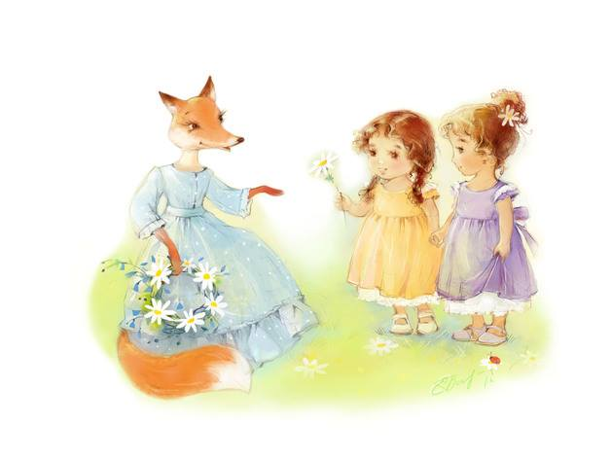
Sweet dreams, sweet reality by Kate Babok…
You can enjoy more of her sunny illustrations freely on the Internet sites

Slide 20
Source
https://illustrators.ru/users/id33417
http://www.quotegarden.com/childhood.html

