Slide 1
Let’s Respect our Elderly Parents
Appeal for 8-11 Formers
Автор:
Ольга Михайловна Степанова
учитель английского языка
МБОУ «Цивильская СОШ №1
имени Героя Советского Союза М.В. Силантьева»
города Цивильск
Чувашской Республики
2016

Slide 4
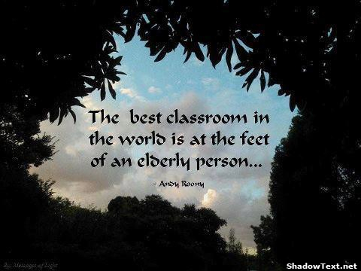

Slide 5
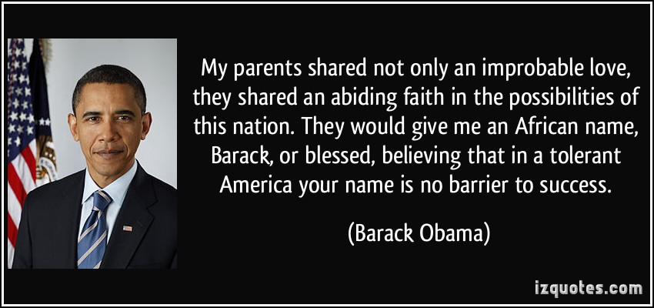

Slide 6
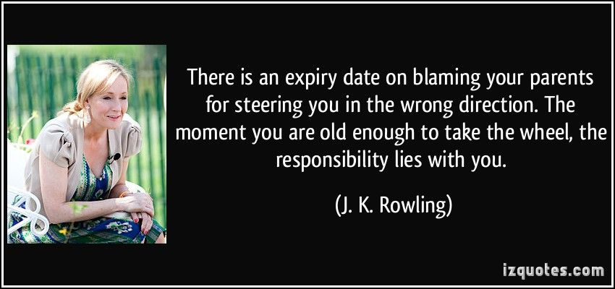

Slide 14
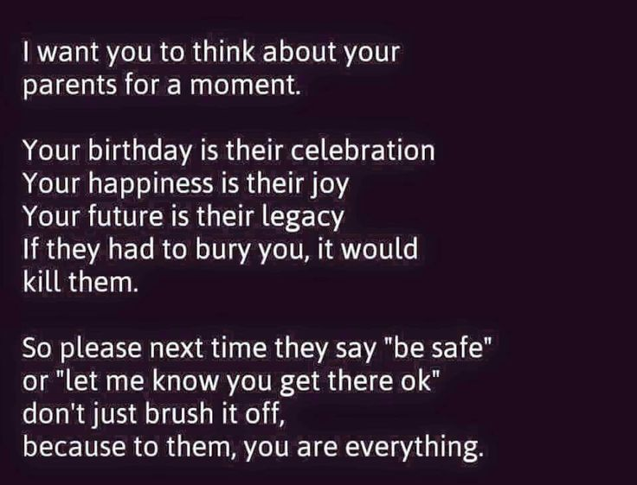

Slide 15
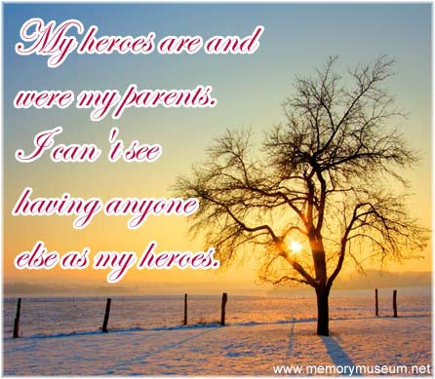

Slide 19
Sources
https://s-media-cache-ak0.pinimg.com/736x/54/4b/7f/544b7f4dee5c9ee0aa78ec7c33458229.jpg
https://qph.is.quoracdn.net/main-qimg-ba6a89b7fe759911bfa3cf9ba909cc35?convert_to_webp=true
https://s-media-cache-ak0.pinimg.com/736x/ac/cd/5f/accd5f3bcddd046c1b1143d208d2b6bd.jpg
http://quotescloud.com/wp-content/uploads/2015/03/Love-your-parents.-We-are-so-busy-growing-up-we-often-forget-they-are-also-growing-old.4.jpg
http://66.media.tumblr.com/525da1c7d17616202874c02e1f921bec/tumblr_nmwadrlvH41svctszo1_1280.jpg
https://s-media-cache-ak0.pinimg.com/736x/03/b8/7a/03b87a4457b5e042e75b5bd49cda76d1.jpg
https://encrypted-tbn2.gstatic.com/images?q=tbn:ANd9GcR2xRKA_2Rdk4zX1pwztDtZwQVfSc49Mq2wUptthWPy8ec-WUMN
https://jiaahmad.files.wordpress.com/2015/05/parents-love-quotes-2.jpg
http://www.famous-quotes.us/wp-content/uploads/2015/03/Quotes-on-Parents-Love-3.jpg
https://s-media-cache-ak0.pinimg.com/736x/ae/c5/9b/aec59be6a6421235205e79eb7ad67b1c.jpg
http://www.memorymuseum.net/quotes/parents-quotes/parents-quotes-4.jpg
https://s-media-cache-ak0.pinimg.com/736x/19/d9/b0/19d9b05b55abdbb91575f03b7cec840f.jpg
https://s-media-cache-ak0.pinimg.com/736x/8d/e3/13/8de313f77ab2fa0a2e47f62caabe0a18.jpg
https://s-media-cache-ak0.pinimg.com/736x/44/c2/8d/44c28db203ae7e4d0a73d5333c5eec3d.jpg
https://s-media-cache-ak0.pinimg.com/736x/92/7b/51/927b5101cfc17846c9de764049e5fbf3.jpg
http://cdn.quotesgram.com/small/97/26/175404943-parents-quotes-thoughts-respect-never-forget.jpg
http://izquotes.com/quotes-pictures/quote-there-is-an-expiry-date-on-blaming-your-parents-for-steering-you-in-the-wrong-direction-the-moment-j-k-rowling-286398.jpg
http://izquotes.com/quotes-pictures/quote-my-parents-shared-not-only-an-improbable-love-they-shared-an-abiding-faith-in-the-possibilities-of-barack-obama-138240.jpg
http://i.quoteaddicts.com/media/quotes/2/79951-quotes-about-elderly-people.jpg

