Slide 1
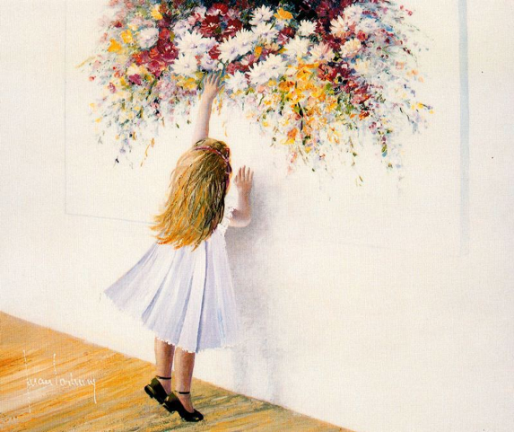
КОРОЛЕВСКИЙ
ХУДОЖНИК
ХУАН
ФОРТУНИ
Виртуальная
экскурсия
в художественную
галерею
Автор:
Ольга Михайловна Степанова
учитель английского языка
МБОУ «Цивильская СОШ №1
имени Героя Советского Союза
М.В. Силантьева»
города Цивильск
Чувашской Республики
2016

Slide 2
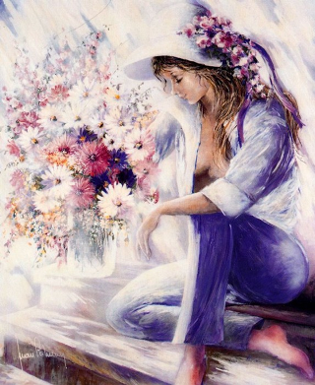
Juan Fortuny was born in Badalona, a small fishing town near to Barcelona, on the 20th of April, 1939.

Slide 3
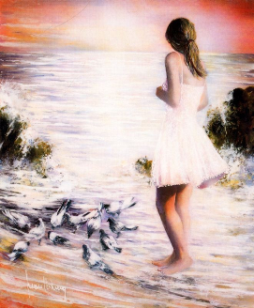
A work of art
signed by Fortuny
is,
first and foremost,
a suite of details, each and every one of witch is of primary importance.

Slide 4
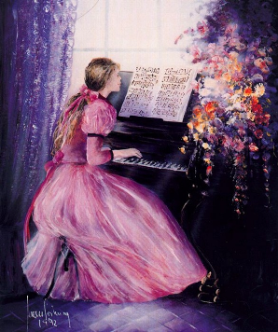
A surprising and outstanding composition, fruit of
long
years of experience with
colours, canvas, techniques, visits
to
galleries
and museums

Slide 5
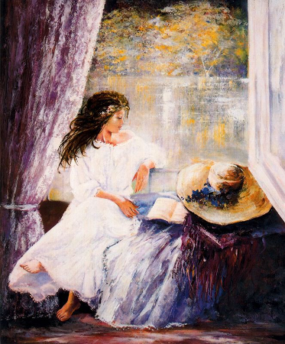
The route that
leads to Juan Fortuny today takes
the traveller backwards in
time,
to
his childhood.

Slide 6
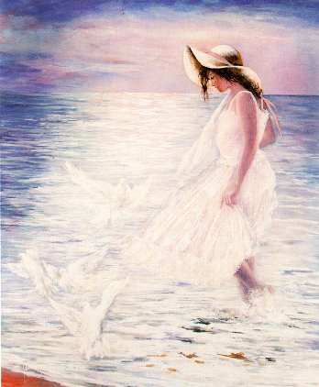
Four
years later his
affair
with drawings, his passion, triumphed and started
a new career
as a painter.

Slide 7
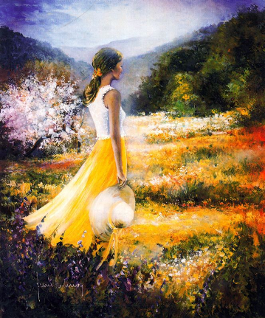
Fortuny’s surrounding world, his private life, like him, is contradictory, passionate. His house reflects on his personality. It can be completely classical, modern or even vanguardist.

Slide 8
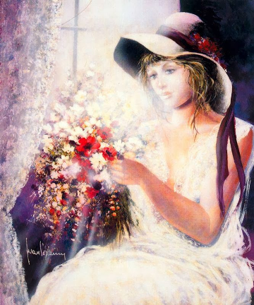
His home, a roomy and stately building dating back to before the Twelfth Century, is close the Montserrat Mountain, a natural park where pines and fir trees predominate.

Slide 9
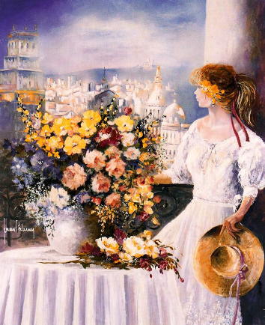
Juan Fortuny lives in constant contact with nature. Realism is a mark of Fortuny’s work. Tidy painting, where the central theme is treated exquisitely, with care, and as if in contrast, there is the background, where the brush and stroke become freer, blending into powerful and intense chromatic abstraction.

Slide 10
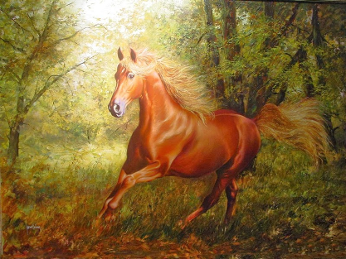
As far as subjects go, he feels equally at ease with a floral as with a figurative subject, with a landscape or with horses, which are his weakness.
Horses galloping, horses peacefully grazing in a corral.

Slide 11
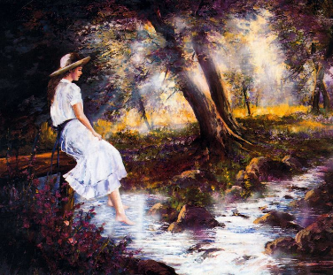
Hope, you enjoyed
the paintings by Juan Fortuny,
the official artist of the Spanish Royal Family
You can find some more of his paintings here
http://gallerix.ru/storeroom/700220764/#
Welcome!

Slide 12
ИСТОЧНИКИ
Изображения взяты с сайта:
http://gallerix.ru/storeroom/700220764/#
Использование материалов данного сайта разрешается при указании активной ссылки на сайт и на правила:
http://gallerix.ru/action/rules/
Текст презентации:
Juan Fortuny ~ Spanish painter. http://www.tuttartpitturasculturapoesiamusica.com/2014/02/Juan-Fortuny.html

