Slide 1
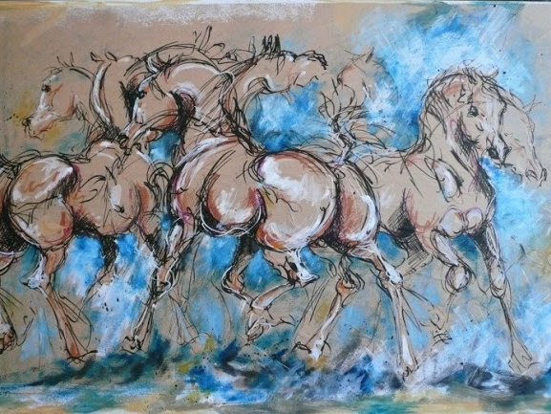
Amazing World
of Jeanne Saint Cheron
Interactive Quiz
in the Picture Gallery for 8-11 Formers
Автор:
Ольга Михайловна Степанова
учитель английского языка
МБОУ «Цивильская СОШ №1
имени Героя Советского Союза М.В. Силантьева»
города Цивильск Чувашской Республики
2016

Slide 2
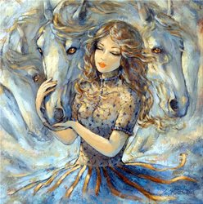
I would travel
only by horse,
if I had
the … .
Linda McCartney
choice

Slide 3
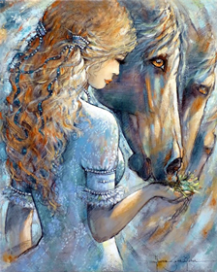
A horse is a thing of ... none will tire of looking at him as long as he displays himself in his splendor. Xenophon
beauty

Slide 4
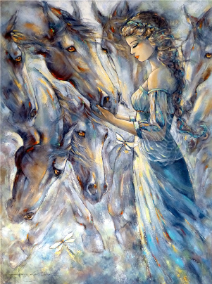
Horse sense is the thing a horse has which keeps it from betting on … .
W. C. Fields
people

Slide 5
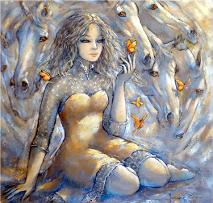
Get off
your horse and drink
your … .
John Wayne
milk

Slide 6
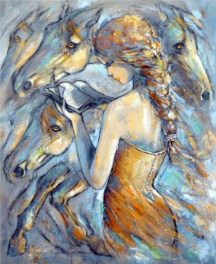
You took care of your horse, and your horse took … of you.
Elton Gallegly
care

Slide 7
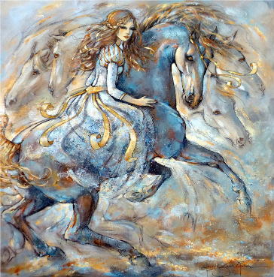
If a horse has four … , and I'm riding it, I think I can win.
Charles Caleb Colton
legs

Slide 8
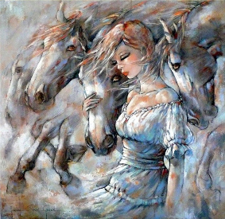
If you fall off a horse, you get back up. I am not
a … .
Olivia Wilde
quitter

Slide 9
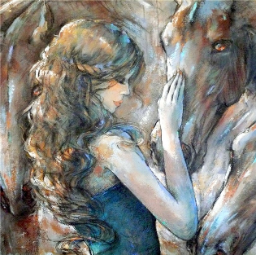
As a little girl I used to daydream about my real … coming on a white horse to rescue me. Christine Keeler
father

Slide 10
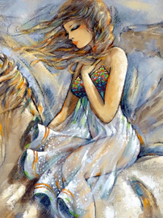
Being born in a … does not make one a horse.
Arthur Wellesley
stable

Slide 11
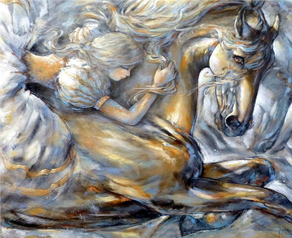
One thing I like about Twitter is that you can hear it from the horse's … .
Big Boi
mouth

Slide 12
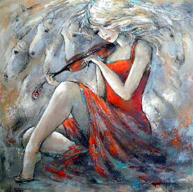
When my horse is running good, I don't stop to give him … . Douglas Horton
sugar

Slide 13
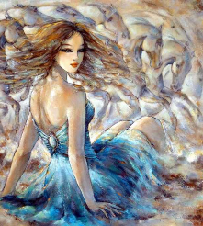
I eat like a horse - my mother still brings me Cadbury's … from Britain.
Catherine Zeta-Jones
chocolate

Slide 14
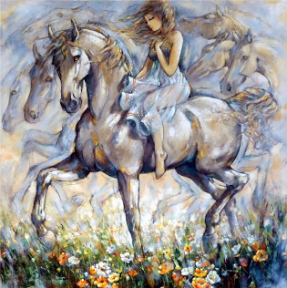
I speak Spanish to God, Italian to women, French to men, and … to my horse.
Charles V
German

Slide 15
This is the End
Thank you!

Slide 16
Sources
Horse Quotes http://www.brainyquote.com/quotes/keywords/horse.html
Изображения – картины французской художницы Jeanne Saint Cheron –
взяты из https://fotki.yandex.ru/next/
Условия использования сервиса Яндекс.Фотки
https://yandex.ru/legal/fotki_termsofuse/

