Slide 1
Муниципальное Бюджетное Общеобразовательное Учреждение
«Цивильская средняя общеобразовательная школа №1
имени Героя Советского Союза М.В. Силантьева»
города Цивильск Чувашской Республики
Interactive Quiz
Discover November
Автор:
учитель английского языка
Степанова Ольга Михайловна

Slide 2
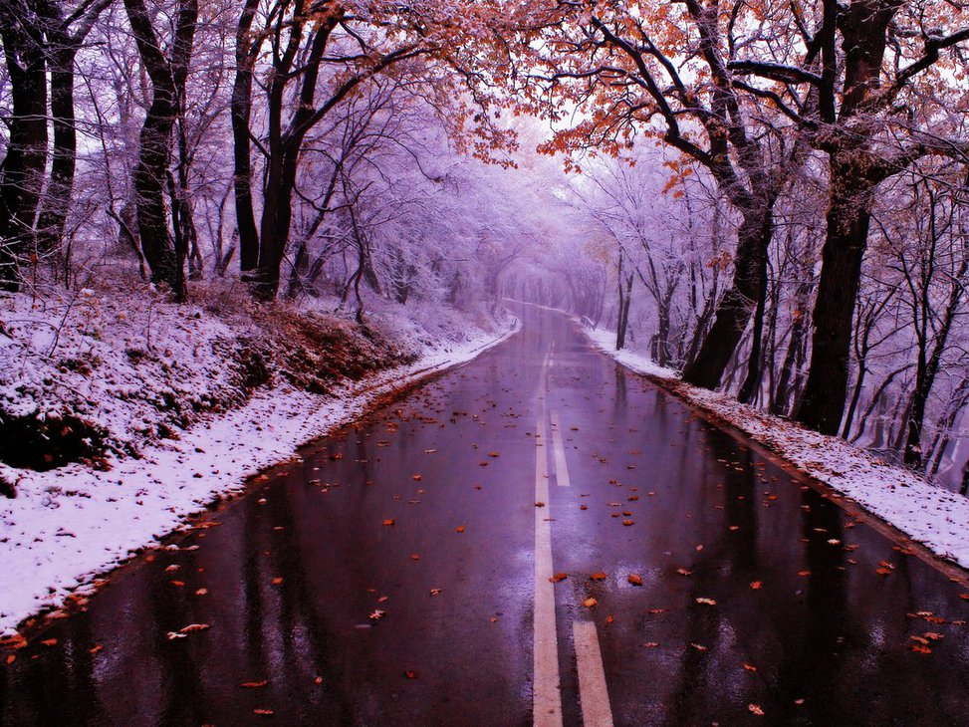
November's birthstones are the topaz (particularly, yellow) which symbolizes … and the citrine.
hope
wedding
friendship
friendship

Slide 3
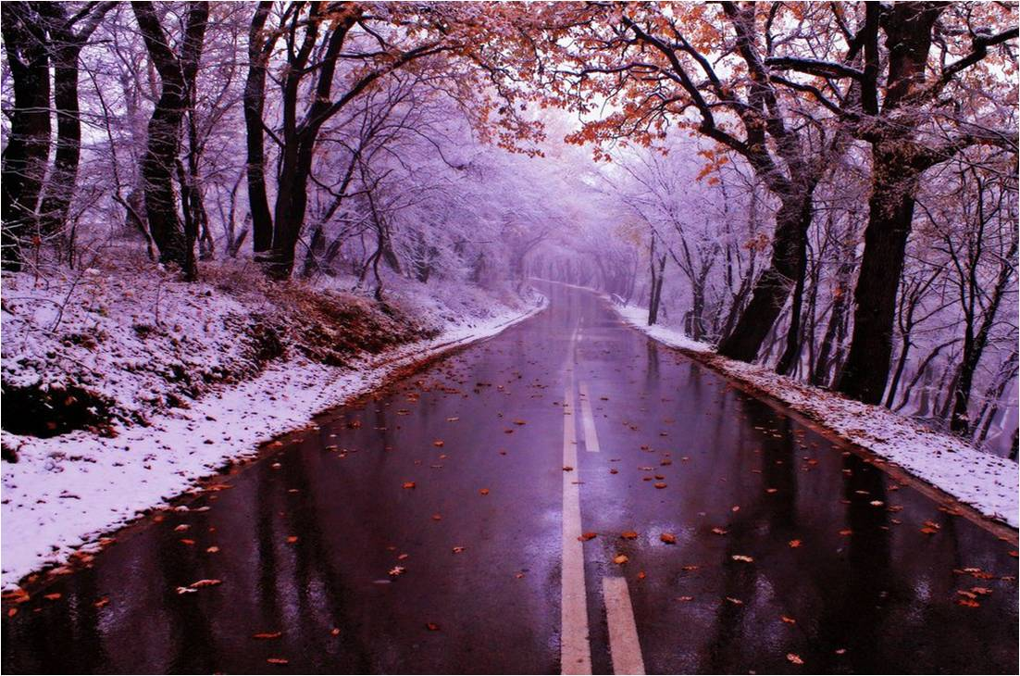
November’s birth flower is the … .
dahlia
cornflower
chrysanthemum
chrysanthemum

Slide 4
November comes And November goes, With the last red berries And the first white … .
snows
showers
meadows
snows

Slide 5
"The gloomy months of November, when the people of … hang and drown themselves." - Joseph Addison
Scotland
England
Australia
England

Slide 6
The United States celebrates Thanksgiving holiday on the fourth … of November.
Friday
Tuesday
Thursday
Thursday

Slide 7
… symbolise Remembrance Day in the UK on November 11th.
Roses
Poppies
Daffodils
Poppies

Slide 8
November's birthstones are the topaz (particularly, yellow) which symbolizes … and the citrine.
hope
wedding
friendship
friendship

Slide 9
A warm November is the sign of a bad … .
spring
summer
winter
winter

Slide 10
St.Andrew’s Day is on 30th November. St. Andrew is the patron Saint of … .
Wales
Ireland
Scotland
Scotland

Slide 11
On the 13 November Robert Louis Stevenson , author of “Treasure …” , was born.
Sea
Ocean
Island
Island

Slide 12
" … November brings the blast, Then the leaves are whirling fast." - Sara Coleridge
dull
rainy
golden
Dull

Slide 13
"November's sky is chill and drear, November's leaf is … and sear." - Sir Walter Scott.
red
brown
orange
red

Slide 14
"The name 'November' is believed to derive from 'novem' which is the Latin for the number 'nine'. In the ancient Roman calendar November was the ninth month after … .
May
March
September
March

Slide 16
Source
November http://www.egreenway.com/months/monnov.htm
November https://en.wikipedia.org/wiki/November
Facts about November http://projectbritain.com/year/november.htm

