Slide 1
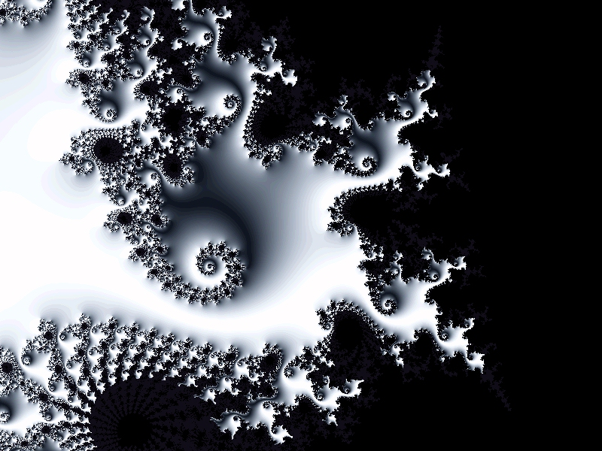
Fractals,
the World of Magic
Fractal Gallery
for 5-11 Formers
Автор:
Ольга Михайловна Степанова
учитель английского языка
МБОУ «Цивильская СОШ №1
имени Героя Советского Союза
М.В. Силантьева»
города Цивильск Чувашской Республики
2016

Slide 2
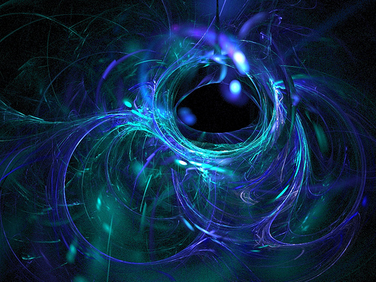
Clouds are not spheres, mountains are not cones, coastlines are not circles, and bark is not smooth, nor does lightning travel in a straight line."
Benoit Mandelbrot

Slide 3
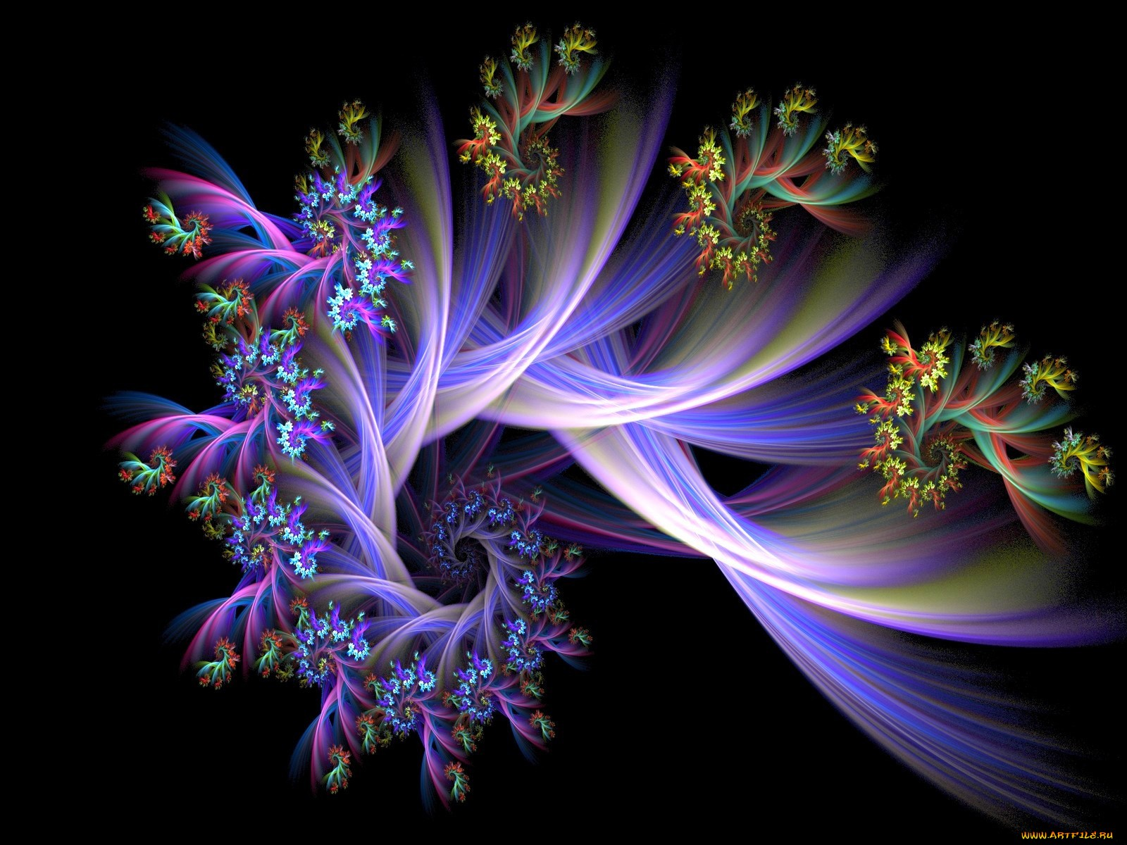
Fractals is a new branch of mathematics and art. Perhaps this is the reason why most people recognize fractals only as pretty pictures useful as backgrounds on the computer screen or original postcard patterns. But what are they really?

Slide 4
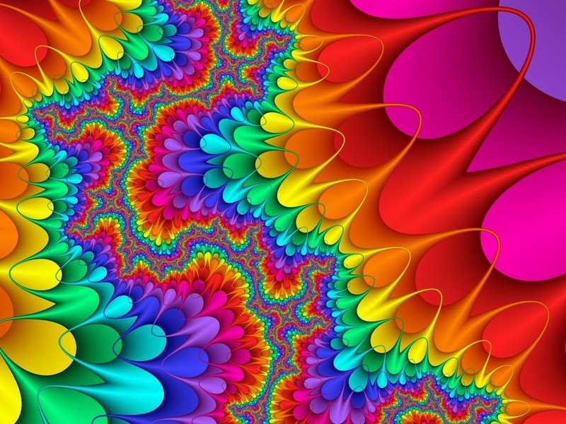
Most physical systems of nature and many human artifacts are not regular geometric shapes of the standard geometry derived from Euclid. Fractal geometry offers almost unlimited waysof describing, measuring and predicting these natural phenomena. But is it possible to define the whole world using mathematical equations?

Slide 5
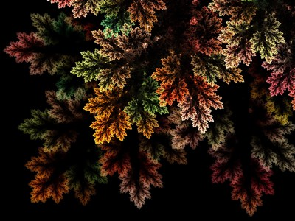
Many people are fascinated by the beautiful images termed fractals. Extending beyond the typical perception of mathematics as a body of complicated, boring formulas, fractal geometry mixes art with mathematics to demonstrate that equations are more than just a collection of numbers.

Slide 6
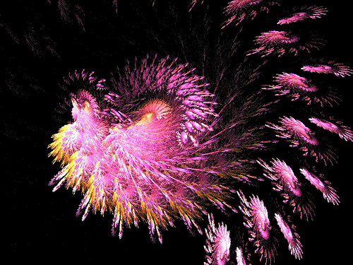
What makes fractals even more interesting is that they are the best existing mathematical descriptions
of many natural forms, such as coastlines, mountains or parts of living organisms.

Slide 7
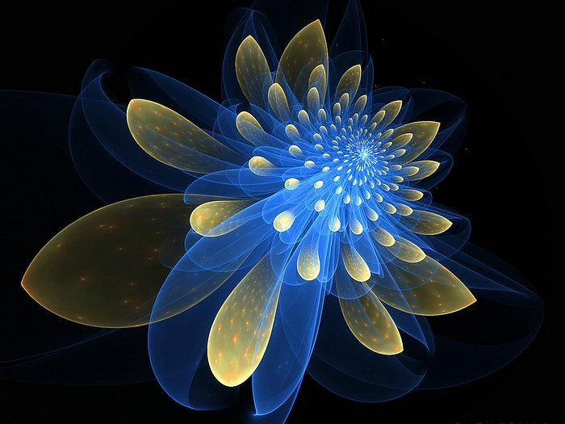
Although fractal geometry is closely connected with computer techniques, some people had worked on fractals long before the invention of computers. Those people were British cartographers, who encountered the problem in measuring the length of Britain coast.

Slide 8
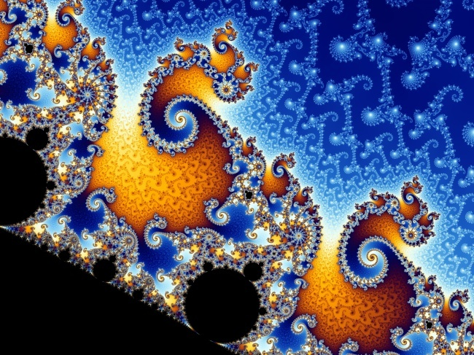
The coastline measured on a large scale map was approximately half the length of coastline measured on a detailed map. The closer they looked, the more detailed and longer the coastline became. They did not realize that they had discovered one of the main properties of fractals.

Slide 9
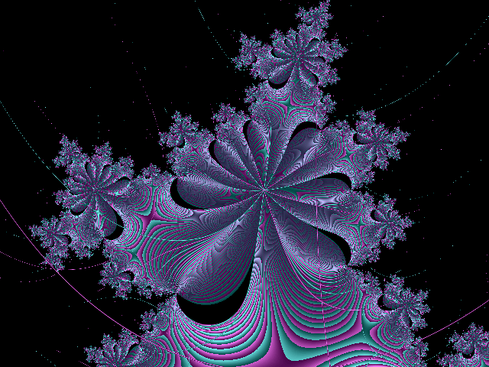
What does self-similarity mean? If you look carefully at a fern leaf, you will notice that every little leaf - part of the bigger one - has the same shape as the whole fern leaf. You can say that the fern leaf is self-similar.
Two of the most important properties of fractals are self-similarity and non-integer dimension.

Slide 10
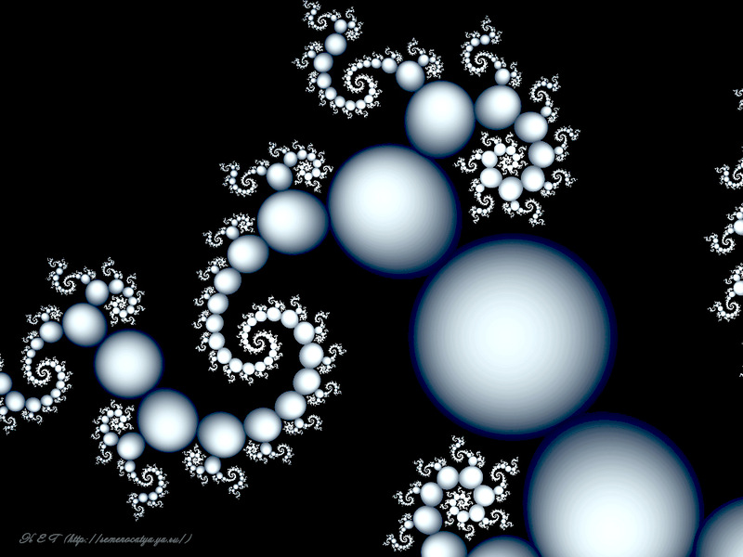
The same is with fractals: you can magnify them many times and after every step you will see the same shape, which is characteristic of that particular fractal.

Slide 11
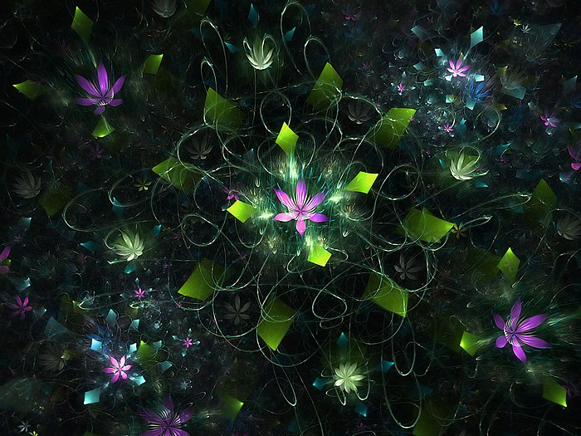
The non-integer dimension is more difficult to explain. Classical geometry deals with objects of integer dimensions: zero dimensional points, one dimensional lines and curves, two dimensional plane figures such as squares and circles, and three dimensional solids such as cubes and spheres. However, many natural phenomena are better described using a dimension between two whole numbers.

Slide 12
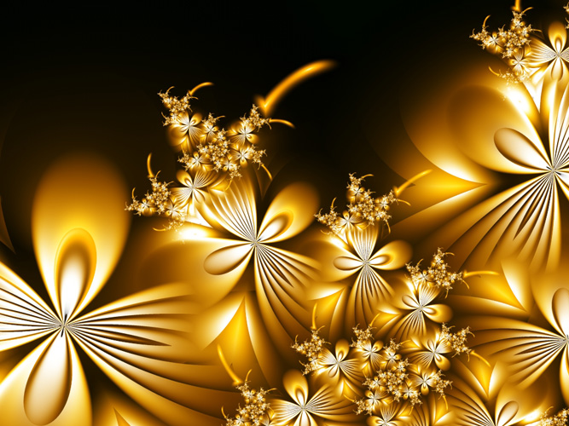
So while a straight line has a dimension of one, a fractal curve will have a dimension between one and two, depending on how much space it takes up as it twists and curves. The more the flat fractal fills a plane, the closer it approaches two dimensions.

Slide 13
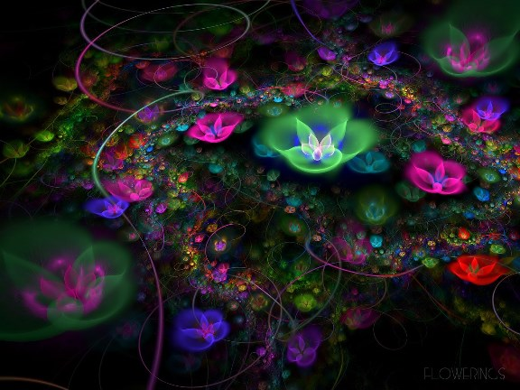
Likewise, a "hilly fractal scene" will reach a dimension somewhere between two and three. So a fractal landscape made up of a large hill covered with tiny mounds would be close to the second dimension, while a rough surface composed of many medium-sized hills would be close to the third dimension.

Slide 14
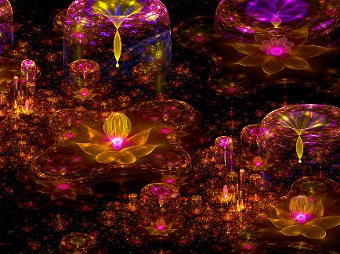
Two leading researchers in the field of complex number fractals are Gaston Maurice Julia and Benoit Mandelbrot.
Gaston Maurice Julia was born at the end of 19th century in Algeria. He spent his life studying the iteration of polynomials and rational functions. Around the 1920s, after publishing his paper on the iteration of a rational function, Julia became famous. However, after his death, he was forgotten.

Slide 15
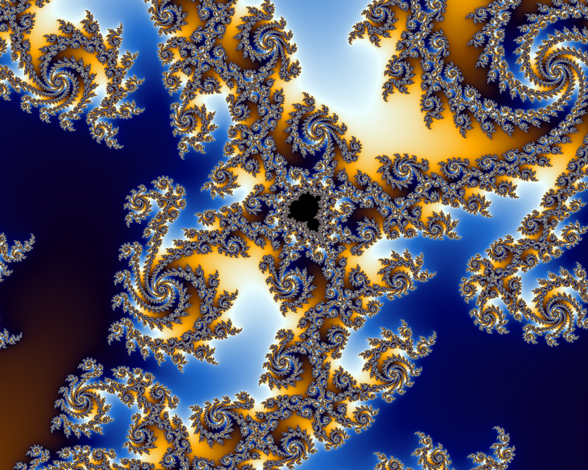
In the 1970s, the work of Gaston Maurice Julia was revived and popularized by the Polish-born Benoit Mandelbrot. Inspired by Julia’s work, and with the aid of computer graphics, IBM employee Mandelbrot was able to show the first pictures of the most beautiful fractals known today.

Slide 16
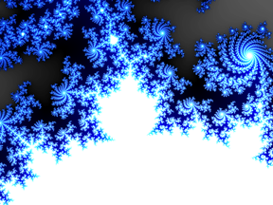
Fractal geometry has permeated many area of science, such as astrophysics, biological sciences, and has become one of the most important techniques in computer graphics.

Slide 17
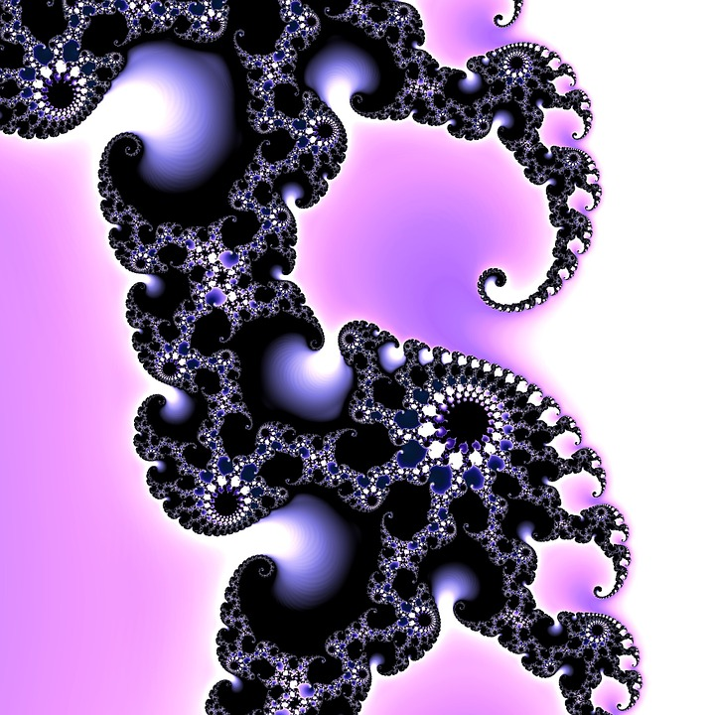
Many scientists have found that fractal geometry is a powerful tool for uncovering secrets from a wide variety of systems and solving important problems in applied science. The list of known physical fractal systems is long and growing rapidly.

Slide 18
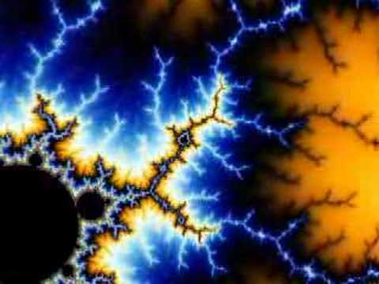
Perhaps for many people fractals will never represent anything more than beautiful pictures.

Slide 19
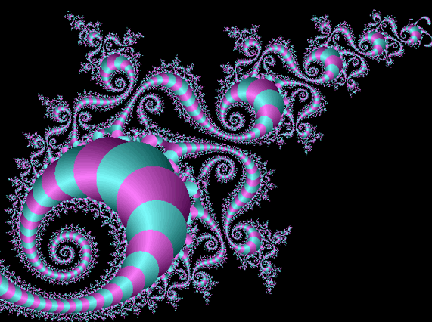
The End
Thank You
for Visiting the Gallery!

Slide 20
Source:
Fractals: Useful Beauty http://www.fractal.org/Bewustzijns-Besturings-Model/Fractals-Useful-Beauty.htm
What are Fractals? http://fractalfoundation.org/resources/what-are-fractals/
Изображения взяты на сайте http://yandex.ru
Условия использования сайта https://yandex.ru/legal/fotki_termsofuse/

