Slide 1
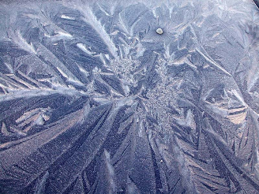
Captivating Fractals
from Nature
Virtual Walking
into the Fractal Nature
for 5 - 11 Formers
Автор:
Ольга Михайловна Степанова
учитель английского языка
МБОУ «Цивильская СОШ №1
имени Героя Советского Союза М.В. Силантьева»
города Цивильск Чувашской Республики
2016

Slide 2
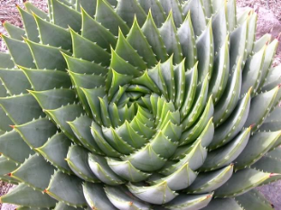
Fractals: they’re famously found in nature and artists have created some incredible renderings as well. Fractals are purely a wonder – too irregular for Euclidean geometry; iterative and recursive and seemingly infinite. They turn up in food and germs, plants and animals, mountains and water and sky. Here are some stunning examples.

Slide 3
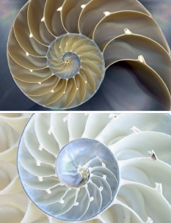
The nautilus is one of the most famous examples of a fractal in nature. The perfect pattern is called a Fibonacci spiral.

Slide 4
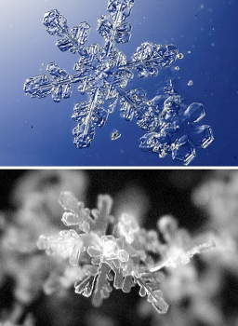
Another real-life place to find fractals is snowflakes. Generally, if you zoom on on any of the ‘leaves’ of a snowflake, you’ll find that the zoomed-in bit looks the same as the whole leaf.

Slide 5
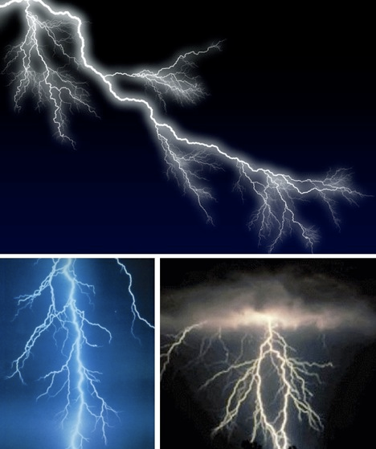
Lightning’s terrifying power is both awesome and beautiful. The fractals created by lightning are fascinatingly arbitrary and irregular.

Slide 6
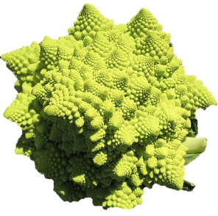
A special type of broccoli, this cruciferous and tasty cousin of the cabbage is a particularly symmetrical fractal. Cook it for your favorite mathematician.

Slide 7
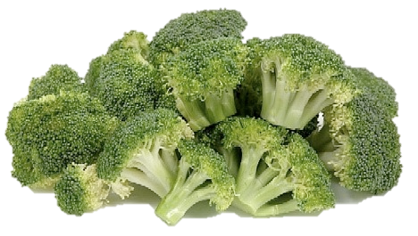
Though not as famously geometric as its relative the Romanescu, broccoli is also a fractal.

Slide 8
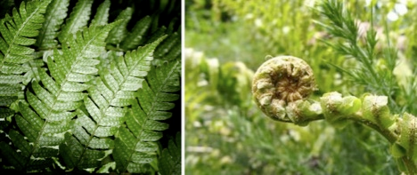
The fern is one of many flora
that are fractal;
it’s an especially good example.

Slide 9
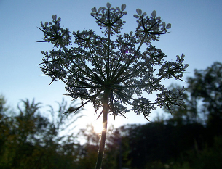
The delicate Queen Anne’s Lace, which is really just wild carrot, is a beautiful example of a floral fractal. Each blossom produces smaller iterative blooms. This particular image was shot from underneath to demonstrate the fractal nature of the plant.

Slide 10
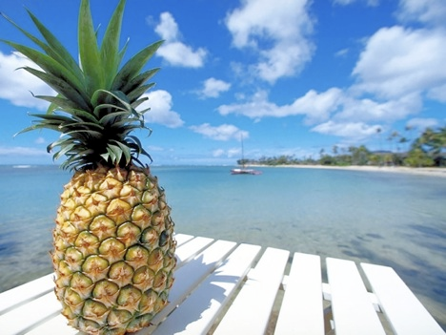
The pineapple is an unusual fruit that is, in fact, a fractal. Though often associated with Hawaii the fruit is a native of southern Brazil.

Slide 11
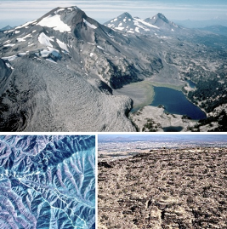
Both shorelines and mountain ranges are considered loosely fractal. These particular examples are beautiful.

Slide 12
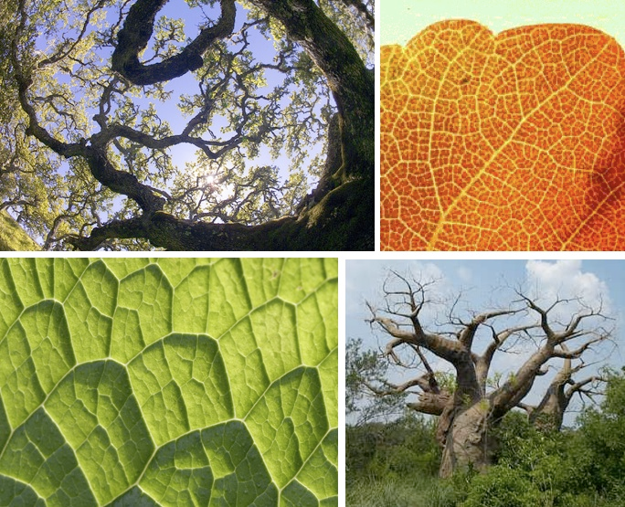
From the macro view of a leaf to the span of a tree’s branches, fractals turn up frequently.

Slide 13
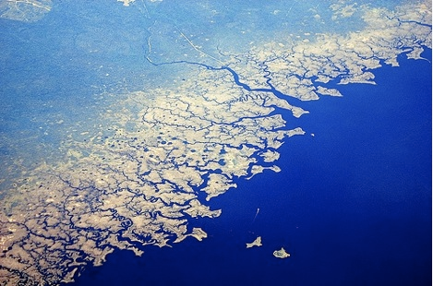
This stunningly complex fractal shoreline is none other than the pan handle of Florida.

Slide 14
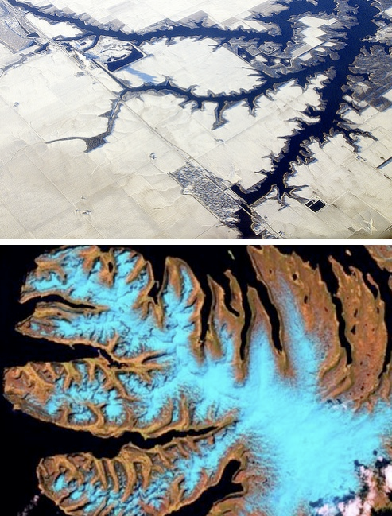
From the midwest of the United States to the icy fjords of Norway, fractals are often viewed by airline passengers – these particular travelers were savvy enough to snap photographs.

Slide 15
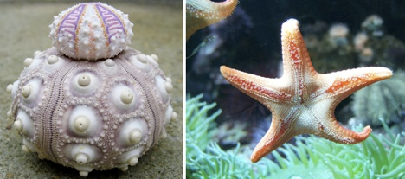
Sea urchins are compact, almost artistic little creatures; sea stars are more commonly referred to as starfish.

Slide 16
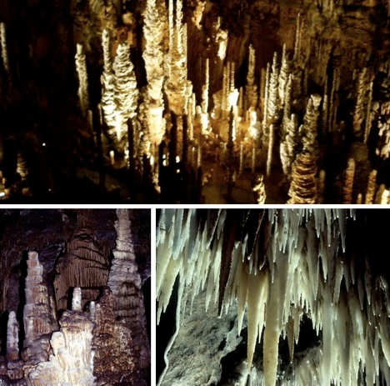
By now you know that stalagmites shoot up from the ground while stalactites form overhead.

Slide 17
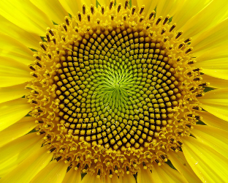
The End
Thanks!
Amazing fractal configurations.
Explore more wondrous natural and artificial fractals and share with your friends!

Slide 18
Source:
17 Captivating Fractal found in Nature http://webecoist.momtastic.com/2008/09/07/17-amazing-examples-of-fractals-in-nature/

