Slide 1
Verbs
in Present Continuous
Interactive Picture Quiz
for 2 - 4 Formers
Автор:
Ольга Михайловна Степанова
учитель английского языка
МБОУ «Цивильская СОШ №1
имени Героя Советского Союза М.В. Силантьева»
города Цивильск Чувашской Республики
2016

Slide 2
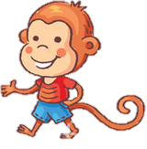
Is the Monkey walking or riding?
He is walking!

Slide 3
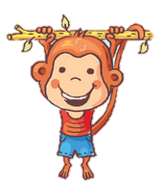
Is the Monkey running or hanging?
He is hanging!

Slide 4
Is the Monkey standing or
skiing?
He is standing!

Slide 5
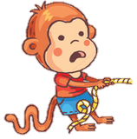
Is the Monkey pulling or skating?
He is pulling!

Slide 6
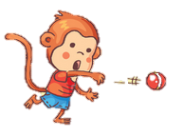
Is the Monkey shooting or throwing?
He is throwing!

Slide 7
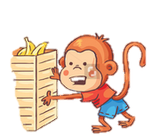
Is the Monkey pushing or dropping?
He is pushing!

Slide 8
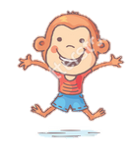
Is the Monkey jumping or driving?
He is jumping!

Slide 9
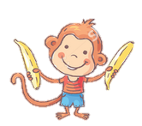
Is the Monkey eating or holding?
He is holding!

Slide 10
Is the Monkey sleeping or singing?
He is sleeping!

Slide 11
Is the Monkey skating or sitting?
He is sitting!

Slide 12
Is the Monkey flying or swimming?
He is swimming!

Slide 13
Is the Monkey eating or painting?
He is painting!

Slide 14
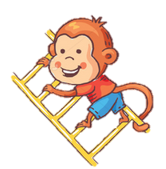
Is the Monkey crawling or climbing?
He is climbing!

Slide 15
Well done!
The End

Slide 16
Источник:
Изображения для презентации взяты на сайте http://yandex.ru Условия использования сайта https://yandex.ru/legal/fotki_termsofuse/

