Slide 1
Fun and Wisdom
Together
Fun and Wisdom Gallery
with an Interactive Exercise
for 8 - 11 Formers
Автор:
Ольга Михайловна Степанова
учитель английского языка
МБОУ «Цивильская СОШ №1
имени Героя Советского Союза М.В. Силантьева»
города Цивильск Чувашской Республики
2016

Slide 2
sleep
sleep
slept
slept

Slide 3
bark
barked barked
barked

Slide 4
opened
opened
opened
open

Slide 5
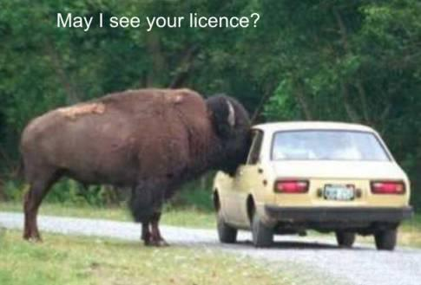
see
saw
seen
see

Slide 6
forget
forget
forgot
forgotten

Slide 7
insert
inserted
inserted
inserted

Slide 8
have
have
had
had

Slide 9
regenerate
regenerate
regenerated
regenerated

Slide 10
trust
trust
trusted
trusted

Slide 11
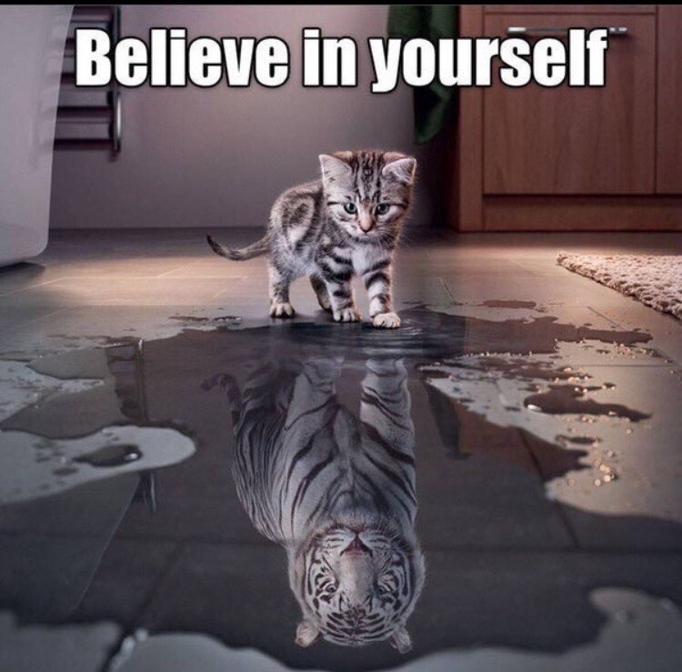
believe
believe
believed
believed

Slide 12
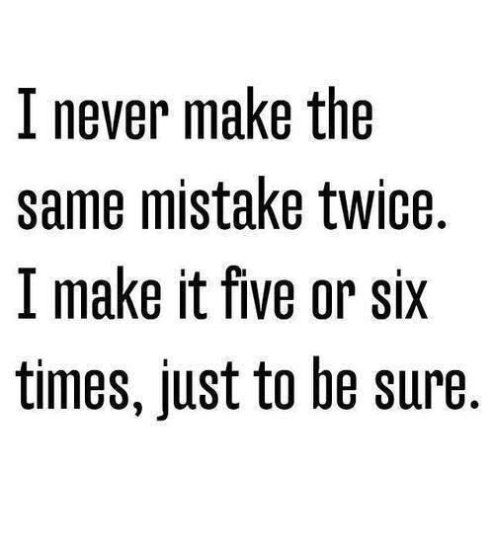
make
make
made
made

Slide 13
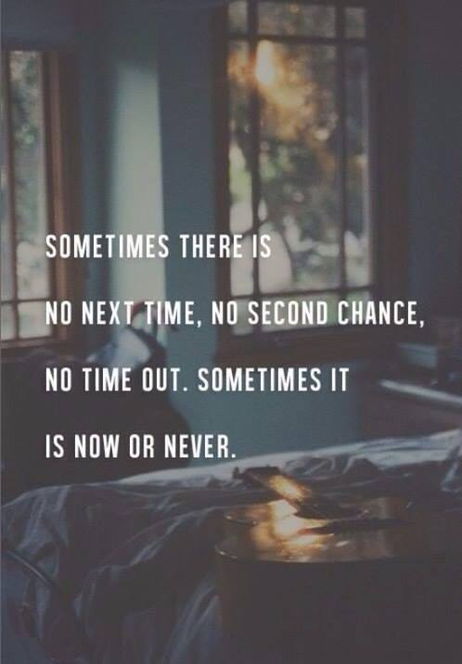
be
be
was/were
been

Slide 14
dream
dream
dreamed
dreamed
or
dream
dreamt
dreamt

Slide 15
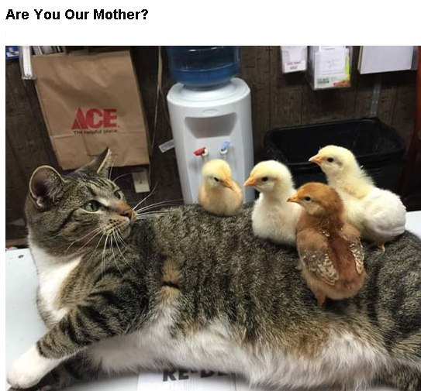
be
be
was/were
been

Slide 16
give up
give up
gave up
given up

Slide 17
The End
Good Luck!

Slide 18
Источник:
Изображения для слайдов взяты на сайте http://yandex.ru
Условия использования сайта https://yandex.ru/legal/fotki_termsofuse/

