Slide 1
Phrasal Verbs’ Island
Excursion
into
the Phrasal
Verbs’ World
for 8-11 formers
Автор:
Ольга Михайловна Степанова
учитель английского языка
МБОУ «Цивильская СОШ №1
имени Героя Советского Союза
М.В. Силантьева»
города Цивильск
Чувашской Республики
2017

Slide 2
What is a Phrasal Verb?
A phrasal verb is a combination of a verb and preposition, a verb and an adverb, or a verb with both an adverb and a preposition.
A phrasal verb has a meaning which is different from the original verb. That's what makes them fun, but confusing.

Slide 3
You may need to try to guess the meaning from the context, or, failing that, look it up in a dictionary.
The adverb or preposition that follows the verb are sometimes called a particle.
The particle changes the meaning of the phrasal verb in idiomatic ways.

Slide 4
Shortly speaking,

Slide 5
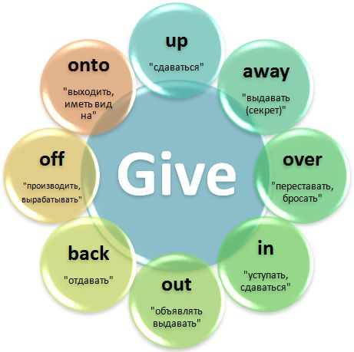

Slide 6
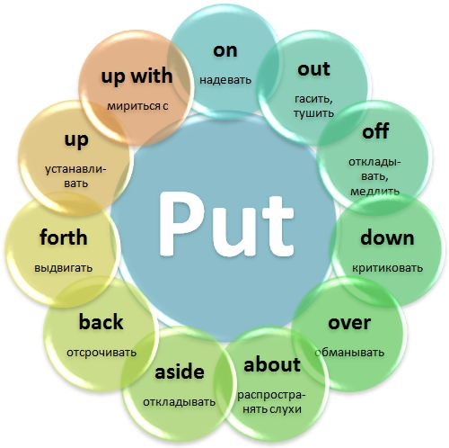

Slide 7
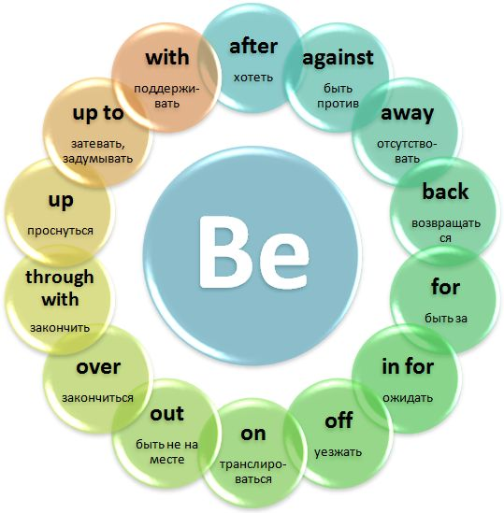

Slide 8
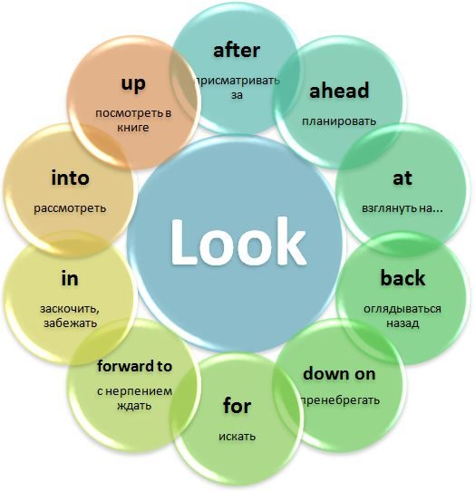

Slide 9
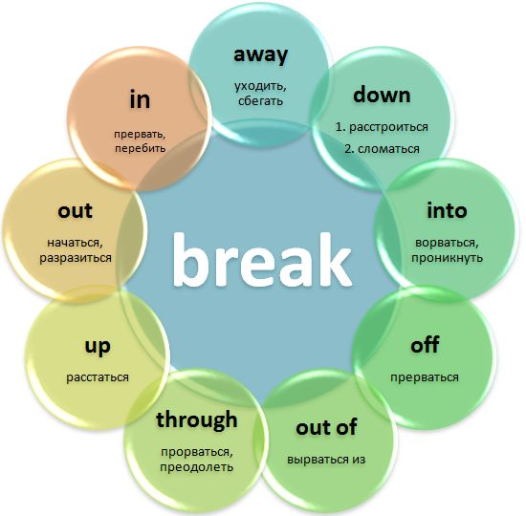

Slide 10
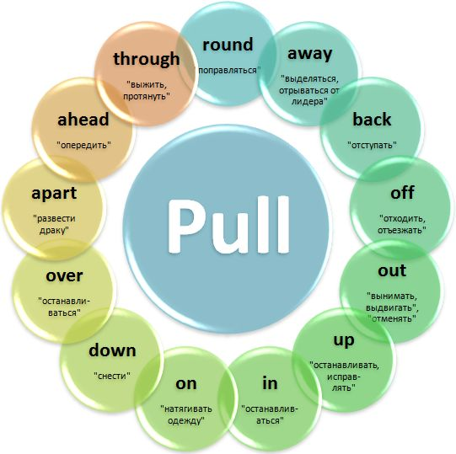

Slide 11
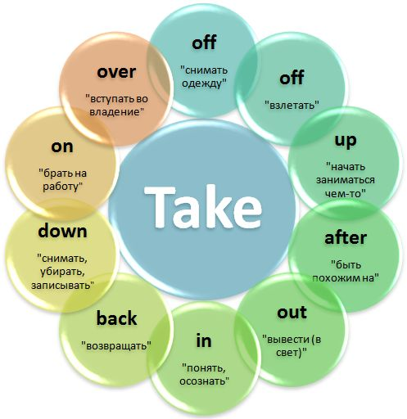

Slide 12
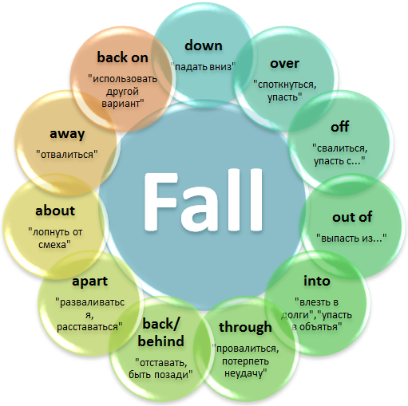

Slide 13
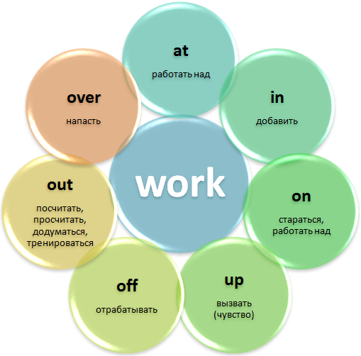

Slide 14
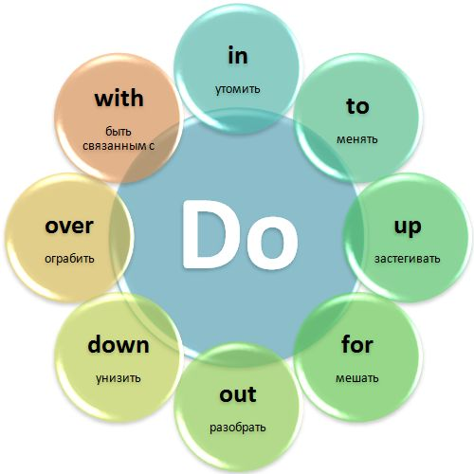

Slide 15
When learning a phrasal verb, it's a good idea to remember
a few typical collocations for that
verb.

Slide 19
Source :
Phrasal Verbs https://www.learnenglish.de/grammar/verbphrasaltext.html
Фразовые глаголы английского языка http://begin-english.ru/angliyskie-slova-po-temam/frazovye-glagoly-angliyskogo-yazyka-to-give-i-to-take

