Slide 1
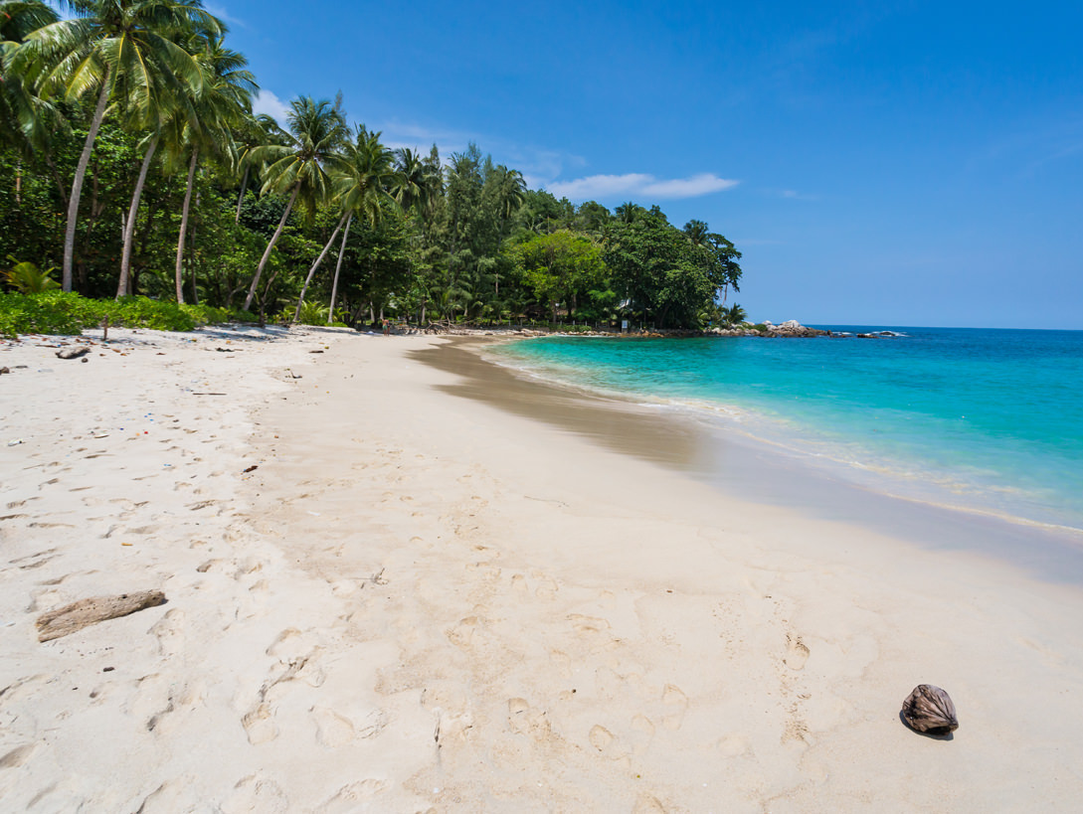
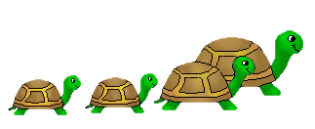
Happy Turtle Day!
Story for 8-11 Formers
Автор:
Ольга Михайловна Степанова
учитель английского языка
МБОУ «Цивильская СОШ №1
имени Героя Советского Союза М.В. Силантьева»
города Цивильск Чувашской Республики
2017

Slide 2
May, 23rd

Slide 3
When did World Turtle Day start?
In 2000

Slide 4
In 2000, the year that the summer Olympics were held in Sydney, that Florida electoral boards poured over hanging chads, and Microsoft founder Bill Gates stepped down to focus on his foundation—the American Tortoise Rescue declared May 23rd World Turtle Day.
The goal, according to their official website, is to “help people celebrate and protect turtles and tortoises and their disappearing habitats around the world.”

Slide 5
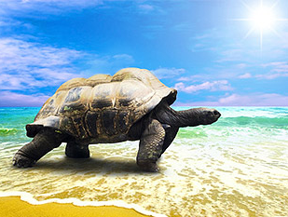
Turtles live on every continent except for ___________________.
Antarctica

Slide 6
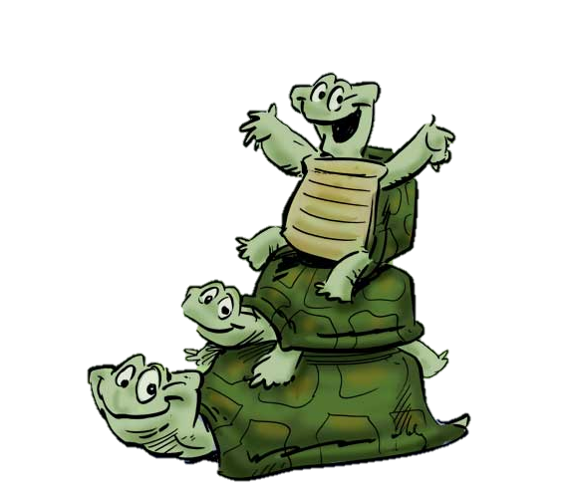
1000
Only about 1 in ______ sea turtle eggs survive to adulthood
100
500
1000

Slide 7
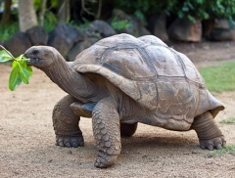
Majority of turtle shells are covered in scutes and made up of approximately _______ bones.
60
30
60
100

Slide 8
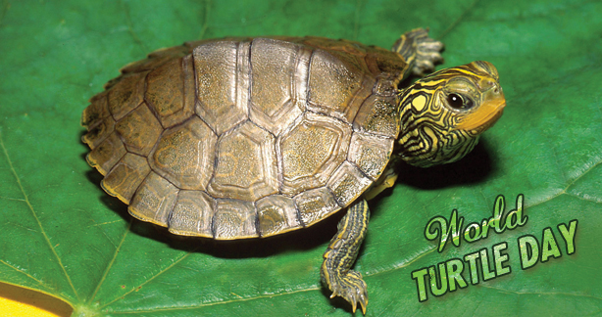
Turtles spend most of their lives in water. They are adapted for aquatic life, with webbed feet or flippers and a streamlined body. Sea turtles rarely leave the ocean, except to lay eggs in the ________.
sand

Slide 9
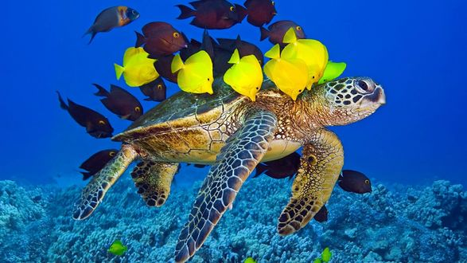
Freshwater turtles live in ponds and lakes, and they climb out of the water onto logs or rocks to bask in the warm ___________ .
sun

Slide 10
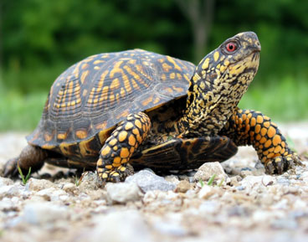
Tortoises are land animals. Their feet are round and stumpy, adapted for walking on land. They also dig burrows with their strong forelimbs, and slip ________________ hen the sun gets too hot.
underground

Slide 11
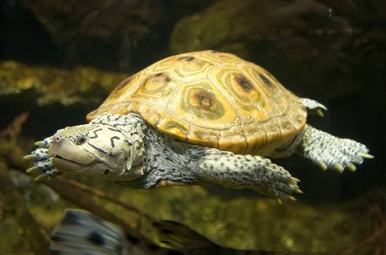
Terrapins live on land and in water, usually in swamps, ponds, lakes and ______________ .
rivers

Slide 12
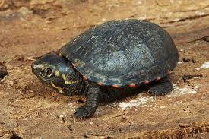
Turtles are not silent creatures. Some sound like electric motors, some sound like belching humans and some bark like dogs. The red-footed tortoise from South America clucks like a ____________ .
chicken
goose
duck
chicken

Slide 13
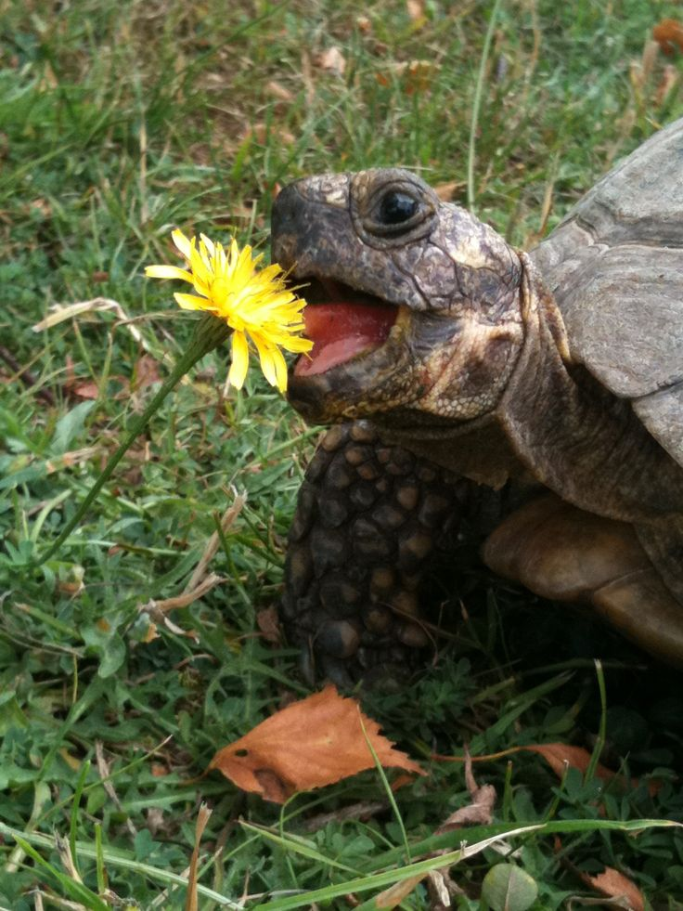
algae
fish
insects
Most turtles are omnivores; they eat a variety of different things, depending on their species. Musk turtles eat mollusks, plants, small fish and insects. The cooter turtle is mostly vegetarian, and the green sea turtle only eats grasses and ________ .
algae

Slide 14
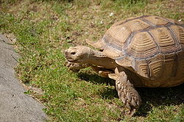
All turtles lay eggs. They find a place on land to lay their eggs, dig a ________ into the sand or dirt and then walk away. No species of turtle nurtures their young.
nest
nest
hole
crack

Slide 15
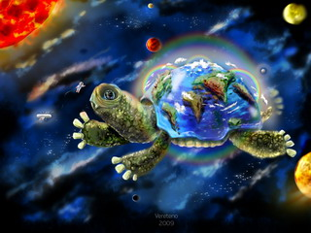
weight
appetite
eyesight
A pair of Russian tortoises went into space. In 1968, the Soviet Union launched Zond 5, a space probe that was the first spacecraft to orbit the moon. It returned safely and the tortoises survived.
They had lost about 10 percent of their body weight, but they remained active and showed no loss of ______________ , according to NASA.
appetite

Slide 16
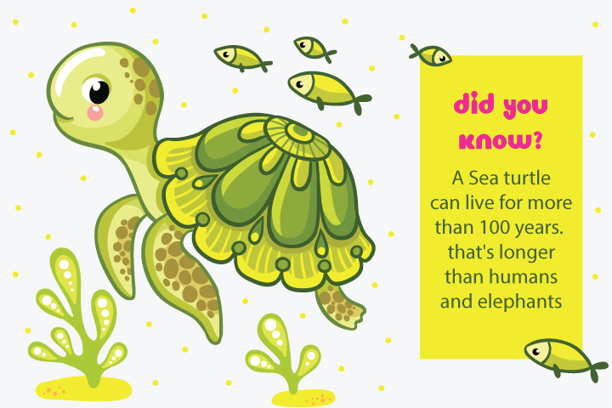

Slide 17
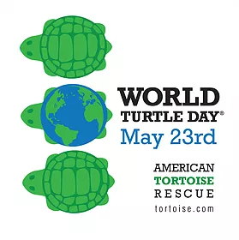
Started by the American Tortoise Rescue (ATR) in 2000, the annually celebrated day shines a spotlight on care, conservation and awareness of the oldest living reptiles in the world.
Remember !

Slide 18
People celebrate World Turtle Day around the globe through various means and methods. Some create awareness by promoting turtles and tortoises through social media networks. Others choose to celebrate by wearing turtle-themed clothing such as T-shirts or hats and by teaching children about tortoises and turtles. Some may choose this time to donate to charities, rescue groups, and organizations that specialize in tortoise and turtle care and conservation.

Slide 19
Thank You for Visiting
Happy Turtle Day!

Slide 20
Источник
Turtle https://en.wikipedia.org/wiki/Turtle
It's World Turtle Day, so here are a bunch of adorable turtles http://www.popsci.com/world-turtle-day-pictures
Изображения взяты на сайте http://yandex.ru
Условия использования сайта https://yandex.ru/legal/fotki_termsofuse/

