Slide 1
Laughter Rules!
Interactive Lecture for 8-11 Formers
Автор:
Ольга Михайловна Степанова
учитель английского языка
МБОУ «Цивильская СОШ №1
имени Героя Советского Союза М.В. Силантьева»
города Цивильск Чувашской Республики
2017

Slide 2
Laughter may not be the best medicine. But laughter’s great for you,
it is a great exercise to keeping you healthy and disease free.
A good laugh has great short-term effects.

Slide 3
When you start to laugh, it doesn’t just lighten your load mentally, it actually induces physical changes in your body. Laughter is a powerful antidote to stress, pain, and conflict.

Slide 4
Here is the run down health benefits of Laughter according to Dr. Lee Berk and Dr. Stanley Tan of Loma Linda University in California

Slide 5
People with low blood pressure will reduce their risk of strokes and heart attacks.
Benefit 1:
Lower Blood Pressure

Slide 6
You benefit from reducing the level of stress hormones your body produces because hormone-level reduction simultaneously cuts the anxiety and stress impacting your body.
Benefit 2:
Reduces Stress
Hormone Levels

Slide 7
Laughter can help you tone your abs. When you are laughing your muscles in the stomach contract, similar to when you exercise
your abs.
Benefit 3:
Fun Ab Workout

Slide 8
Laughter is a great cardio workout, especially for those who are incapable of doing other physical activity due to injury or illness.
Benefit 4: Improves Cardiac Health

Slide 9
T-cells are specialized immune system cells just waiting in your body for activation. When you laugh, you activate T cells that immediately begin to help you fight off sickness. Next time you feel a cold coming on, add chuckling to your illness prevention plan.
Benefit 5:
Boost T Cells

Slide 10
Endorphins are the body’s natural painkillers. By laughing, you can release endorphins, which can help ease chronic pain and make you feel good all over.
Benefit 6:
Trigger The Release Of Endorphins

Slide 11
Laughter can increase your overall well-being. Positive outlook on life tends to fight diseases better than people who tend to be more negative.
Benefit 7:
Produces A General Sense OF Well-Being

Slide 12
Do you agree?
So smile, laugh and live longer!

Slide 13
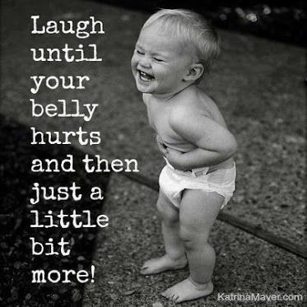

Slide 15
Sources:
Here Are The Powerful Health Benefits Of Laughter https://uniquefacts.net/health/health-benefits-of-laughter/
Изображения взяты на сайте http://yandex.ru
Условия использования сайта https://yandex.ru/legal/fotki_termsofuse/

